Slide 1
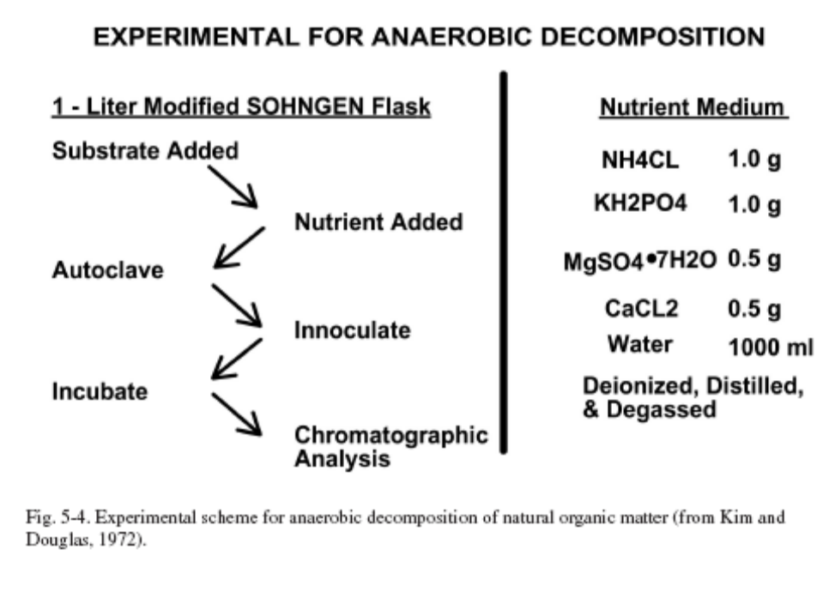
MICROBIOLOGICAL PROSPECTING
Basic Premise: Seeps occur and bacterial colonies develop and oxidize these
Seepage hydrocarbons
Known Facts: Development/support of bacterial colonies require not only food,
(the hydrocarbons), but also nutrients, as shown below.

Slide 2
The presence or absence of such nutrients in the sediments associated with hydrocarbon seepage adds additional random scatter to the development of bacterial colonies –
without nutrients no colony develops
Even when bacterial colonies are associated with hydrocarbon seepage, they cover only that portion of the seepage having adequate nutrients to support the colony, resulting in adding additional random noise to an already noisy signal
In addition, one gets only a positive magnitude, with no compositional information that can be used to evaluate and prove the relationship of the surface hydrocarbon seepage to a deeper source. Since seepage magnitudes have no relationship to the economics of the subsurface source, magnitude alone is of limited value
Experience conducting environmental surveys has shown that bacterial colonies develop on all oxidizing organic matter, and that they are not specific and can adapt to many types of organic compounds. The presence of near-surface organics always generates large concentrations of CO2

Slide 3
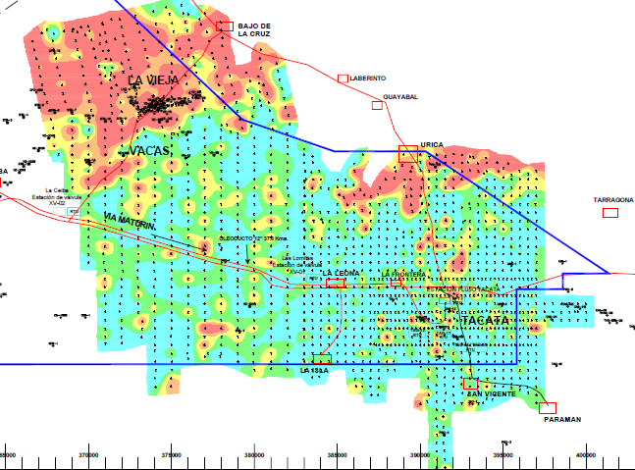

Slide 4
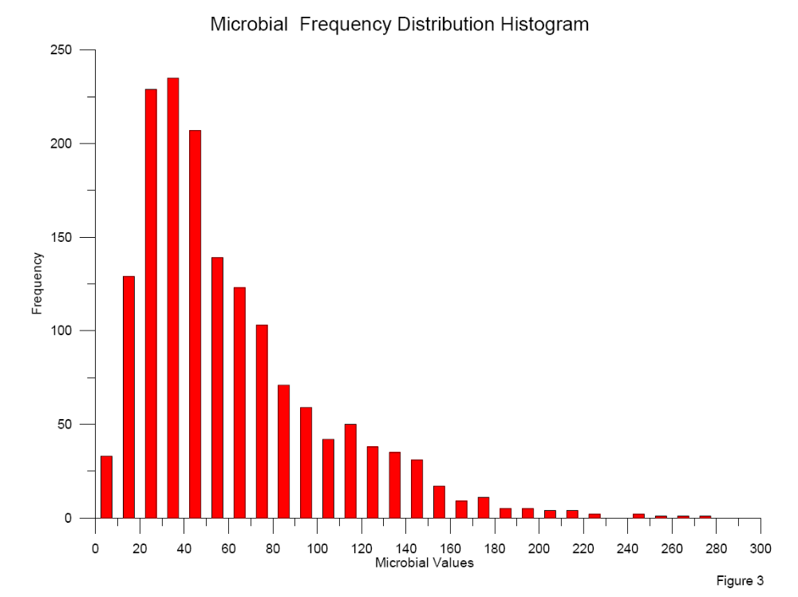

Slide 5
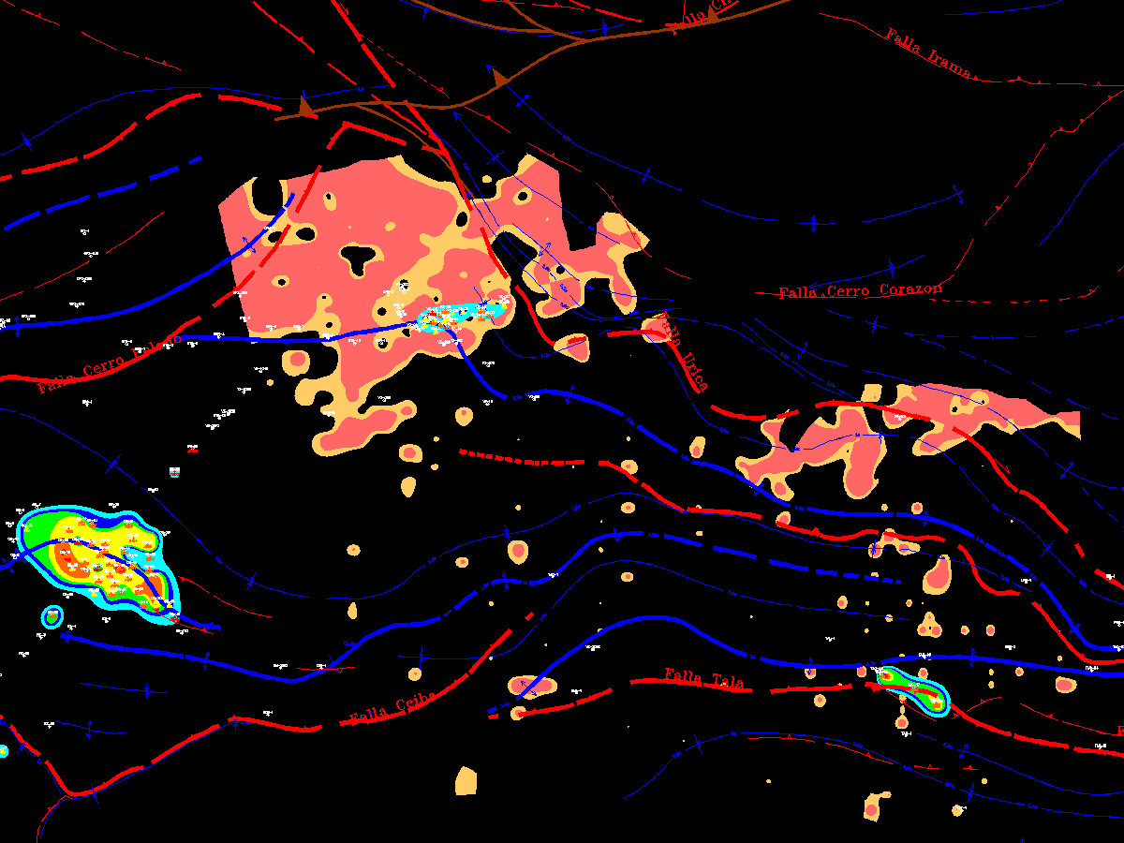

Slide 6
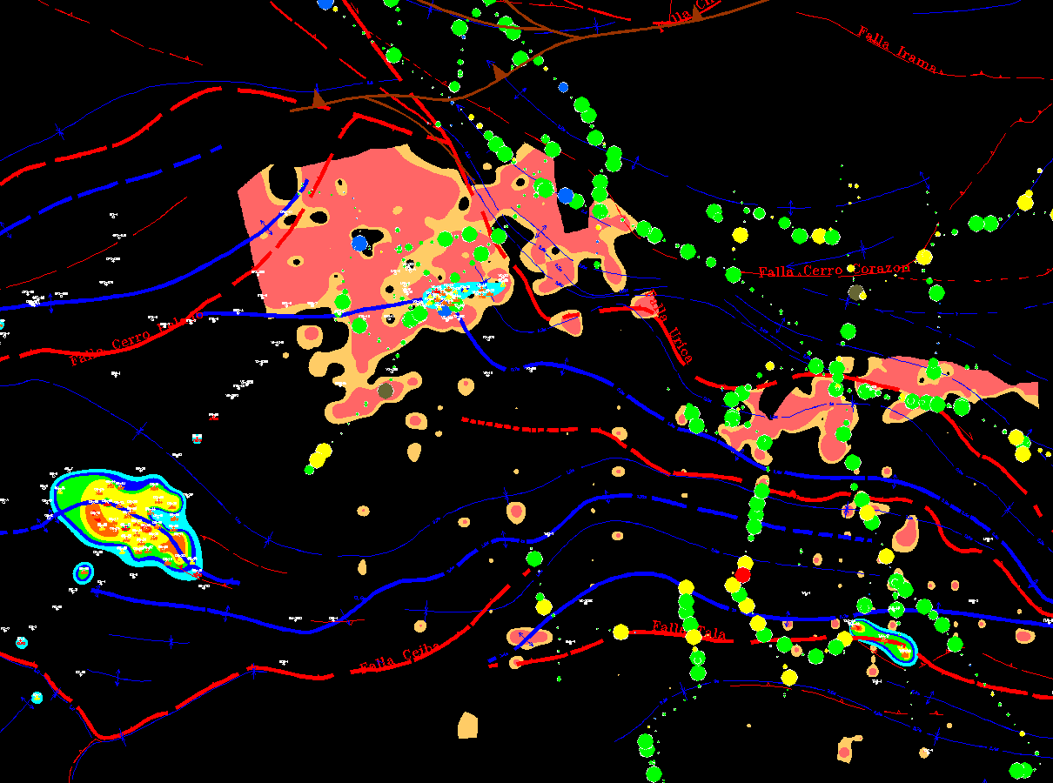

Slide 7
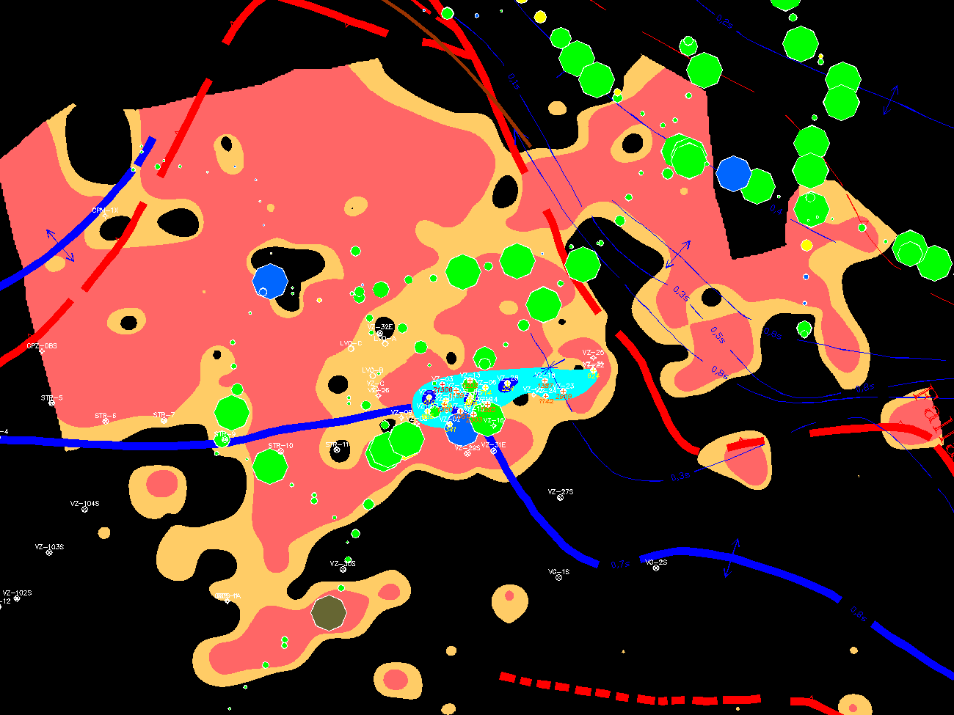

Slide 8
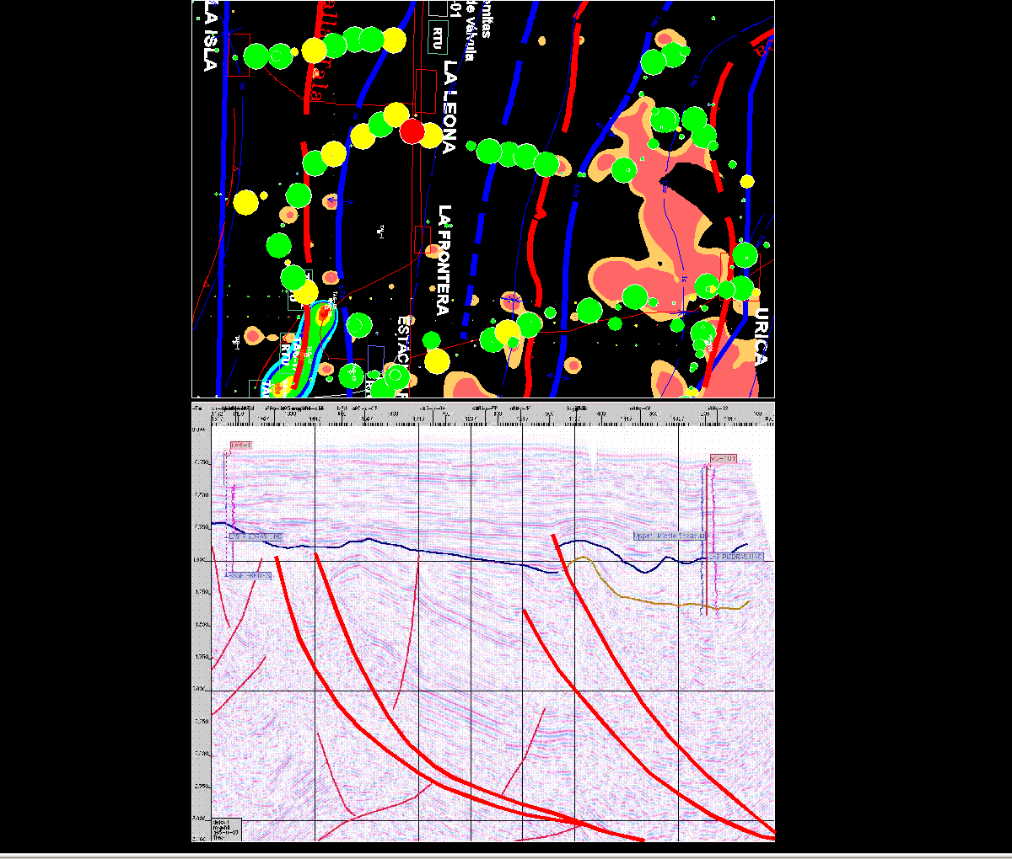

Slide 9
