Slide 1
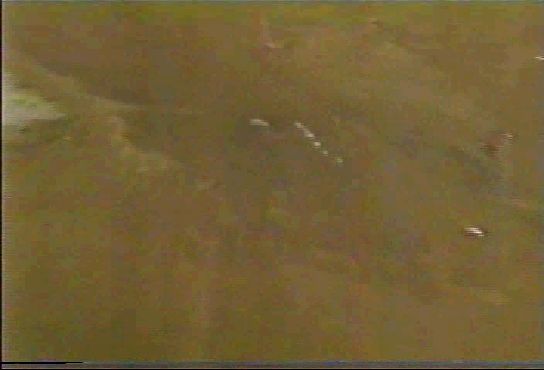
SURFACE GEOCHEMICAL PROSPECTING FOR HYDROCARBON EXPLORATION AND DEVELOPMENT
May, 2012
HANSON-WADE
Houston, Texas
Organized by
EXPLORATION TECHNOLOGIES, Inc.
7755 Synott Road
Houston, Texas
Victor T. Jones, III, PhD.
Nelson Cortes.
Notes:
This is a free gas macroseep in the Ballona Channel in Los Angeles in California

Slide 2
The Foundation of Petroleum Exploration
Is Based on Mapping Seeps
Macro or Micro
May , 2012
Hanson-Wade
Houston, Texas
Notes:
As we all would agree, the foundation of this technology lies in locating and analyzing macro and micro seeps, such s the macro seeps shown on this slide. Light gases, such as ethane can be mapped, even in microseeps, as shown by the next slide.

Slide 3
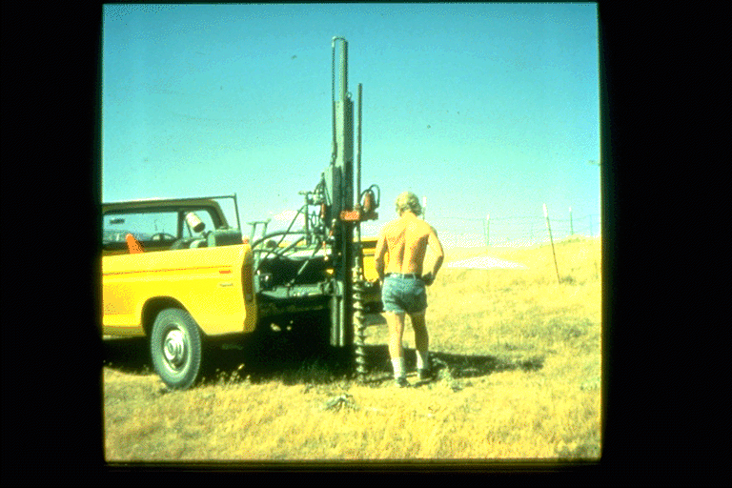
Notes:
In the 1970’s we auger drilled 3 ½ inch, 12 foot deep holes to collect soil gas samples

Slide 4
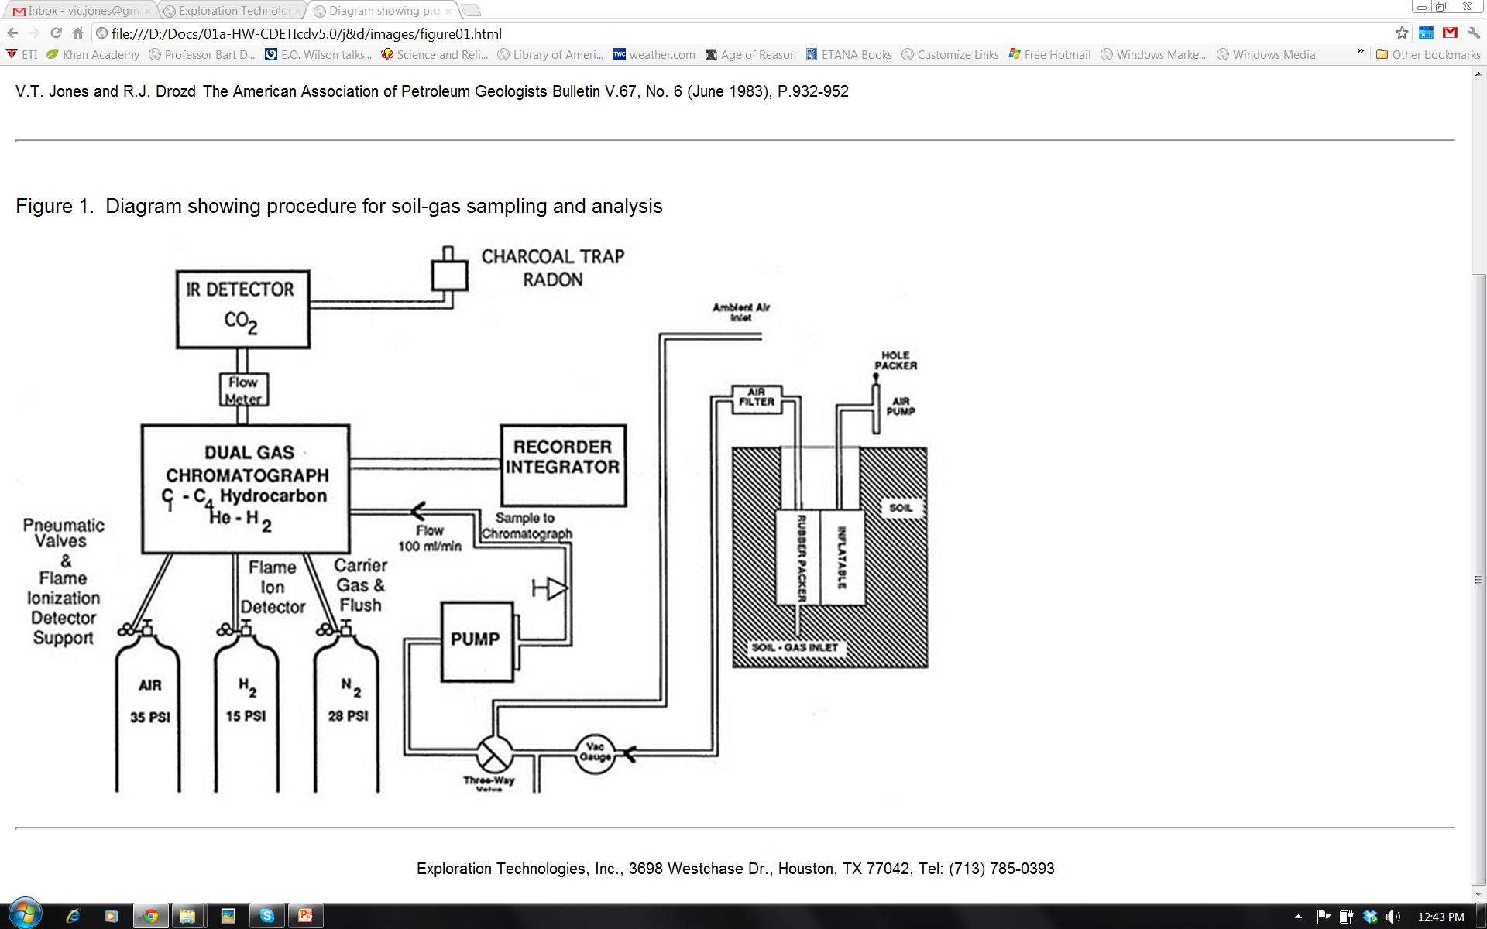
Notes:
An inflatable rubber packer was pressurized to seal the hole before withdrawing soil gas at a low rate, 100 ml.minute
The GC was in a truck mounted lab and samples analyzed for C1 –C4
Methane through butanes, helium and hydrogen, CO2 and
Sometimes Radon, H2S and CO

Slide 5
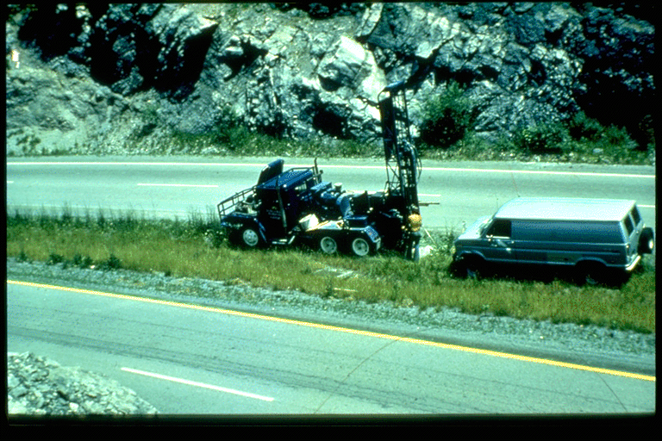
Notes:
In 1976 we added larger drills, an H800 Geospace rig capable of both air and auger drilling in hard rock areas, such as the Copper Ridge Dolomite in Virginia
GC was in a Ford van

Slide 6
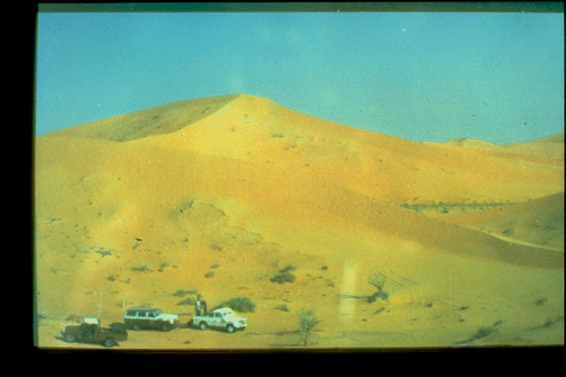
Notes:
By 1979 operations extended to foreign areas, such as Oman, Pakistan, Nigeria, Cameroons, Colombia, Venezuela and many others

Slide 7
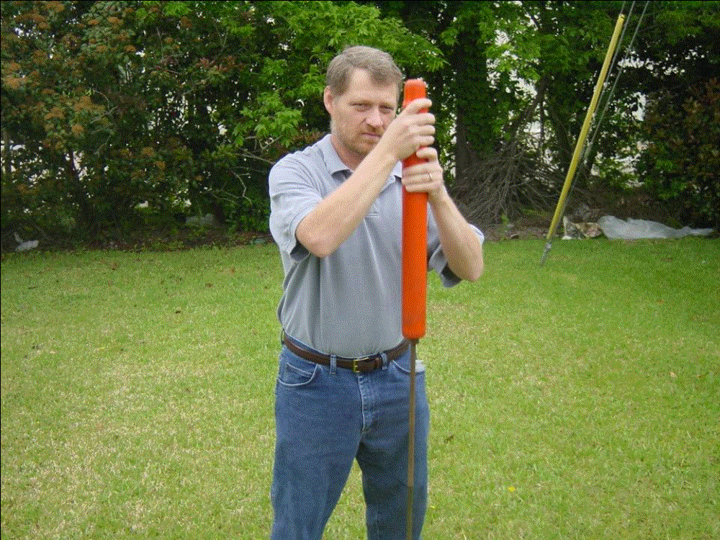
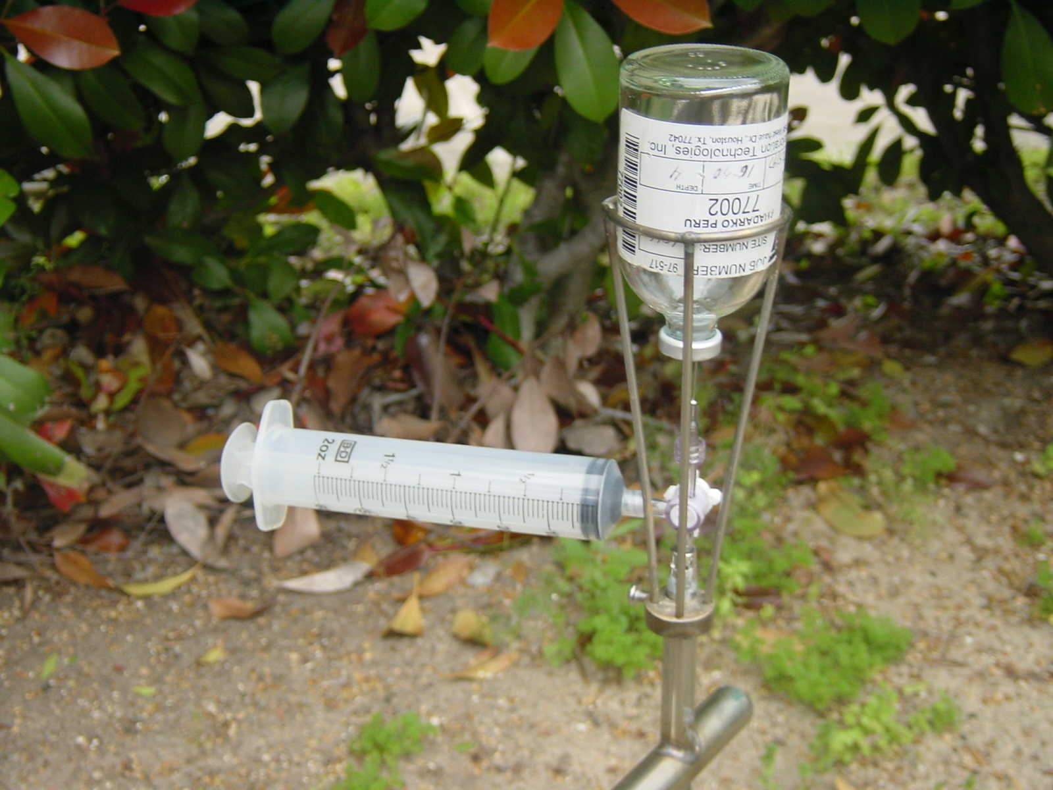
Soil Gas extraction is obtained by pounding a 4 foot hole in the ground inserting a probe into the hole that is connected to a clean evacuated bottle where gas is drawn under vacuum. The gas is brought into the lab for measurement
Notes:
Ethane is nearly as volatile as methane and is never generated biogenically. Ethane can be collected as a free gas sample in the soil vapor space down to our detection limits, which is 10 ppb in the small 125 ml glass bottle shown by this slide. As long as free gases are collected, their ethane content is useful for prospecting.
The examples shown today will demonstrate the usefulness of ethane microseeps that range from our detection limit of 10 ppb up to moderate concentrations ranging from 30 to 100 ppb

Slide 8
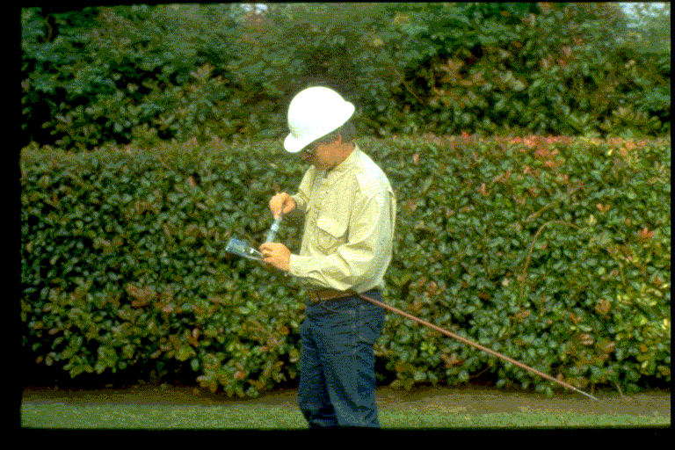
Notes:
Pumping ambient air through soil gas probe

Slide 9
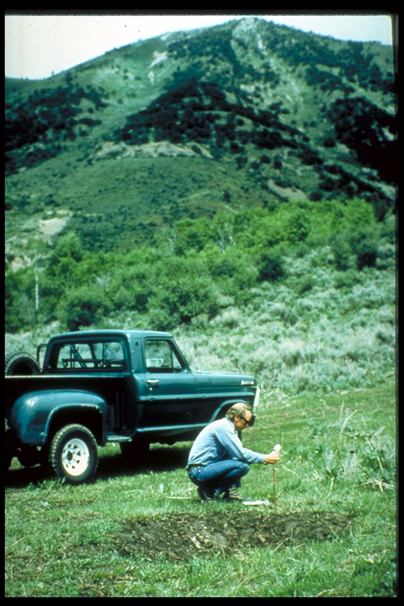
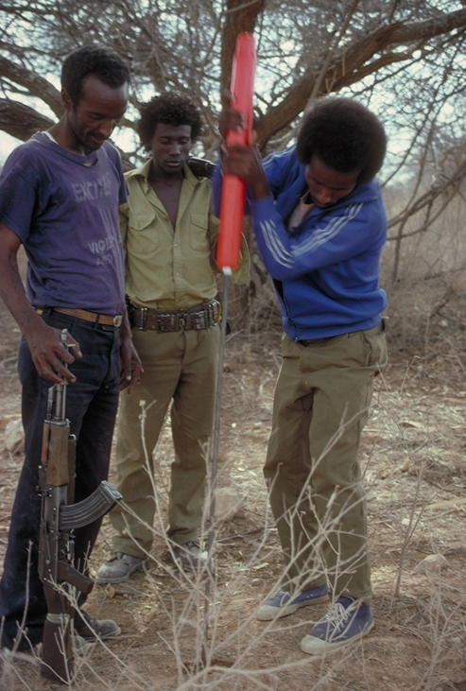
Notes:
Soil gas collection, Western Utah-Wyoming Overthrust and Ethopia

Slide 10
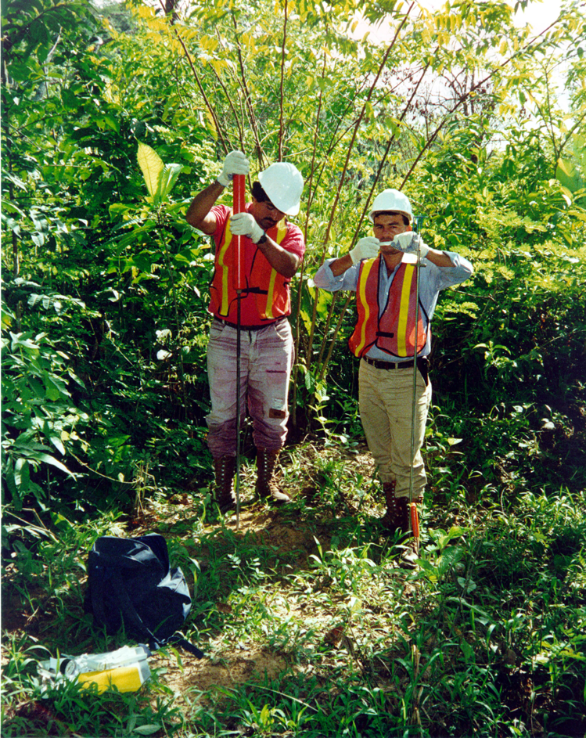
Notes:
Venezuela

Slide 11
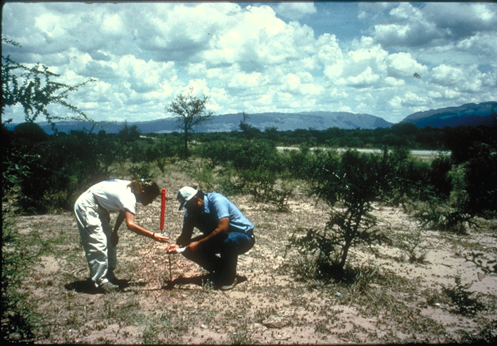
Notes:
Argentina Neuquin Basin Loma de La Latta field

Slide 12

Notes:
Panama

Slide 13
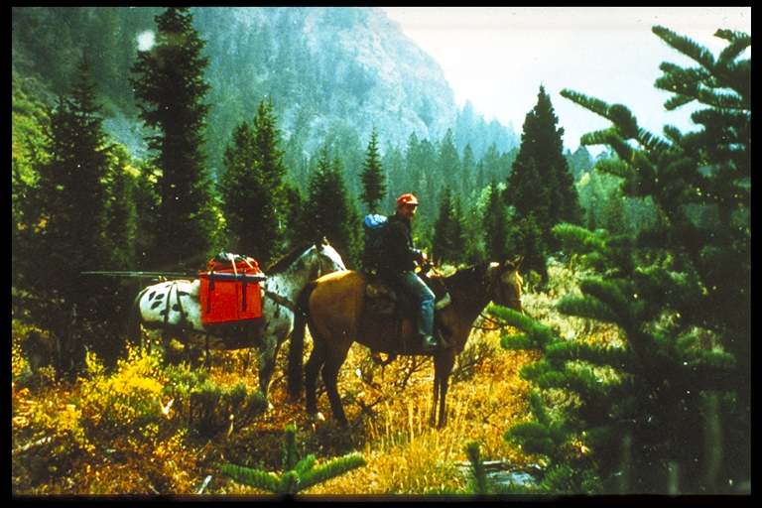
Notes:
BLM Wilderness Areas in Western Overthrust Belt where seismic cannot go

Slide 14

Notes:
The two most important controversies are probably related to the concept of vertical migration, halos, and the insistence that seepage magnitudes can somehow be related to economics.
There are no “halos”. Seeps occur all over the basins and no just over fields, however, fields do occur along preferential migration pathways that can be defined by surface seeps. Even more important, soil gas can predict the composition “oil vs. gas” of the subsurface source.
Obviously the magnitude of a seep has nothing to do with economics
Economics regarding whether or not a well is “commercial” or not is determined by many factors that have nothing to do with the magnitude of a seep, i.e. volumes and flow rates of oil and/or gas, location and depth of the well, distance to market, etc.

Slide 15
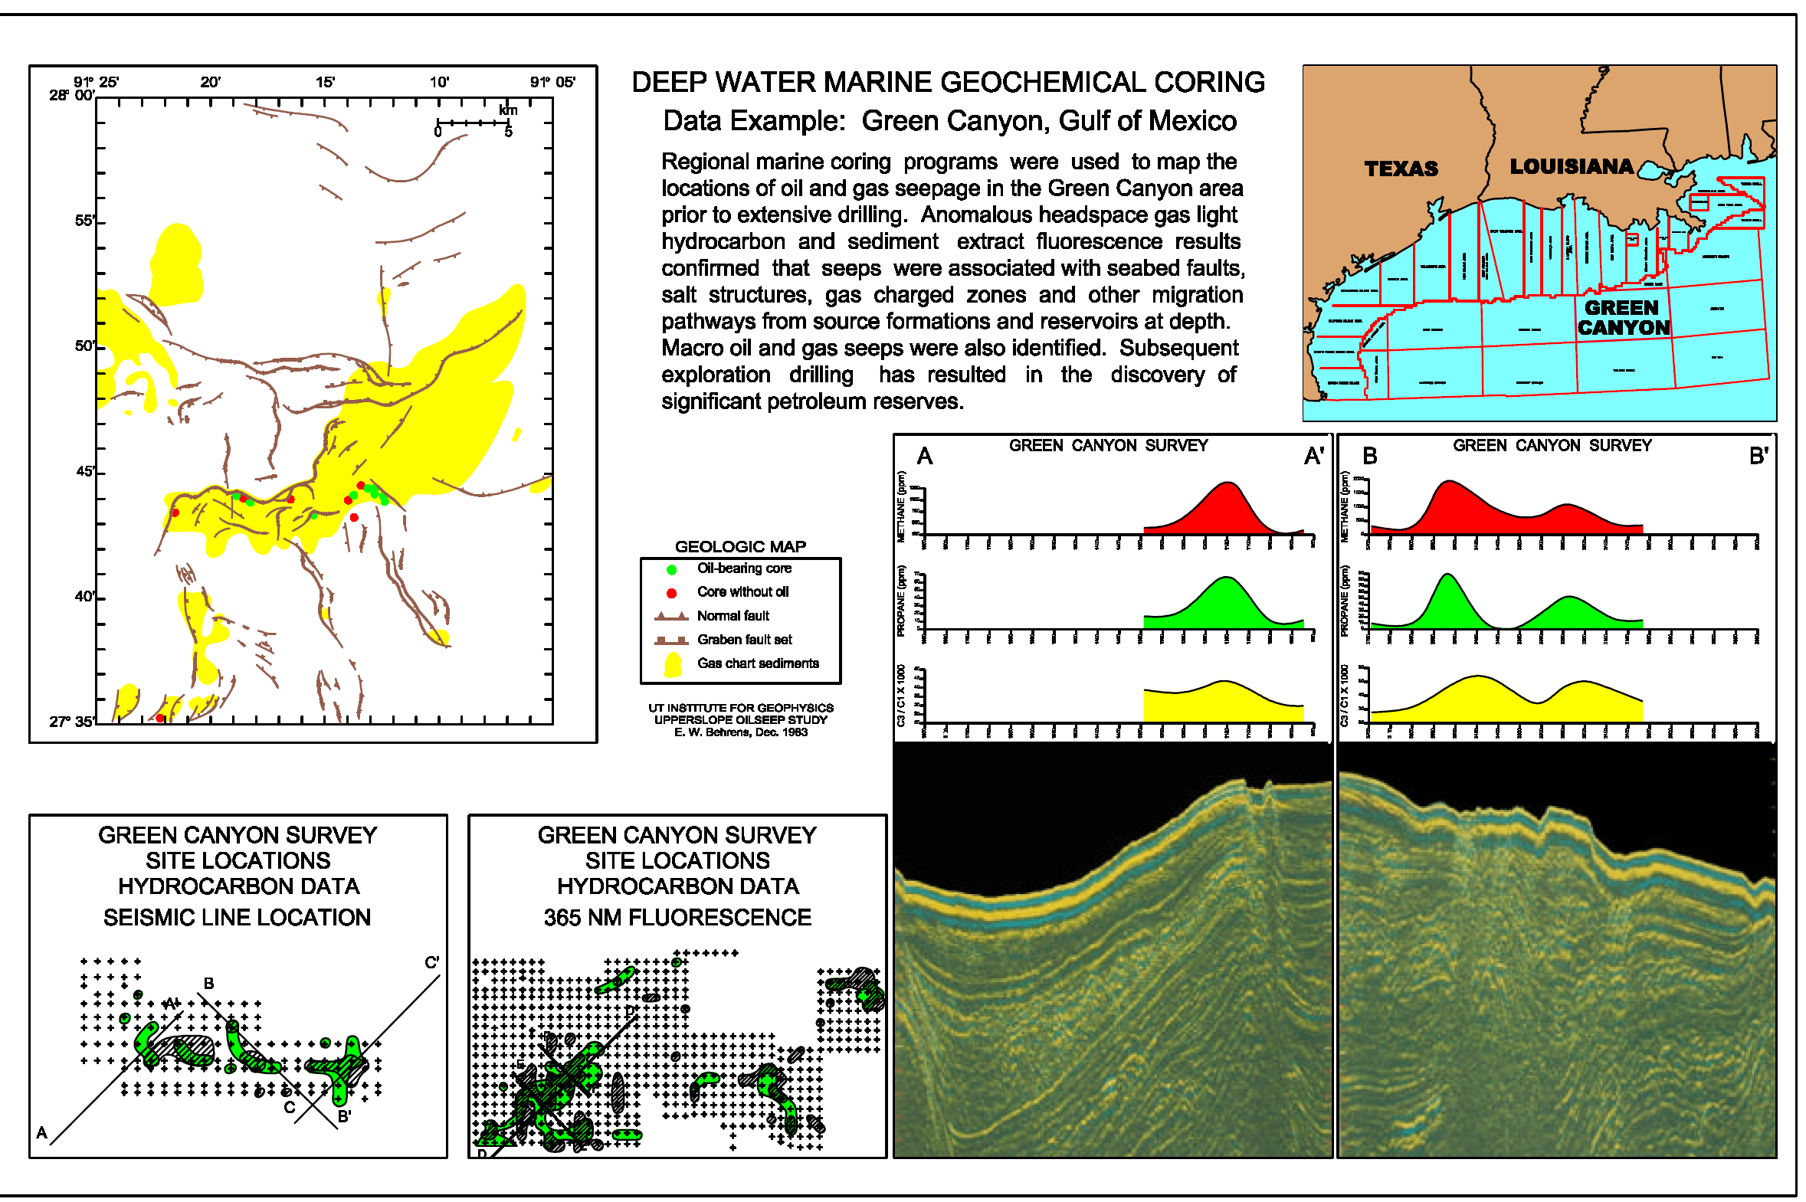
Notes:
Sediment coring data collected in the Green Canyon by Gulf-Tenneco where the first live oil seeps were found in the Gulf og Mexico by Parker et al. 1983, published in Science
Green cores contain live oil, note faults and yellow ZOD wipeout on seismic due to gas charging

Slide 16
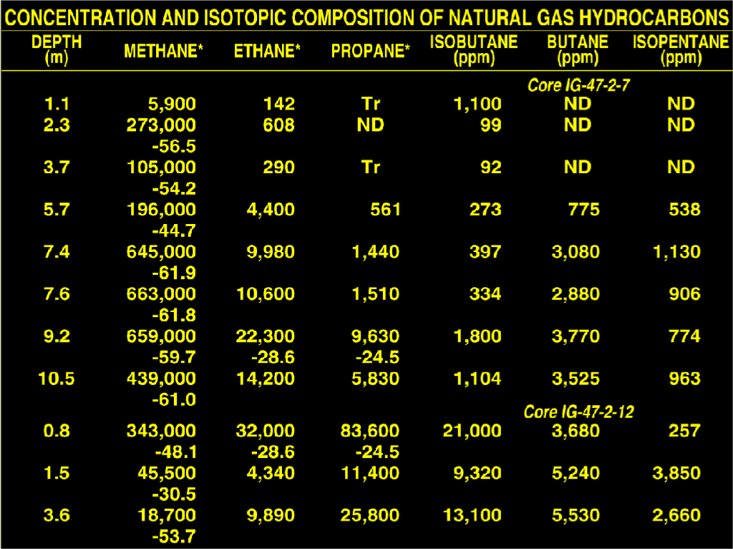
Notes:
First Hydrocarbon data from Green Canyon, note very large methane along with significant ethane plus hydrocarbons, some with inverted ethane/propane ratios and very heavy (oxidized) methane isotopes of -30.5 due to degredation

Slide 17
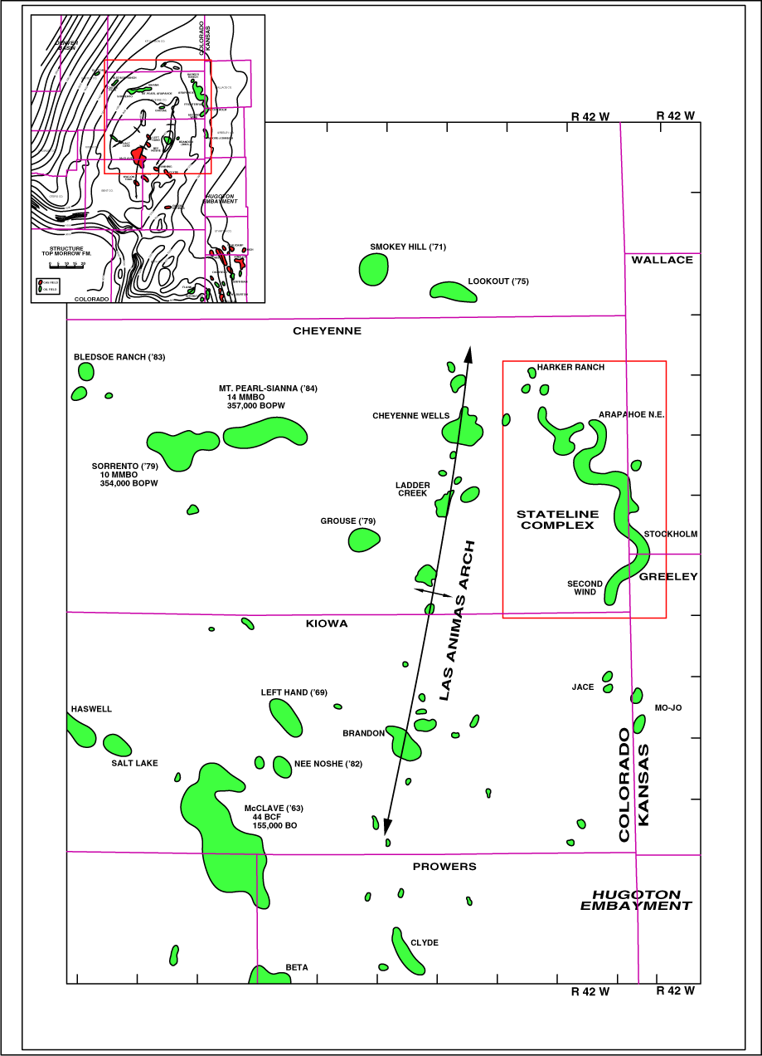
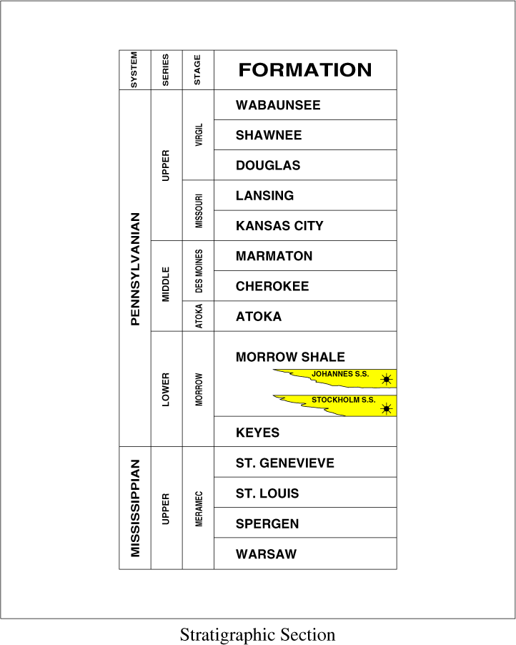
Notes:
Stateline Complex in Kansas

Slide 18
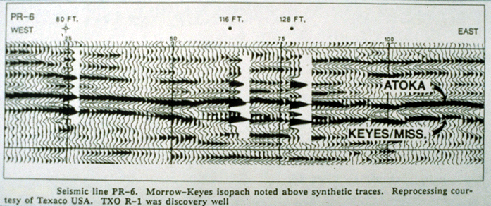
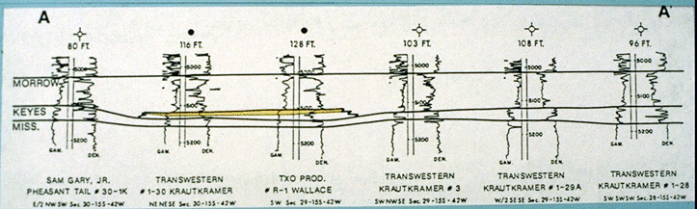
Notes:
Paleolows and isopach thicks mapped from seismic are not effective

Slide 19
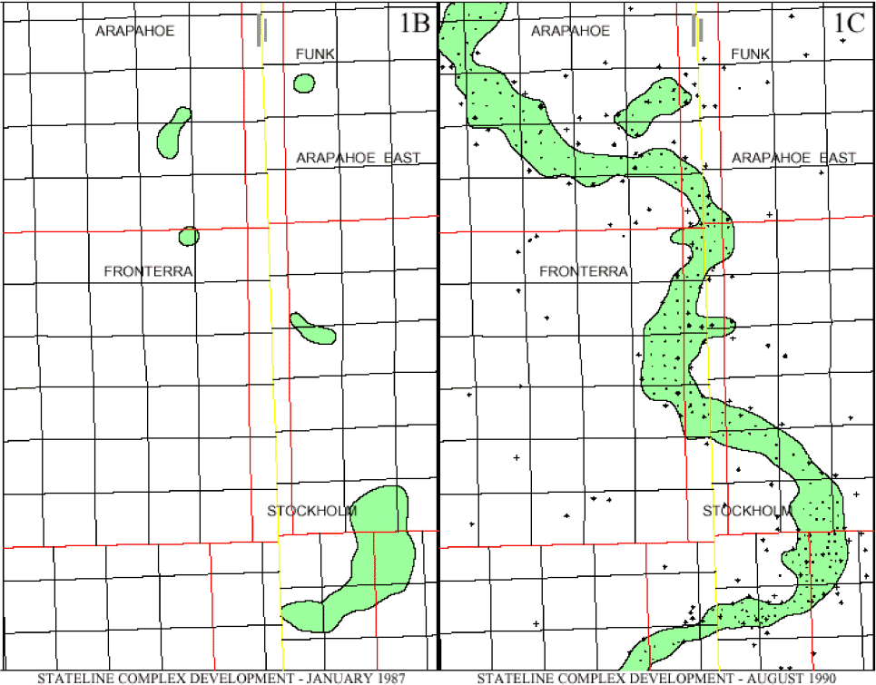
Notes:
1987 production on the left and 1990 production found after soil gas survey

Slide 20
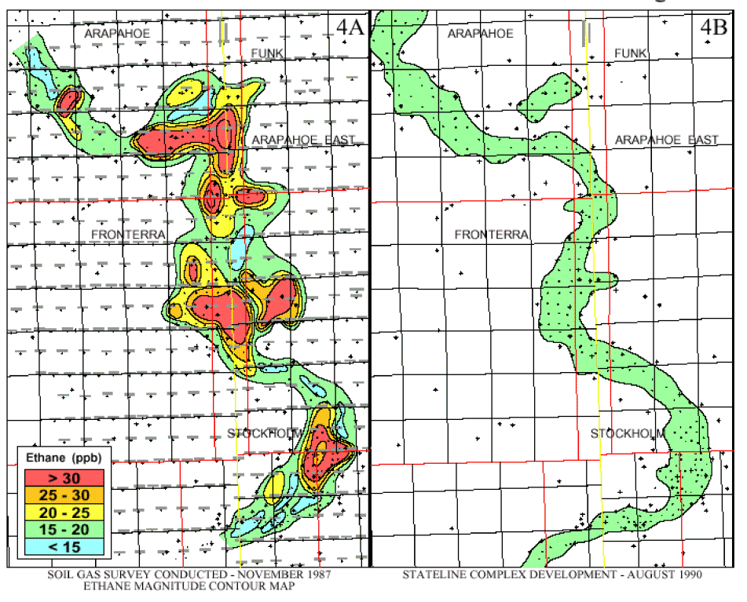
Notes:
Ethane contour map made in 1987 from soil gas three years before Stateline production was found
Note largest ethane is 30 ppb (red colors), only 3 times ETI detection limit

Slide 21
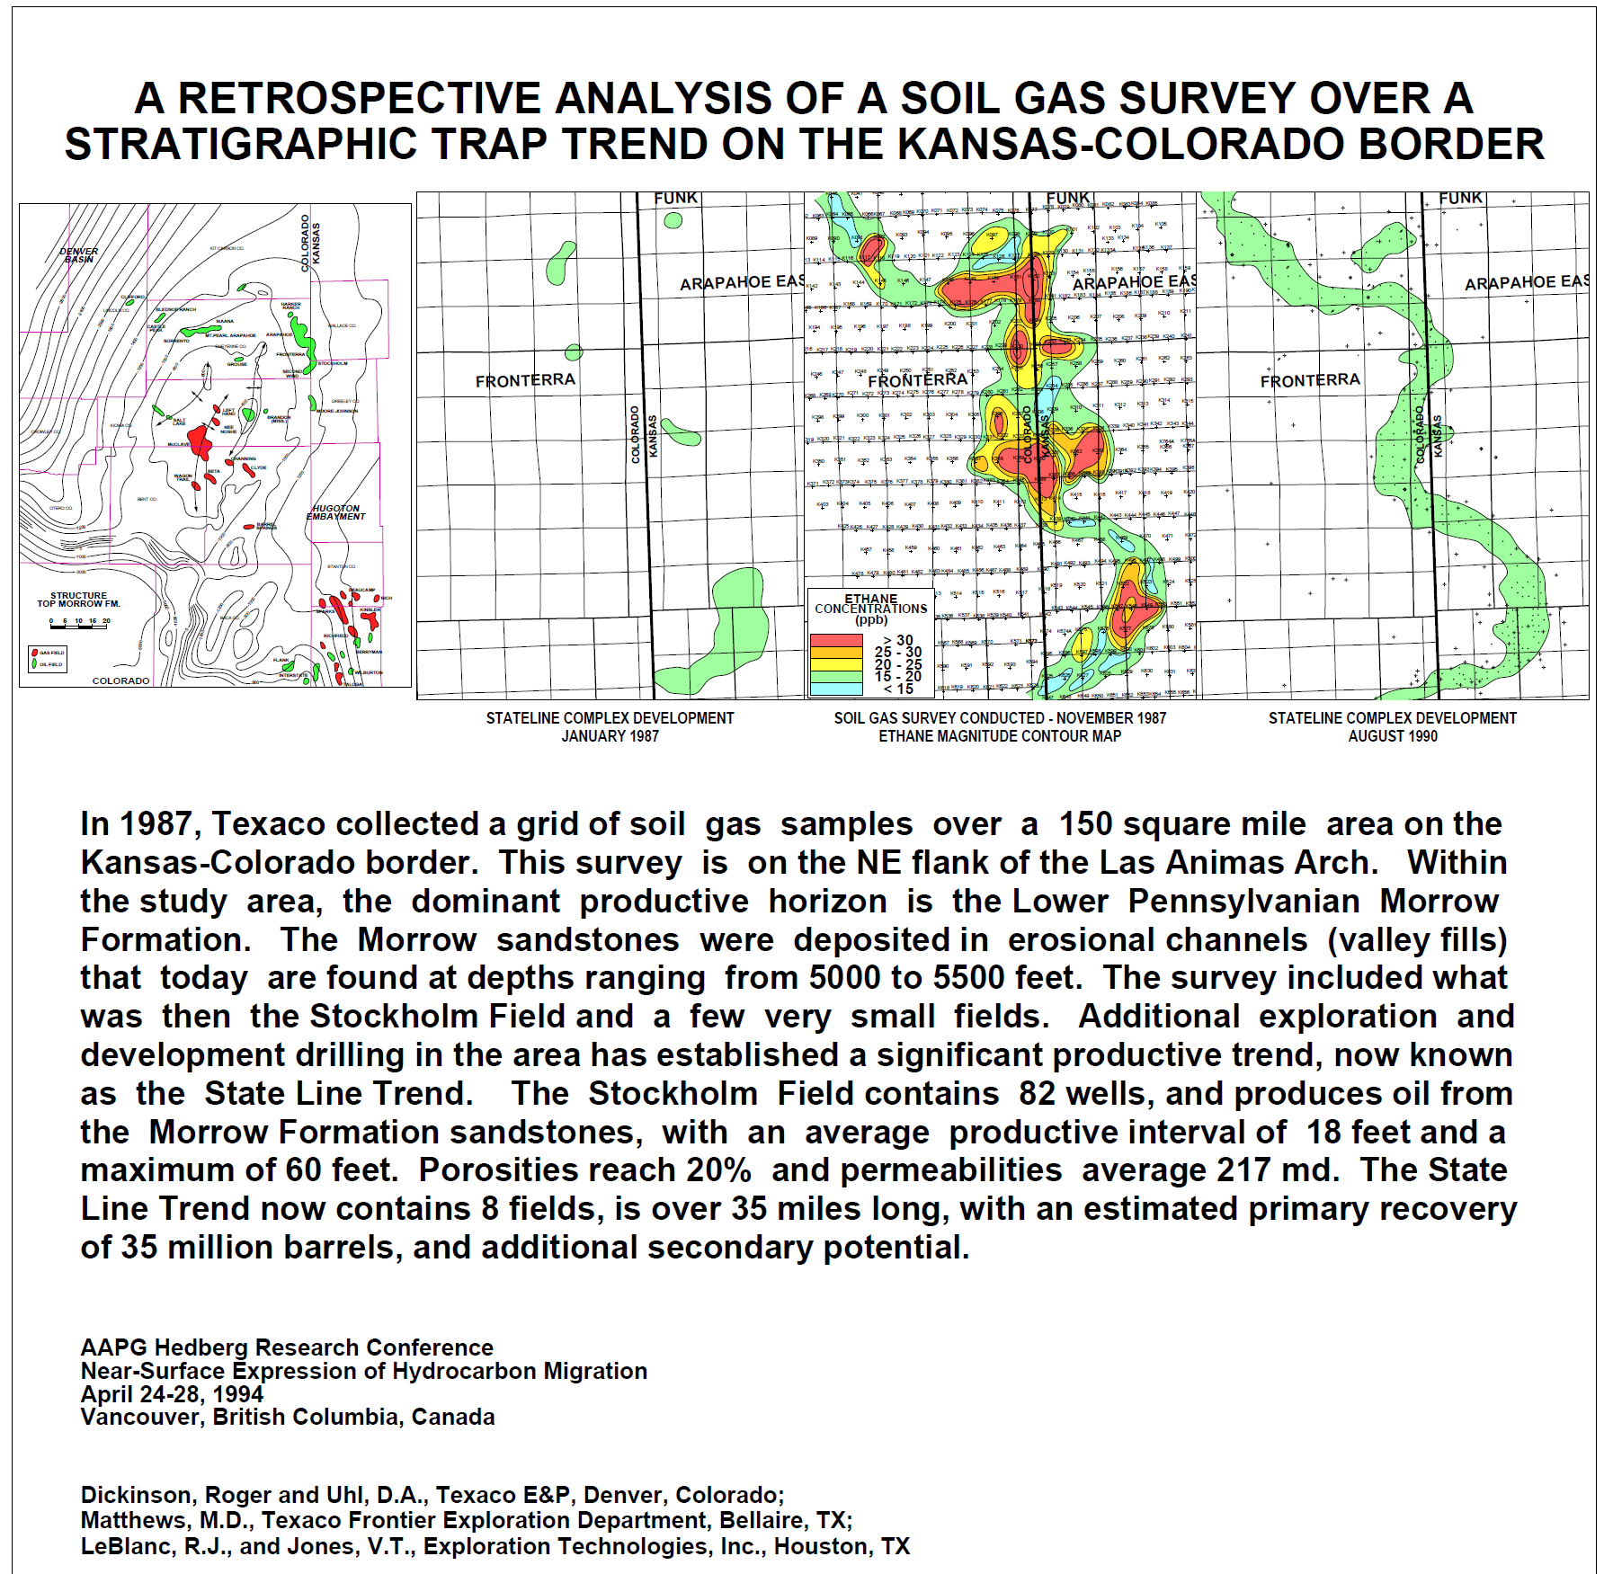

Slide 22
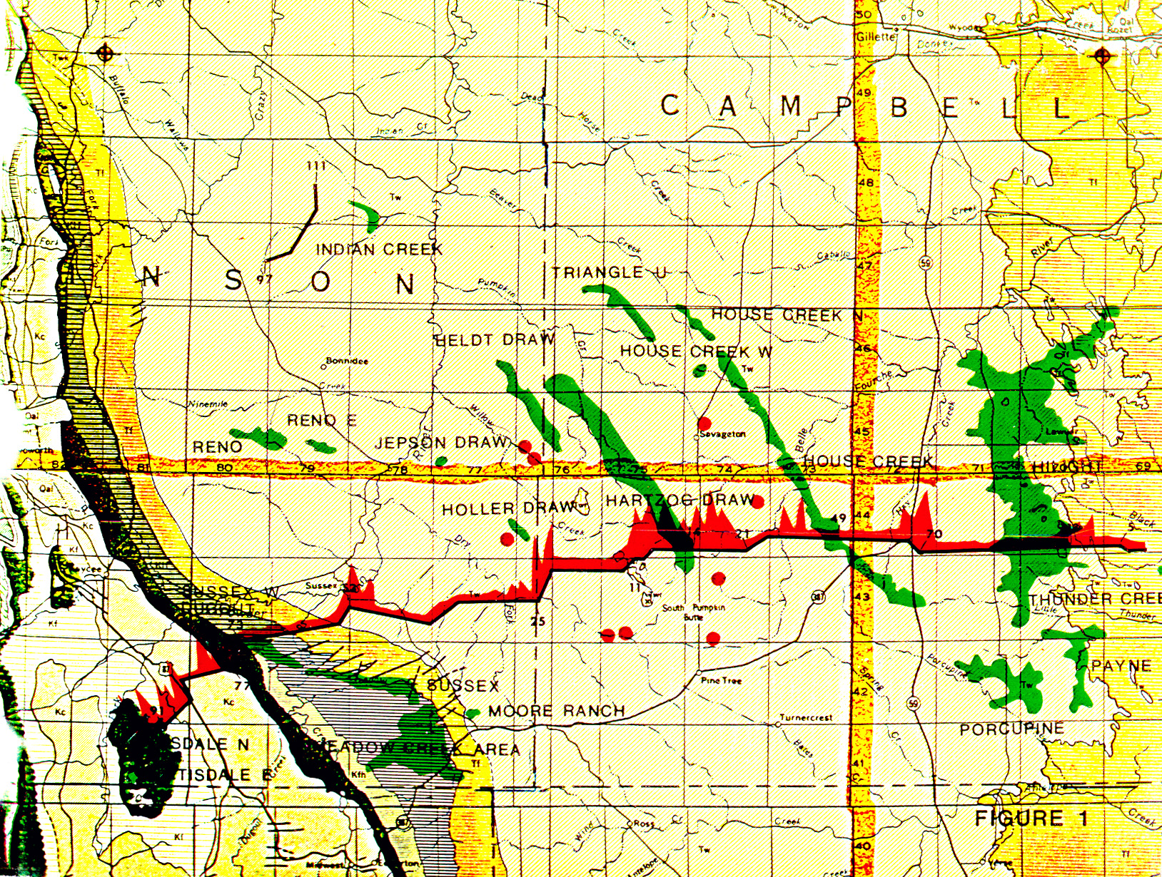
Notes:
First Discovery, Hartzog Draw Oil Field made in 1976, when soil gas survey completed there was a small field called East Heldt Draw, which was then extended down to the large soil gas anomaly found at Pumpkin Buttes
Second largest field in the Powder River basin, a 9000 foot deep Cretaceous sand

Slide 23
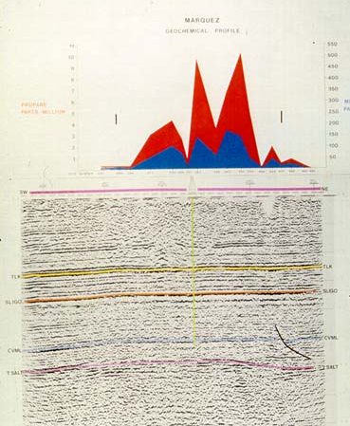
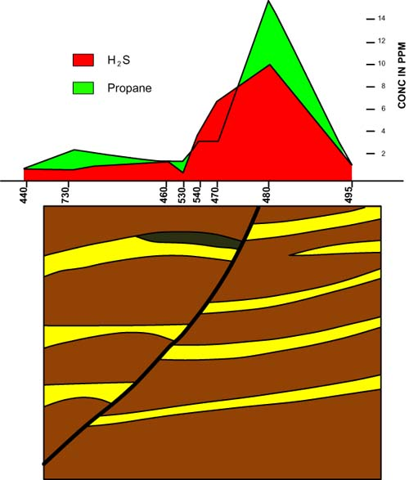
Notes:
On left Marquez Gas Condensate Discovery, the number 1 drilling project in 1979 in Gulf Oil’s Houston District, 12,500 foot deep Cotton Valley reservoir located under an Astroblem
On right Hydrogen sulfide and propane migrating up growth fault in east Texas over Weyland Oil Field, a high sulfur oil

Slide 24
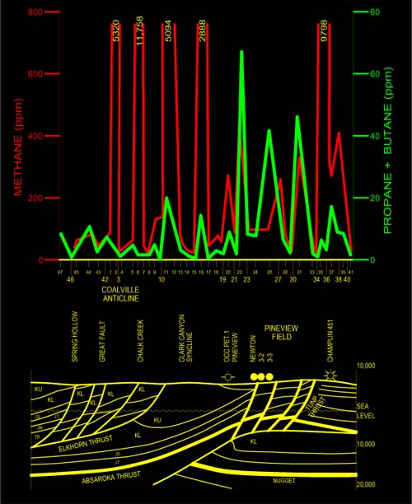
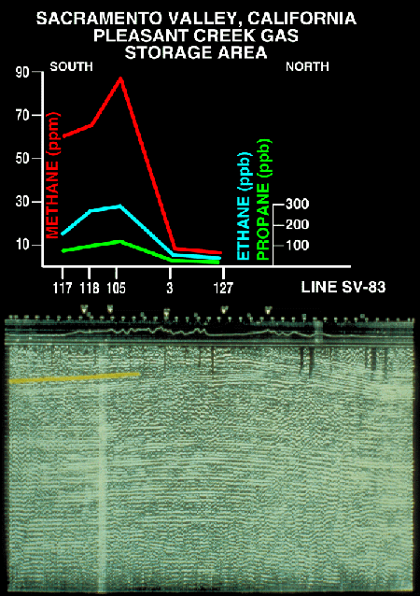
Notes:
On left, A 1500 foot deep stratigraphic gas storage field showing one profile from a grid placed over the field, charges with 2000 psig of Canadian gas when surveyed in 1975
On right, Pineview Oil Field, gas storage field on left side of profile between tow large red methane anomalies, note green propane plus butanes directly over oil field, completed in 1976 when there were only 3 producing wells in field, dry hole on left side of Pineview field became a producer after soil gas survey was conducted, as expected from green profile

Slide 25
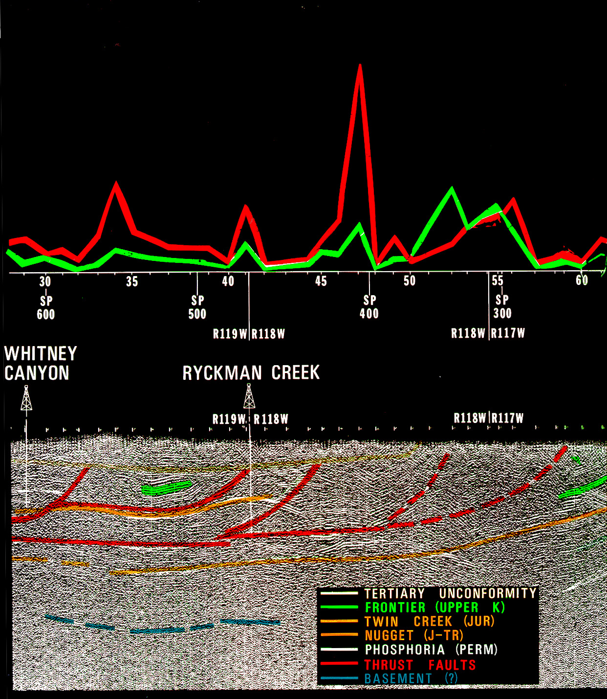
Notes:
Amoco-Gulf Ryckman Creek number 1 well was drilling when survey was conducted, 500 feet of pay found after survey, note both methane (red) and propane plus butane (green) anomalies suggest migration up thrust faults
The left-most anomaly is Whitney Canyon, which had not been discovered until much later

Slide 26
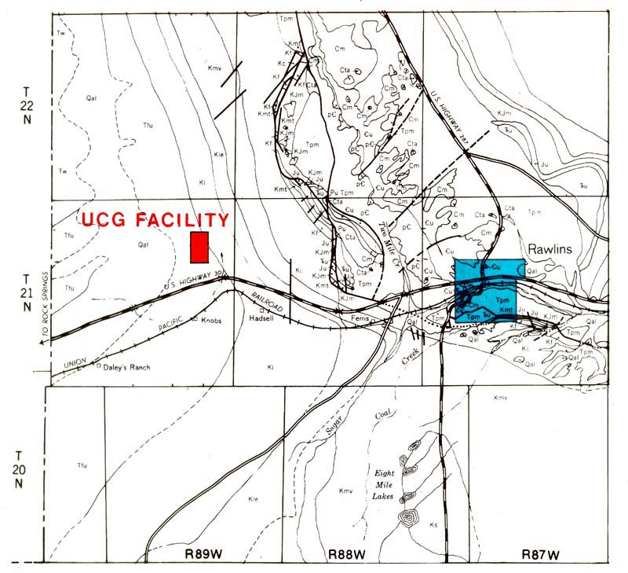
Notes:
Rawlings Wyoming UGC Coalbed methane facility

Slide 27
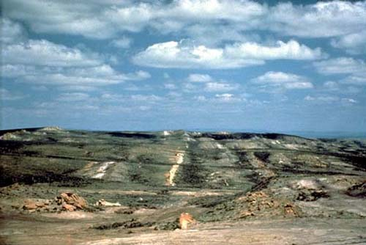
Notes:
Looking north, note sandstone ridges alternating with coals

Slide 28
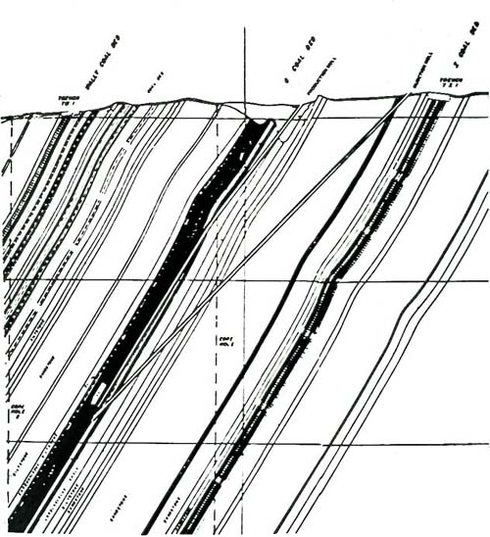
Notes:
Cross section of sandstones and coals showing vertical and slant wells used to product gas from an underground retort

Slide 29
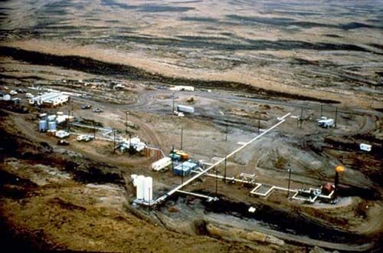
Notes:
Looking west at facility, soil gas trucks on left

Slide 30
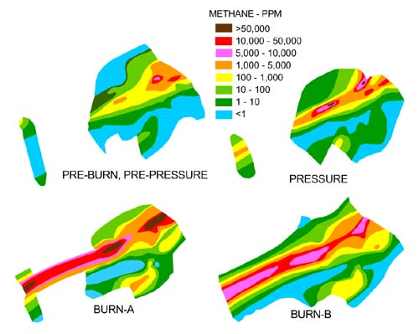
Notes:
Contour maps of methane concentrations made in four time windows during operations

Slide 31
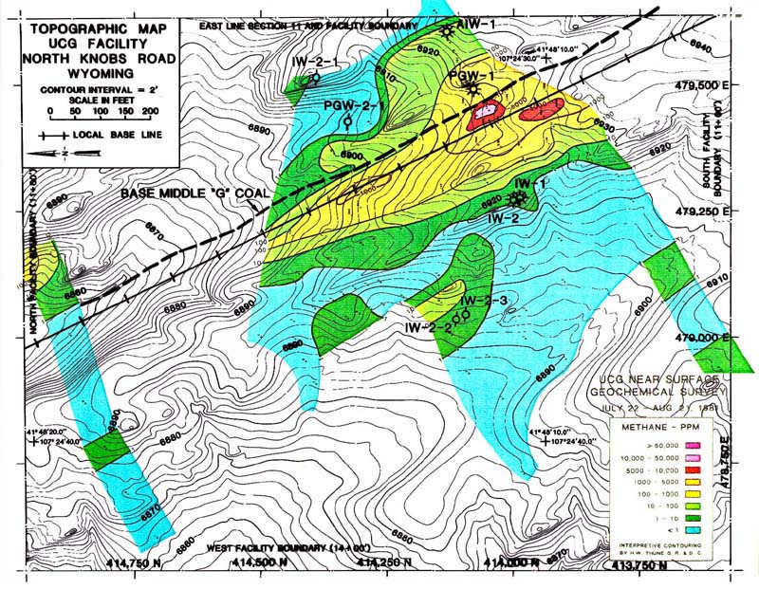
Notes:
First time interval, initial condition showing seepage from first burn at 600 foot depth, some small vertical seepage shows above the new wells placed downdip at 1000 feet below surface

Slide 32
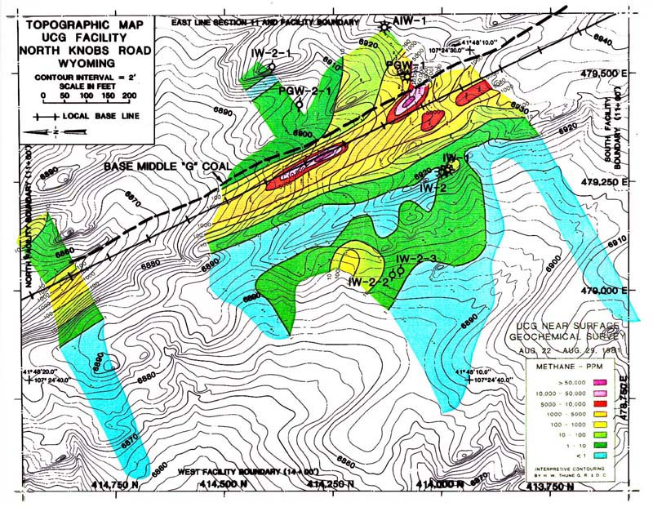
Notes:
Second time interval, note new seepage on over coal formation and vertically through dipping beds, 2 day response to pressure changes

Slide 33
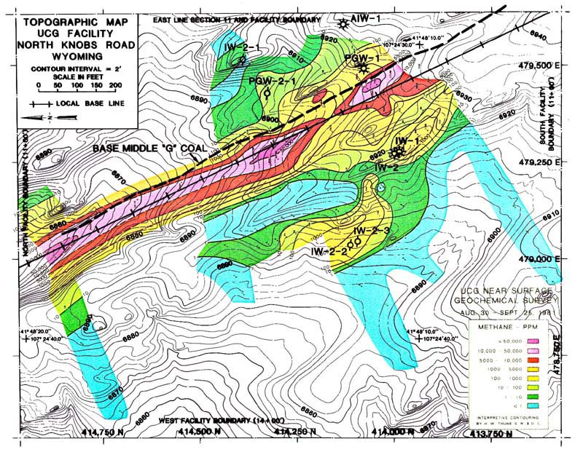
Notes:
Third window showing hydrocarbon spots marching down along outcrop

Slide 34
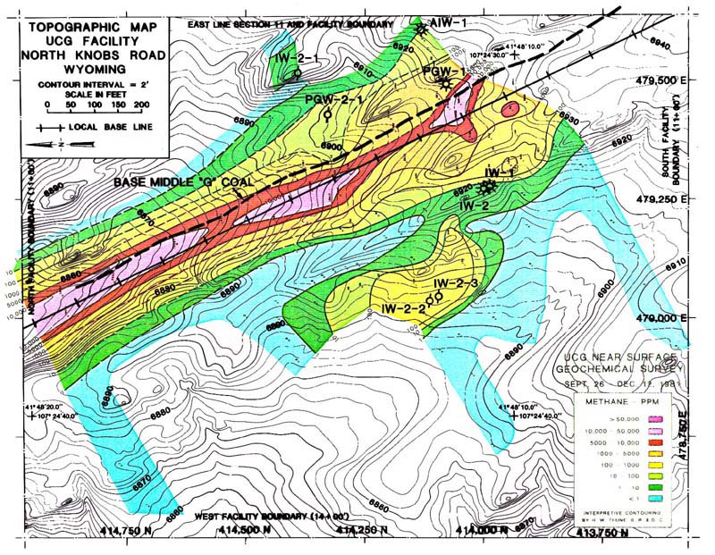
Notes:
Fourth time window after underground retort filled with water showing decay of anomalies

Slide 35
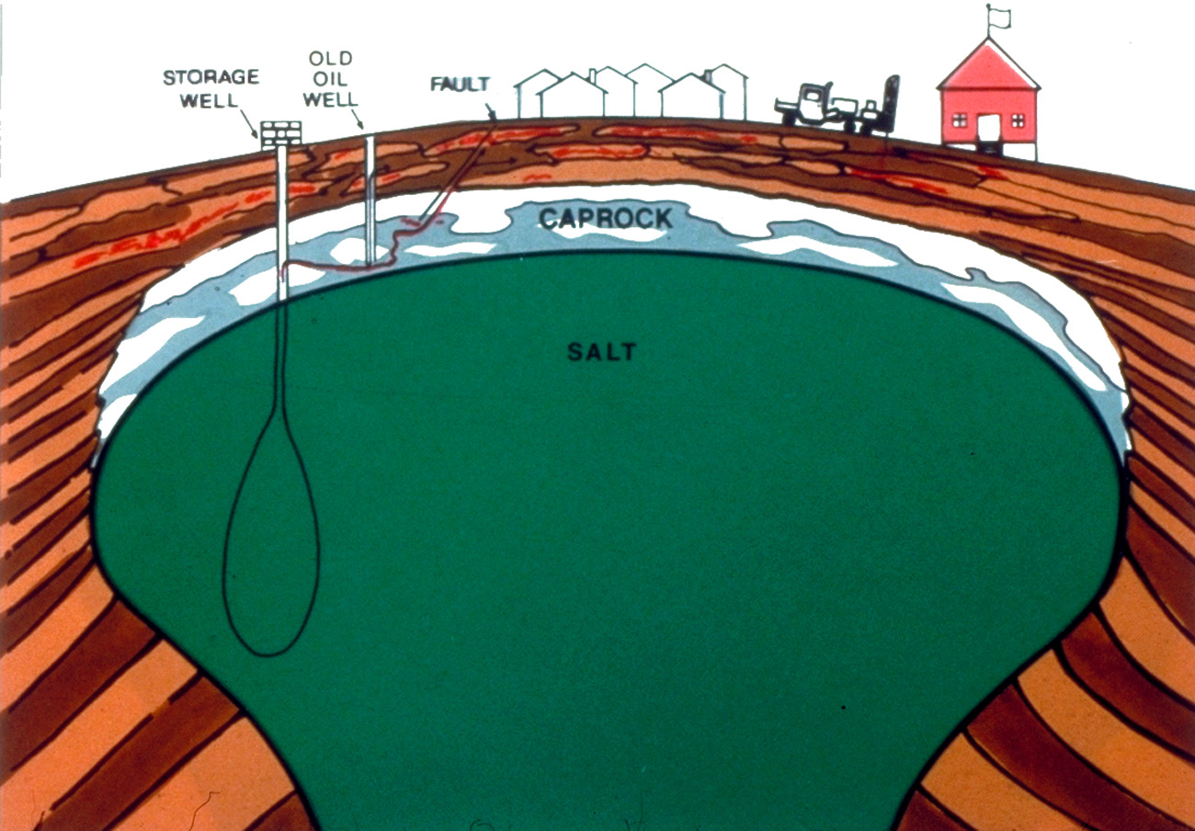
PREPARATION MEETS OPPORTUNITY
Notes:
Mount Belview salt dome gas storage

Slide 36


Slide 37
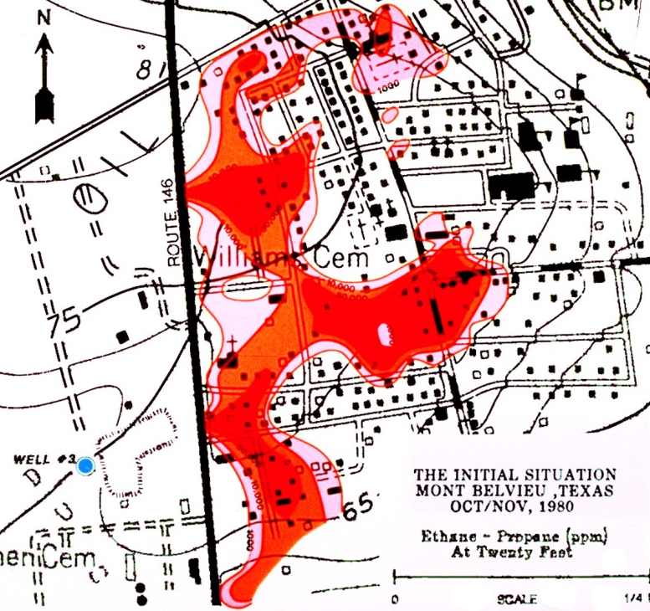
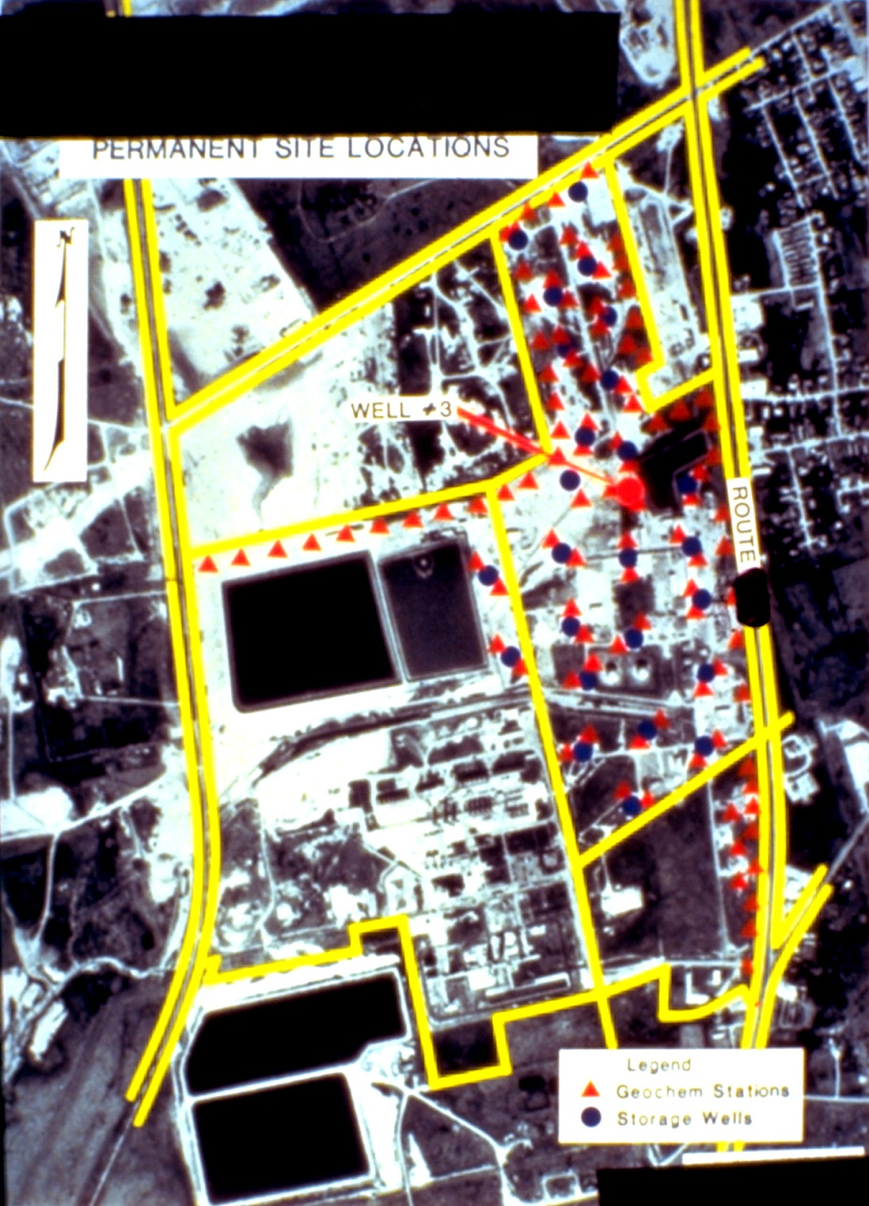
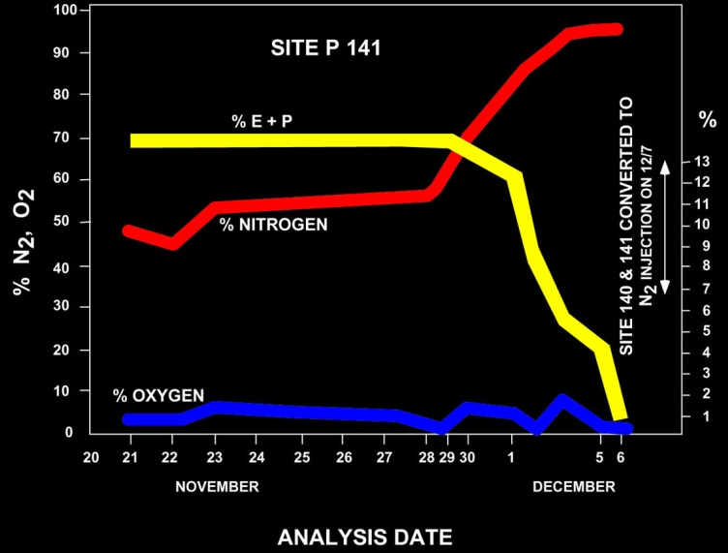
1980 Gulf Oil Continuous Monitoring Systems Established in Mount Belvieu, Texas for Monitoring Underground Gas Storage Wells
Notes:
In 1980 a woman’s dishwasher blew u. The cause was a loss of an ethane/propane mix that had escaped from an underground gas storage well located in the Barber’s Hill salt dome. A soil gas survey consisting of approximately 500 30-foot deep monitoring wells defined the lateral extent of the migration. Cleanup involved injecting nitrogen into these wells and pushing the ethane/propane back onto the source property. Following the cleanup operations, an advance warning system was installed to catch leakage from other storage wells before they could become a problem. Two permanent monitoring stations were installed at every storage well casing. This type of monitoring system, if properly sampled on a regular basis, can allow early detection of well leakage before it appears at the adjacent boundary of the property. Application of such a monitoring system could also be used for CO2 detection. My associate, Dr. Pirkle still monitors this system.

Slide 38
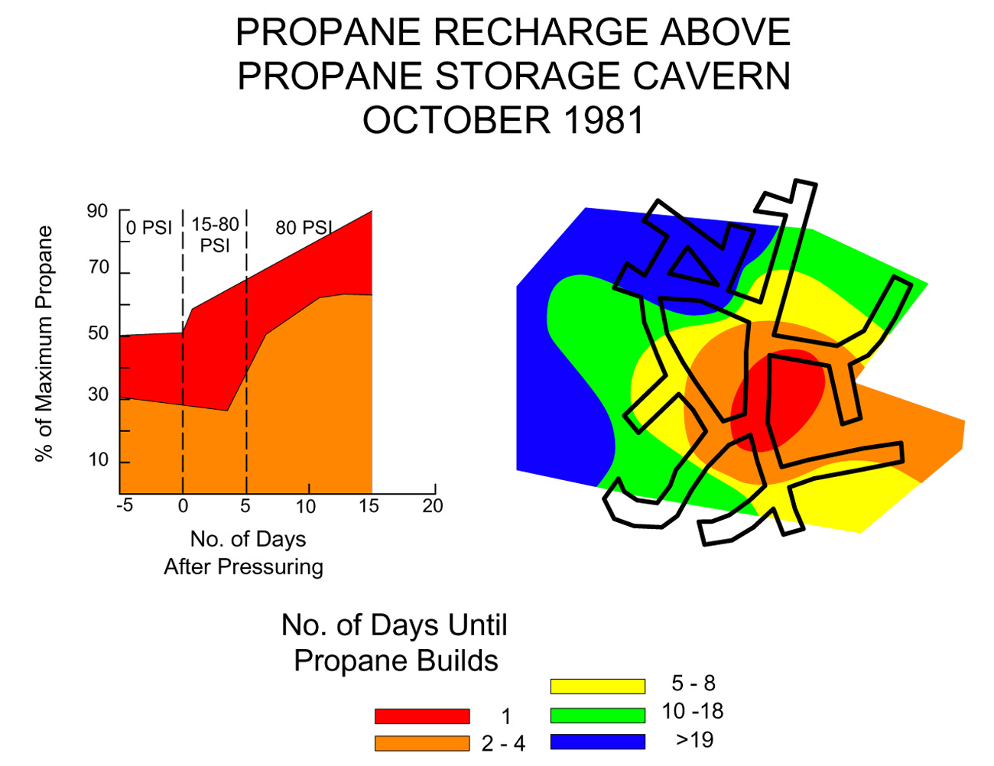
Notes:
Another excellent example was provided by a survey conducted over a 200 foot deep propane storage cavern. The objective was to determine the leakage rates and to determine the success of ongoing remedial efforts. 455 soil gas measuring stations were installed to a depth of 20 feet using PVC pipe placed on 10 foot centers. This slide shows the propane collected over the cavern.

Slide 39
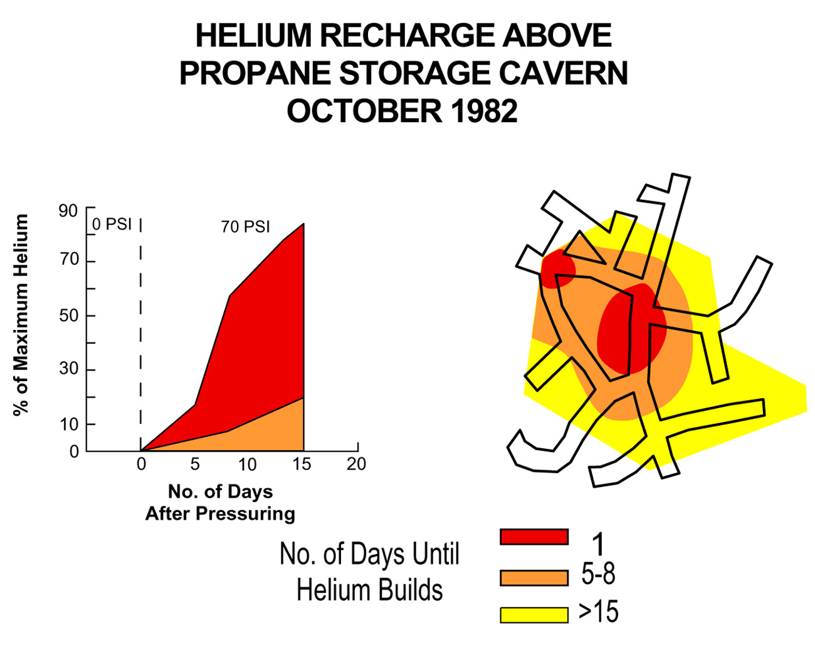
Notes:
Because of the quantity of propane contamination over this cavern it was impossible to determine the recharge rate whenever the cavern was depressurred and then recharged after repairs. In response we injected helium into the cavern.as a tracer. Two 1A cylinders provided 600 ppm helium in the cavern, adequate for a tracer, but low enough not to cause a problem with the BTU value of the propane product. As shown, the helium concentration at the surface was 90% of the value in the cavern within 15 days. This helium injection also allowed for the detection of a helium leak in one of the mined drifts that had not been detected when measuring only helium.

Slide 40
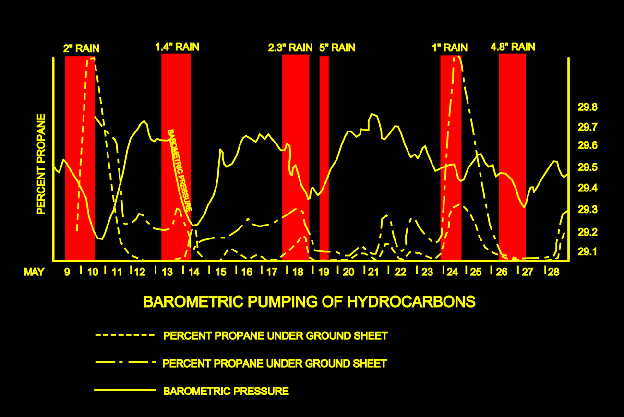
Notes:
This slide shows the effects of barometric pumping of propane flux into the atmosphere under a plastic ground sheet. This is described in more detail in the flux paper published in AAPG Memoir 66. This slide shows just how dynamic the gas flux was over this cavern. The existence of such large seeps for over 20 years should be adequate to get some migrated propane into the adsorbed state, so to test this concept, fresh canned samples were collected from two areas; a seep area over the leaking reservoir and a background site off the reservoir. Interestingly enough, a fresh sample again contained no adsorbed propane even when the sample was only two days old. Leo Horvitz did, however, confirm the interstitial headspace propane in the 2 day old cans.
These experiments were significant and suggested that macroseeps with tremendous gas flux (large enough to attract and kill blow flies at the surface in this case) could exist; yet there was no adsorbed propane on the soil. If we had used only the Horvitz adsorbed method, then we would not have found any evidence of the propane gas leakage.
This made us aware that all of the surface geochemical methodologies were not equivalent, and could, in fact yield spurious or invalid results.

Slide 41
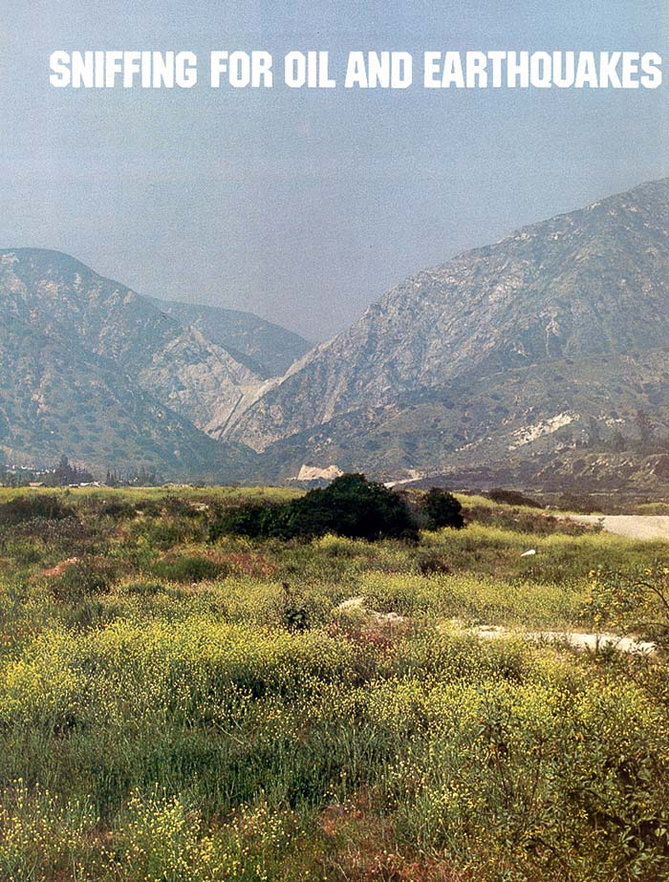
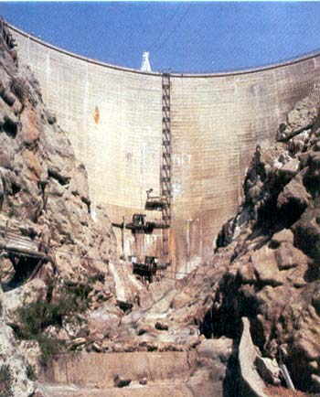
Notes:
Cover of Gulf Orange Disk magazine showing Pacoima Dam site

Slide 42
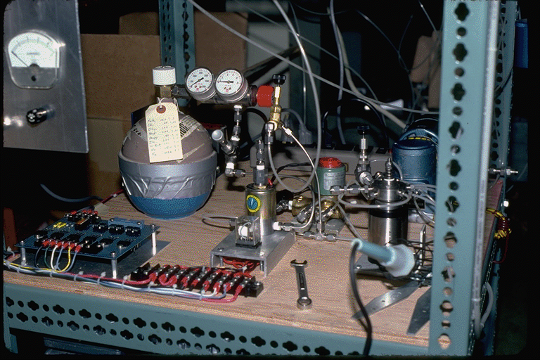
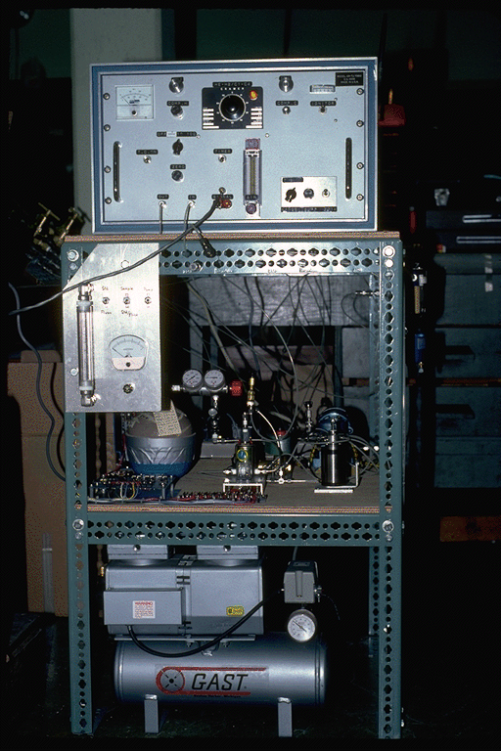
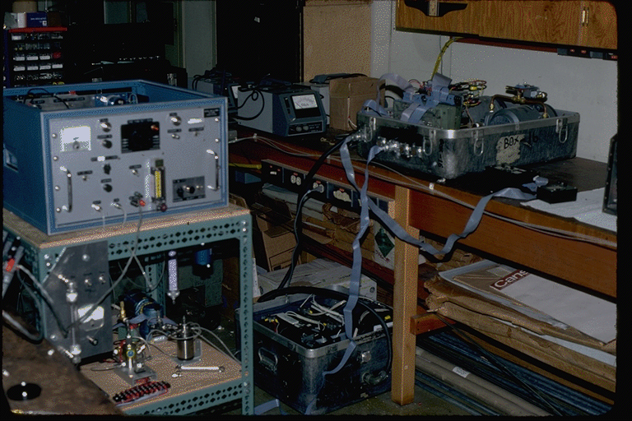
Notes:
First computer controlled gas chromatograph designed by Gulf and Caltech scientists, note standard bottle on top right, GC could be operated remotely from Caltech Vax computer

Slide 43
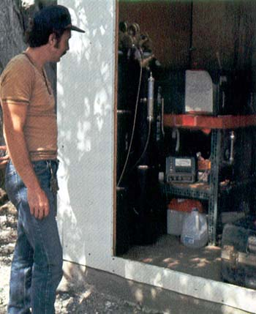

Notes:
David Masdea, Gulf Technician assigned to Caltech to build and operate system at Pacoima Dam site

Slide 44

Notes:
Gulf Oil designed and built the first gas chromatographs, they were used extensively, but never patented, purchased from Gulf by ETI in 1984
Note very high sensitivity of 10 ppb in flow-through operating mode
Only 40 ppb sensitivity could be obtained by hand inject of sample

Slide 45




Notes:
Helium-hydrogen anomalies on Hwy 46 in California on San Andreas Fault
Hwy 46 rupture by 1966 earthquake where soil gas collected in 1975
Lower right hydrogen anomaly at Pacoima Dam

Slide 46

Notes:
Arrowhead Hot Springs on San Andreas Fault

Slide 47

Notes:
Picture of one of the Arrowhead Hot Springs on San Andreas Fault

Slide 48

Notes:
Gulf-Caltech setup for collecting gas at Arrowhead Hot Springs on San Andreas Fault, Dec 1981

Slide 49

Notes:
First gas data at Arrowhead Hot Springs on San Andreas Fault collected on a weekly basis from 12-8-1981 to 1-17-1982

Slide 50

1981-82 Arrowhead Hot Springs Continuous Monitoring
Conducted by Gulf Oil - CalTech Illustrating Natural Variations
in Gas Flux over Time
Notes:
The best monitoring station was located at Arrowhead Springs in San Bernardino, CA where we measured the gas flow rates and composition of the deep earth gases for nearly one year. Methane and propane are shown on the top two graphs and the propane/methane and helium are shown on the bottom two graphs. Compositional propane/methane and helium changes appeared to be related to earth stress changes, unfortunately, the takeover of Gulp by Chevron ended this research effort.
Now let us quickly review some CO2 and methane data that has a significant bearing on determining the baseline concentrations and distributions that must be understood before establishing CO2 monitoring locations.

Slide 51

MAGNITUDE RELATED TO PRESSURE
AND PERMEABILITY
Notes:
Matt Matthews “Bullshit slide” made at Texaco

Slide 52

Notes:
Now let us examine a regional data set collected on 5000 foot centers within a Nevada Valley. Sample are collected on section corners and centers. This slide provides a methane dot map with the dot sizes proportional to the methane magnitudes and the color chosen from the Pixler ratio plots of the soil gas data.
Note that the methane seepage is concentrated along the basin margins, but exists all over the basin. There is no known commercial production in this valley, and perhaps never will be. Clearly the source rocks are expulsing hydrocarbons to the surface, defining fairways where reservoirs are likely to form. The soil gas data shows the maturity of the subsurface source rocks in the basin.

Slide 53

Notes:
As shown by this cross-section, the Chainman Shale shown by the pink layer dips to the west, where the subsurface sources would tend to be more mature.
Thus a gassier signature would be expected on the left where the source rocks are more deeply buried and therefore more mature and an oilier signature on the right where the source rocks are less deeply buried and therefore less mature.
Also note that the lowest ratios (blue dots) occur at the most updip location where the migrated oils have lost their lighter ends, methane and ethane have evaporated relative to propane and butane, indicating the possibility for dead-oil reservoirs.

Slide 54

85% OF HYDROCARBONS GENERATED ARE NOT TRAPPED THEY ARE EXPLUSED, AND THIS IS WHAT WE MEASURE
Notes:
The Pixler ratios are plotted on this slide with the methane dot map. The Pixler ratio data has been divided into west and east sides to show the compositional differences across the basin. Remember that the color code for the methane/ethane ratio was chosen empirically to fit typical reservoirs. For example <5 is blue, 5 – 10 is green, 10 – 20 is yellow and >20 is colored red. Obviously the changes in compositional show by the soil gas data is not random, but is very stable. Only the source rocks in the basin can provide such a regional change over an entire basin.
Clearly the difference in composition must be controlled by the subsurface source maturity.

Slide 55

Notes:
Lets look at some data collected on a 1 km grid, or 3300 feet over the Baru and Motatan fields and partially over the Meno Grande Field in the Maracaibo Basin in Venezuela.

Slide 56

Notes:
First we’ll look at a cross-section over the Meno Grande field. As you might expect, we found fairly large oily seeps directly over and updip from this giant field. The yellow color on the right is associated with the condensate production produced below the heavy oil that is produced from the upper layers of this field. The condensate cannot migrate through the gas-depleted oils and instead show up at the subcrop to the east where the dipping beds have allowed some of the condensate compositional sources to exit the basin.

Slide 57

Notes:
The next two cross-sections are parallel to and south of the first and better show the main structural configuration of this basin. The Mesoa is the main producing horizon and outcrops to the east. As you can see the seepage does occur over the two fields, but does not outline the locations of the fields. Seepage magnitudes also increases updip toward the subcrop and outcrop, as would be expected. Again the condensate signature shows up at the subcrop along the eastern margin of this basin.

Slide 58

Notes:
My very first experience that I had to deal with when I began my career at the Gulf Oil Co. was that the seeps we mapped did not just occur over the known fields. It was very clear that seeps were occurring over entire basins, not just over commercial fields. In addition, as demonstrated by the previous Kansas and Green Canyon examples, there was no magnitude threshold for telling commercial from non-commercial.
Seeps are basin wide. Although fields may add further focus to the seeps, extensive survey experience has demonstrated that such focus is an exception, and is not the rule.
Large grids collected over entire basins clearly showed that migration patterns are controlled by basin dynamics.

Slide 59

Notes:
The key to understanding this technology was provided by collecting grids over whole basins
These regional grids clearly showed that these regional seepage patterns could only be explained by the subsurface source rocks, coupled with basin dynamics.
This relationship is best defined through the chemical compositions of the seeps, that is, whether they are gas or oil
As you will see - surface geochemistry is nothing more than a source rock tool applied at the surface, and that is it’s main value.

Slide 60

Notes:
Average gas compositions from Gulf Oil soil gas surveys over gas and oil fields in California, over gas-condensate fields and oil fields
This repeatability and response to different basins containing various gas, condensate and oil sources saved soil gas at Gulf Oil and helped to build interest and support

Slide 61

Notes:
In a comprehensive program carried out in the 1970-80’s evidence was obtained that the natural seepage could be used to predict the oil vs. gas potential of an unknown area by measuring these light gas compositions. Figure-4a shows the location of three of Gulf Oil’s soil gas data sets that were gathered within basins having different , but unimodal reservoir compositions: red-gas in the Sacramento Basin, yellow-gas-condensate from the Pincher Creek field and mixed oil & gas from the Permian Basin oil fields. The three plots along the bottom of the figure are histograms that show the compositional variation of the percent methane )relative to the C1-C4 gases), the propane/methane and the methane/ethane ratios. Extensive data sets collected over the past 30 years has shown that surface seepage gases from world-wide basins always contain similar compositional data as their underlying, associated fields.
The table in Figure-4 shows the actual methane, ethane, propane and butane compositions in reservoirs (Katz & Williams, 1957). Methane, ethane, propane and butanes occur in essentially all petroleum reservoirs, and most significantly, their compositions are defined principally by the source type and maturity. These source rocks then control all reservoir and surface seepage compositions.

Slide 62

Notes:
As further proof of this concept we examined both mud logging and actual reservoir compositions from producing wells. The leftmost diagram, based on mud logging data, was published by Pixler in 1969. The plot on the far right shows actual reservoir analytical data from the producing wells in three fields, the red dots are from a gas field, the yellow dots are from a gas-condensate field and the green dots are from an oil field (published by Verbanic et al.in 1982).
The center plot shows the average compositional values of the soil gas data from the previous slide, plotted on the Pixler mud logging diagram. As shown, the seepage data collected in the vicinity of these three fields that produce gas, condensate and oil, fit without correction, or adjustment to their associated reservoirs.

Slide 63

Notes:
This ternary plot displays the composition of every soil gas sample point collected over the Corning dry gas, the Pincer Creek gas-condensate and the Sprayberry oil reservoirs. All three of these calibration data sets consists of large 400 to 600 site grids that were collected over producing reservoirs that lie within basins containing uni-modal source rocks. All three surveys were conducted within areas covered by recent sediments that have well cultivated and watered soils that would provide excellent conditions for generation of bacterial gases. Although there is a slight overlap in these populations, it is clear that they represent statistically different compositional data sets, and that there is no sign of interference from biogenic methane within any of the three basins. These distinct compositional differences are obviously coupled to the subsurface gas, gas-condensate and oil sources.

Slide 64

Notes:
In a 1991 AAPG meeting in Dallas ETI presented some calibration survey data collected over the Filo Morado and Loma de la Lata fields in the Neuquen Basin, in Argentina.
Filo Morado is a 9000’ deep oil field in a lower plate structural trap and Loma de la Lata (shown on the next slide) has two stacked reservoirs, an oil sand at 6000’ and a gas field at 9000’, both stratigraphic.
As shown by this and the next slide, these two fields provide excellent oil and gas calibration data.

Slide 65

Notes:
The mixed compositional information measured over the Loma de La Lata field is clearly defined by this Pixler ratio diagram. The gas-water contact and a permeability barrier mapped from deep tests of the underlying gas reservoir are shown by the purple lines on the slide. West of the permeability barrier there is no underlying gas field. In this area the soil gas data has an oily (green and yellow dots) composition, indicating that the soil gas data has mapped this permeability barrier that defined the western border of the underlying gas field through the blanket oil sand that covers the gas field.

Slide 66

Notes:
The slide on the left shows some calibration data over a dry gas area in Alaska and the slide on the right shows soil gas collected over a non-commercial heavy oil in Nevada. The Nevada data is from North Butte Valley where Gulf drilled a non-commercial oil well that contained dead oil. These seeps were very large magnitude, but as shown by the Pixler ratio diagram, they were much too oily.
The low C1/C2 ratio and flat slope are typical for light gases observed over dead, non-commercial oil deposits.

Slide 67

Notes:
Kenai Gas field lies within the gas samples on the lower left shown by red dots and the Point Simpson Oil field lies right under the green and yellow dots

Slide 68

Notes:
The Currant well drilled in Railroad Valley Nevada produced a 14 gravity oil from 7000 feet. This well was drilled within the blue-green area on this slide. The yellow-red compositions are typical of a Grant Canyon-type deposit.
Actual empirical soil gas data collected over all the other commercial fields in Nevada indicated that the yellow-red compositional range were typical for soil gas data observed over the commercial oil fields.
However, the most important point made by this slide is the fact that the color compositions are selected by actual reservoirs and then used to generate the scatter plot and the dot map. As shown, these spatial and compositional relationships are certainly not random, and at 1000 foot centers, this data begins to work at the prospect level.

Slide 69

Notes:
Nikonov Reservoir data base of 3500 wells

Slide 70

Notes:
In addition to the Pixler ratio plots which contain methane which can be biogenic, the C2/C3 ratios is also very useful. There are no biogenic sources for these two gases, ethane and propane and their ratio can be used to predict the oil vs. gas ratios of their associated subsurface reservoirs.
This slide shows the relationship of this ratio defined by 3,500 reservoirs worldwide reservoirs. Our experience suggests that the brown curve may apply mainly to very dry gases, with most oil and gas fields falling between ratios defined by the blue to red curves. Thus most commercial oil and gas fall between 2 and 4.

Slide 71

Notes:
Let us examine scatter plots for the C2/C3 ratios for a dry gas area, a heavy, dead oil deposit and for commercial oil and gas fields such as Filo Morado and Loma de la Lata fields, which provide typical oil and gas field responses.
Note that the Kenai dry gas field has an ethane/propane ratio of about 4, while the heavy, dead oil is generally less than 1 to 1.5.
Filo Morado and Loma de la Lata fall right in the middle, splitting apart at about 2 to 2.5.
More importantly, note that both the Pixler and the C2/C3 ratios form coherent, well-behaved populations that clearly can be related to their subsurface sources.

Slide 72

Notes:
For comparison I have plotted the Pixler's and the C2/C3 ratio for a Nevada area that was found to be over mature by drilling. Non-commercial gas shows were seen in the well drilled on this soil gas anomaly.
This data fits quite well with our previously determined empirical C2/C3 ratios, suggesting that our other regional Nevada data set may actually have an intermediate potential which requires some additional, local calibration.

Slide 73

Notes:
Let us examine an ethane dot map using the C2/C3 ratio to control the color of the dots.
On the right is a scatter-plot of this data using the base we previously generated from some of our other calibration soil gas data sets.
The yellow and red dots cluster, suggesting the gassiest areas. Clearly, the blue and green dots dominate and suggests that the west side of the valley has the lightest oil and/or it may be gas generated from an over mature oil source.
Again, both the C1/C2 and the C2/C3 ratios of the soil gases are not random, they are coupled and are measuring the maturity of the deeper source rocks.

Slide 74

Notes:
This slide shows two different color choices for the C2/C3 ratio, demonstrating the extensive information contained by this regional soil gas data set. This soil gas data is anything but random. Sampled on a 5000 foot scale, this data can only be measuring changes controlled by deep regional sources.
Our experience has demonstrated that this type of data can be obtained within any basin in the world and obviously would be of significant help within any exploration program.

Slide 75


Notes:
Coal bed methane occurs in fractures which can be mapped using soil gas, note very gassy signatures on Pixler Plots

Slide 76
Notes:
This then is the system

Slide 77

Notes:
Generation of methane in test tubes in Gulf Oil basement happens within 7 to 14 days

Slide 78

Notes:
Generation of methane in test tubes in Gulf Oil basement at tow different temperatures, 25 and 36 degrees
Only methane and ethylene generated
Dennis Coleman dissertation on Illinois biogenic gases showed the very light methane ranging from -80 to -60 relative to PDB, age dated using C 14 to 40,000 years showed no ethane generated with biogenic methane

Slide 79

Notes:
Venezuelan basin where biogenic methane is found, note only methane extends upwards from correlation line, no ethane extends to right

Slide 80

Notes:
Ethane/propane cross plot shows a good fit with correlated values for all sites

Slide 81

Notes:
Looking only at the ethane/propane sites where biogenic methane was found sows slightly more scatter, but no biogenic input for either

Slide 82

Notes:
There is no biogenic ethane or propane

Slide 83


Notes:
Very large gas seepage over a salt dome field casued by a leaky well casing at 11, 600 feet subsurface, gas charged cap rock and shothole rig cause fir and burned up, question, was this only biogenic gas, or a mixture driven mainly by reservoir gas

Slide 84

Notes:
Map of venting gases in yellow and places where ETI collected gas samples
Leaking well casing shown by red dot

Slide 85

Notes:
Pixler Plot suggests some biogenic gas mixed with reservoir gas

Slide 86

Notes:
All gases plot in thermogenic areas on Coleman Isotope plot

Slide 87

Notes:
Additional Plots of carbon and deuterium isotope ratios with one another and with ethane/methane ratios prove that only methane was added as a mixing gas as reservoir gases migrate to surface from 11,500 feet
Methane just diluted the ethane/methane ratio

Slide 88

Notes:
Gulf of Mexico Marine Geochemistry

Slide 89

Notes:
Hollis Hedberg and Gulfrex seismic-sniffer ships operated by Gulf Oil

Slide 90


Notes:
Gravity core on left and Abrams Piston core on right showing alternate method for collecting core samples instead of water

Slide 91



Notes:
Hull and Deep propane from sniffer
Gulf Oil Gas stripper on top right
Lower right, 1200 foot depth capability of ETI sniffer, showing winch and fish

Slide 92

Notes:
Typical sniffer anomaly over Gulf Oil discovery

Slide 93

Notes:
Gulf Oil Gulf of Mexico sniffer data given by Chevron to Texas Univ, then to Texas A&M, then to HARC (Houston Area Research Council) and purchased from HARC by ETI

Slide 94

Notes:
Duddly Rice USGS well data used for calibration

Slide 95

Notes:
Expanded view of Duddly Rice USGS well data used for calibration

Slide 96

Notes:
Duddly Rice USGS well data used for calibration on left slide and
146 localized sniffer anomalies on right

Slide 97

Notes:
Comparison of a gas prone area versus an oil prone area in sniffer data

Slide 98

Notes:
Comparison of oil and gas field reserves to number of gas versus oil seeps in GOM

Slide 99




Notes:
Fish finder added punch to presentation to management, note inversion layer on left top, pipeline on top right and looks like fish on bottom left and a fault on bottom right

Slide 100

EAST CAMERON BLOCK 248 AREA - DATA AND WELLS THRU 1978
Notes:
Second year detailed HARC study for oil companies showing discoveries

Slide 101

EAST CAMERON BLOCK 248 AREA – ALL DATA AND WELLS

Slide 102

EAST CAMERON BLOCK 248 AREA – DATA AND WELLS THRU 1978

Slide 103

EAST CAMERON BLOCK 248 AREA – ALL DATA AND WELLS

Slide 104

EUGENE ISLAND BLOCK 252 AREA – DATA AND WELLS THRU 1976

Slide 105

EUGENE ISLAND BLOCK 252 AREA – DATA AND WELLS THRU 1978

Slide 106

EUGENE ISLAND BLOCK 252 AREA – ALL DATA AND WELLS

Slide 107


Slide 108


Slide 109


Slide 110


Slide 112


Slide 113


Slide 114

Notes:
We’ve looked at two onshore examples where the adsorbed gases did not respond to the presence of a macroseep. This next example is an offshore marine example from the Chukchi Sea.
In 1985 Fugro/ETI conducted a 1000 sites dart core survey in the Chukchi Sea for several major oil companies. One of our significant finding was a macro gas seep in the northern Chukchi, referred to as the Northern Geochemical Anomaly. This was a macro gas seep from mature source rocks associated with a shale diaper.

Slide 115

Notes:
This slide shows the outline of the macroseep based on the 3.5 kilohertz shallow sparker data

Slide 116

Notes:
In addition to seeing the shallow acoustic wipeout zone, we also found a macro gas seep containing percent levels (as mush as 8% methane) at the surface measured in gravity dart cores and/or jet hole drilled using an anchored drill ship
All the gas components were present, this slide just shows methane and iso-butane

Slide 117


Slide 118
First Joint AAPG/AMPG Research Conference
“Geological Aspects of Petroleum Systems”
October 2 – 6, 1994
Mexico City, Mexico
NORTHERN GULF OF MEXICO: AN INTEGRATED
APPROACH TO SOURCE MATURATION AND
MIGRATION
L.M. Wenger, L.R. Goodoff, O.P. Gross, S.C. Harrison, K.C. Hood
Exxon Production Research Company, P.O. Box 2189, Houston, Tx 77252-2189
Exxon Exploration Company, P.O. Box 4279, Houston, Tx 77210-4279

Slide 119
The recognition of widespread, and often intense, oil
and gas seepage in the Gulf of Mexico has allowed
the extension of hydrocarbon system and maturity
maps far beyond well control. In addition, abundant
seepage has documented that the Gulf of Mexico
slope is an actively migrating hydrocarbon system
and provides a means of identifying major migration
pathways. There is a correlation between major fields
on the slope and intense seepage from the migration
pathways to these fields. Thus, seeps provide
information that can potentially be used to rank
migration pathways to prospects.

Slide 120


Slide 121


Slide 122


Slide 123


Slide 124


Slide 125


Slide 126


Slide 127


Slide 128


Slide 129


Slide 130


Slide 131


Slide 132


Slide 133


Slide 135


Slide 136


Slide 137



Slide 138


Slide 139


Slide 140



Slide 141


Slide 142


Slide 143
Pine Valley Data
Marathon Texaco
1986 1007 sites 1988 985 sites
Methane 0.925 1.32
Ethane 0.020 0.027
Propane 0.015 0.016
C1/C2 103.0 112.0
46.8 46.8
21.6 20.6
Notes:
This slide shows the basic statistics for these two independent soil gas data sets collected two years apart by the same geologist using map and compass. The median methane, ethane and propane concentrations are shown on this slide. These very low median concentrations of 20 to 27 for ethane and 15 to 16 for propane mean that 50 % of the samples (approximately 500 samples) have less than 20 ppb of ethane.
50% of these two independent soil gas sites have ethane and propane concentrations that are < 30 ppb and < 15 ppb.
Note the repeatability of the methane/ethane quartiles. The median C1/C2 ratio is 46.8 on both surveys conducted two years apart. The upper quartile is nearly the same 103 to 112 and the lower quartile is also very close to the same value 21.6 to 20.6
Soil gases have the unique ability to predict the oil versus gas potential of an unknown basin through the compositions of the light gases (Jones and Drozd, 1983). This compositional relationship of soil gas to the gases generated within the basins surveyed is its most valuable asset.

Slide 144


Slide 145


Slide 146


Slide 147


Slide 148


Slide 149


Slide 152


Slide 153


Slide 154


Slide 155


Slide 156


Slide 157


Slide 159


Slide 160


Slide 161


Slide 162


Slide 163


Slide 164


Slide 165

Ethane
Notes:
This is an example from the Thrace Basin in Turkey where we conducted a 1 km grid over a large frontier area having unknown potential. Note the very large hook shaped soil gas anomaly.

Slide 166

Notes:
A 3-D seismic survey conducted over this same area provided an excellent seismic-geochemical correlation, and confirms a vertical seismic chimney, or wipe-out zone that appears to have a direct association with the soil gas anomaly. This is a class-A, drillable prospect, however, please note that the presence of both geochemical and seismic anomalies does not prove that the associated reservoir will be economic. In addition, the reservoir zone must be identified and tested for porosity and permeability. More than one well is likely required to determine the size of the economic base before the actual economics can be predicted.
Soil gas is a good tool if applied on a grid and then integrated with both geological and geophysical data. Experience has shown that a proper geological/geophysical prospect that has seepage can significantly raise the finding ratio to as much as 80%.

Slide 167


Slide 168


Slide 169


Slide 170

Sniffing Oil From The Sky
Jonathan Fahey, 01.21.10, 06:00 PM EST
Shell is working to detect hydrocarbons in the air and track them to oil deposits under the earth's surface.

Slide 171

LightTouch is a new, fast, low-cost oil and gas prospecting technique developed by Shell Global Solutions. The technique helps to locate new hydrocarbon reserves by measuring the ethane gas that naturally migrates from hydrocarbon reservoirs through the overlying rocks into the atmosphere.
"LightTouch maps where the ethane is escaping from the ground, providing a whole extra set of constraints useful to the explorationist seeking to understand and interpret complex subsurface data and to decide where best to drill the next well," says Bill Hirst, Principal Scientist, Measurement and Instrumentation, Shell Global Solutions International BV.
Ethane gas is measured because, unlike methane, it is not produced by biological decay. Ethane is formed through the cracking of larger hydrocarbon molecules, and this makes it a good indicator for oil and gas reservoirs. Furthermore, the atmospheric background concentration of ethane is a thousand times lower than that of methane, so seepages of ethane show up more clearly than methane would.

Slide 172

Notes:
These are the three most important points to remember.

Slide 173

Notes:
One must remember that both deep and shallow sources can provide mixed signatures at the surface, however, the deeper, higher pressure reservoirs often dominate this signature. This mixing of signatures can be deciphered if adequate grids of soil gas data are collected.
Extensive experience has shown that soil sediment extracted hydrocarbons contain false signals and do not contain the compositional information and should be avoided as a surface prospecting method.

Slide 174
The Foundation of Petroleum Exploration
Is Based on Mapping Seeps
Macro or Micro
May , 2012
Hanson-Wade
Houston, Texas
Notes:
As we all would agree, the foundation of this technology lies in locating and analyzing macro and micro seeps, such s the macro seeps shown on this slide. Light gases, such as ethane can be mapped, even in microseeps, as shown by the next slide.

Slide 175
THE FOUNDATION OF SURFACE GEOCHEMISTRY
IS BASED ON MAPPING SEEPS, MACRO OR MICRO
85% OF HYDROCARBONS GENERATED ARE
EXPULSED, NOT TRAPPED IN RESERVOIRS
EVERY SEEP FOUND IS RELATED TO A SUBSURFACE SOURCE
HOWEVER, REGIONAL SAMPLING, COUPLED
WITH INTEGRATION AND GENERATION OF
APPROPRIATE GEOLOGICAL/GEOPHYSICAL MODELS ARE REQUIRED FOR INTERPRETATION

Slide 176
PIERCE JUNCTION SALT DOME,
HARRIS COUNTY, TEXAS
By W.F. Bowman
September 8, 1927
Published by The Oil Weekly
“Since the starting of operations in this area in 1901, some 35 different companies and individuals have drilled a total of about 180 wells in the area. Of this number 52 had been completed before commercial production was found by the Snowden-McSweeney Company in July of 1921”.
Notes:
Pierce Junction is a major salt dome that was noted to have associated macro gas seepages. These seepages attracted attention to this particular salt dome, which did ultimately become a major oil field.
This paper demonstrates the exploration difficulties that any company can have in applying any exploration tool, including soil gas. Most explorationists are too impatient and expect that the first well will always result in an economic success.
The macro seep observed here was a geochemical success, yet that did not translate into immediate economic success. Free soil gases can reduce the exploration risk in most areas and even predict the type of hydrocarbons expected, however, that does not mean that the interpretation of the soil gas data with respect to the subsurface geology is trivial - “One does not build a house with only a hammer”.

Slide 178


Slide 179


Slide 181

Notes:
A four-foot deep soil gas survey, consisting of 812 samples collected on a surveyed grid with 100 feet between samples, was conducted from October through December 1999. The survey was also designed to determine if there were any associated methane homologs (ethane, propane, or butanes) from a deep thermogenic source.

Slide 182

Notes:
Because methane had previously been detected at fairly large concentrations in the groundwater, it was suggested that these 41 monitor wells be drilled on a grid spacing determined from the soil gas data and used to collect two different and independent types of samples. A free gas sample was collected using a bubble pail and a dissolved gas sample was collected directly from the aquifer in a 125 ml bottle. Both samples were collected under water by water displacement, providing very high quality samples with no ambient air or other possible contaminants. Each well was pumped at a fairly low flow rate (approximately ½ gallon per minute) for an extended period of time, designed to provide numerous samples from successive well volumes. These free gas and dissolved gases samples were then averaged for each well and plotted on contour maps so that any methane gas anomalies in the 50-foot gravel aquifer could be mapped and studied. Average methane concentrations ranged from 0.005 mg/l to 48.3 mg/l (Plate 11). The highest concentration of methane (99.7%) was observed in MMW 226. This sample also contained the 48.3 mg/l dissolved gas concentration.

Slide 183

Notes:
Analytical results of methane concentrations in the free gas samples from the 41 monitor wells are illustrated on Plate 11. The highest concentration of methane (99.7%) was observed in MMW 226. In general, the highest free gas methane concentrations are present in areas of anomalous methane soil gas and anomalous methane concentrations in groundwater
The strong spatial correlation between the soil gas anomalies and the groundwater anomalies implies that the dominant migration of gas is vertical. There is very little migration of gas laterally within the aquifer
The free gases liberated from the monitor wells provide an independent data set for comparison with the soil gases and with the dissolved gases in the groundwater. When accompanied by significant levels of methane homologs (ethane, propane, and butanes), it is concluded that these gases have a thermal origin. The source of this thermal methane gas has to be derived from Pliocene and possibly deeper gas sands, as previously discussed (3.4 Shallow Natural Gas).

Slide 184

Notes:
This slide shows a soil gas survey conducted on 100 foot centers directly over two seismic wipe-out zones. The red areas have concentrations as large as 75 to 98 % methane at four feet. These two soil gas anomalies,coupled with the seismic data, have defined drillable gas prospects. These anomalies also demonstrate the inherent variability in magnitude of soil gas data. In order to properly correlate with geophysical features (as above) the soil gas data has to be collected on a spacing that is comparable with the seismic or geological feature. Even 1000 foot centers would be too wide to map these two seismic features which actually define the sources of the soil gas anomalies.

Slide 185


