Slide 1
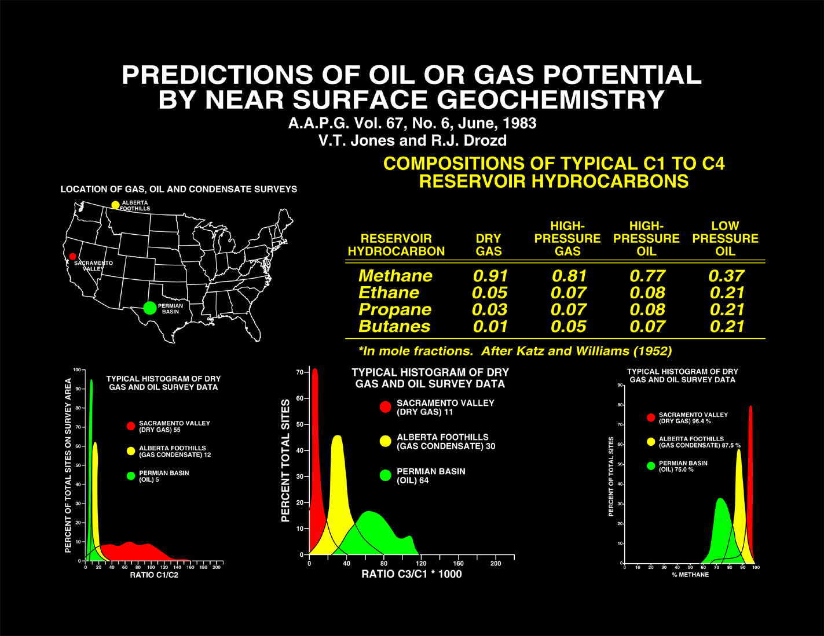
Notes:
In a comprehensive program carried out in the 1970-80’s evidence was obtained that the natural seepage could be used to predict the oil vs. gas potential of an unknown area by measuring these light gas compositions. Figure-4a shows the location of three of Gulf Oil’s soil gas data sets that were gathered within basins having different , but unimodal reservoir compositions: red-gas in the Sacramento Basin, yellow-gas-condensate from the Pincher Creek field and mixed oil & gas from the Permian Basin oil fields. The three plots along the bottom of the figure are histograms that show the compositional variation of the percent methane )relative to the C1-C4 gases), the propane/methane and the methane/ethane ratios. Extensive data sets collected over the past 30 years has shown that surface seepage gases from world-wide basins always contain similar compositional data as their underlying, associated fields.
The table in Figure-4 shows the actual methane, ethane, propane and butane compositions in reservoirs (Katz & Williams, 1957). Methane, ethane, propane and butanes occur in essentially all petroleum reservoirs, and most significantly, their compositions are defined principally by the source type and maturity. These source rocks then control all reservoir and surface seepage compositions.

Slide 2
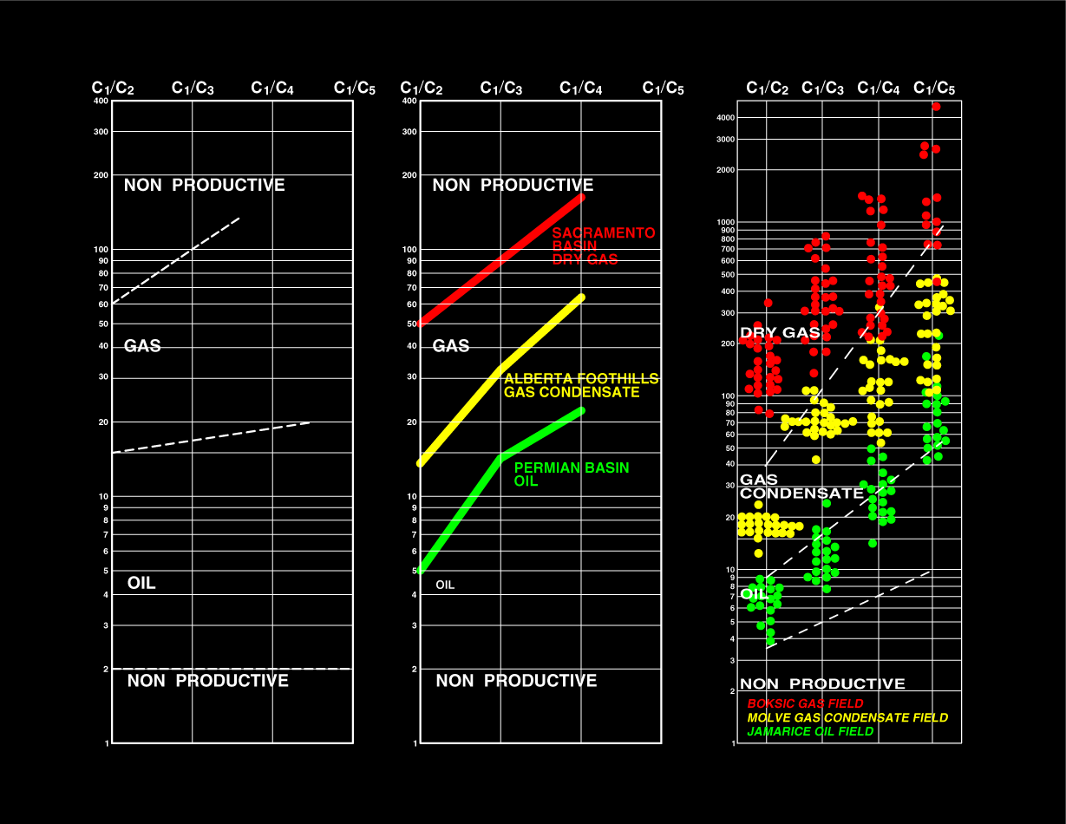
Notes:
As further proof of this concept we examined both mud logging and actual reservoir compositions from producing wells. The leftmost diagram, based on mud logging data, was published by Pixler in 1969. The plot on the far right shows actual reservoir analytical data from the producing wells in three fields, the red dots are from a gas field, the yellow dots are from a gas-condensate field and the green dots are from an oil field (published by Verbanic et al.in 1982).
The center plot shows the average compositional values of the soil gas data from the previous slide, plotted on the Pixler mud logging diagram. As shown, the seepage data collected in the vicinity of these three fields that produce gas, condensate and oil, fit without correction, or adjustment to their associated reservoirs.

Slide 3
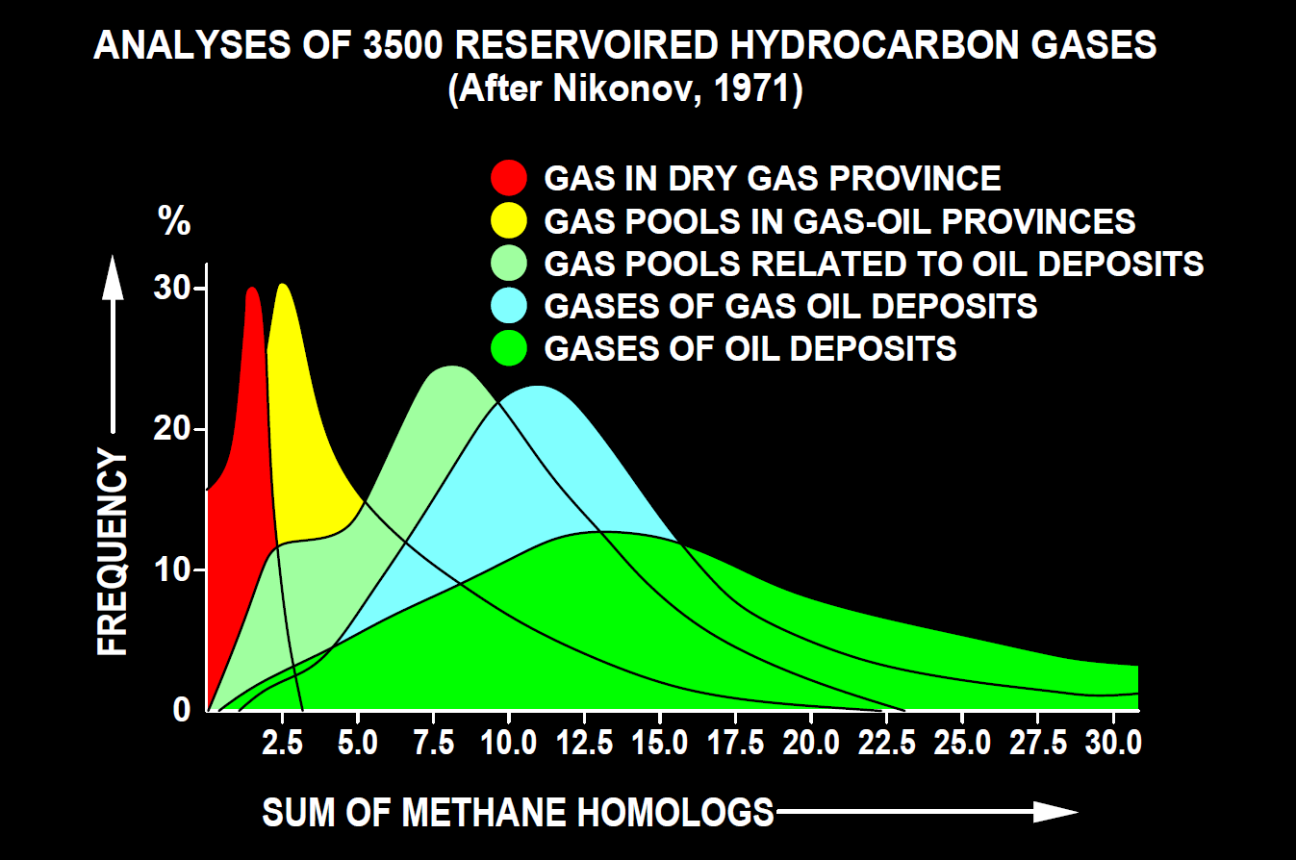
Notes:
Nikonov Reservoir data base of 3500 wells

Slide 4
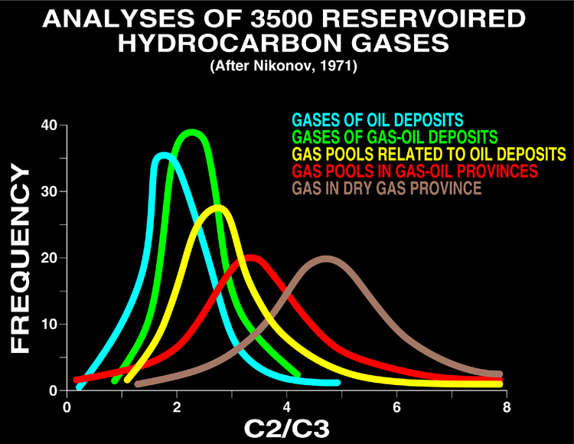
Notes:
In addition to the Pixler ratio plots which contain methane which can be biogenic, the C2/C3 ratios is also very useful. There are no biogenic sources for these two gases, ethane and propane and their ratio can be used to predict the oil vs. gas ratios of their associated subsurface reservoirs.
This slide shows the relationship of this ratio defined by 3,500 reservoirs worldwide reservoirs. Our experience suggests that the brown curve may apply mainly to very dry gases, with most oil and gas fields falling between ratios defined by the blue to red curves. Thus most commercial oil and gas fall between 2 and 4.

Slide 5
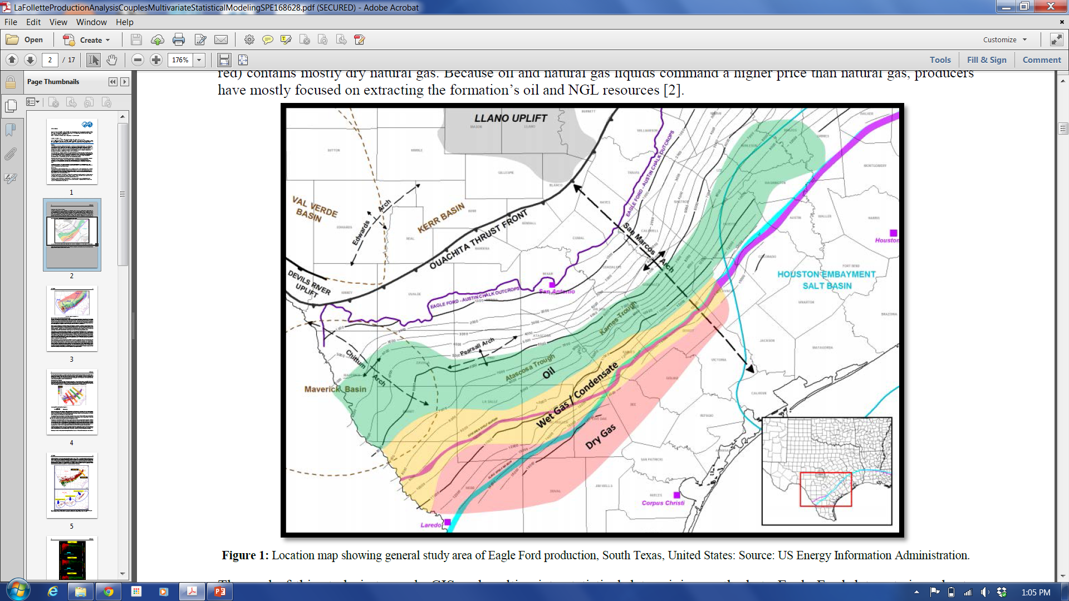
Notes:
This slide showing the oil versus gas compositional variations in the Texas Eagle Ford Shale was borrowed from LaFollette et al., 2014 SPE paper 168628

Slide 6
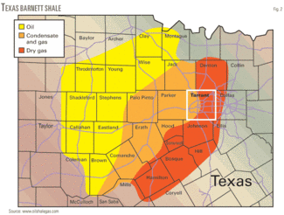
Click here to enlarge image
Notes:
Texas Barnett Shale showing dry gas to oil variations

Slide 7
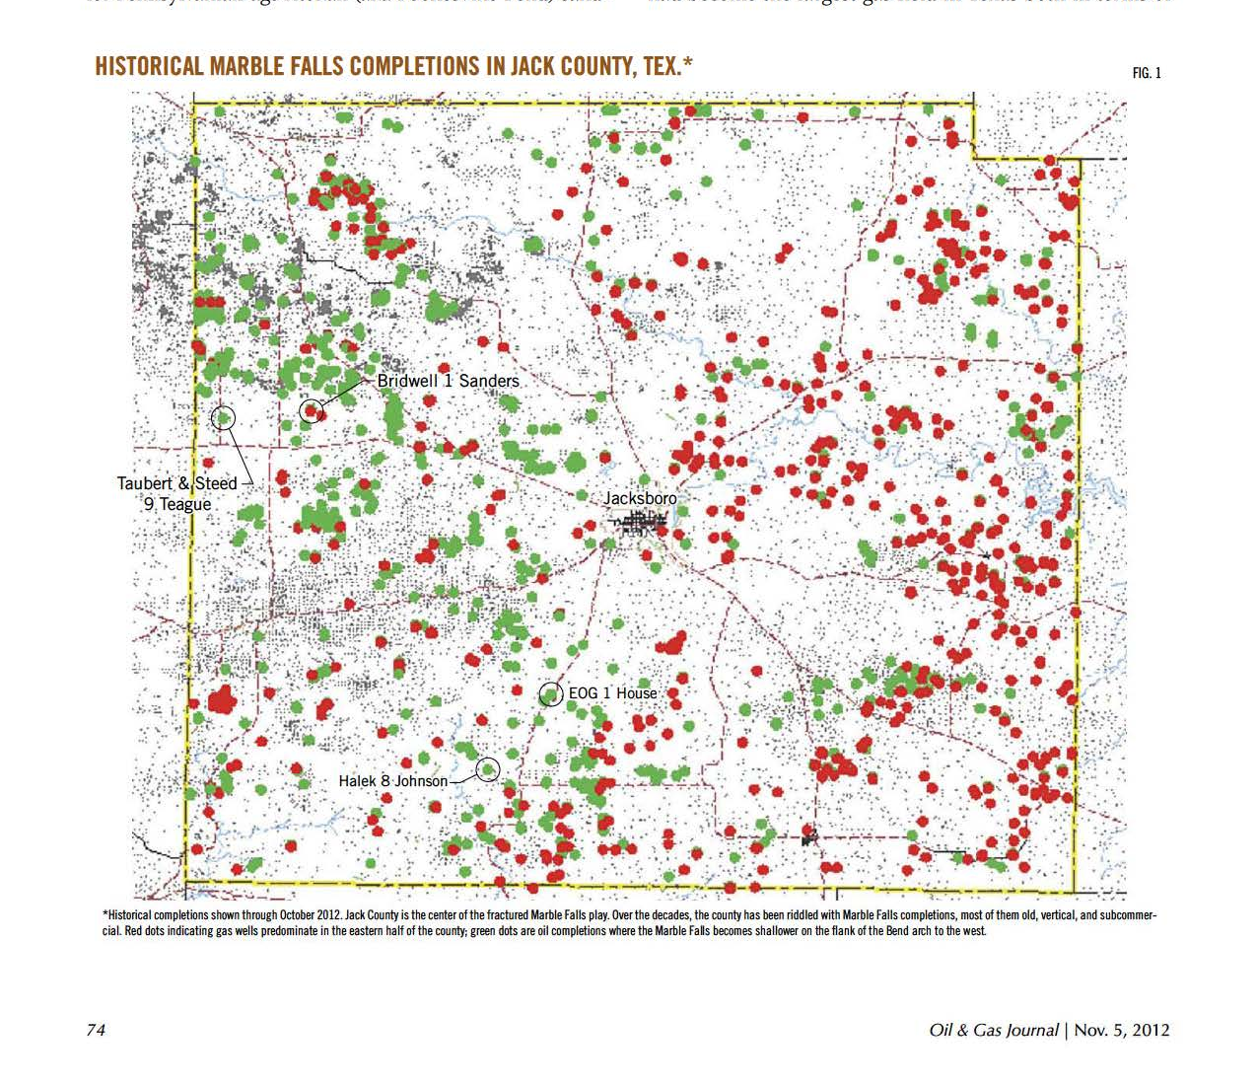
Notes:
Marble Falls FM above Barnett Shale in Jack County, Tx
Showing gas wells in red and oil wells in green
Marble Falls stratigraphic with likely source Barnett
One can see gas versus oil changing from east to west as in the previous slide
But note localized variability in composition

Slide 8
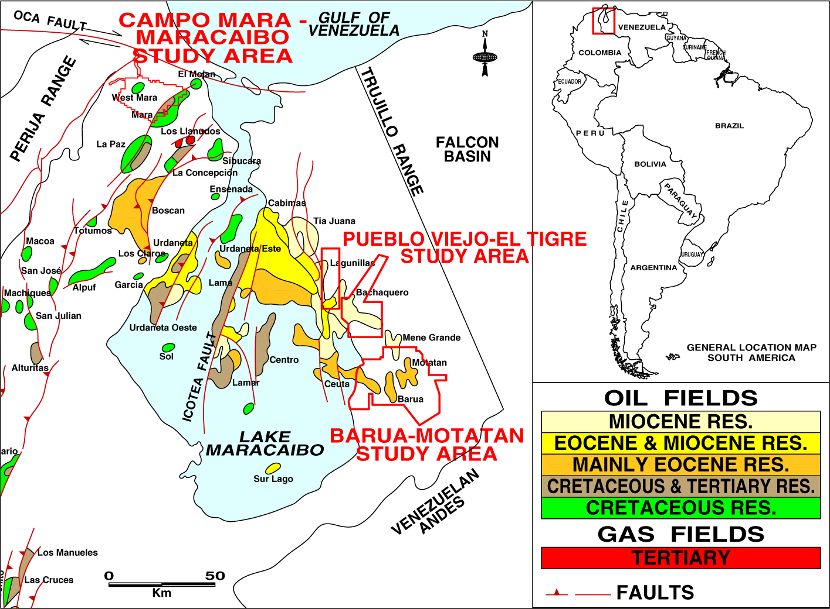
Notes:
Lets look at some data collected on a 1 km grid, or 3300 feet over the Baru and Motatan fields and partially over the Meno Grande Field in the Maracaibo Basin in Venezuela.

Slide 9
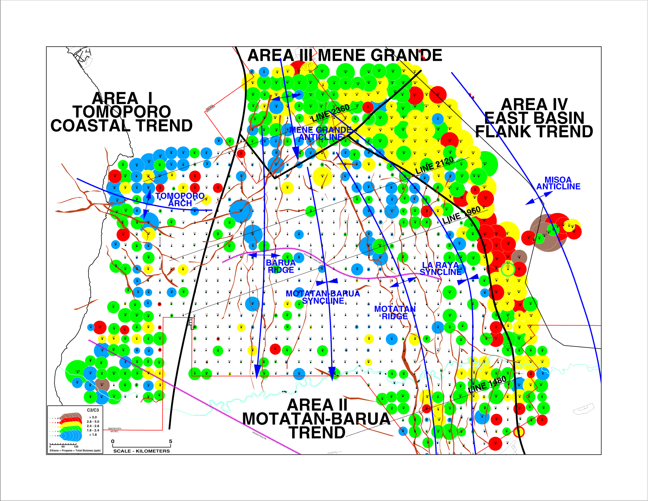
Notes:
Adjusting the C2/C3 soil gas ratios with some knowledge of the compositional changes reflected in the known fields and source rocks suggests cuts of 2.8 for red-yellow, 2.4 for yellow-green, and 1.8 for green-blue.
Now most of the blue dots are in the central basin directly over the heaviest oils. The blue-greens split at the Tomoporo Arch. Meno Grande is mainly green and suggests that this giant field can be extended updip to the east and there is an excellent anomaly located in the deepest portion surveyed.

Slide 10
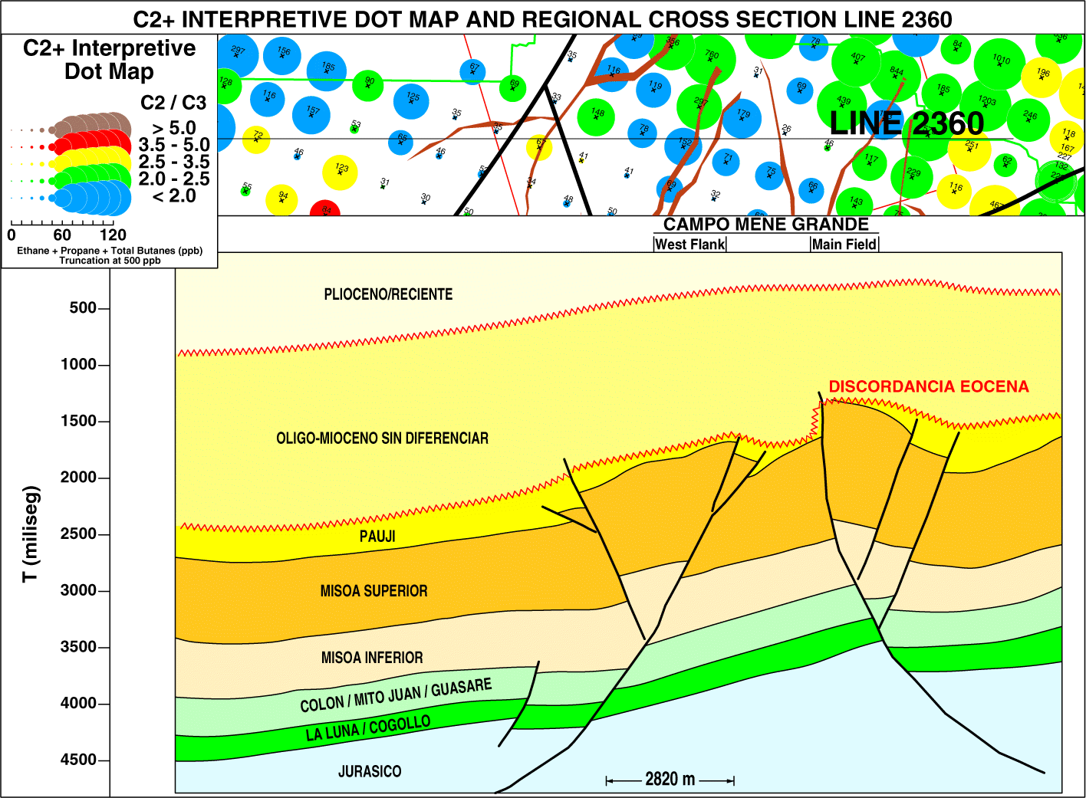
Notes:
First we’ll look at a cross-section over the Meno Grande field. As you might expect, we found fairly large oily seeps directly over and updip from this giant field. The yellow color on the right is associated with the condensate production produced below the heavy oil that is produced from the upper layers of this field. The condensate cannot migrate through the gas-depleted oils and instead show up at the subcrop to the east where the dipping beds have allowed some of the condensate compositional sources to exit the basin.

Slide 11
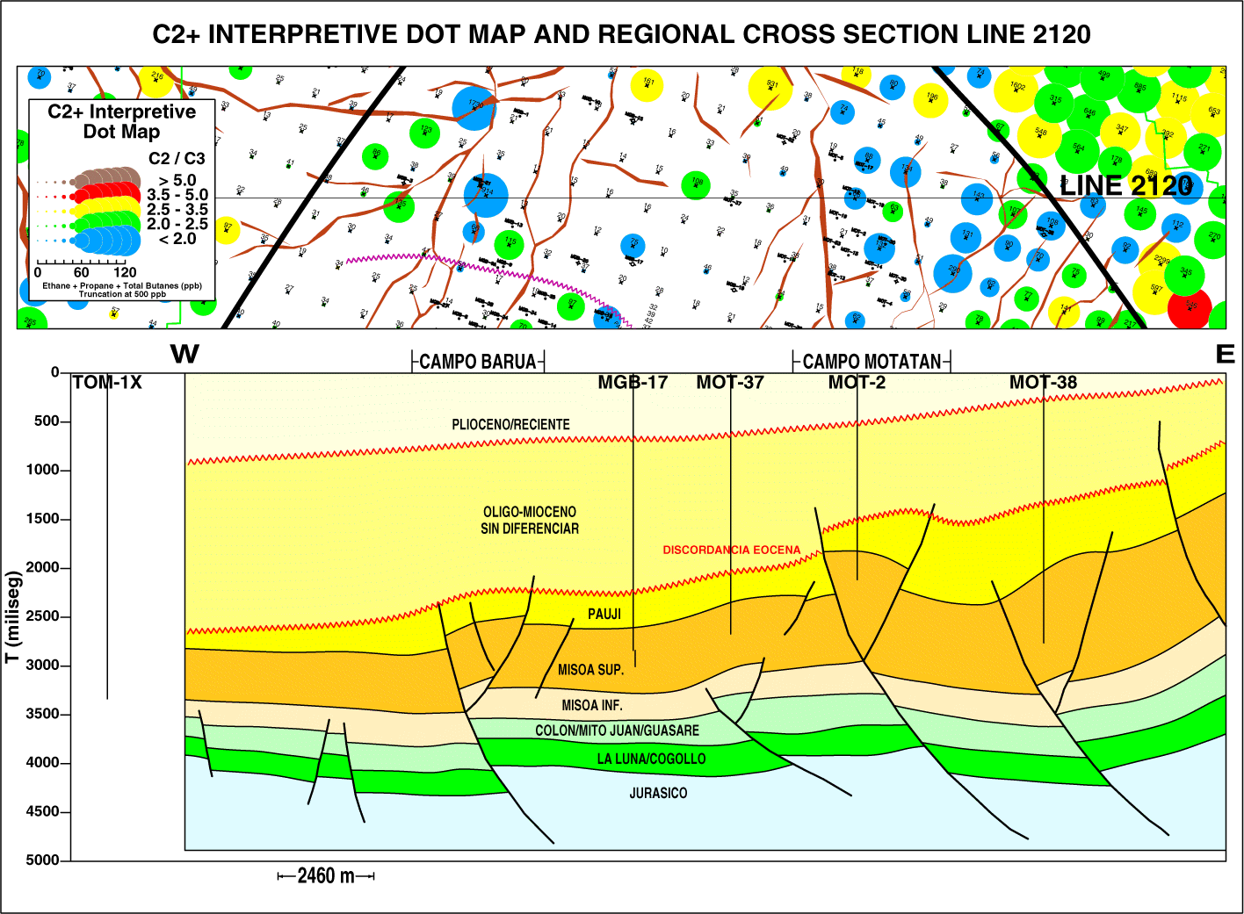
Notes:
The next two cross-sections are parallel to and south of the first and better show the main structural configuration of this basin. The Mesoa is the main producing horizon and outcrops to the east. As you can see the seepage does occur over the two fields, but does not outline the locations of the fields. Seepage magnitudes also increases updip toward the subcrop and outcrop, as would be expected. Again the condensate signature shows up at the subcrop along the eastern margin of this basin.

Slide 12
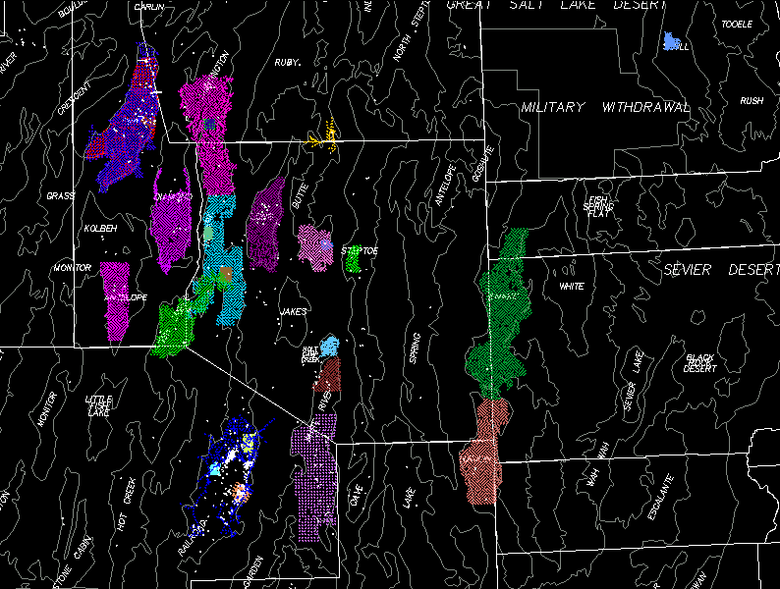
Notes:
Nevada Great Basin regional soil gas surveys conducted by ETI

Slide 13
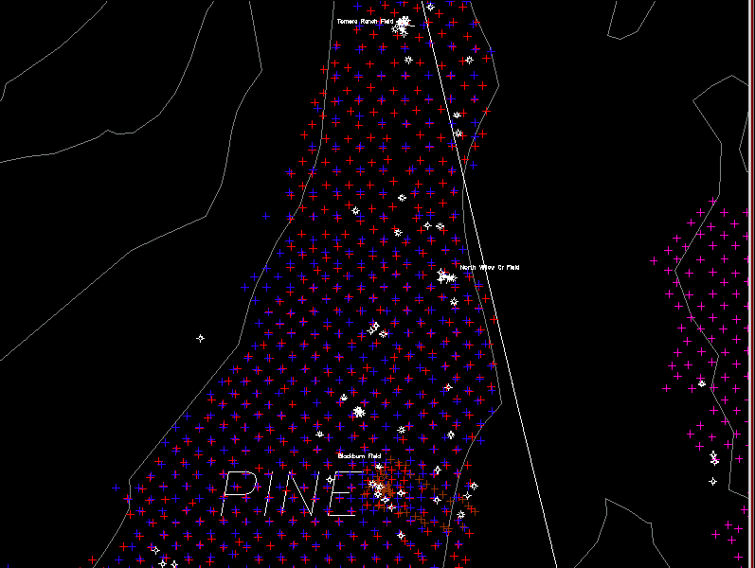
Notes:
Pine Valley, two regional soil gas surveys conducted two years apart in 1986 and 1988
In addition to the Blackburn field there are three others,
Tomera Ranch at the top
North Willow Creek
And Three Bar just west of Blackburn

Slide 14
Pine Valley Data
Marathon Texaco
1986 1007 sites 1988 985 sites
Methane 0.925 1.32
Ethane 0.020 0.027
Propane 0.015 0.016
C1/C2 103.0 112.0
46.8 46.8
21.6 20.6
Notes:
This slide shows the basic statistics for these two independent soil gas data sets collected two years apart by the same geologist using map and compass. The median methane, ethane and propane concentrations are shown on this slide. These very low median concentrations of 20 to 27 for ethane and 15 to 16 for propane mean that 50 % of the samples (approximately 500 samples) have less than 20 ppb of ethane.
50% of these two independent soil gas sites have ethane and propane concentrations that are < 30 ppb and < 15 ppb.
Note the repeatability of the methane/ethane quartiles. The median C1/C2 ratio is 46.8 on both surveys conducted two years apart. The upper quartile is nearly the same 103 to 112 and the lower quartile is also very close to the same value 21.6 to 20.6
Soil gases have the unique ability to predict the oil versus gas potential of an unknown basin through the compositions of the light gases (Jones and Drozd, 1983). This compositional relationship of soil gas to the gases generated within the basins surveyed is its most valuable asset.

Slide 15
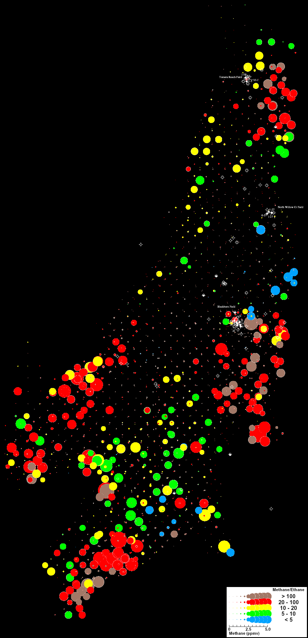
Notes:
Regional methane dot maps showing changes in magnitude (dot size) and composition (colors)

Slide 16
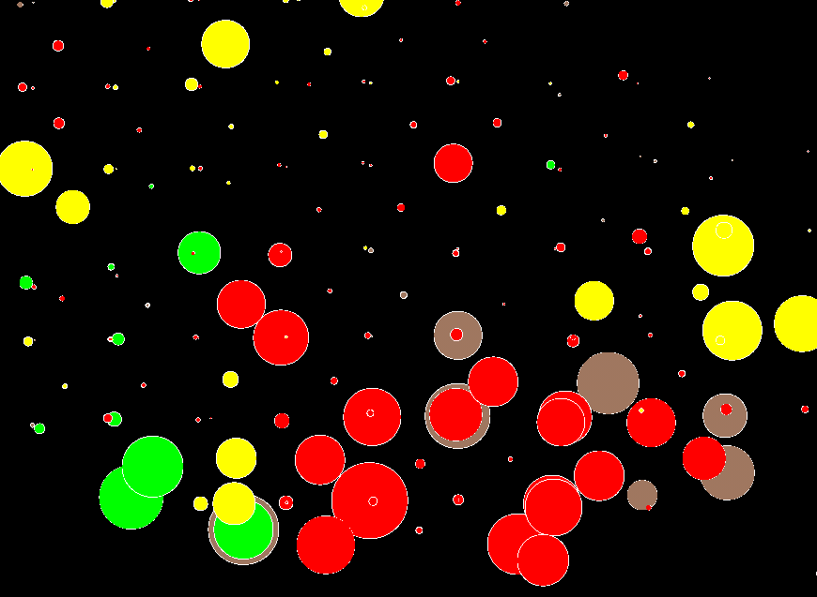
Notes:
Close-up expanded scale of methane dot map

Slide 17
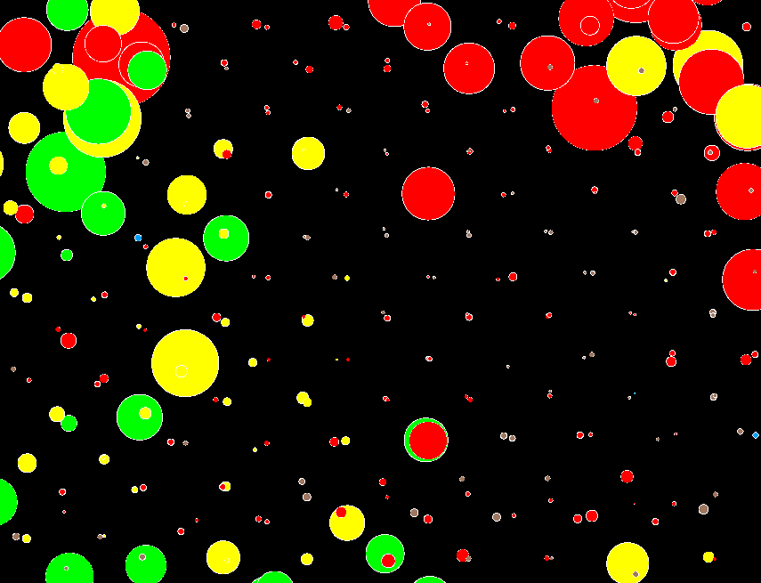
Notes:
Close-up expanded scale of methane dot map, different area

Slide 18
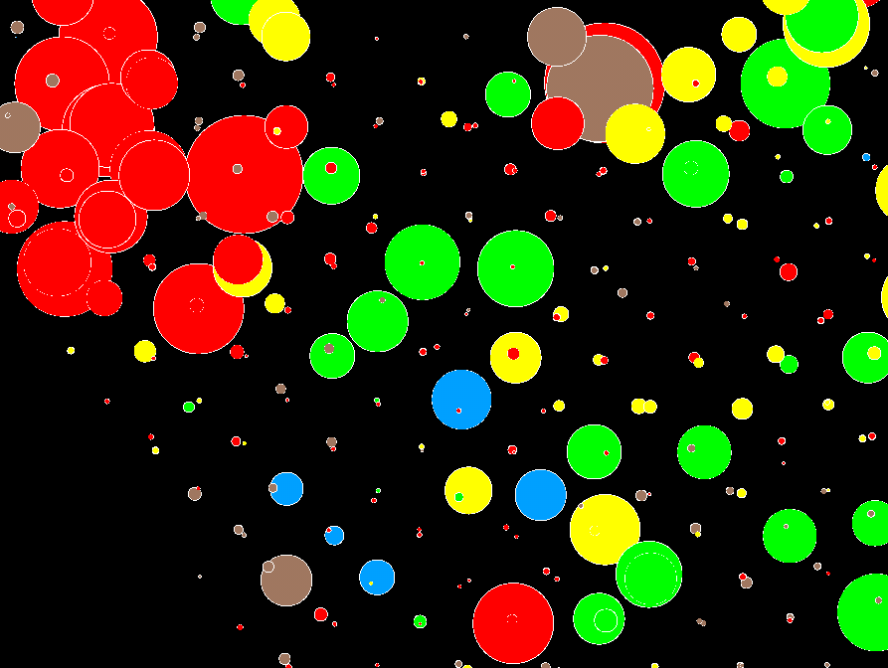
Notes:
Close-up expanded scale of methane dot map, another different area
Note coherence with low variation in background sites and larger variation in anomalous sites in spite of mixing two different surveys from 1986 and 1988

Slide 19
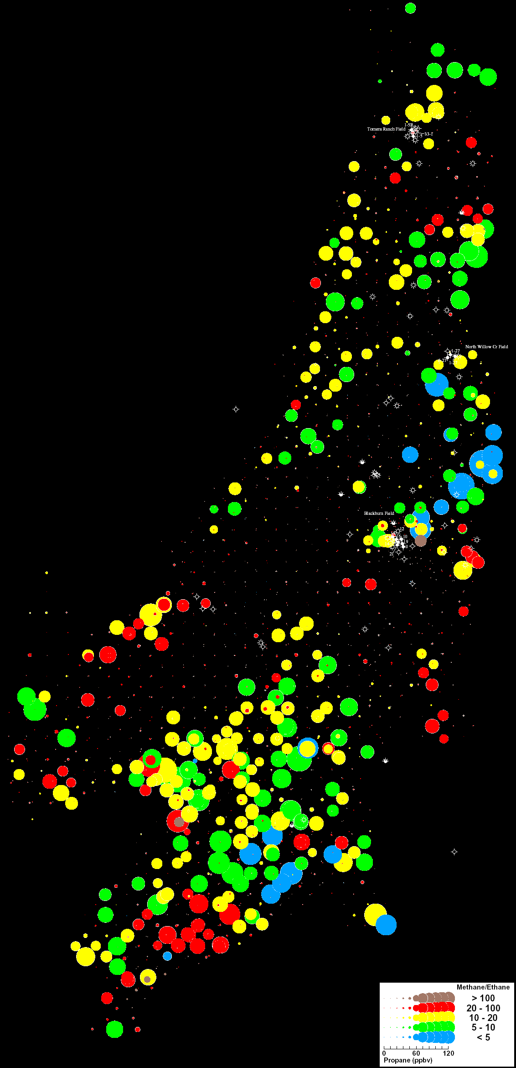
Notes:
Methane dot map on left and propane dot map on right
Methane focuses on volcanic source areas controlling source kitchens
Propane focuses better on oily sites
Note Blackwell Oil field and Blackwell oil trend
Note volcanic hot spot at top with oil fields on both flanks

Slide 20
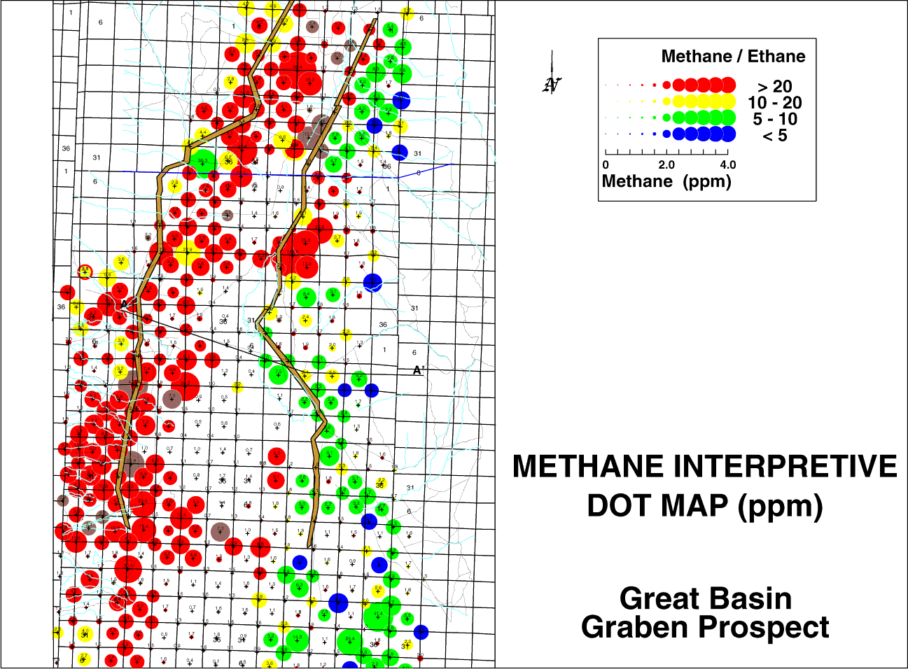
Notes:
Now let us examine a regional data set collected on 5000 foot centers within a Nevada Valley. Sample are collected on section corners and centers. This slide provides a methane dot map with the dot sizes proportional to the methane magnitudes and the color chosen from the Pixler ratio plots of the soil gas data.
Note that the methane seepage is concentrated along the basin margins, but exists all over the basin. There is no known commercial production in this valley, and perhaps never will be. Clearly the source rocks are expulsing hydrocarbons to the surface, defining fairways where reservoirs are likely to form. The soil gas data shows the maturity of the subsurface source rocks in the basin.

Slide 21
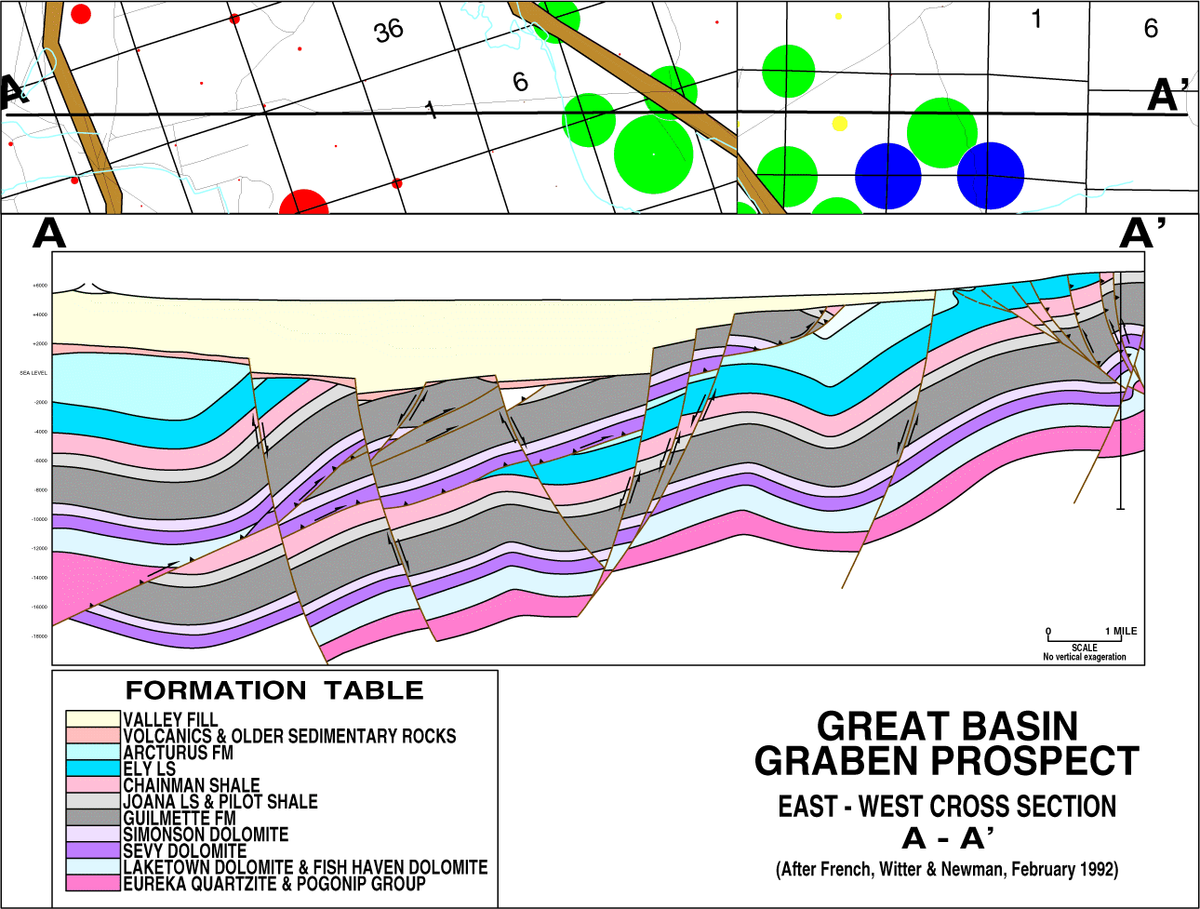
Notes:
As shown by this cross-section, the Chainman Shale shown by the pink layer dips to the west, where the subsurface sources would tend to be more mature.
Thus a gassier signature would be expected on the left where the source rocks are more deeply buried and therefore more mature and an oilier signature on the right where the source rocks are less deeply buried and therefore less mature.
Also note that the lowest ratios (blue dots) occur at the most updip location where the migrated oils have lost their lighter ends, methane and ethane have evaporated relative to propane and butane, indicating the possibility for dead-oil reservoirs.

Slide 22
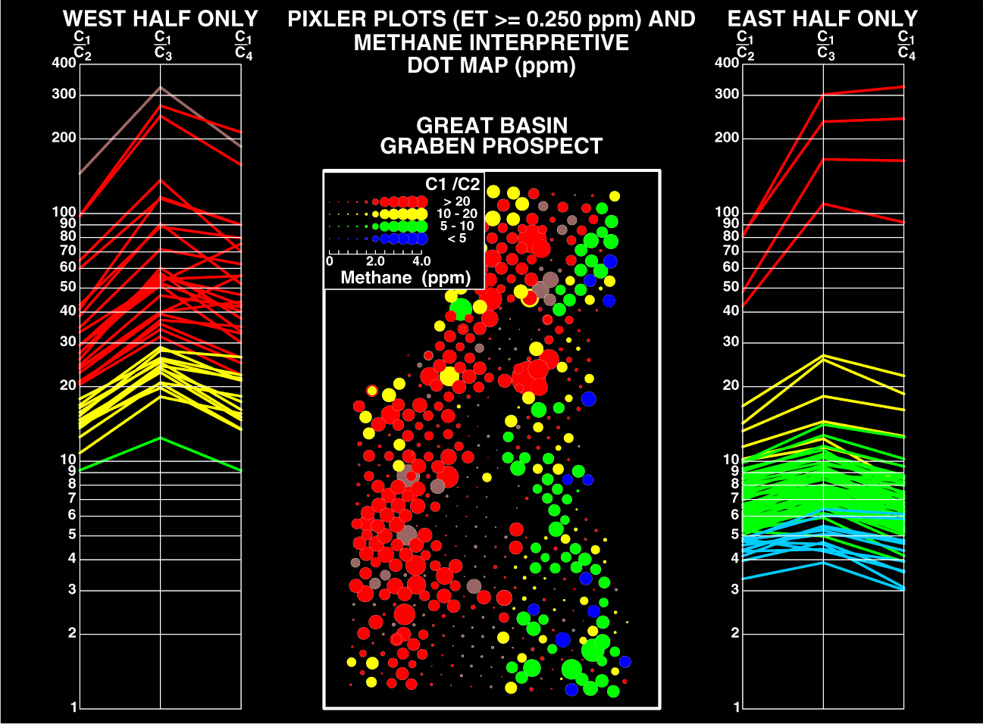
85% OF HYDROCARBONS GENERATED ARE NOT TRAPPED THEY ARE EXPLUSED, AND THIS IS WHAT WE MEASURE
Notes:
The Pixler ratios are plotted on this slide with the methane dot map. The Pixler ratio data has been divided into west and east sides to show the compositional differences across the basin. Remember that the color code for the methane/ethane ratio was chosen empirically to fit typical reservoirs. For example <5 is blue, 5 – 10 is green, 10 – 20 is yellow and >20 is colored red. Obviously the changes in compositional show by the soil gas data is not random, but is very stable. Only the source rocks in the basin can provide such a regional change over an entire basin.
Clearly the difference in composition must be controlled by the subsurface source maturity.

Slide 23
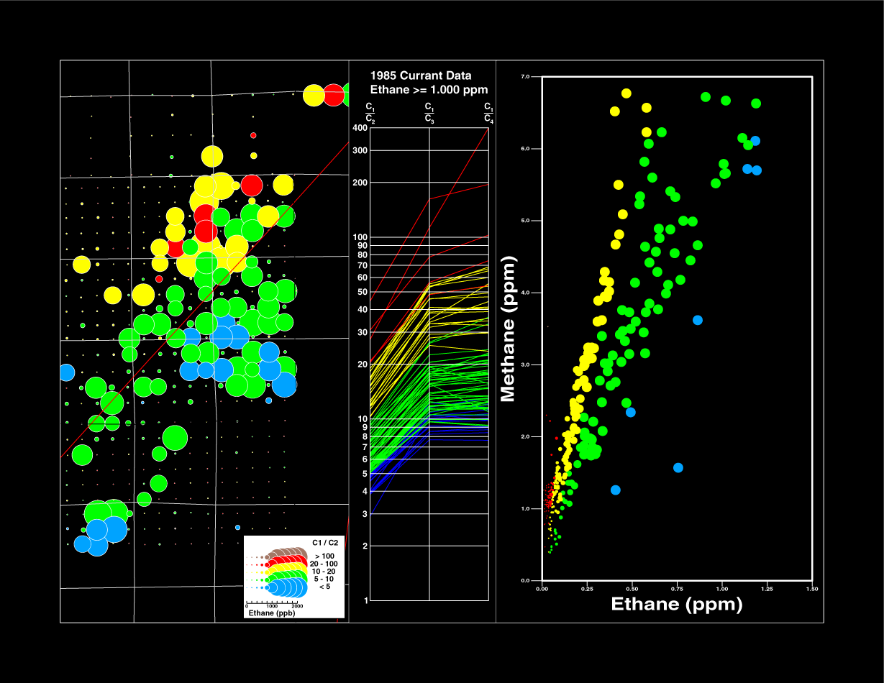
Notes:
The Currant well drilled in Railroad Valley Nevada produced a 14 gravity oil from 7000 feet. This well was drilled within the blue-green area on this slide. The yellow-red compositions are typical of a Grant Canyon-type deposit.
Actual empirical soil gas data collected over all the other commercial fields in Nevada indicated that the yellow-red compositional range were typical for soil gas data observed over the commercial oil fields.
However, the most important point made by this slide is the fact that the color compositions are selected by actual reservoirs and then used to generate the scatter plot and the dot map. As shown, these spatial and compositional relationships are certainly not random, and at 1000 foot centers, this data begins to work at the prospect level.

Slide 24
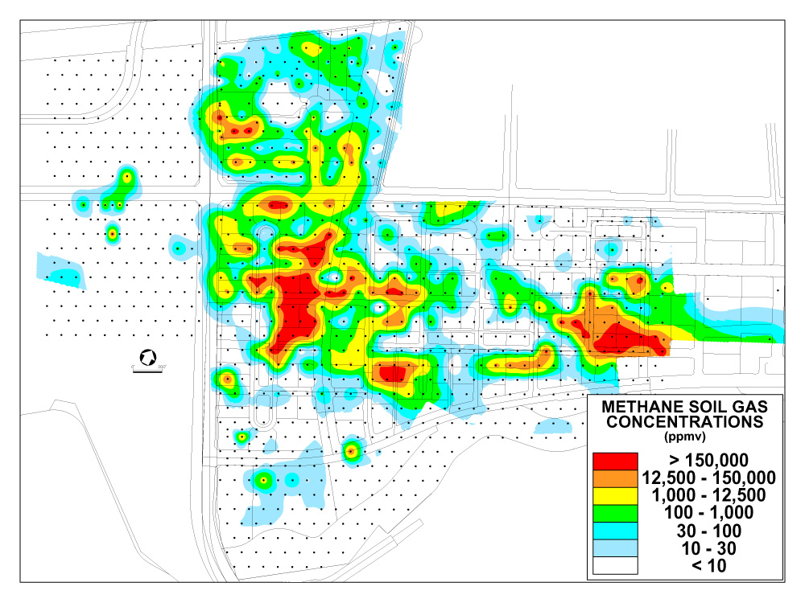
Notes:
A four-foot deep soil gas survey, consisting of 812 samples collected on a surveyed grid with 100 feet between samples, was conducted from October through December 1999. The survey was also designed to determine if there were any associated methane homologs (ethane, propane, or butanes) from a deep thermogenic source.

Slide 25
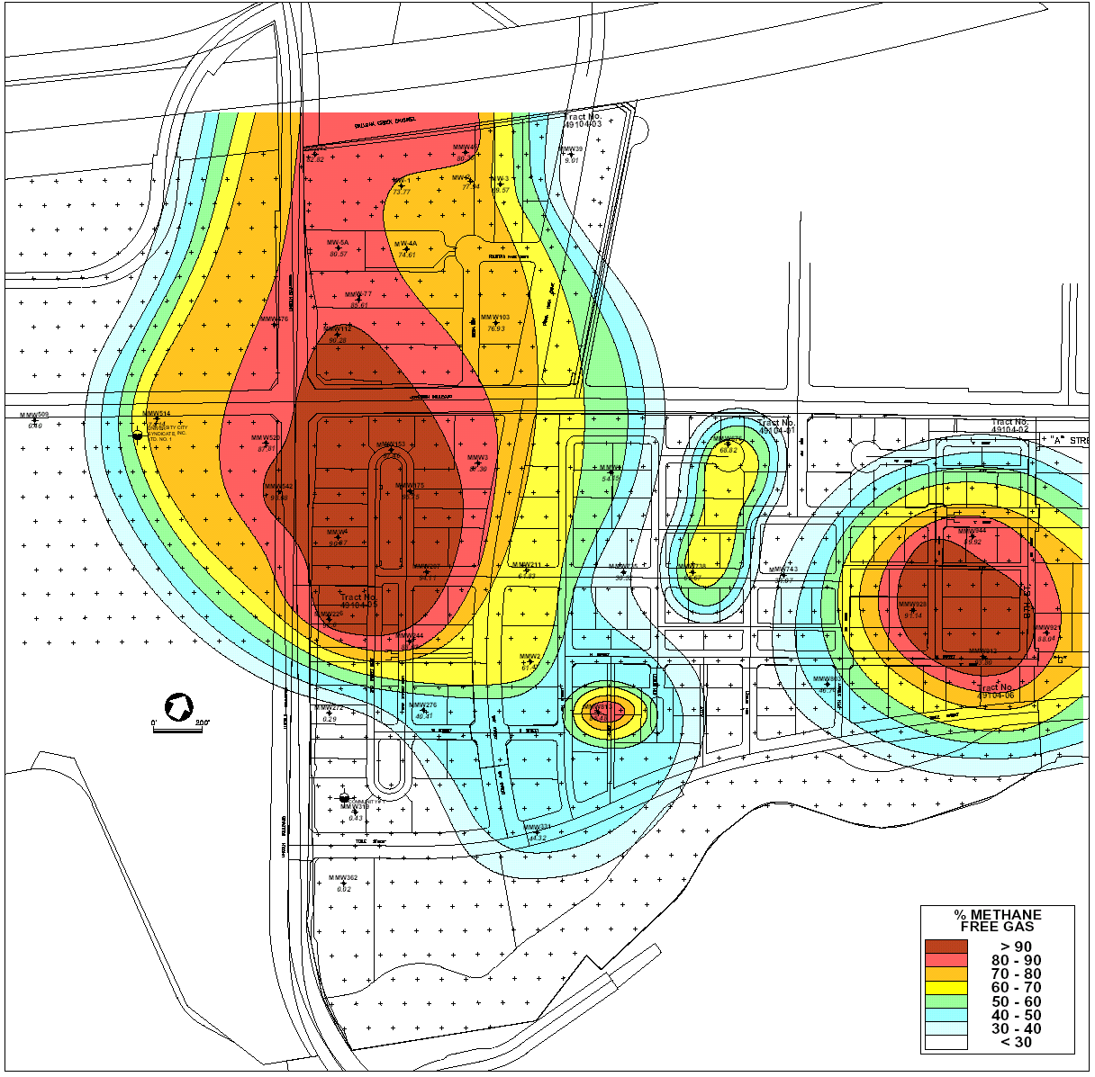
Notes:
Because methane had previously been detected at fairly large concentrations in the groundwater, it was suggested that these 41 monitor wells be drilled on a grid spacing determined from the soil gas data and used to collect two different and independent types of samples. A free gas sample was collected using a bubble pail and a dissolved gas sample was collected directly from the aquifer in a 125 ml bottle. Both samples were collected under water by water displacement, providing very high quality samples with no ambient air or other possible contaminants. Each well was pumped at a fairly low flow rate (approximately ½ gallon per minute) for an extended period of time, designed to provide numerous samples from successive well volumes. These free gas and dissolved gases samples were then averaged for each well and plotted on contour maps so that any methane gas anomalies in the 50-foot gravel aquifer could be mapped and studied. Average methane concentrations ranged from 0.005 mg/l to 48.3 mg/l (Plate 11). The highest concentration of methane (99.7%) was observed in MMW 226. This sample also contained the 48.3 mg/l dissolved gas concentration.

Slide 26
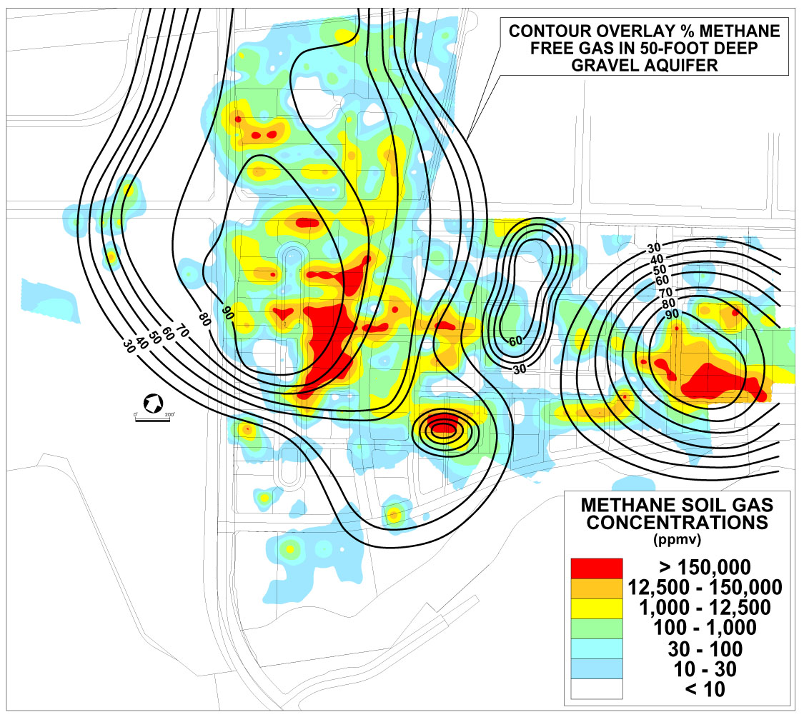
Notes:
Analytical results of methane concentrations in the free gas samples from the 41 monitor wells are illustrated on Plate 11. The highest concentration of methane (99.7%) was observed in MMW 226. In general, the highest free gas methane concentrations are present in areas of anomalous methane soil gas and anomalous methane concentrations in groundwater
The strong spatial correlation between the soil gas anomalies and the groundwater anomalies implies that the dominant migration of gas is vertical. There is very little migration of gas laterally within the aquifer
The free gases liberated from the monitor wells provide an independent data set for comparison with the soil gases and with the dissolved gases in the groundwater. When accompanied by significant levels of methane homologs (ethane, propane, and butanes), it is concluded that these gases have a thermal origin. The source of this thermal methane gas has to be derived from Pliocene and possibly deeper gas sands, as previously discussed (3.4 Shallow Natural Gas).

Slide 27
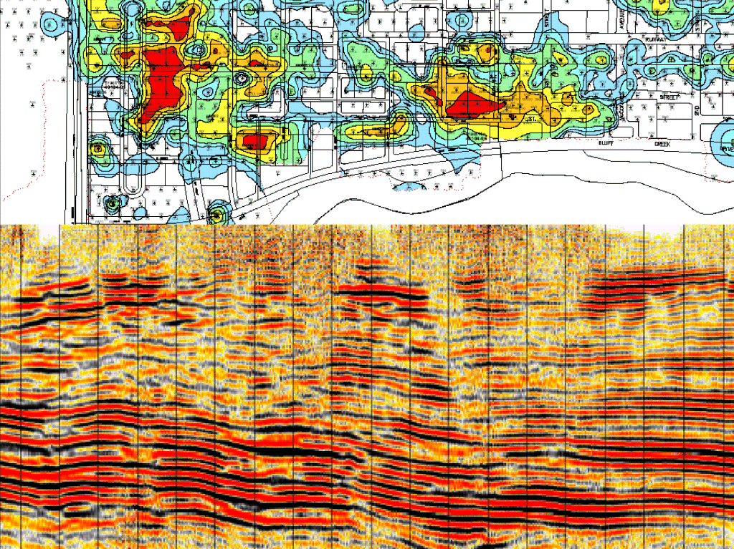
Notes:
This slide shows a soil gas survey conducted on 100 foot centers directly over two seismic wipe-out zones. The red areas have concentrations as large as 75 to 98 % methane at four feet. These two soil gas anomalies,coupled with the seismic data, have defined drillable gas prospects. These anomalies also demonstrate the inherent variability in magnitude of soil gas data. In order to properly correlate with geophysical features (as above) the soil gas data has to be collected on a spacing that is comparable with the seismic or geological feature. Even 1000 foot centers would be too wide to map these two seismic features which actually define the sources of the soil gas anomalies.

Slide 28
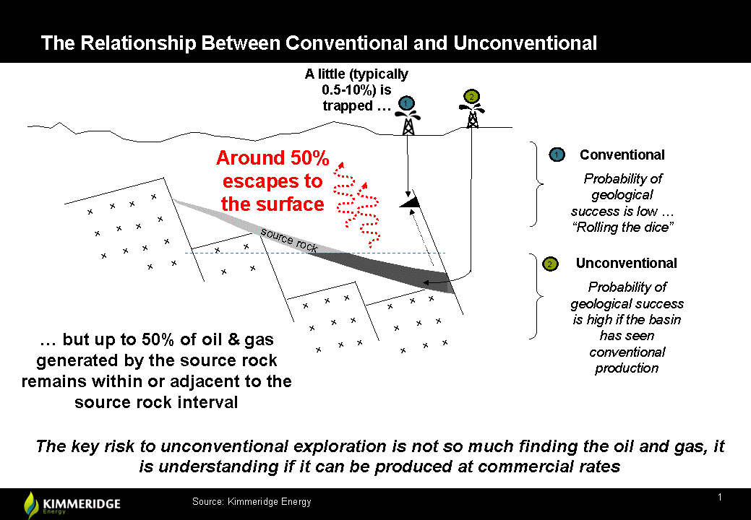
Notes:
Kimmeridge Energy Cartoon suggesting 50% of gas escaping to surface
See next slide

Slide 29
David Bamford, New Age Exploration, Finding Petroleum
Insight: Global exploration for shale “sweet spots”
Most geoscientists will be aware that the key idea behind shale gas and shale oil exploration is that not all the hydrocarbons generated by a source rock are expelled from that source rock and find their way into conventional traps or to the earth’s surface.
However, understanding how much hydrocarbon a source rock might generate and then what proportion has migrated away compared with what proportion has stayed in, or very close to, the source rock itself demands significant insights in petroleum geochemistry – a much neglected science in seismic-dominated oil & gas companies.
Kimmeridge Energy has researched this topic extensively, taking a ‘mass balance’ approach. Their conclusions are summarized in the sketch in the previous slide.
Using their global dataset of petroleum system mass balance calculations, they estimate that typically around 50% of hydrocarbons generated remain within the source rock.
Bamford suggests that petroleum geochemistry can be used as an aid in locating “sweet spots”, particularly within new plays.
Notes:
Insight: Global exploration for shale “sweet spots” (David Bamford, New Age Exploration, Finding Petroleum)
Most geoscientists will be aware that the key idea behind shale gas and shale oil exploration is that not all the hydrocarbons generated by a source rock are expelled from that source rock and find their way into conventional traps or to the earth’s surface. However, understanding how much hydrocarbon a source rock might generate and then what proportion has migrated away compared with what proportion has stayed in, or very close to, the source rock itself demands significant insights in petroleum geochemistry – a much neglected science in seismic-dominated oil & gas companies. Kimmeridge Energy has researched this topic extensively, taking a ‘mass balance’ approach. Their conclusions are summarized in the sketch below: Using their global dataset of petroleum system mass balance calculations, they estimate that typically around 50% of hydrocarbons generated remain within the source rock. Bamford suggests that petroleum geochemistry can be used as an aid in locating “sweet spots”, particularly within new plays.

Slide 30
Notes:
Kimmeridge Energy Cartoon suggesting 50% of gas escaping to surface
See next slide

Slide 31
Jim Redden World Oil, March 2014
Drilling the unconventionals: Shale focus shifts to increasing IP rates
Jim Redden states:
Even the primary developers contend that the heterogeneity and complexity of many shale plays do not lean themselves to wholesale factory-style drilling
Martin Craighead, Baker-Hughs, CEO quotes
“I can drill one well here, and a quarter-of-a-mile away, it looks like I’m in another state.
Notes:
Drilling the unconventionals: Shale focus shifts to increasing IP rates, Jim Redden World Oil, March 2014)
“I can drill one well here, and a quarter-of-a-mile away, it looks like I’m in another state (Martin Craighead, Baker-Hughs CEO)
Even the primary developers contend that the heterogeneity and complexity of many shale plays do not lean themselves to wholesale factory-style drilling

Slide 32
Don Francis World Oil March 2014
Advances made in shale-specific geology and geophysics
Herb Martin, Devon, VP quote on Reservoir Variability:
There is a perception that shale reservoirs are blankets and that location doesn’t matter and that the presence of natural fractures is a negative factor for productivity
What has been learned is that shale’s are anisotropic and contain heterogeneities across a variety of scales
Shale reservoirs can contain multiple sweet spots mixed with non-productive rock, thus cumulative production can vary widely in a field, depending on well placement
Dave Rainey BHP Billiton, President quote:
Thus it’s a geoscience project to determine how the geology concentrates the hydrocarbons into economic quantities
Notes:
Advances made in shale-specific geology and geophysics Don Francis World Oil March 2014
Reservoir Variability:
There is a perception that shale reservoirs are blankets and that location doesn’t matter and that the presence of natural fractures is a negative factor for productivity (Herb Martin, Devon VP)
What has been learned is that shale’s are anisotropic and contain heterogeneities across a variety of scales
Shale reservoirs can contain multiple sweet spots mixed with non-productive rock, thus cumulative production can vary widely in a field, depending on well placement
Thus it’s a geoscience project to determine how the geology concentrates the hydrocarbons into economic quantities (Dave Rainey BHP Billiton, President)

Slide 33
Gale, Reed and Holder, April 2007 AAPG Bull., vol. 91, pp603-622
Natural fractures in the Barnett Shale and their importance for hydraulic fracture treatments
Natural opening-mode fractures reactivate during stimulation and enhance efficiency by widening the treatment zone
All natural fractures, including small sealed fractures and large potentially open fractures, must therefore be taken into account when predicting hydraulic fracture behavior
Natural, regionally developed, opening-mode fractures in the Barnett Shale can reactivate during hydraulic fracture treatments, providing a larger rock volume in contact with the wellbore than would be the case with a single hydraulic fracture
Notes:
Natural fractures in the Barnett Shale and their importance for hydraulic fracture treatments
Gale, Reed and Holder, April 2007 AAPG Bull., vol. 91, pp603-622
Natural opening-mode fractures reactivate during stimulation and enhance efficiency by widening the treatment zone
All natural fractures, including small sealed fractures and large potentially open fractures, must therefore be taken into account when predicting hydraulic fracture behavior
Natural, regionally developed, opening-mode fractures in the Barnett Shale can reactivate during hydraulic fracture treatments, providing a larger rock volume in contact with the wellbore than would be the case with a single hydraulic fracture

Slide 34
Louise Durham, Explorer Magazine October 2011, pp 24-30
With Marcellus, It’s all about the fractures
In the Marcellus, the most productive wells in terms of initial production are in the northeast part of the fairway in Susquehanna, Bradford and Tioga Counties where natural fractures developed due to high methane pressure creating a plume (gas halo) that can extend 3000 to 4000 feet above the shale
The shale play is all about how you connect into the two sets of vertical fractures. The east-northeast J1 fractures, which are confined within the shale are more dense and closely spaced, while the northwest J2 fractures, which cross-cut the J1 fractures are less well-developed and extend upward into formations lying above the shale (Terry Eengelder, Penn. State university Professor)
The most productive wells in the area are found where the largest and most well-developed gas plumes are, as indicated by natural fractures of the rock seen in outcrop
As maturation continues, more and more gas evolves, and the volume during the latter phase is sufficient to charge the gas shale and the rocks immediately above – and it will cause fractured rocks right above the gas shale
Notes:
With Marcellus, It’s all about the fractures (Louise Durham, Explorer Magazine October 2011, pp 24-30)
In the Marcellus, the most productive wells in terms of initial production are in the northeast part of the fairway in Susquehanna, Bradford and Tioga Counties where natural fractures developed due to high methane pressure creating a plume (gas halo) that can extend 3000 to 4000 feet above the shale
The shale play is all about how you connect into the two sets of vertical fractures. The east-northeast J1 fractures, which are confined within the shale are more dense and closely spaced, while the northwest J2 fractures, which cross-cut the J1 fractures are less well-developed and extend upward into formations lying above the shale (Terry Eengelder, Penn. State university Professor)
The most productive wells in the area are found where the largest and most well-developed gas plumes are, as indicated by natural fractures of the rock seen in outcrop
As maturation continues, more and more gas evolves, and the volume during the latter phase is sufficient to charge the gas shale and the rocks immediately above – and it will cause fractured rocks right above the gas shale

Slide 35
David Brown, Explorer Magazine March 2013, pp 26-28
Looking Deeper into Fracturing’s impacts
Recent work by Mark Zoback et al., at Stanford found that slow slip along misoriented or misaligned faults can contribute to high production rates in very low permeability reservoirs.
That response does not show up in microseismic monitoring. Zoback stated “I don’t think shale gas could be produced in these reservoirs if this wasn’t happening”.
According to Zoback, the presence of existing faults and the orientation of those faults can contribute to high production rates.
In addition to induced fractures, other faults in the reservoir can, and do become active. High pore pressure from hydraulic stimulation can induce slip along misoriented old and dead faults.
Fault slippage explained why microseismic has not been a good predictor of production rates.
Notes:
Looking Deeper into Fracturing’s impacts (David Brown, Explorer Magazine March 2013, pp 26-28)
Recent work by Mark Zoback et al., at Stanford found that slow slip along misoriented or misaligned faults can contribute to high production rates in very low permeability reservoirs. That response does not show up in microseismic monitoring. Zoback stated “I don’t think shale gas could be produced in these reservoirs if this wasn’t happening”. According to Zoback, the presence of existing faults and the orientation of those faults can contribute to high production rates. In addition to induced fractures, other faults in the reservoir can, and do become active. High pore pressure from hydraulic stimulation can induce slip along misoriented old and dead faults. Fault slippage explained why microseismic has not been a good predictor of production rates.

Slide 36
George King, Apache, World Oil, March 2014
Best practices lead to successful shale fracturing
The most economic shale wells have several things in common: the wells are in the best part of the shale, well construction yields multiple fractures with very large amounts of undamaged contact area with the reservoir and both natural fractures, and the fractures remain open through the life of the well
Natural fractures, even those closed and filled with calcite are orders of magnitude higher permeability than the shale matrix
Naturally fractured formations tend to allow closer fractures, especially in complex fracturing
Complex fracturing involves preferential opening of the natural fracture system wherever the natural fracture density and formation stresses will allow
Prediction of complex fracture propagation by fracture models does not appear to agree with field data, thus complex fracturing design does not currently appear to be model friendly
Some fields are not affected, however, occurrence of regional fractures or natural fracture sets is one reason for a larger than expected drainage area
Notes:
Best practices lead to successful shale fracturing George King, Apache, World Oil, March 2014)
The most economic shale wells have several things in common: the wells are in the best part of the shale, well construction yields multiple fractures with very large amounts of undamaged contact area with the reservoir and both natural fractures, and the fractures remain open through the life of the well
Natural fractures, even those closed and filled with calcite are orders of magnitude higher permeability than the shale matrix
Naturally fractured formations tend to allow closer fractures, especially in complex fracturing
Complex fracturing involves preferential opening of the natural fracture system wherever the natural fracture density and formation stresses will allow
Prediction of complex fracture propagation by fracture models does not appear to agree with field data, thus complex fracturing design does not currently appear to be model friendly
Some fields are not affected, however, occurrence of regional fractures or natural fracture sets is one reason for a larger than expected drainage area

Slide 37
Notes:
Insight: Global exploration for shale “sweet spots” (David Bamford, New Age Exploration, Finding Petroleum)
Most geoscientists will be aware that the key idea behind shale gas and shale oil exploration is that not all the hydrocarbons generated by a source rock are expelled from that source rock and find their way into conventional traps or to the earth’s surface. However, understanding how much hydrocarbon a source rock might generate and then what proportion has migrated away compared with what proportion has stayed in, or very close to, the source rock itself demands significant insights in petroleum geochemistry – a much neglected science in seismic-dominated oil & gas companies. Kimmeridge Energy has researched this topic extensively, taking a ‘mass balance’ approach. Their conclusions are summarized in the sketch below: Using their global dataset of petroleum system mass balance calculations, they estimate that typically around 50% of hydrocarbons generated remain within the source rock. Bamford suggests that petroleum geochemistry can be used as an aid in locating “sweet spots”, particularly within new plays.

Slide 38
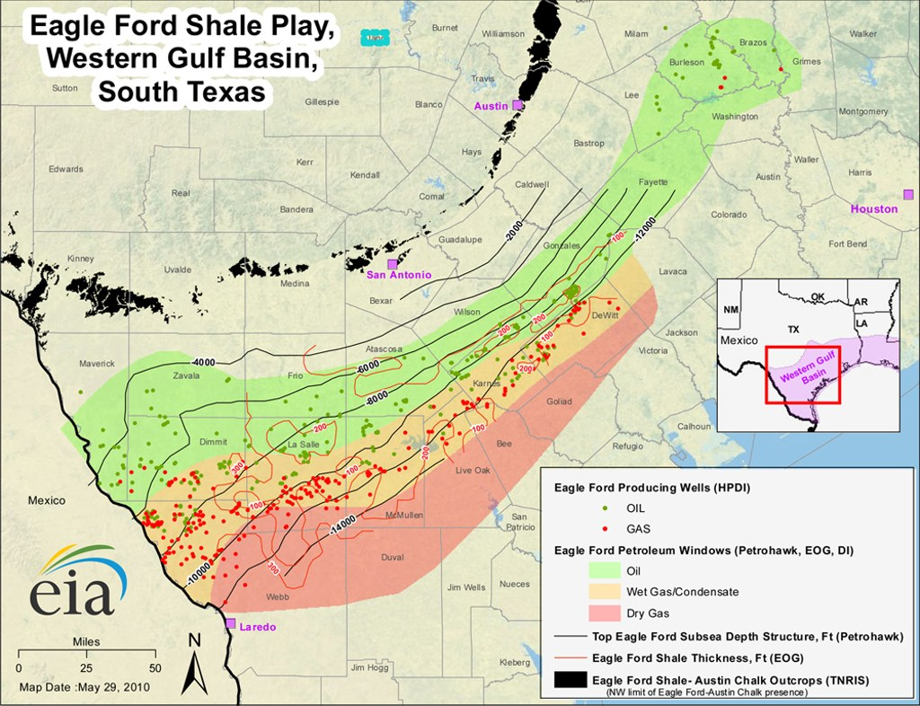
Notes:
Texas Eagle Ford Shale producing gas, condensate and oil wells

Slide 39
Notes:
Lets zoom in on Texas Eagle Ford to Dimmit County

Slide 40
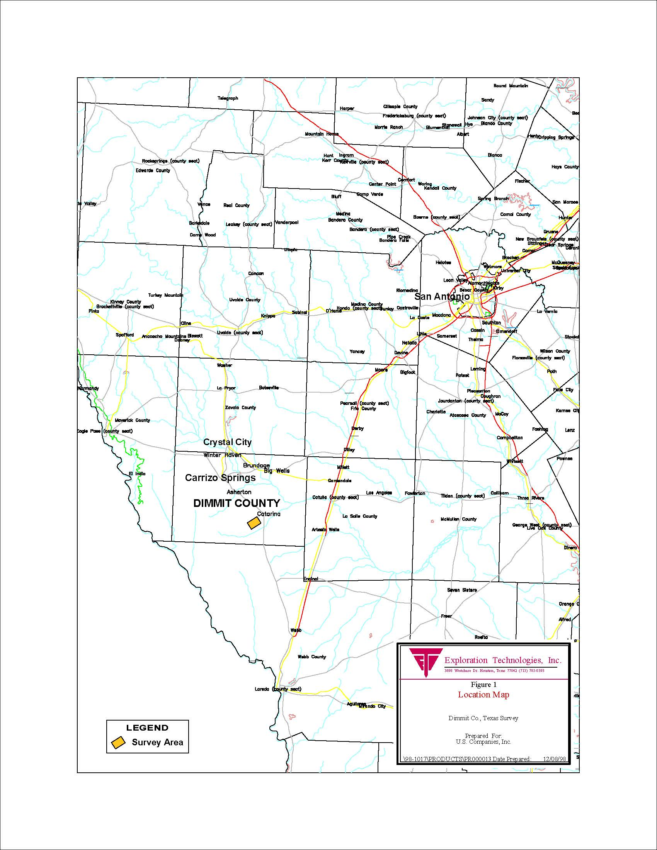
Notes:
Note soil gas survey marked by brown box in Dimmit County, tx

Slide 41
Notes:
Zoom in some more to Soil gas survey area

Slide 42
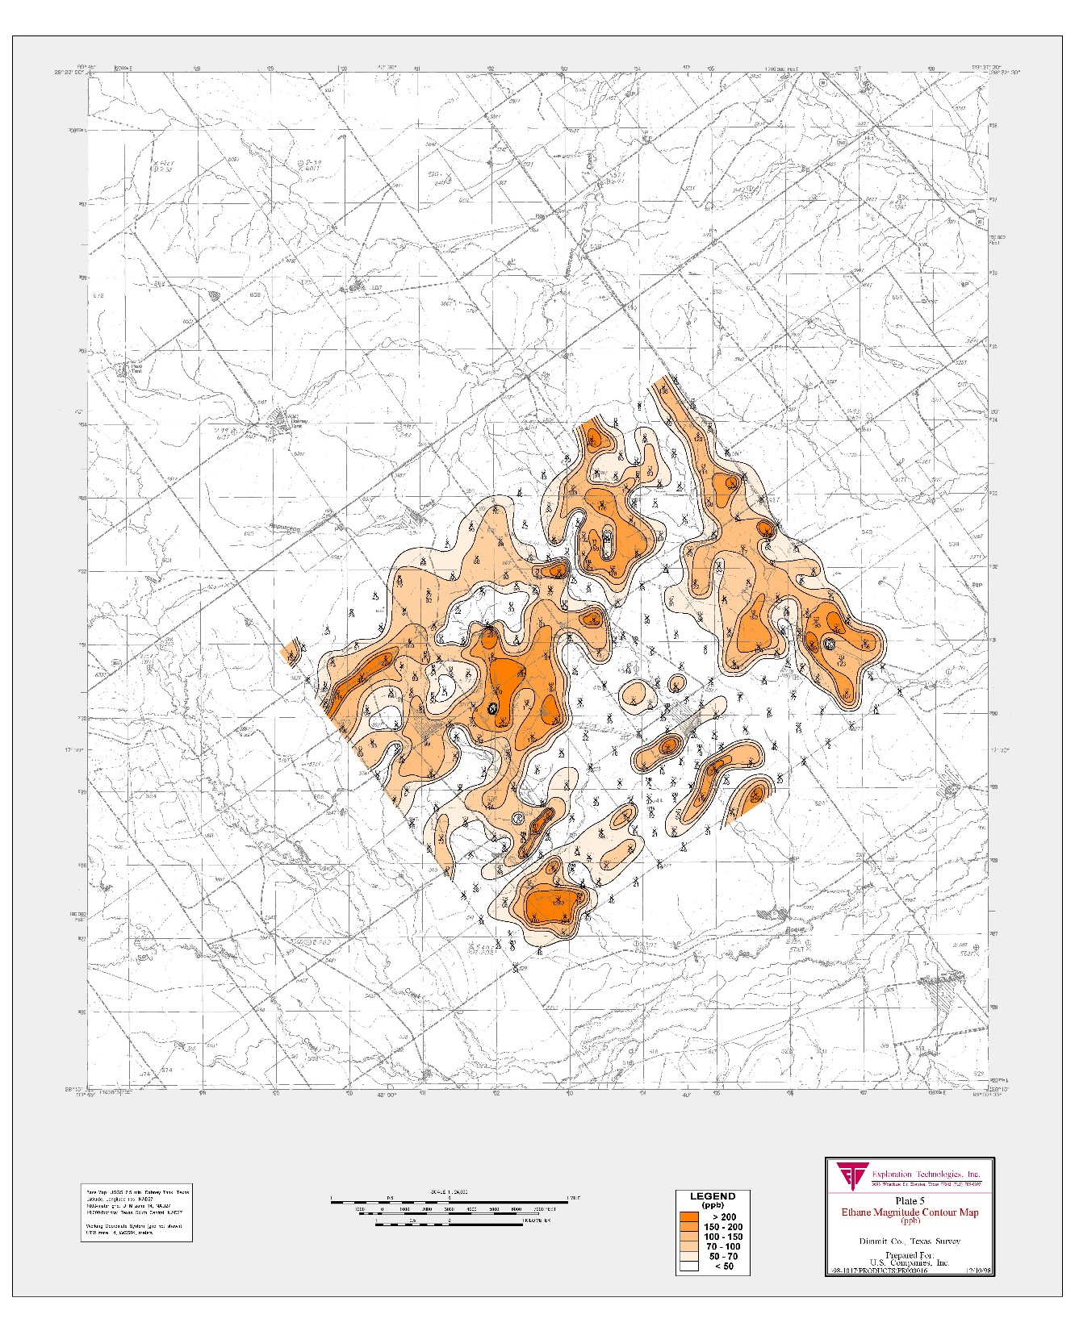
Notes:
Ethane magnitude contour map in Dimmet County

Slide 43
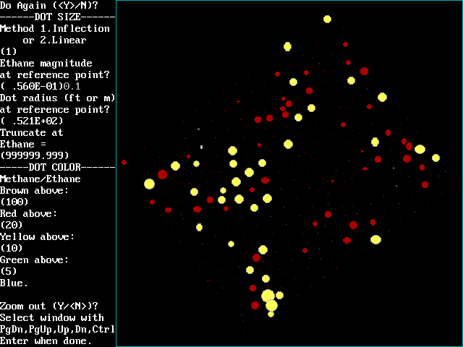
Notes:
Ethane dot map with magnitudes (dot size) and mwthane/ethane color compositions, red gas, yellow for oilier samples

Slide 44
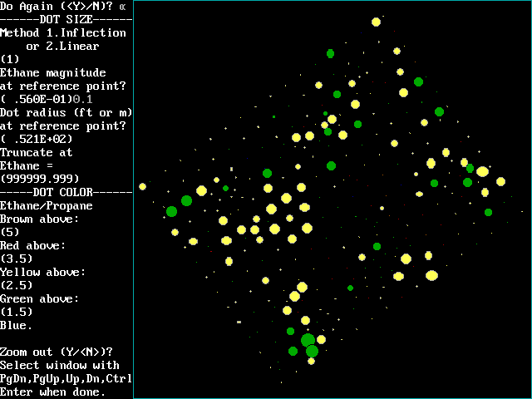
Notes:
Ethane dot map using ethane/propane ratios for compositions
Yellow-green oilier samples

Slide 45
Notes:
Soil gas data from previous slide fits fairly well to Eagle Ford gas well compositions
Unfortunately density of production wells and limited extent of soil gas survey makes
It impossible to compare

Slide 46
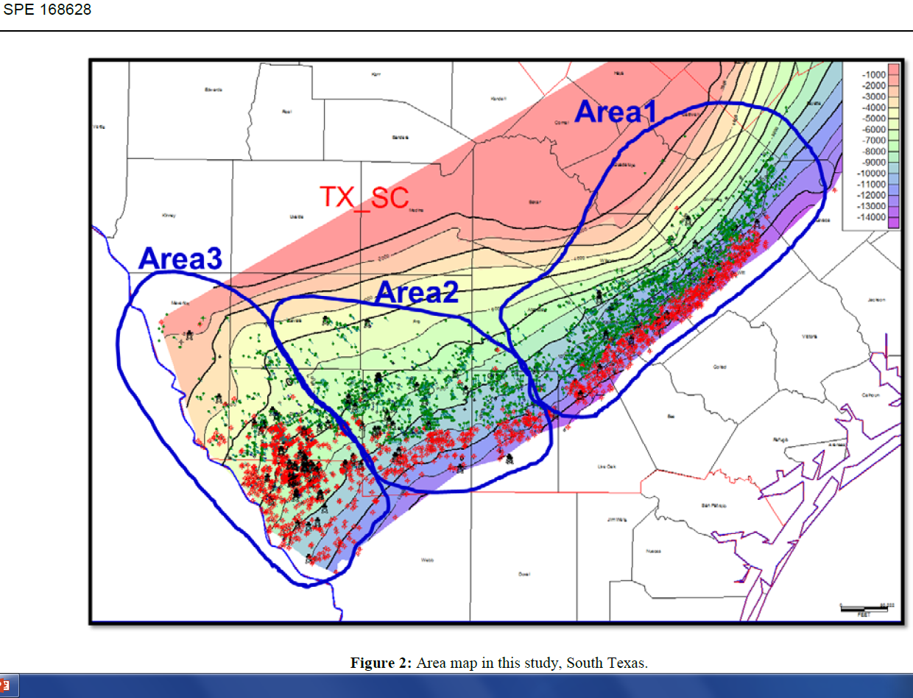

Slide 47
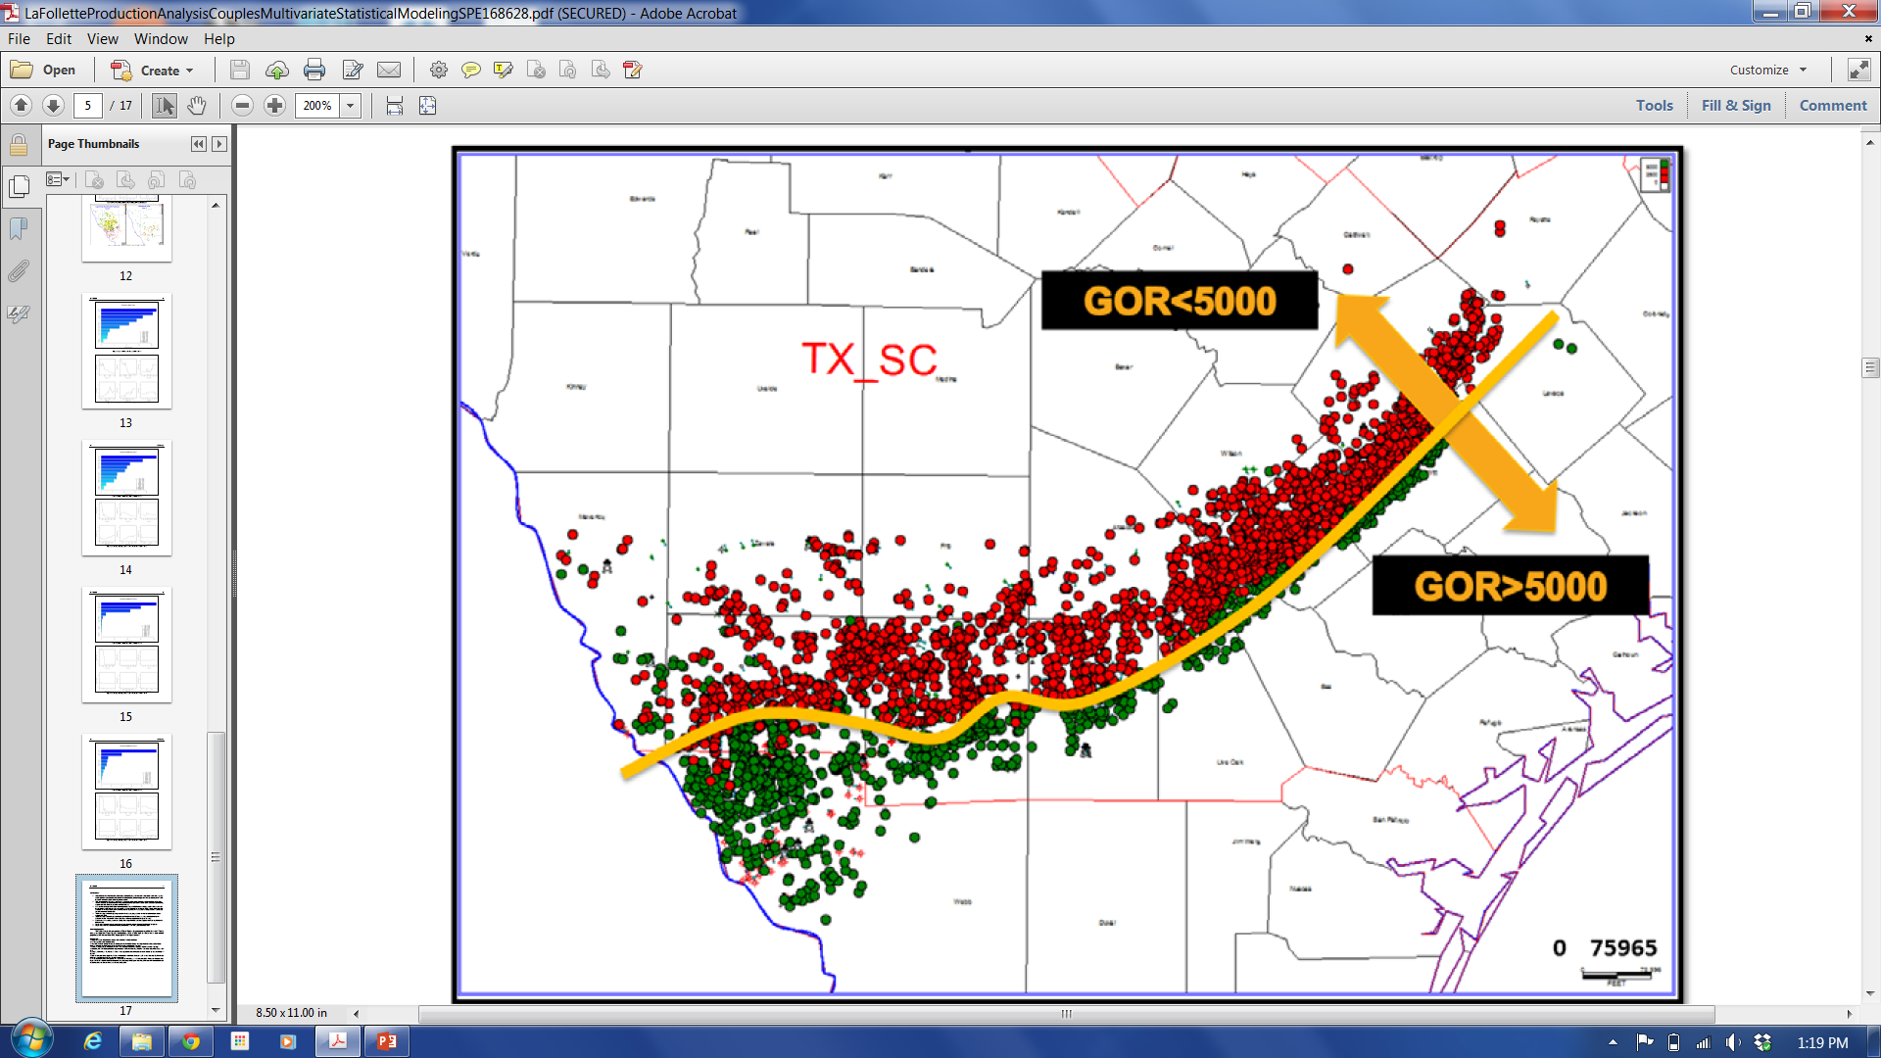
Notes:
LaFollette et al., 2014 plotted all Eagle Ford Shale wells and divided them into
< 5000 scf/bbl red and >5000 scf/bbl green

Slide 48
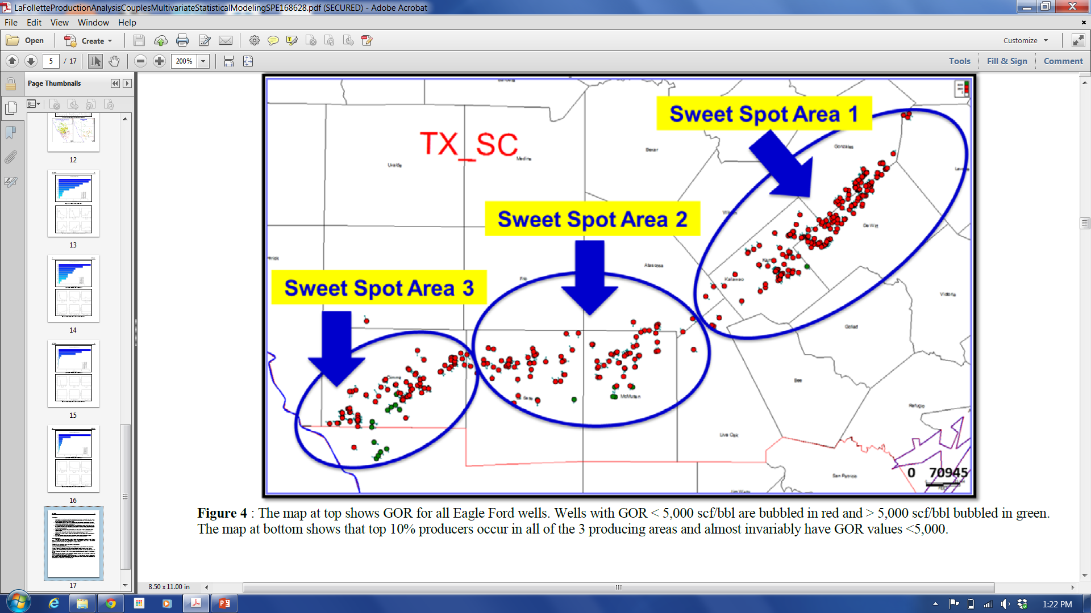
Notes:
The previous slide showed all wells plotted by LaFollette et al., 2014
Now lets look at the upper 10% of producers
Again < 5000 scf/bbl red and >5000 scf/bbl green
So most of the larger volume producers have <5000 scf/bbl
They are not the highest pressure wells and they are scattered along a fairly narrow trend, however, there are many less economic wells between these better wells. Suggesting localized variations in organic source and/or perhaps natural fractures?
Could there be a better way to define the best wells besides the drill rig

Slide 49
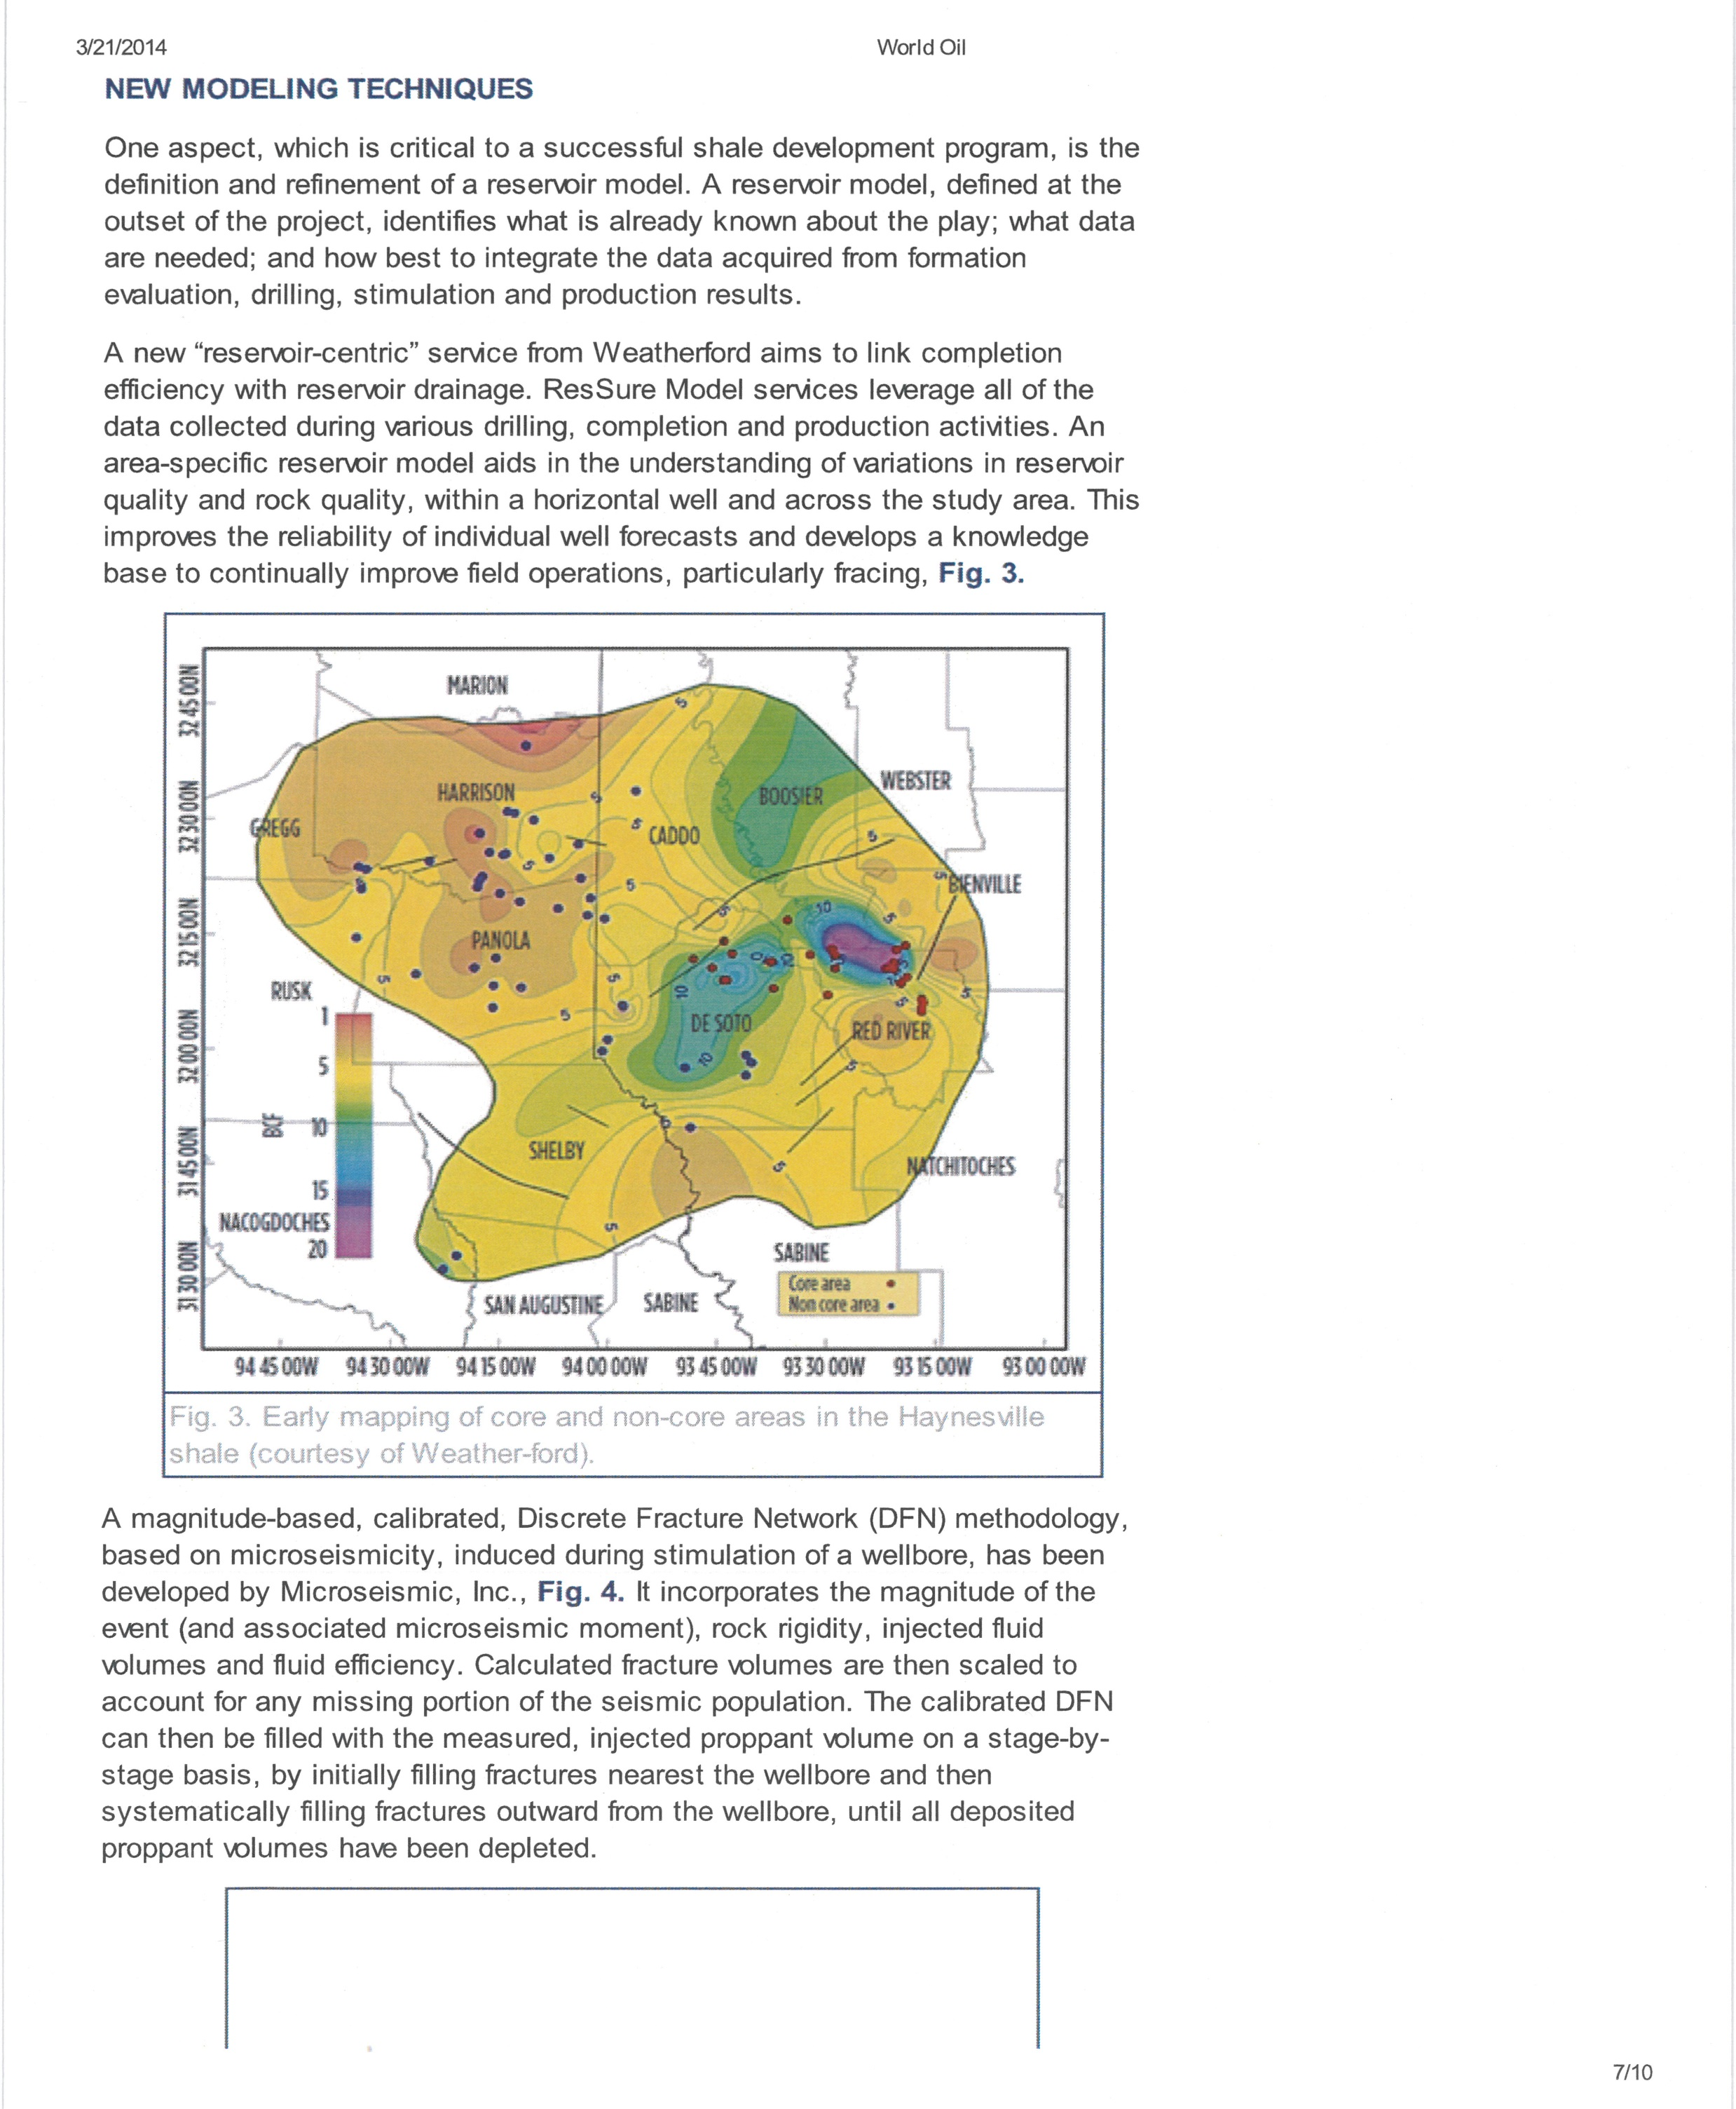
Notes:
Haynesville Shale on Texas- Louisiana Border showing core “sweet spots” and
Non-core more marginal wells

Slide 50
Kennedy, Gupta, Kotov, Burton, Knecht and Ahmed, Baker Hughes SPE 162534
Optimized Shale Resource Development: Proper Placement of Well and Hydraulic Fracture Stages
Performance reveals not all wells producing commercially
only 40% of frack stages make significant contribution to production
must target “sweet spots”
Geometric placement based on current concepts of fixed well/fracture spacing not appropriate
Placement in “sweet spots” appears to be significant for best producing wells
Exploration phase should include basin/area screening to identify core areas (sweet spots).
Definition of sweet spots should include mapping of natural fractures
A naturally fractured reservoir can be drained more efficiently if a complex fracture network can be created by the hydraulic fracture stimulation
Notes:
Optimized Shale Resource Development: Proper Placement of Well and Hydraulic Fracture Stages
(Kennedy, Gupta, Kotov, Burton, Knecht and Ahmed, Baker Hughes SPE 162534)
Performance reveals not all wells producing commercially
only 40% of frack stages make significant contribution to production
must target “sweet spots”
Geometric placement based on current concepts of fixed well/fracture spacing not appropriate
Placement in “sweet spots” appears to be significant for best producing wells
Exploration phase should include basin/area screening to identify core areas (sweet spots).
Definition of sweet spots should include mapping of natural fractures
A naturally fractured reservoir can be drained more efficiently if a complex fracture network can be created by the hydraulic fracture stimulation

Slide 51
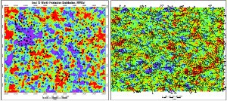
Ran Bachrach and Colin Sayers, Schlumberger August 2014
New method characterizes naturally fractured reservoirs
In reality, production appeared almost haphazard. Shales were alarmingly heterogeneous. The first detailed maps of shale heterogeneity were drawn very slowly, at enormous cost, by the drill bit
Evidence of heterogeneity showed up at multiple scales, from the field down to individual stages within a well.
According to one study, 43% of the perforations in a certain play produced almost no hydrocarbons, while 30% produced more than 80% of total flow.
Drill Bit
Schlumberger recently developed the industry’s first high- resolution orthotropic inversion technique for WAZ seismic (on right).
Notes:
Applying Technology To Enhance Unconventional Shale Production (Jeff Foster, Microseismic CEO/President) World Oil December 2014
The variability in unconventional shale plays is leading to unpredictable performance from wells. Therefore as an industry, we must realize that understanding the composition and behavior of the target geology during fracturing is essential to hit the “sweet spots” and ultimately will result in maximizing the amount of recoverable reserves.
Only approximately 10% if gas in place and 5% of oil in place is being recovered today. IN fact, as much as 25% to 35% of “factory mode” drilled wells do not even produce. Simply put, although this method has allowed for rapid field development, it is yielding lower productivity than expected, which is driving the need for efficiency gains and improved recovery methods.

Slide 52
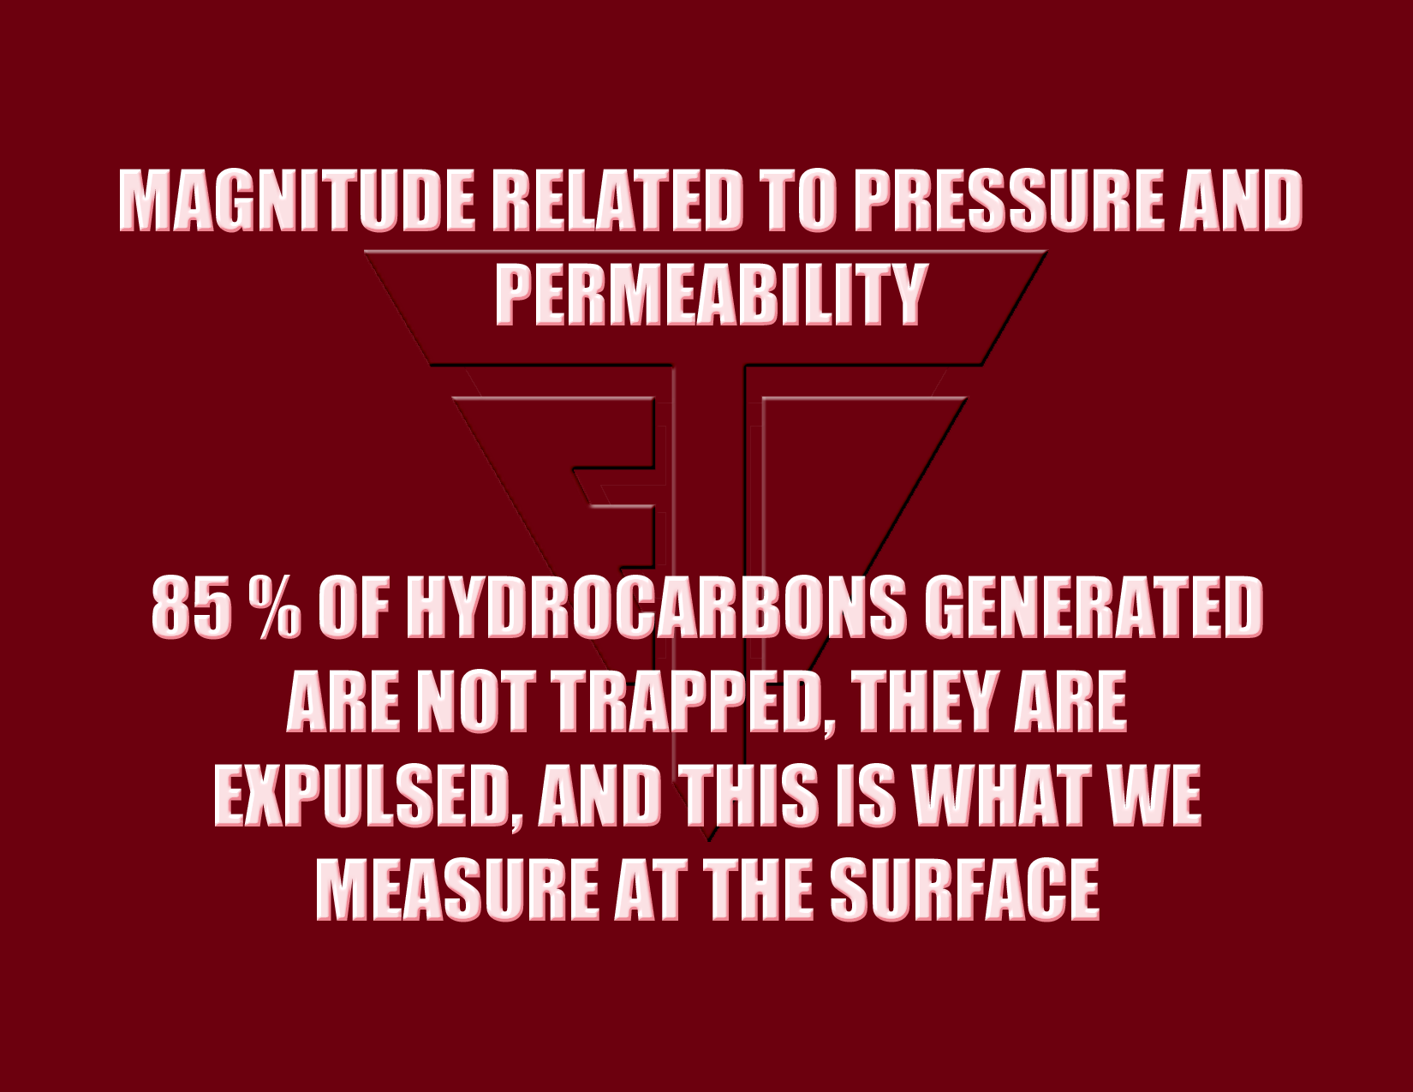
Notes:
Obviously, as suggested by the previous slide generated by Dr. Matthews. Seep magnitudes are related to pressure and permeability, not to economics.
Another very important factor, as noted by Dr. John Hunt, the most noted source rock geochemist in the world, is that 85% of the hydrocarbons generated by the source rocks within any basin are expulsed from the basin and are not trapped in commercial fields.
Organic geochemists tell us that only 15 % of the generated hydrocarbons are trapped in the commercial fields. That’s why seeps occur all over the basin and not just over fields.

Slide 53
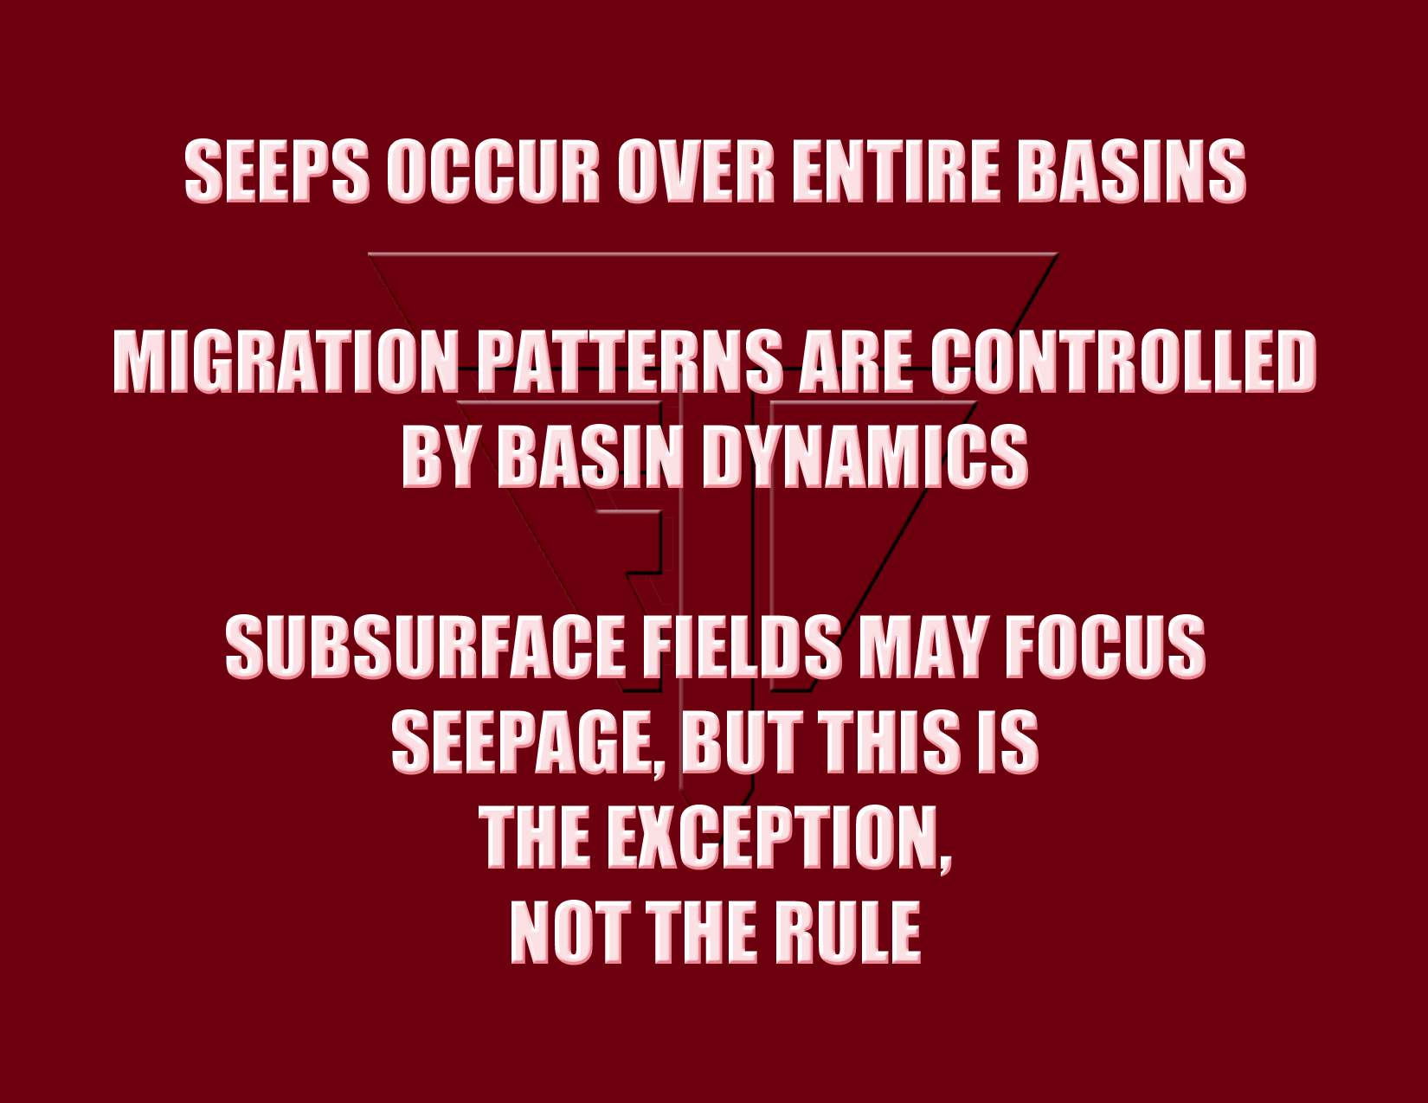
Notes:
My very first experience that I had to deal with when I began my career at the Gulf Oil Co. was that the seeps we mapped did not just occur over the known fields. It was very clear that seeps were occurring over entire basins, not just over commercial fields. In addition, as demonstrated by the previous Kansas and Green Canyon examples, there was no magnitude threshold for telling commercial from non-commercial.
Seeps are basin wide. Although fields may add further focus to the seeps, extensive survey experience has demonstrated that such focus is an exception, and is not the rule.
Large grids collected over entire basins clearly showed that migration patterns are controlled by basin dynamics.

Slide 54
Notes:
All reservoirs, whether conventional or in shale are sourced from shale source rocks
Empirical evidence supports contention that 50% has escaped and can be used to locate
Migration fairways and “sweet spots”, focusing production wells on more economic locations

Slide 55
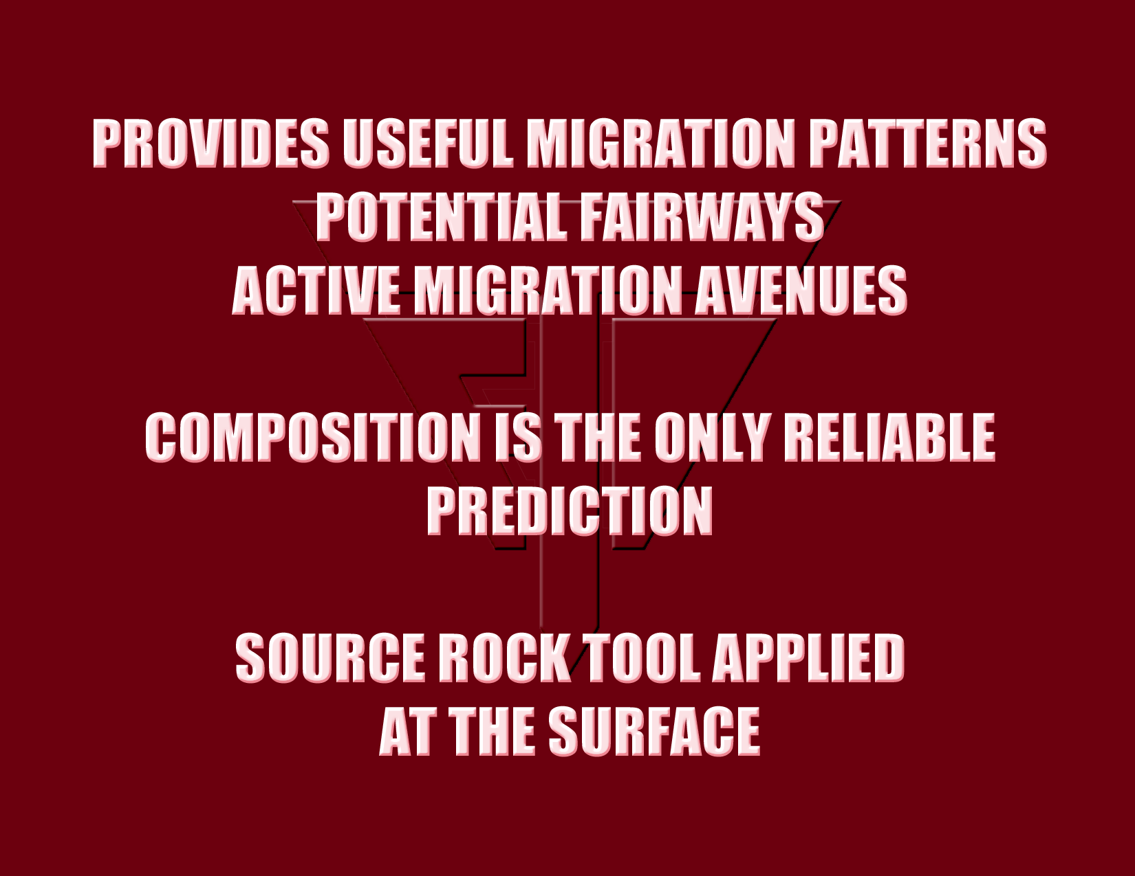
Notes:
The key to understanding this technology was provided by collecting grids over whole basins
These regional grids clearly showed that these regional seepage patterns could only be explained by the subsurface source rocks, coupled with basin dynamics.
This relationship is best defined through the chemical compositions of the seeps, that is, whether they are gas or oil
As you will see - surface geochemistry is nothing more than a source rock tool applied at the surface, and that is it’s main value.

Slide 56
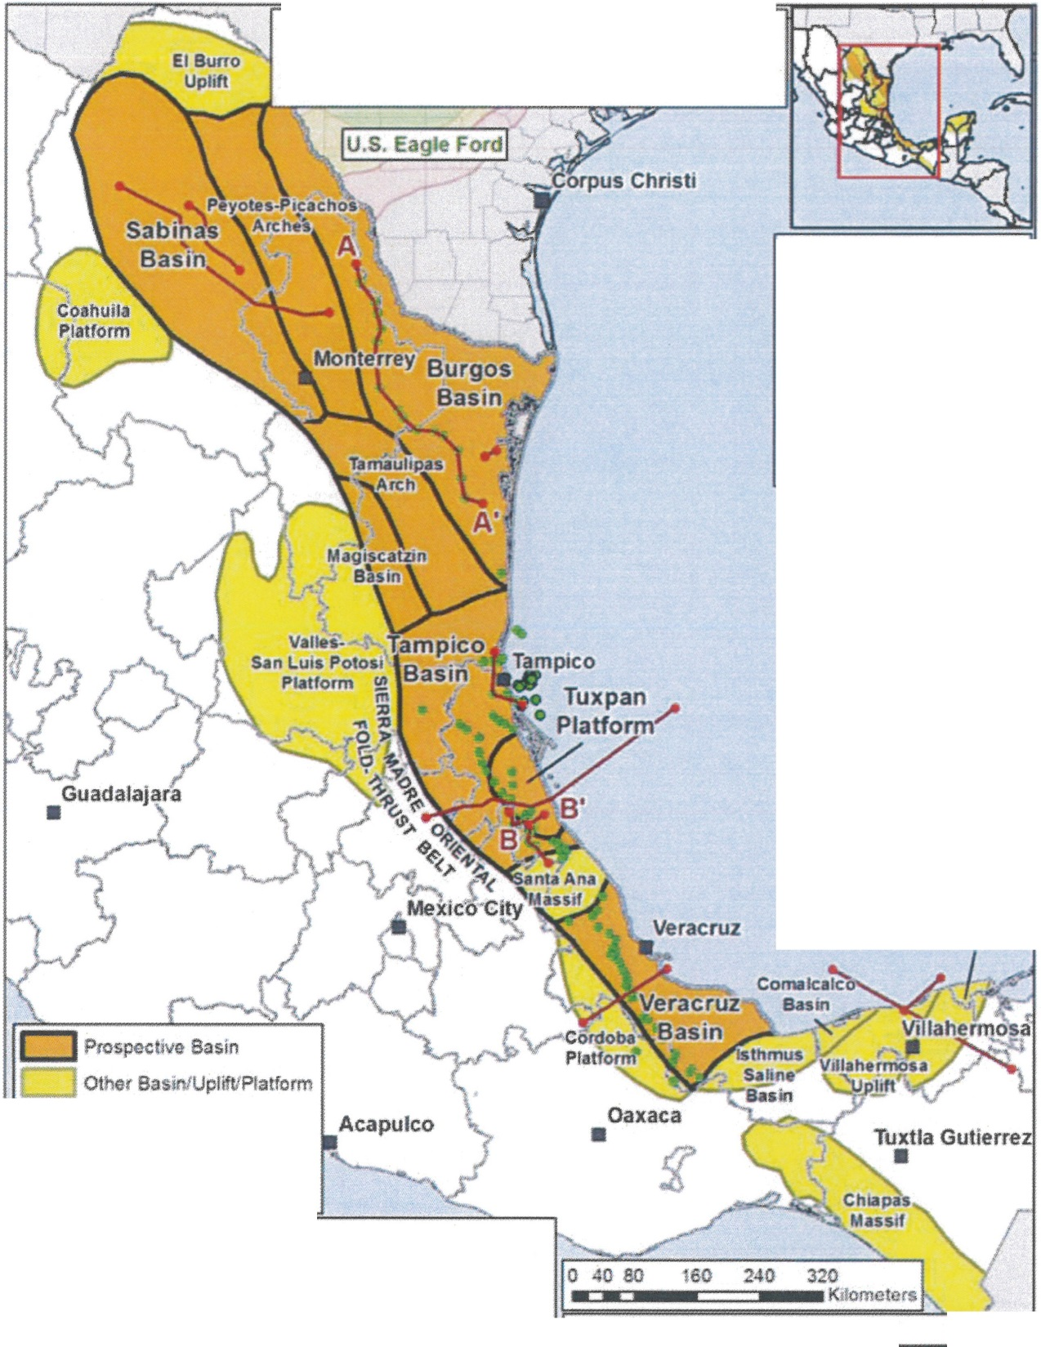
Notes:
Mexican shale basins and plays

Slide 57
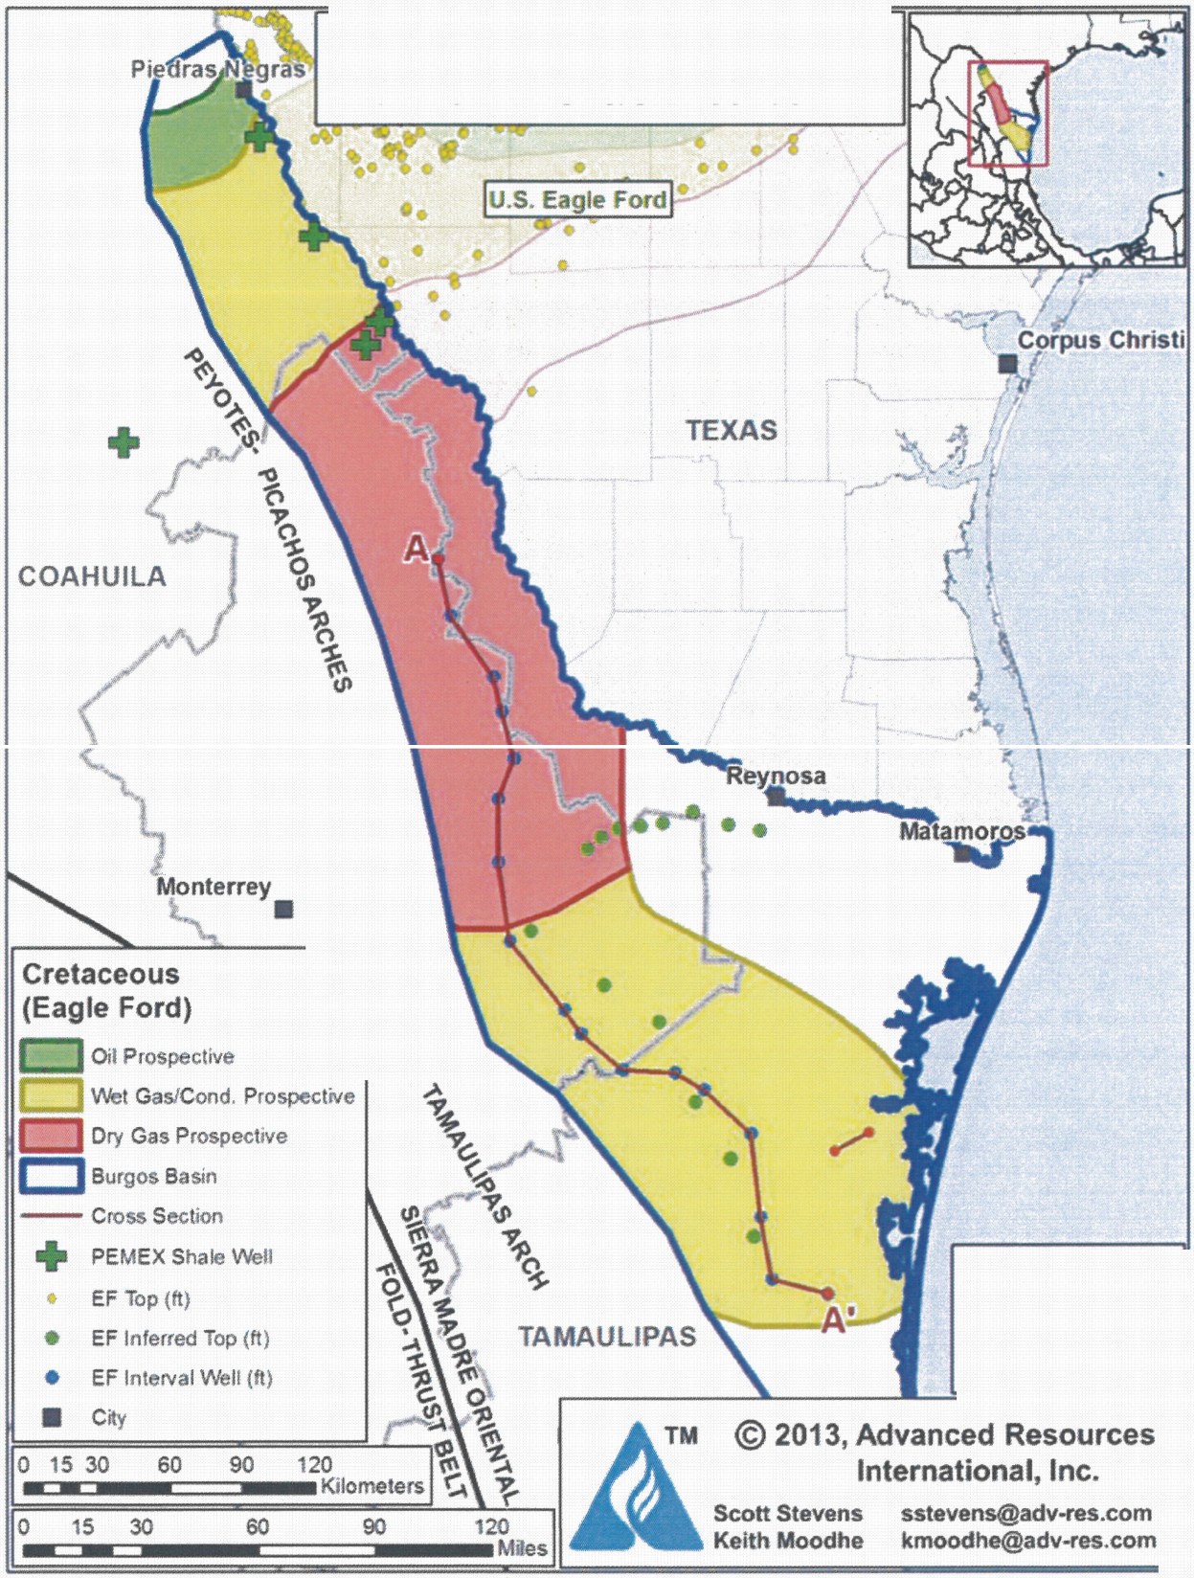

Slide 58
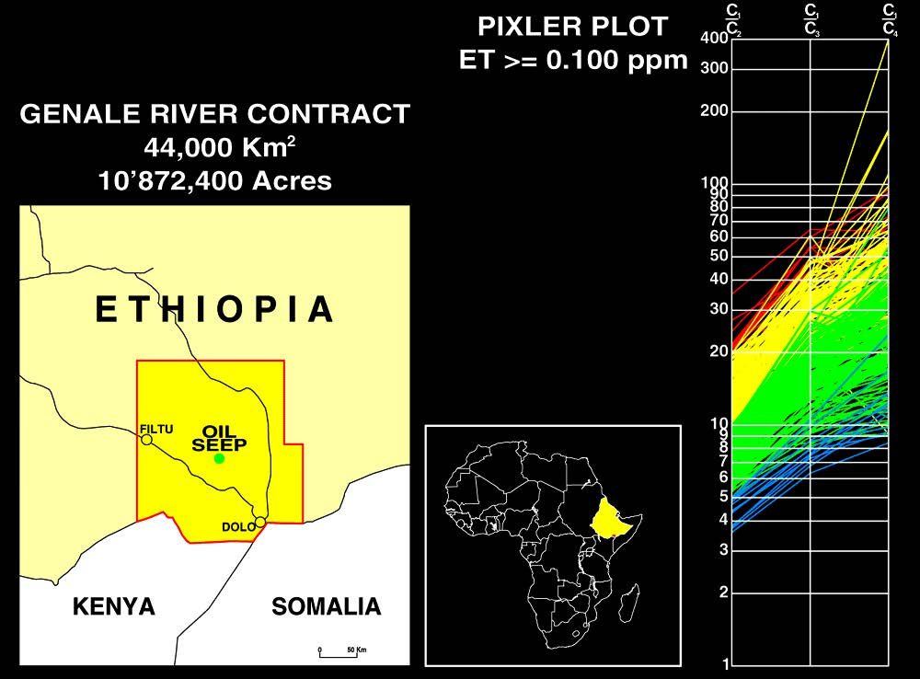
Notes:
5000 site soil gas survey conducted Ethiopia frontier area for Hunt Oil

Slide 59
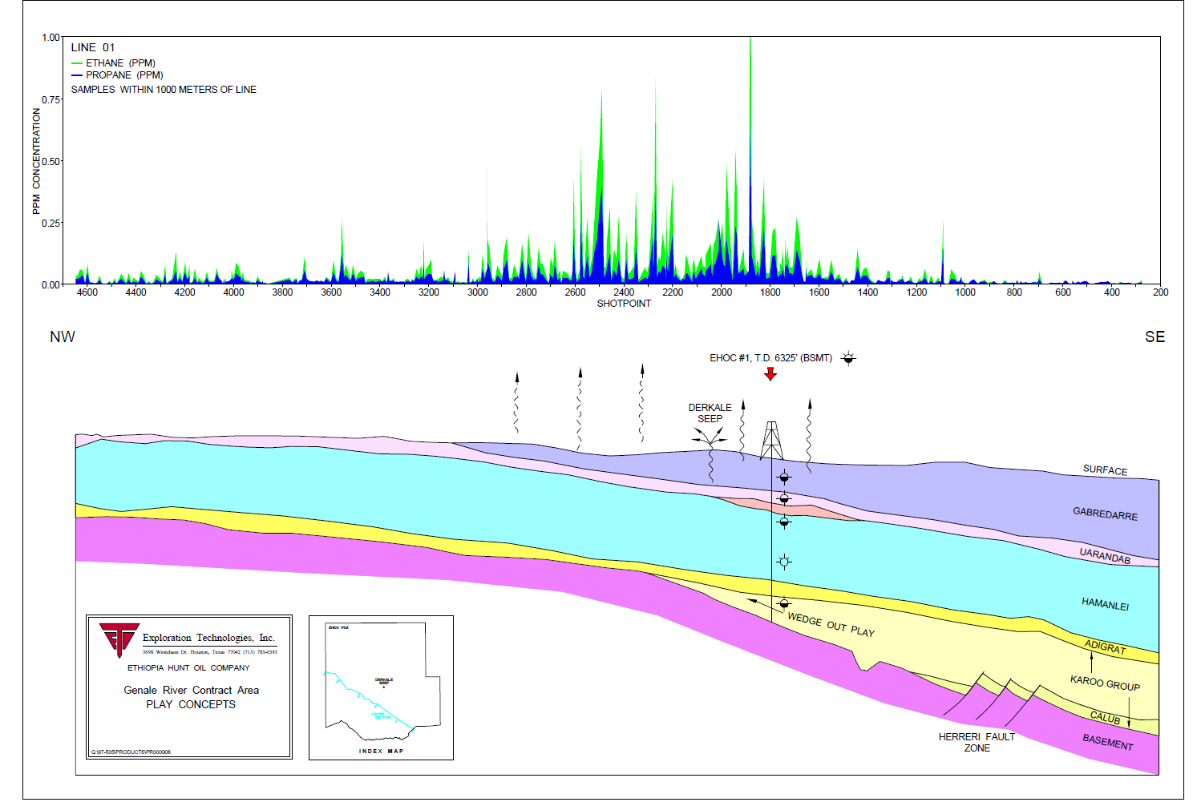
Notes:
Regional profile shows focus area on hinge line, one test well drilled with significant shows confirming soil gas anomaly location, according to Bob Fink at Hunt Oil, the most shows he had ever seen in a non-producing well

Slide 60
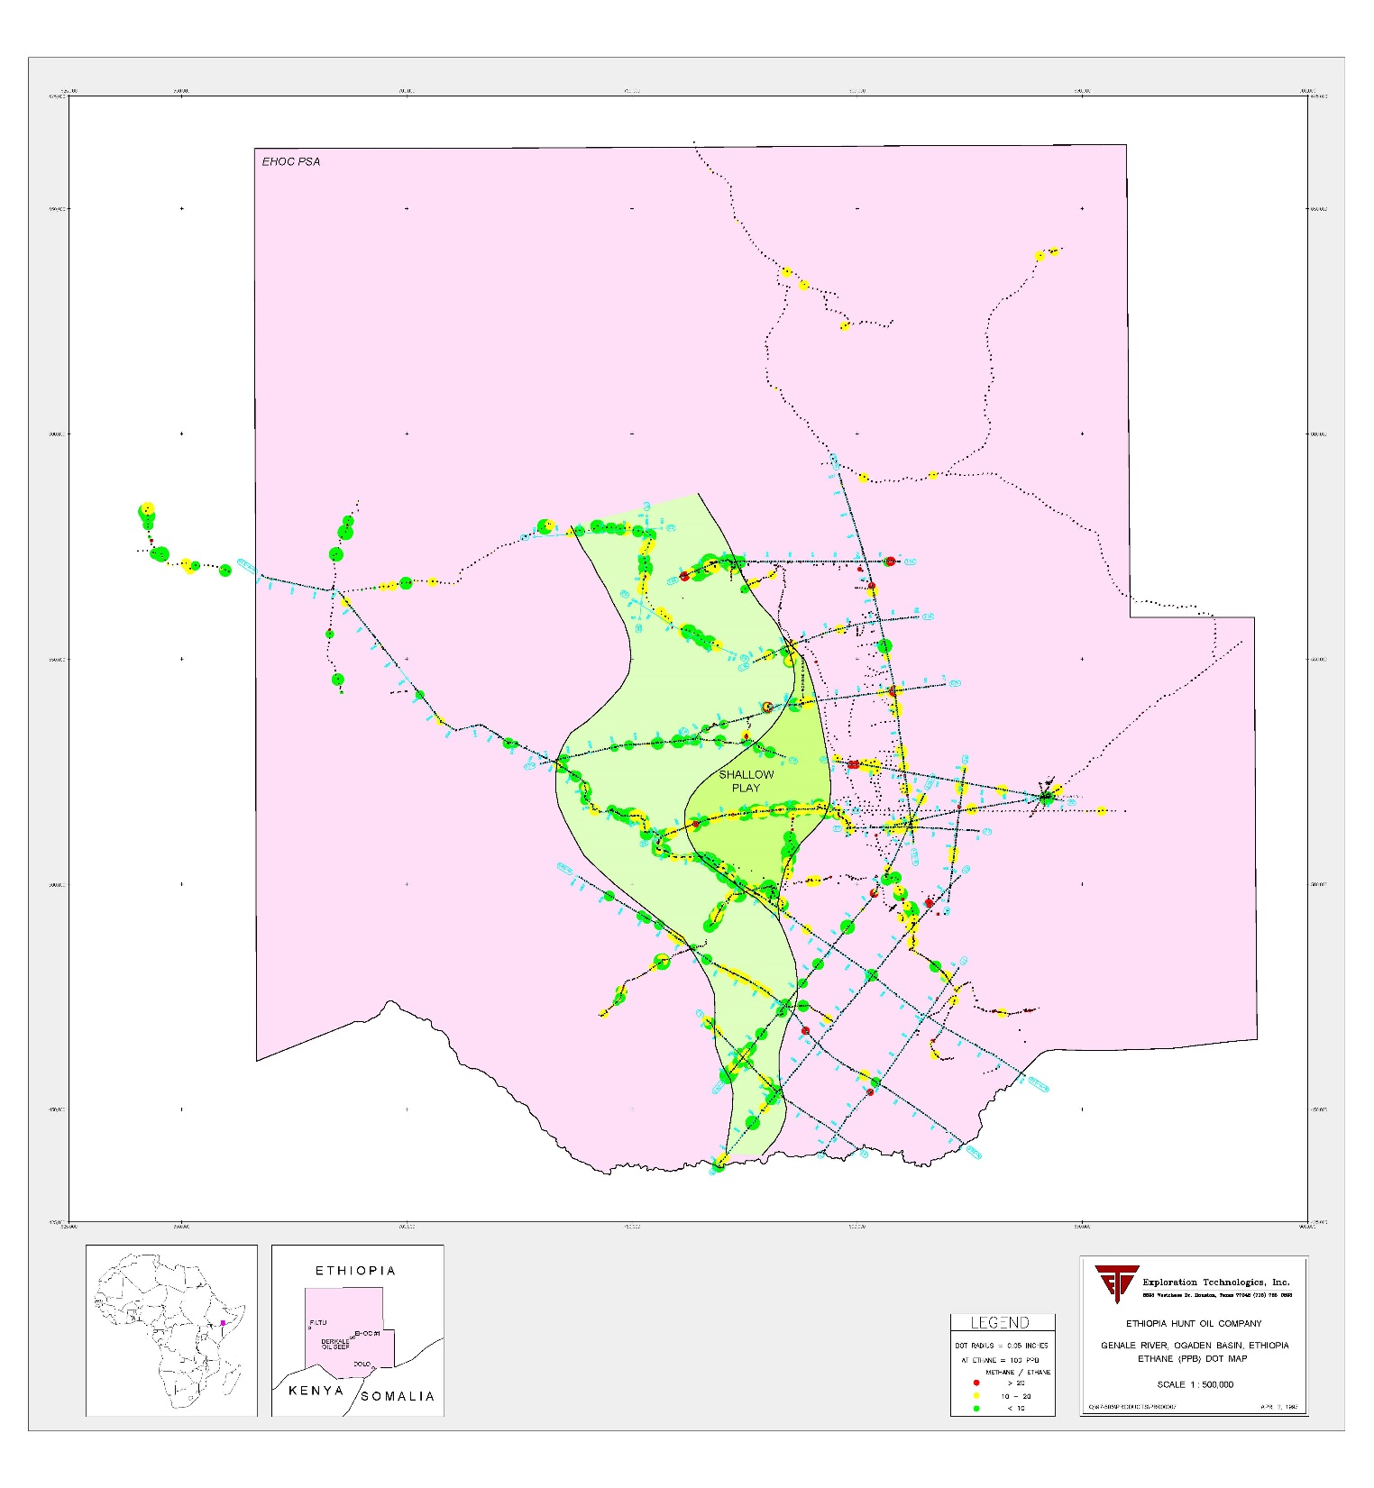
Notes:
Aerial distribution of regional focus area defined by soil gas survey

Slide 61
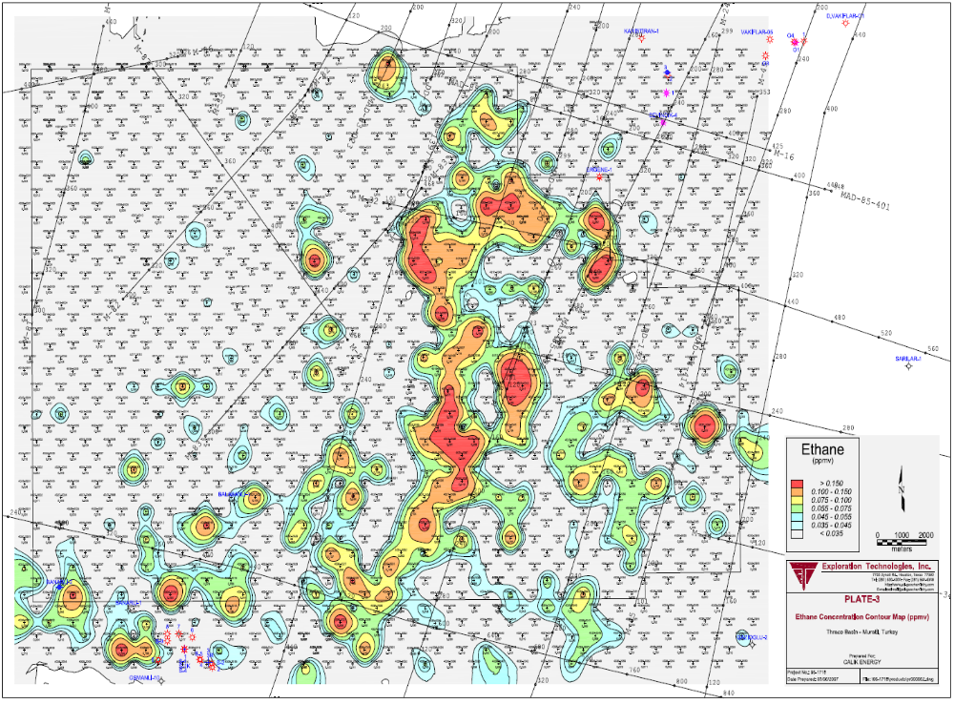
Ethane
Notes:
This is an example from the Thrace Basin in Turkey where we conducted a 1 km grid over a large frontier area having unknown potential. Note the very large hook shaped soil gas anomaly.

Slide 62
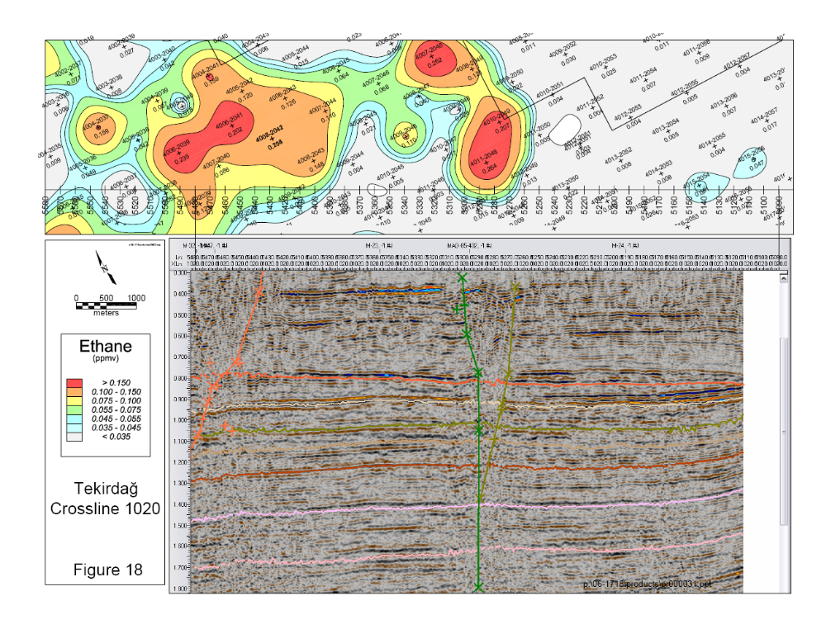
Notes:
A 3-D seismic survey conducted over this same area provided an excellent seismic-geochemical correlation, and confirms a vertical seismic chimney, or wipe-out zone that appears to have a direct association with the soil gas anomaly. This is a class-A, drillable prospect, however, please note that the presence of both geochemical and seismic anomalies does not prove that the associated reservoir will be economic. In addition, the reservoir zone must be identified and tested for porosity and permeability. More than one well is likely required to determine the size of the economic base before the actual economics can be predicted.
Soil gas is a good tool if applied on a grid and then integrated with both geological and geophysical data. Experience has shown that a proper geological/geophysical prospect that has seepage can significantly raise the finding ratio to as much as 80%.

Slide 63
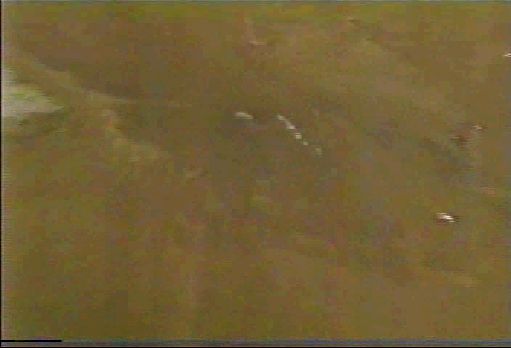
SURFACE GEOCHEMICAL PROSPECTING
FOR
UNCONVENTIONAL HYDROCARBON RESERVOIRS
September, 2014
PEMEX
Villlahermosa, Mexico
Organized by
EXPLORATION TECHNOLOGIES, Inc.
7755 Synott Road
Houston, Texas
Victor T. Jones, III, PhD.
Nelson Cortes.
Notes:
This is a free gas macroseep in the Ballona Channel in Los Angeles in California

Slide 64
The Foundation of Petroleum Exploration
Is Based on Mapping Seeps
Macro or Micro
September , 2014
PEMEX
Villlahermosa, Mexico
Notes:
As we all would agree, the foundation of this technology lies in locating and analyzing macro and micro seeps, such s the macro seeps shown on this slide. Light gases, such as ethane can be mapped, even in microseeps, as shown by the next slide.

