Slide 1
Natural Hydrocarbon Seeps: Toward Understanding a Complex Natural System
Complexity of Biologically Generated Gases
with
Associated Hydrocarbon Seepage
E
Paper Presented by:
Victor T. Jones, III, PhD., Patrick Myers and Bill O’Neal Exploration Technologies, Inc, Houston, Texas 77083
American Chemical Society
April 13, 2012
New Orleans, La.
Annual Meeting
Notes:
Today I’m going to share some empirical case studies which demonstrate the significance of biogenic gases, such as CH4 and CO2 for mapping and understanding .the spatial and chemical variability of hydrocarbon seeps.

Slide 2
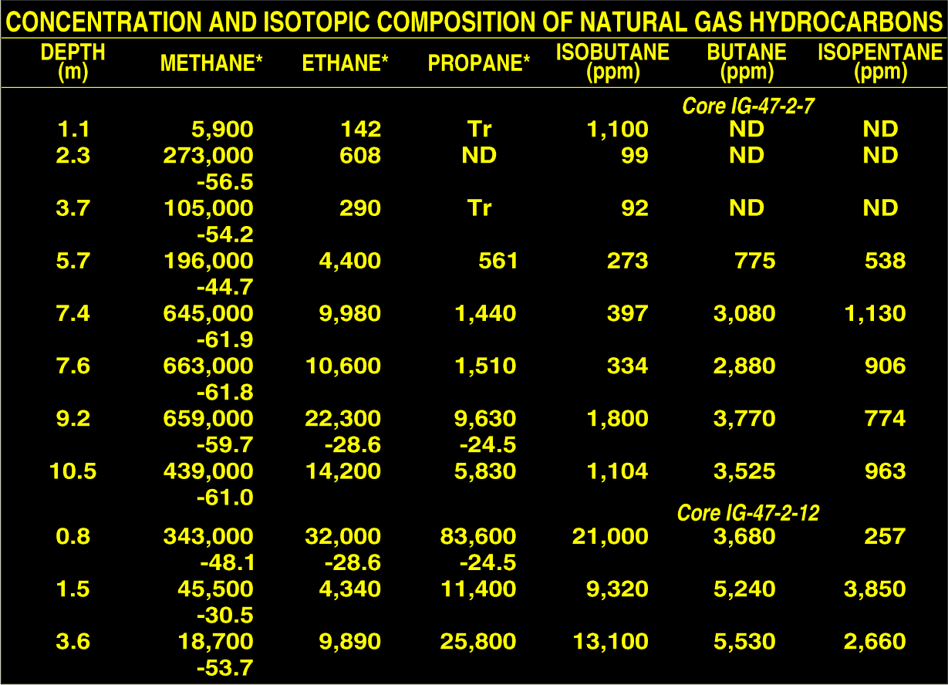
Notes:
Let us begin by reviewing the magnitudes and carbon isotope ratios of methane through butane hydrocarbons in two of the first sea bottom cores that found live oil in the GOM. Although the very large biogenic methane would not be surprising today, it was 1983. Only one core sample has the -44.7 isotopic value found in the reservoir, the rest are clearly mixtures of thermal and biogenic methane. In addition, note the very different ethane/propane ratios within these two cores, which are also very different from the expected 2 or 3 to one ratio typical of oil reservoir gases. Most oil company scientists were surprised at these very large biogenic methane concentrations. It took until 1996 before Keith Thompson “postulated” that biogenic methane was oil seepage hydrocarbons were being converted to biogenic methane.

Slide 3
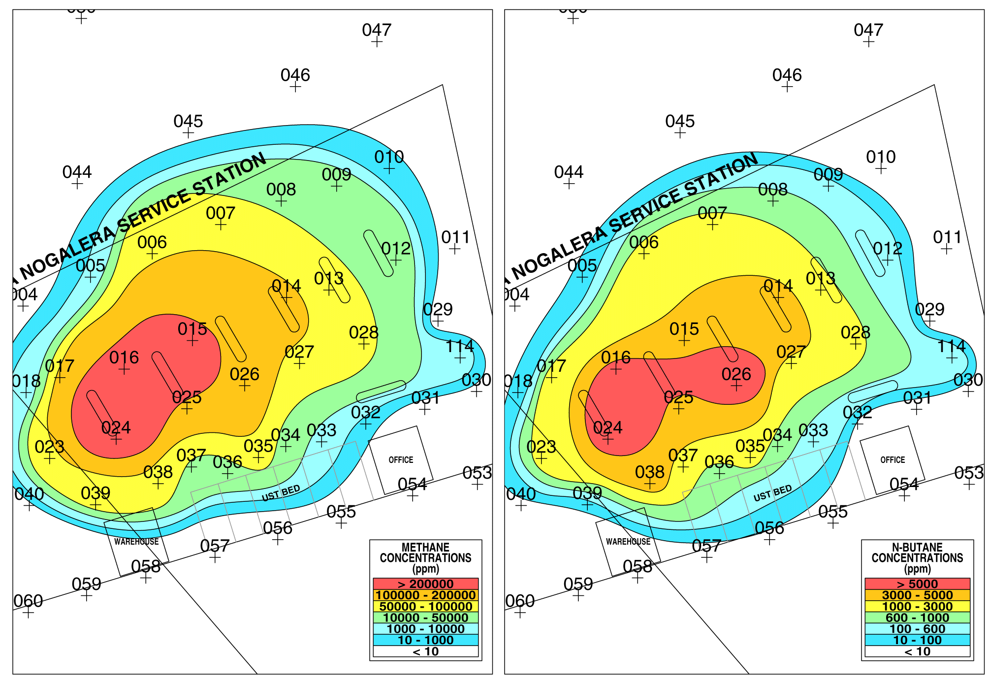
Notes:
During the period from 1983 to 1996 we began to conduct environmental assessments over gasoline stations, as shown in this slide. Butanes and pentanes make up 75% of the vapor pressure in gasoline, so we chose n-butane as the best gasoline indicator. Obviously, biogenic methane also makes an excellent map for gasoline.

Slide 4
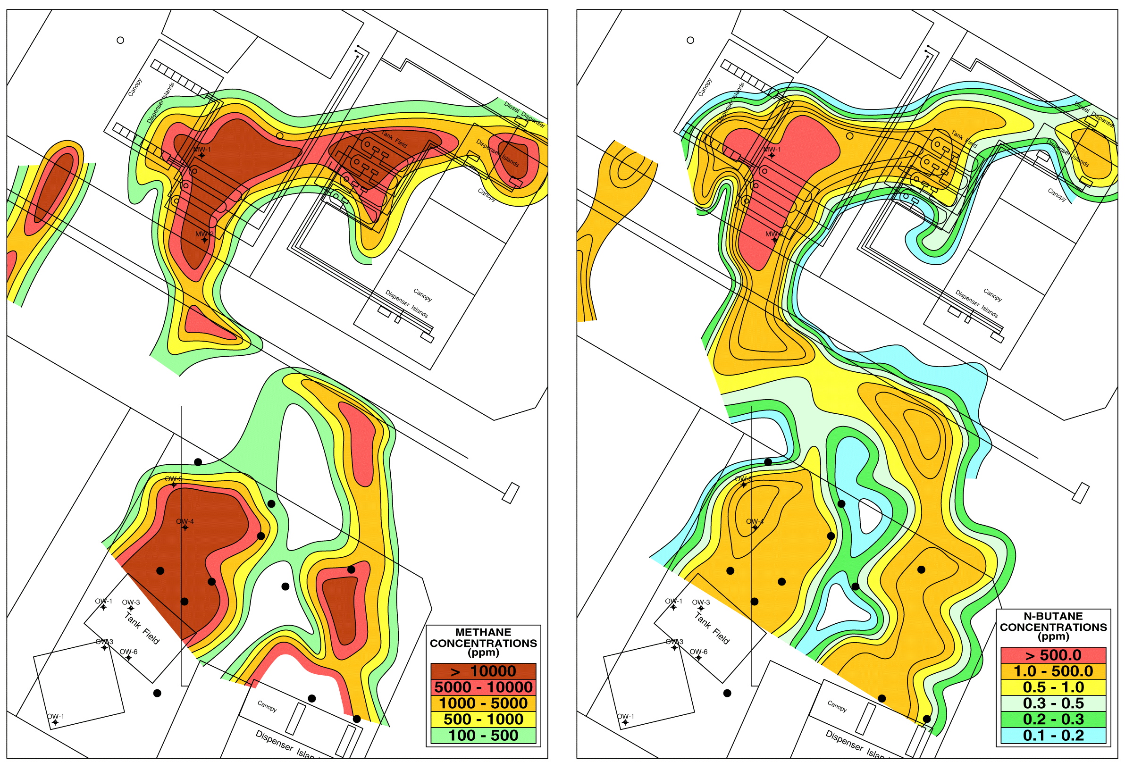
Notes:
Three gasoline stations on a concrete corner located in Austin, Tx, where SW Bell found gasoline in their manhole. All the stations pointed to each other. A soil gas survey defined all the plumes and resolved the liabilities. Note the very narrow migration pathways.

Slide 5
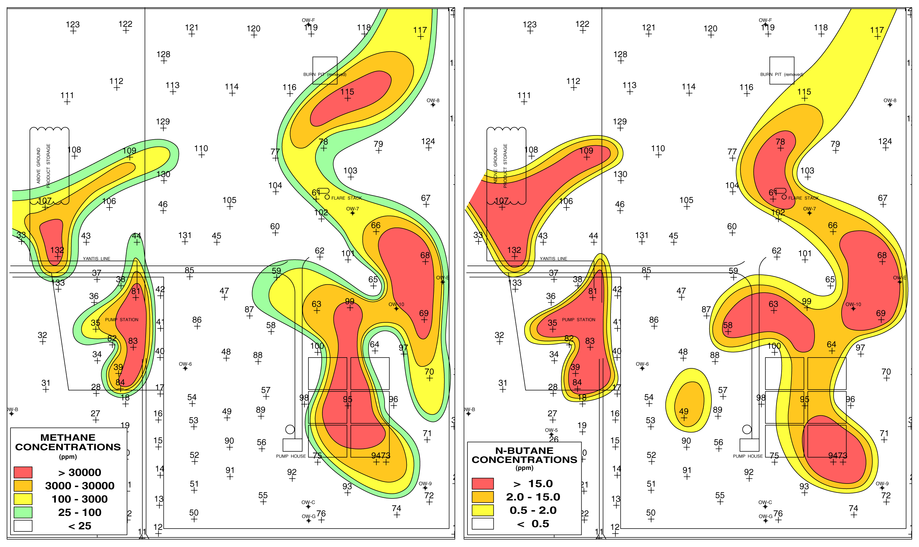
Notes:
This is an east Texas gas condensate plant. Again n-butane is most effective for detection of condensate, which is natures gasoline, and methane clearly mimic’s the underground condensate contamination.

Slide 6
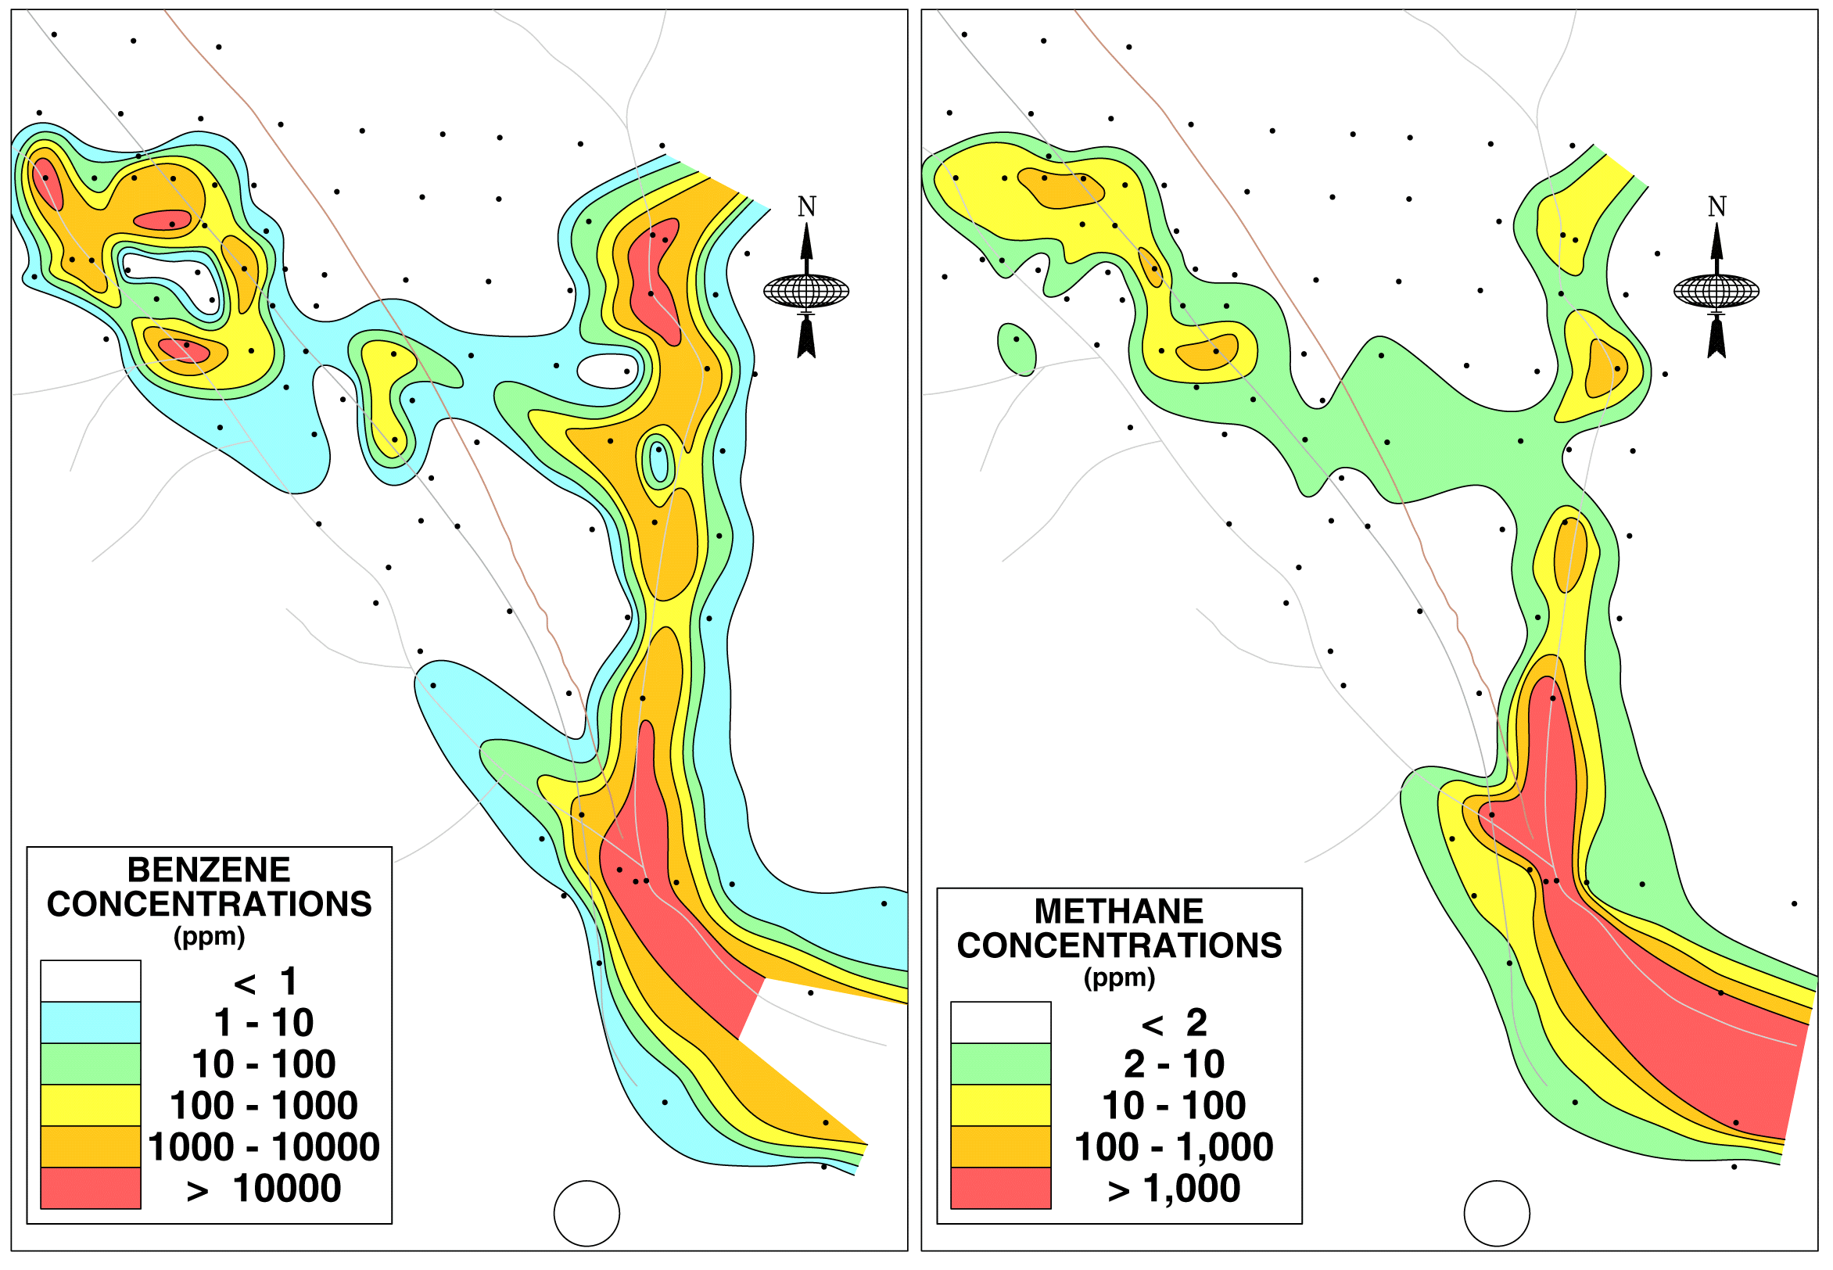
Notes:
The source in this case was a hexane-benzene pipeline at a west Texas refinery. Methane clearly maps the lost benzene-hexane contamination.

Slide 7
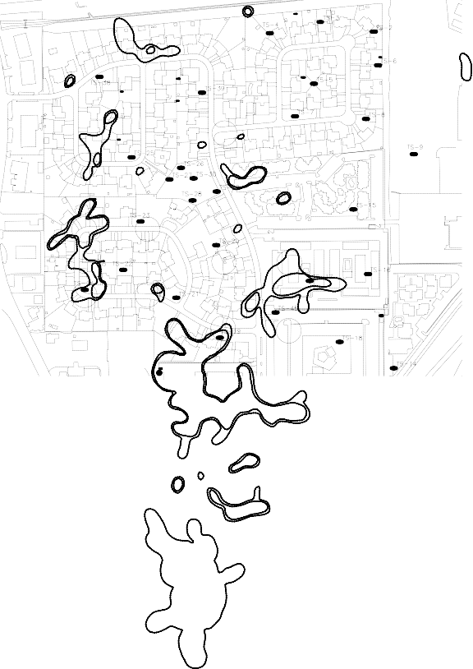
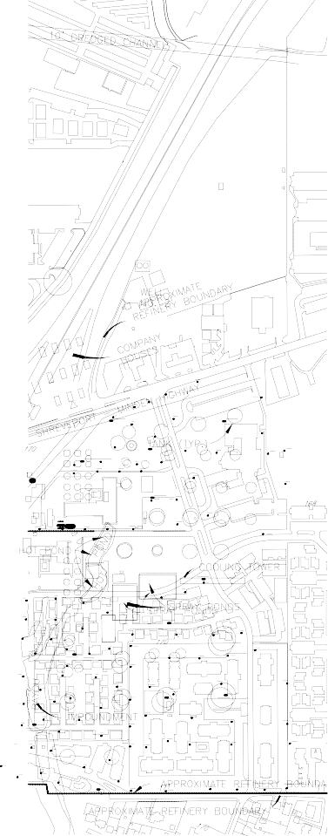
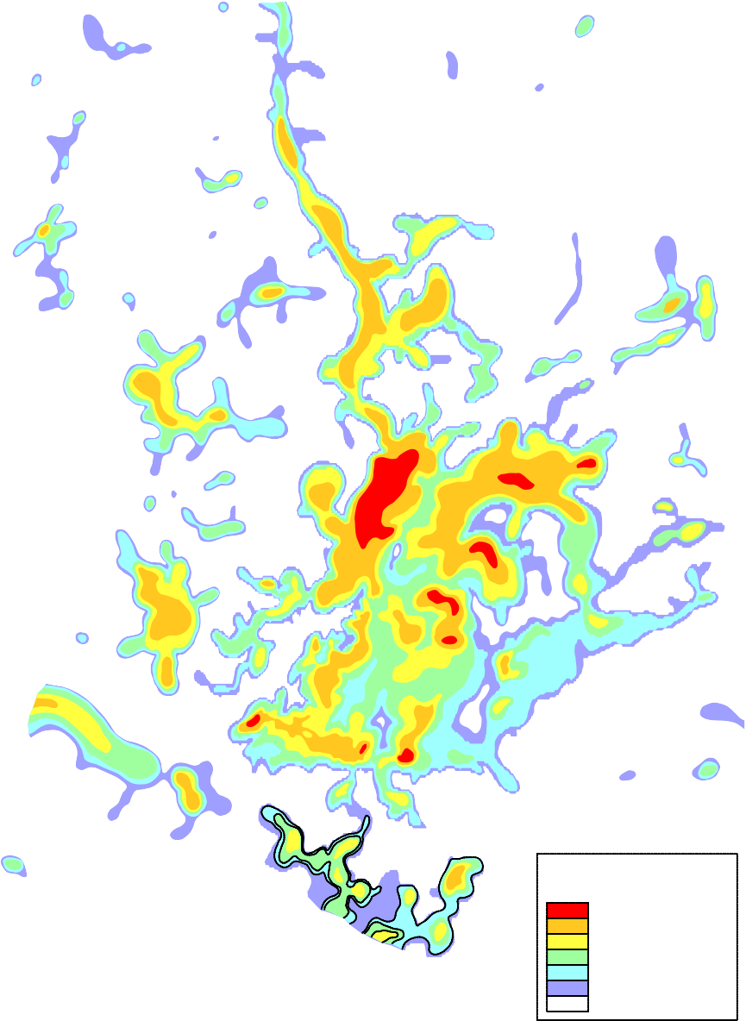


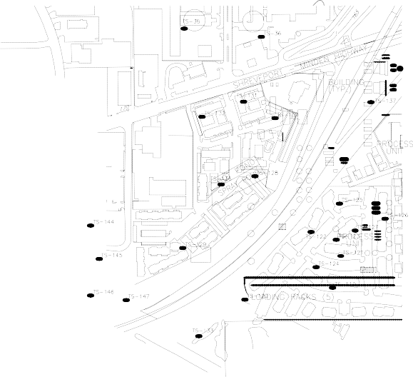

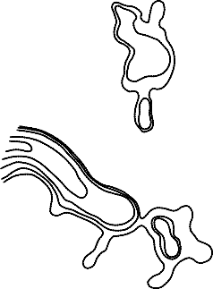
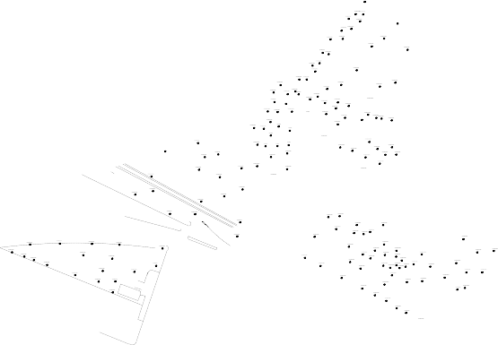
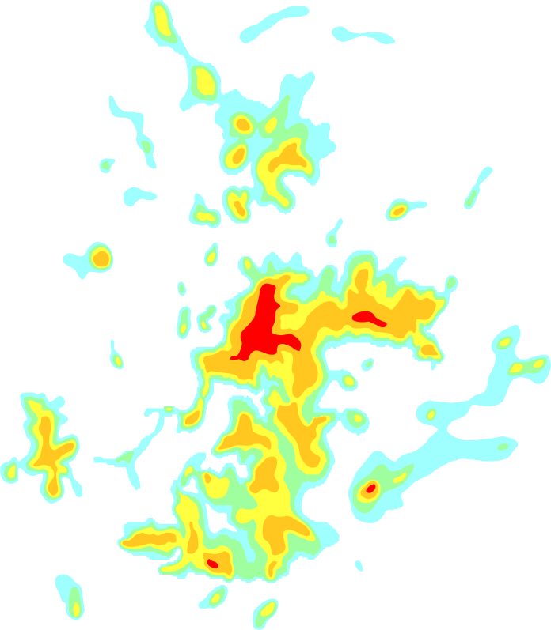
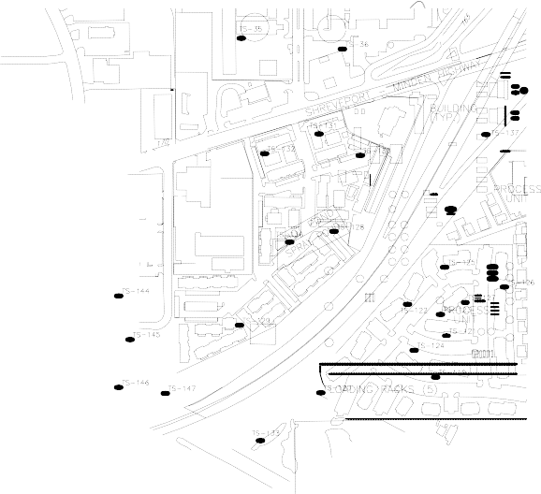


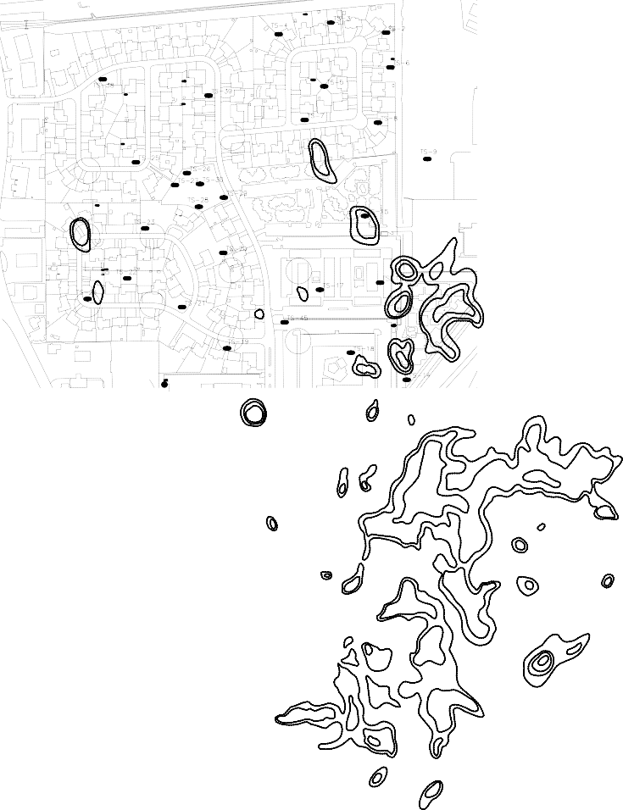



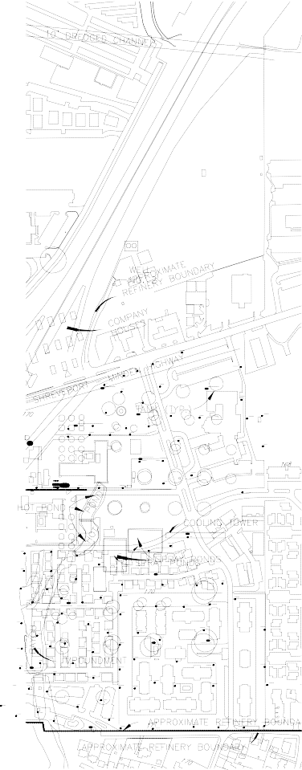

Exploration Technologies, Inc.
3698 Westchase Dr. Houston, Texas 77042 (713) 785-0393
BOSSIER CITY, LA
METHANE
(ppm)
> 600,000
250,000 - 600,000
50,000 - 250,000
2,500 - 50,000
100 - 2,500
10 - 100
< 10
C5+
(ppm)
> 25,000
2,500 - 25,000
500 - 2,500
50 - 500
5 - 50
< 5
Notes:
JP-4 jet fuel leaked from an underground pipeline where Interstate 20 crosses Menden Hwy in downtown Bossier City. Although some of the contamination is related to old refinery waste from the previous Citco refinery, the majority of the methane was biogenic gas generated from the JP-4. Monitor wells found 10 feet of fresh unweathered JP-4 jet fuel under this 1000 foot long plume containing 60% methane that extends from Hwy 20 to the Day’s Inn Motel. Biogenic methane intrusion into the Alexis Park apartments caused the main problem.
Throughout this 1983 to 1992 time frame many environmental consultants questioned the very large biogenic methane. Of particular significance was the fact that Ian Kaplan was also hired as an expert consultant on this project. Even in 1992, Ian was surprised by the extremely large biogenic methane, which did not fit his models.

Slide 8
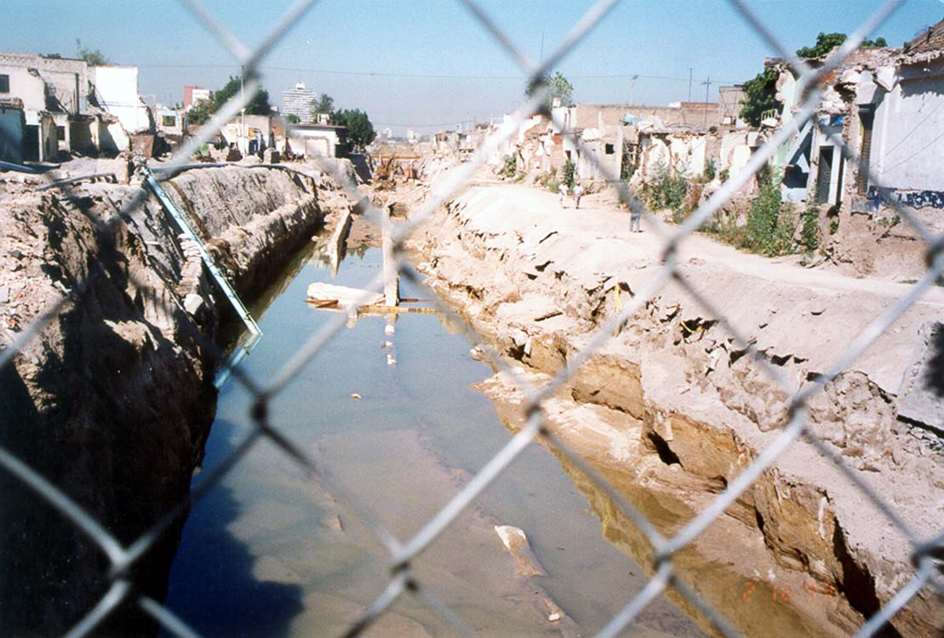
Notes:
In 1992 a gasoline explosion occurred in downtown Guadalajara. Many people were killed, as 9 kms of downtown Guadalajara was destroyed, with vehicles as large as 18 wheel tanker trucks blown landing on the top of three story buildings.

Slide 9
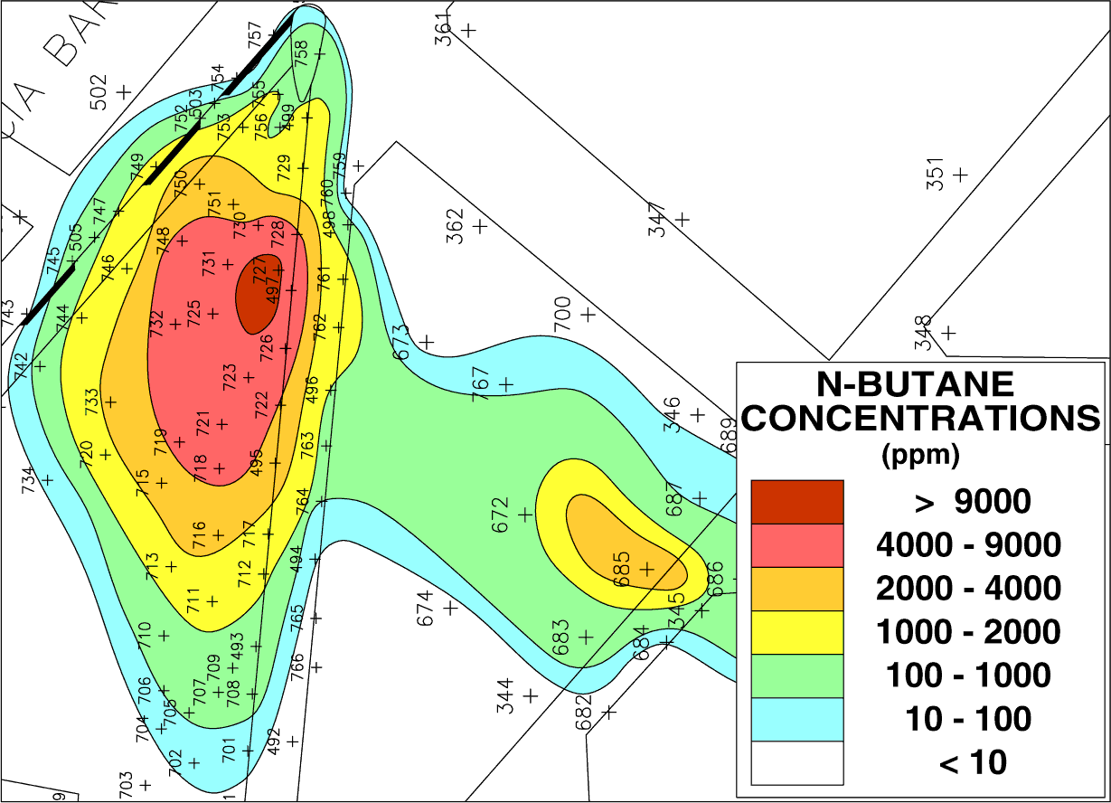
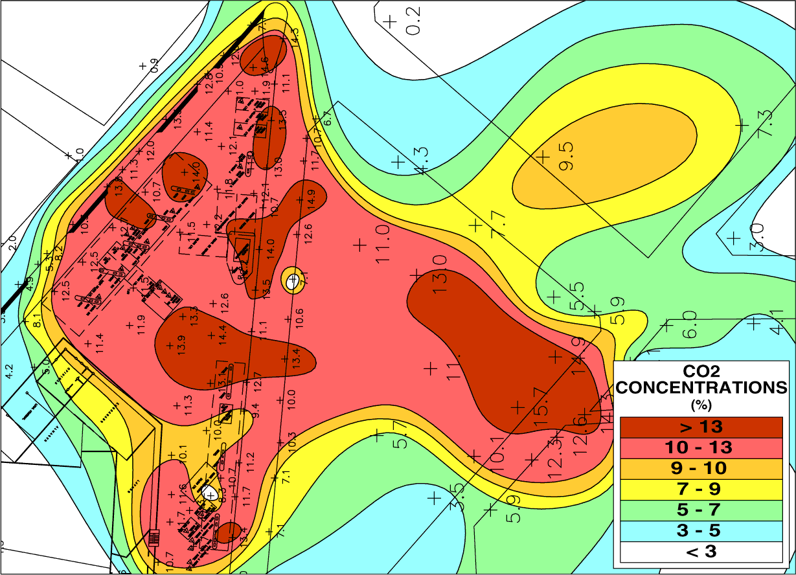
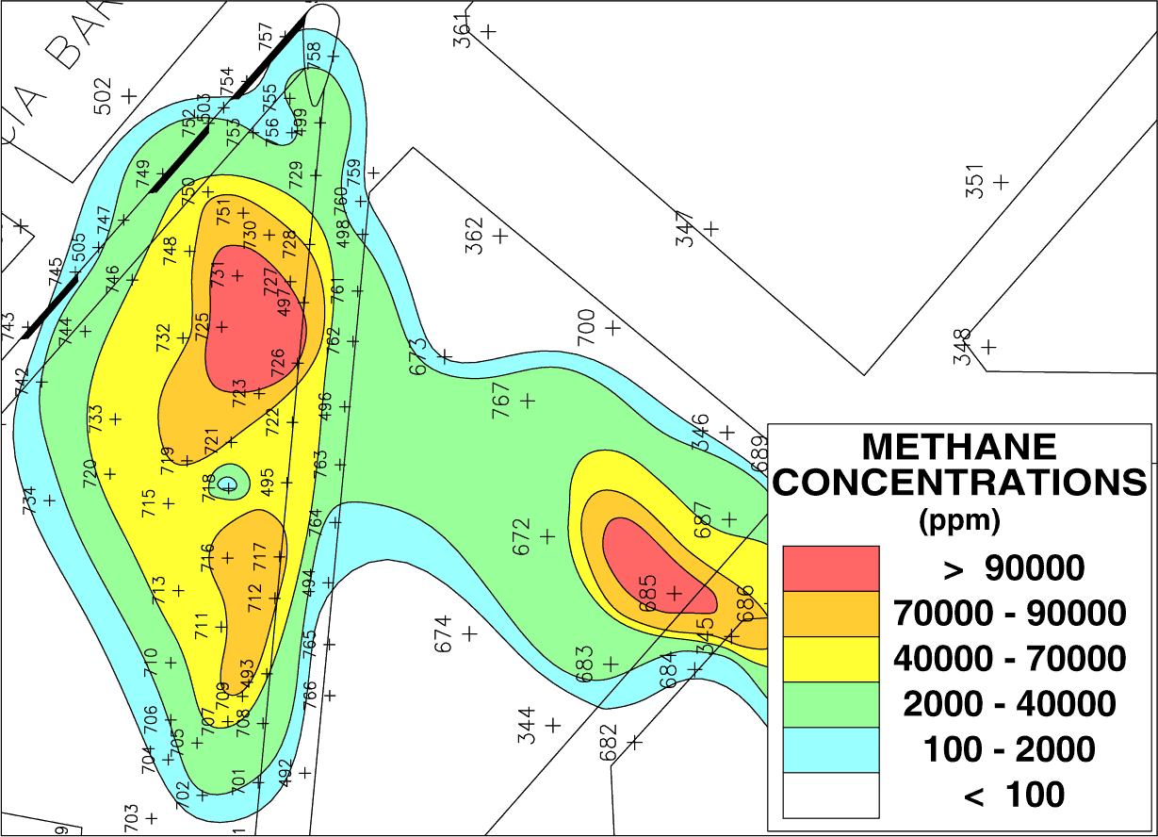
Guadalajara Mexico
Gas Station
CO2 10%
methane 10%
Notes:
This Guadalajara service station likely contributed some of the gasoline. In 1992 in Guadalajara we began to appreciate the usefulness of CO2, which can provide considerable additional information to methane for mapping spills

Slide 10
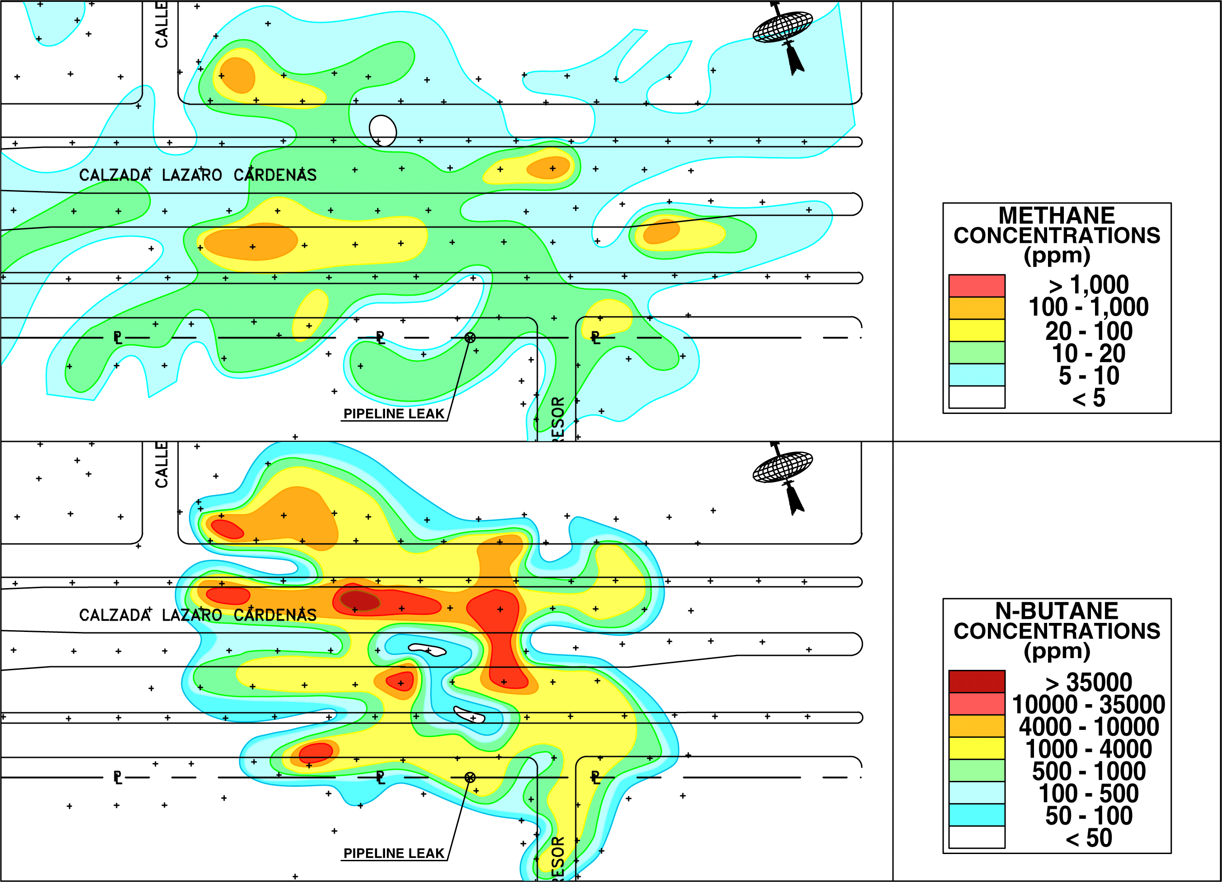
Notes:
This gasoline pipeline erupted 14 days before the explosions and was blamed for the explosions. Note that methane is less than 1000 ppm 14 days after the gasoline impacted the ground. Over the 4 months we worked on remediation and recovery of the gasoline spill. methane reached 20,000 ppm (2%), providing us with evidence that an incubation time was required for the biogenic methane to be generated.

Slide 11
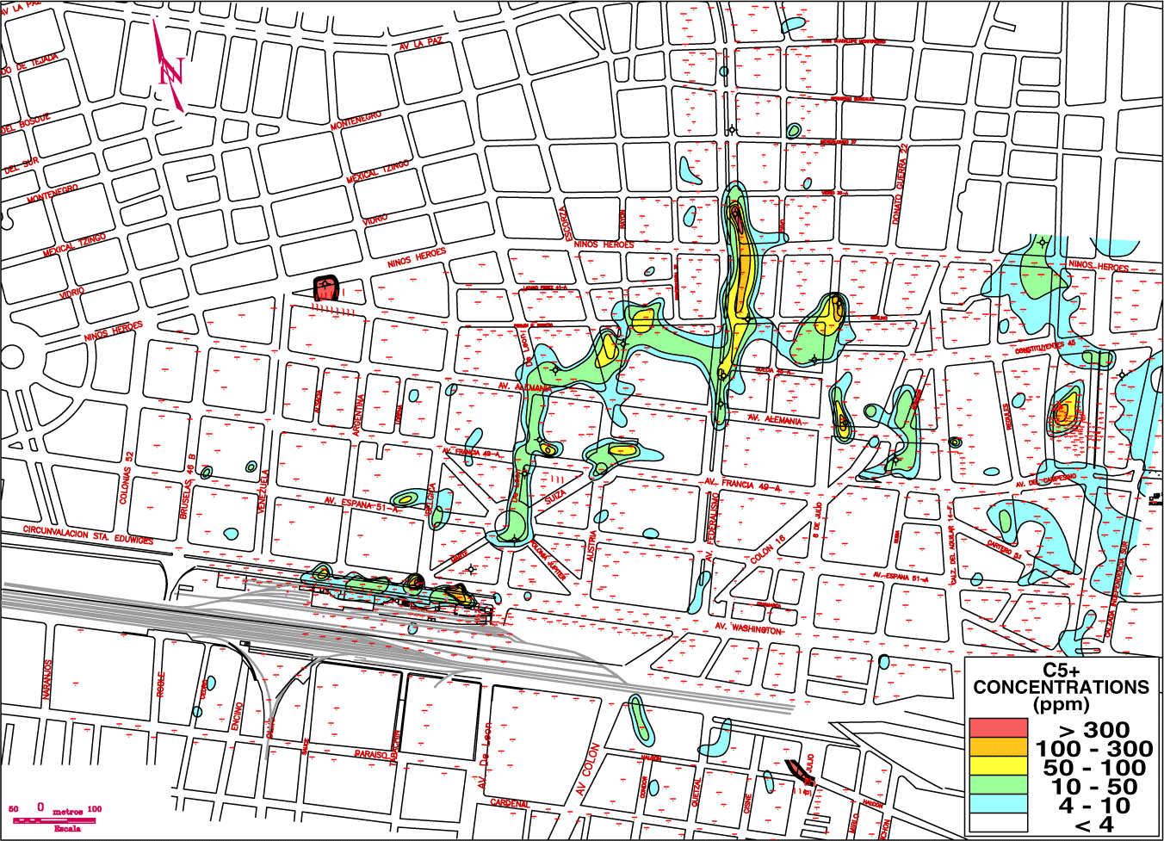
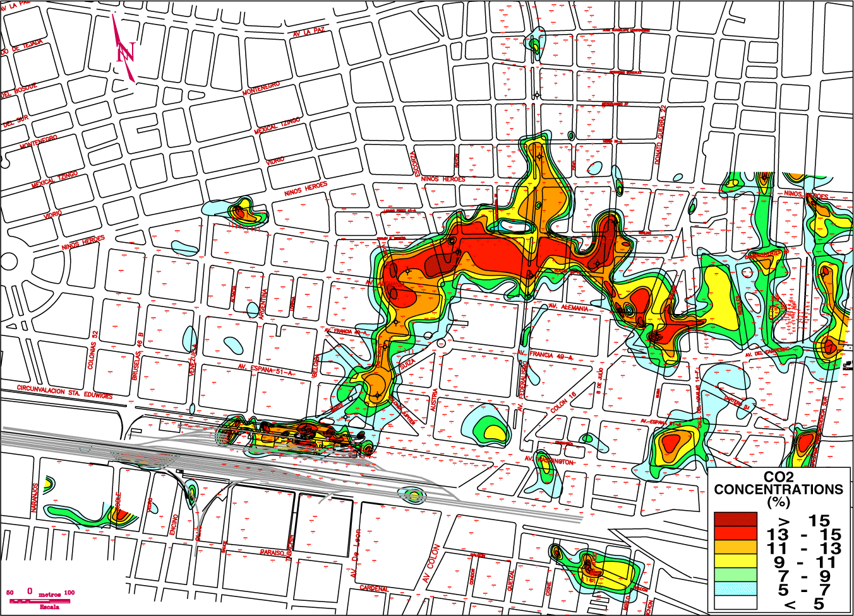
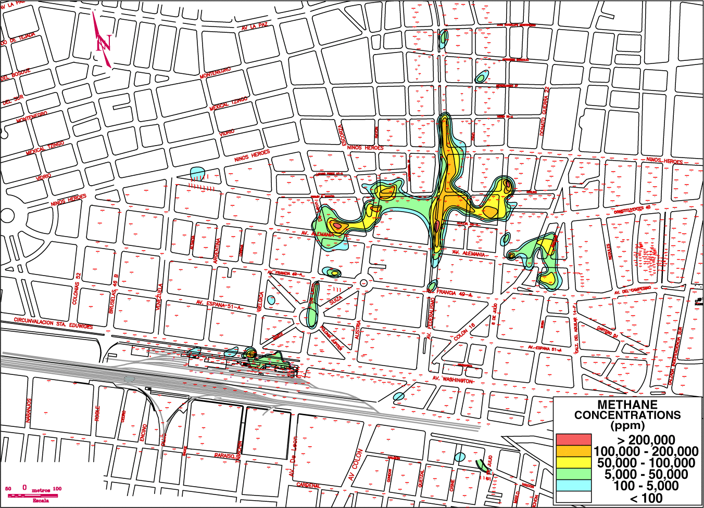
Guadalajara Mexico
Railroad Diesel
CO2 10%
methane 10%
Notes:
In 1993, one year after the explosions, public interest focused on diesel fuel that was still being recovered from monitor wells installed 20 years earlier when the subway was built. In this case CO2 provided the very best indicator for mapping the diesel migration pathway. In contrast, methane and C5+ are very small due to the lack of volatiles in diesel

Slide 12
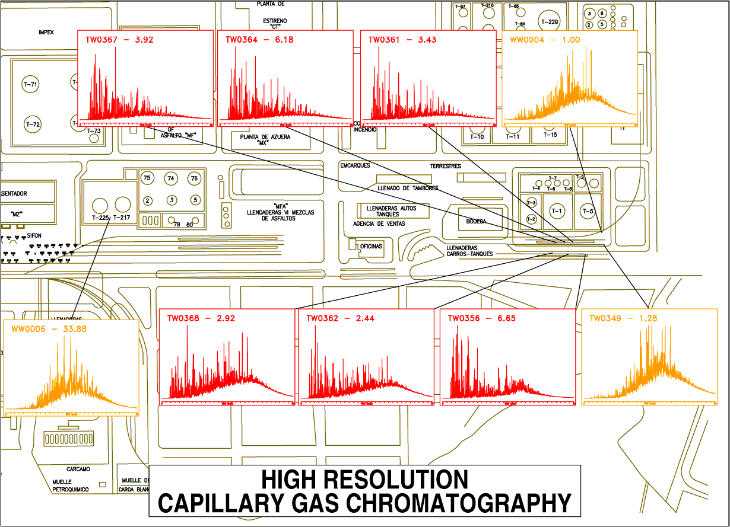
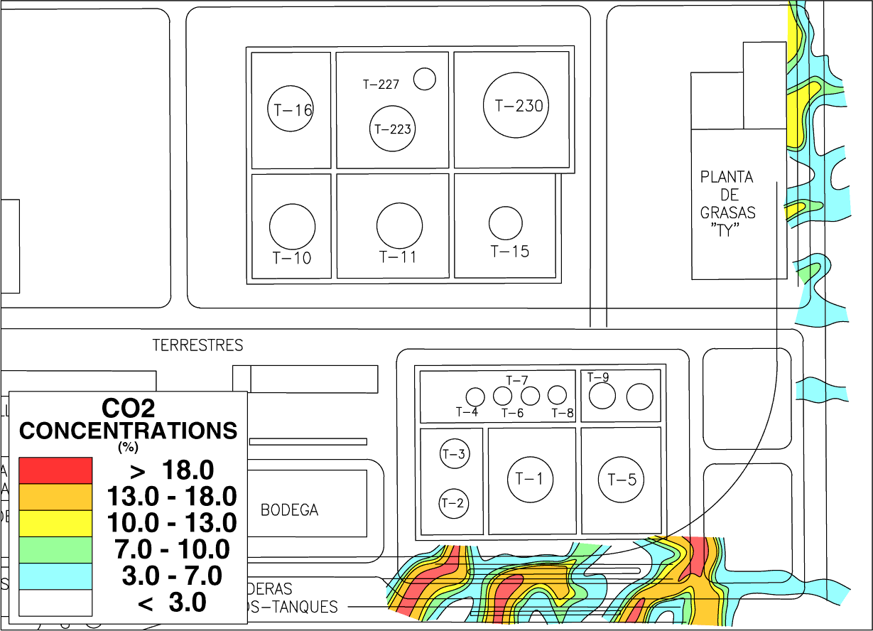
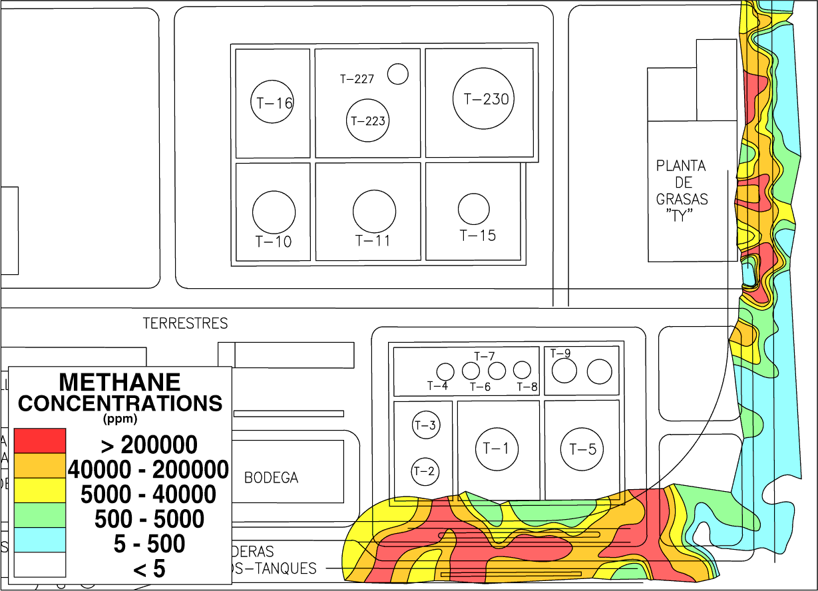
Gulf Coast Refinery
CO2 20%
methane 20%
Notes:
Long term biodegradation of gasoline/diesel produced 20% methane and 18% CO2 plume under railroad car loading terminal. HRCGC signatures at top right define the product source.

Slide 13
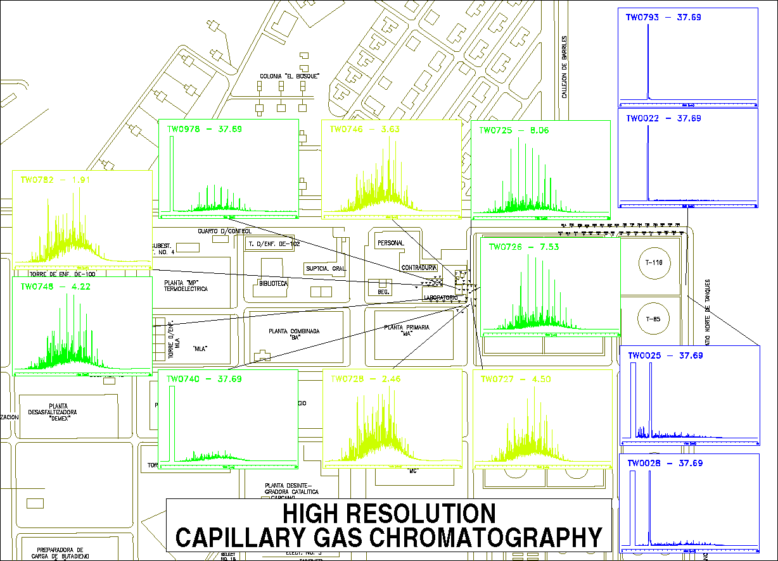
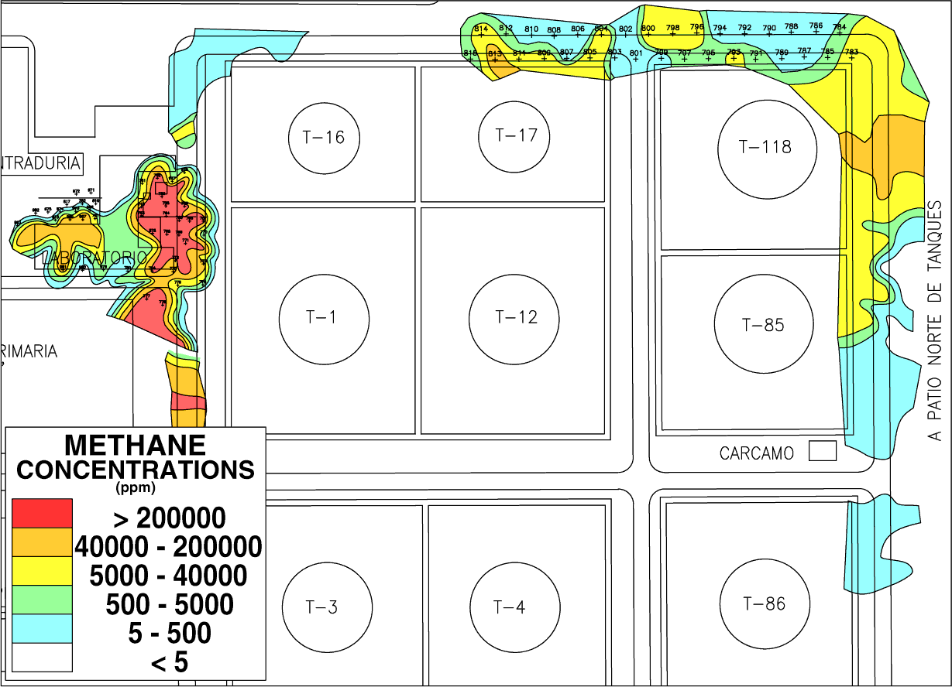
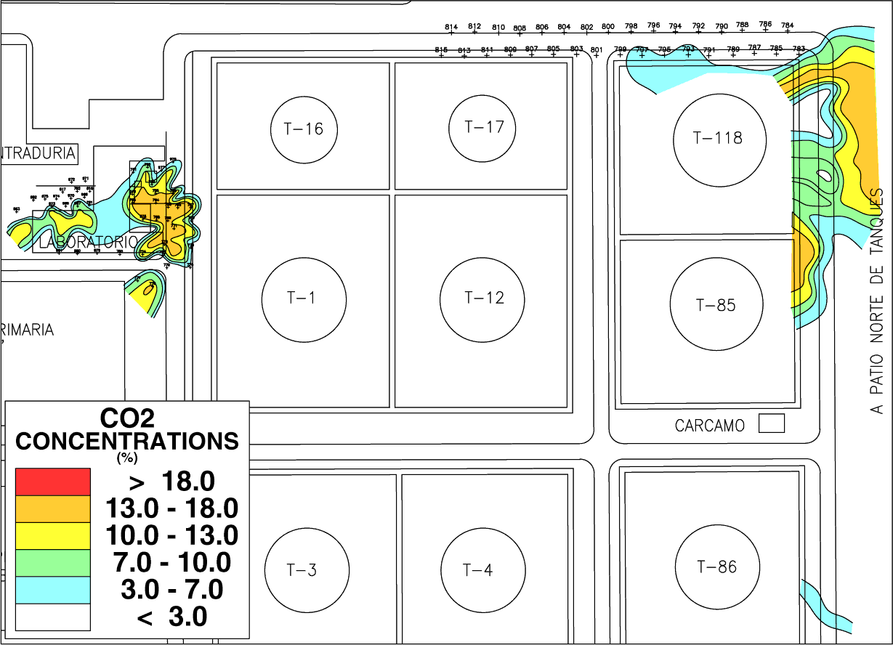
Gulf Coast Refinery
CO2 20%
methane 20%
Notes:
A second example includes preexisting leaks of kerosene and para-xylene. For kerosene 20% methane and 18% CO2 define the plume. HRCGC define the fresh and degraded product on the edges (light green). Para-Xylene is a poor food source and produces lower anaerobic methane and CO2 values as compared to Kerosene.

Slide 14
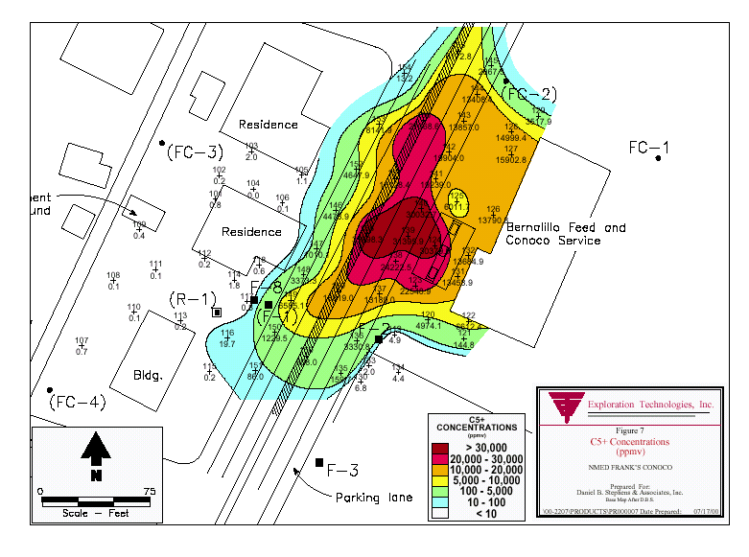
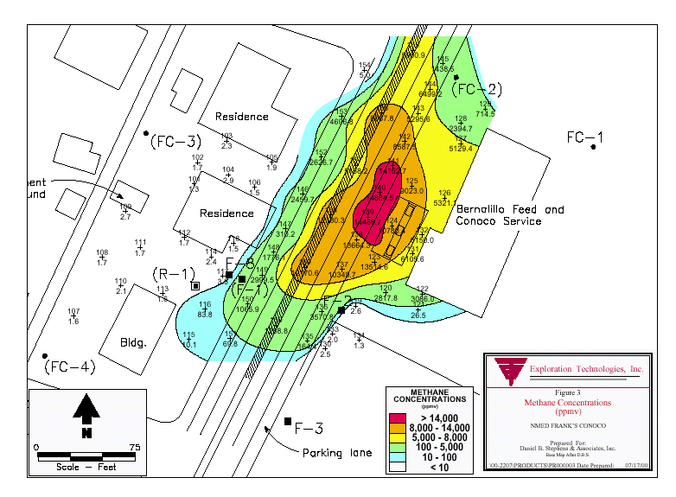
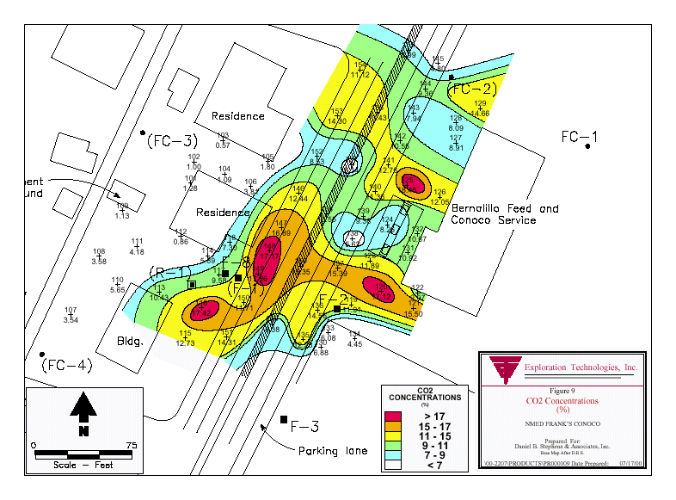
Gasoline Station
CO2 17%
methane 1.4%
Notes:
Service station showing a CO2 halo around C5+ and methane direct anomalies. Product is under the street.

Slide 15
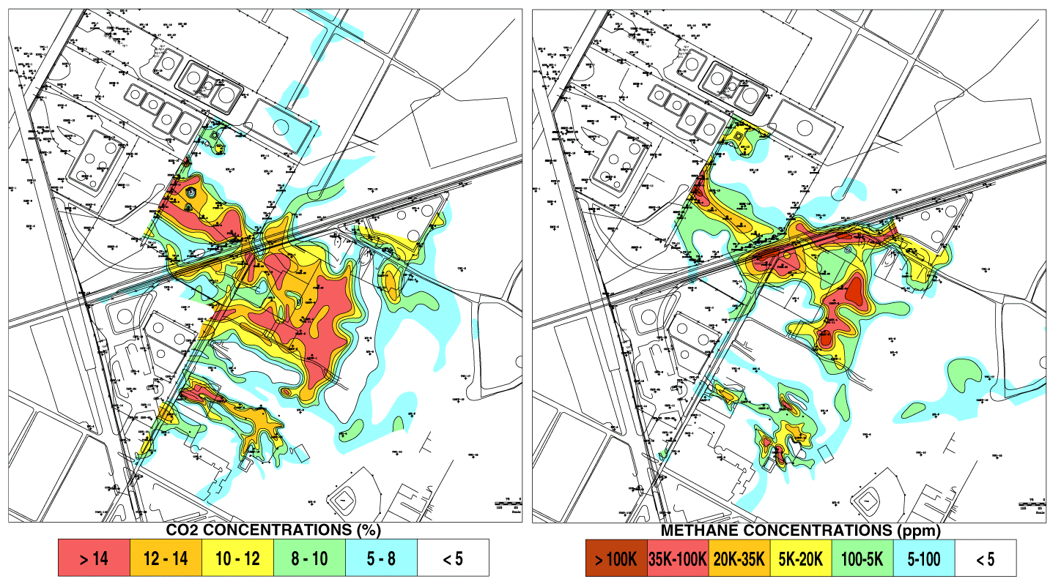
Austin, Texas Tanks Farms Groundwater Plume
Impacting Public Park
CO2 14%
Methane 10%
Notes:
Public park contaminated by gasoline storage terminals. 10% CH4 and 14% CO2 in the overlying soil gas. 3% ethane defined a natural gas pipeline leak. Variations in plumes are related to lithology that can be mapped using soil gases.

Slide 16
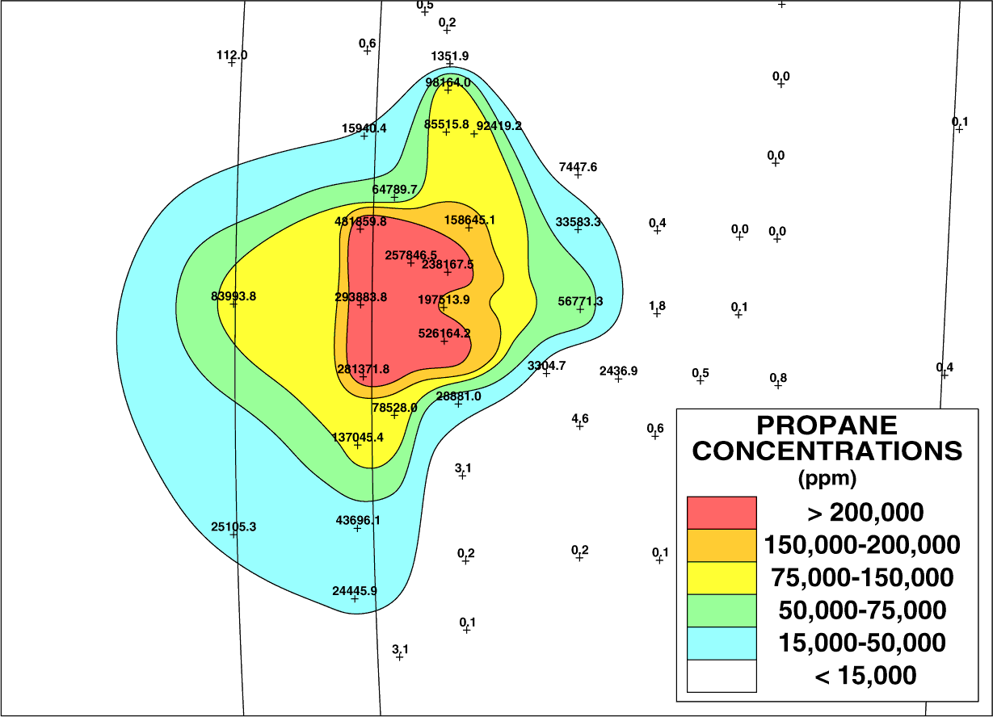
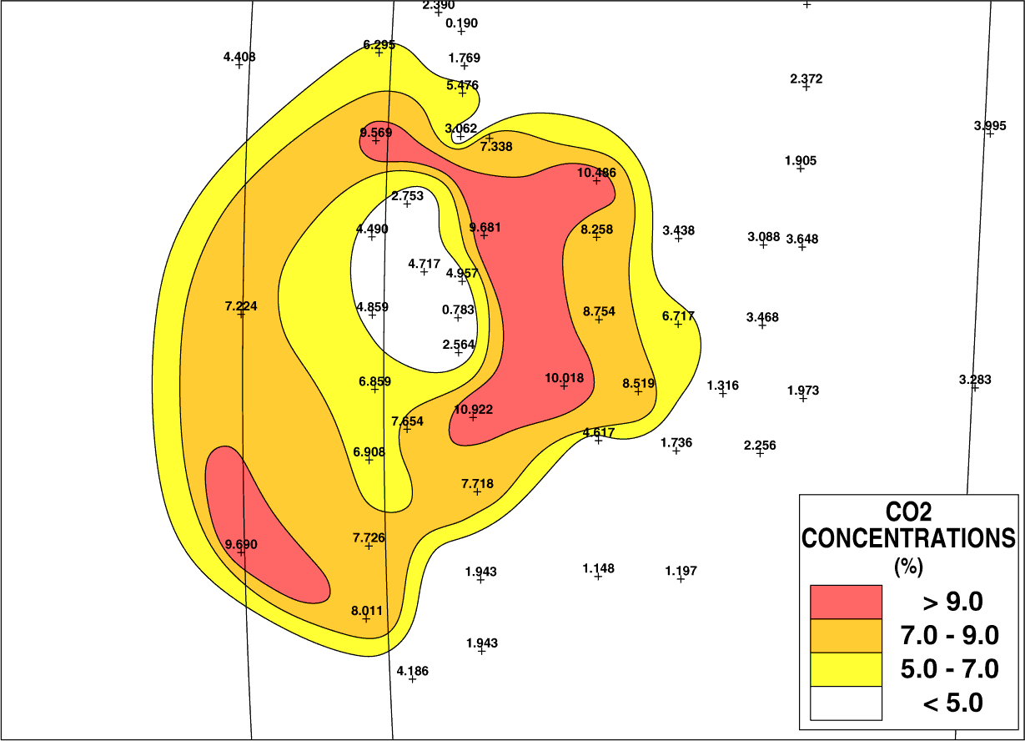
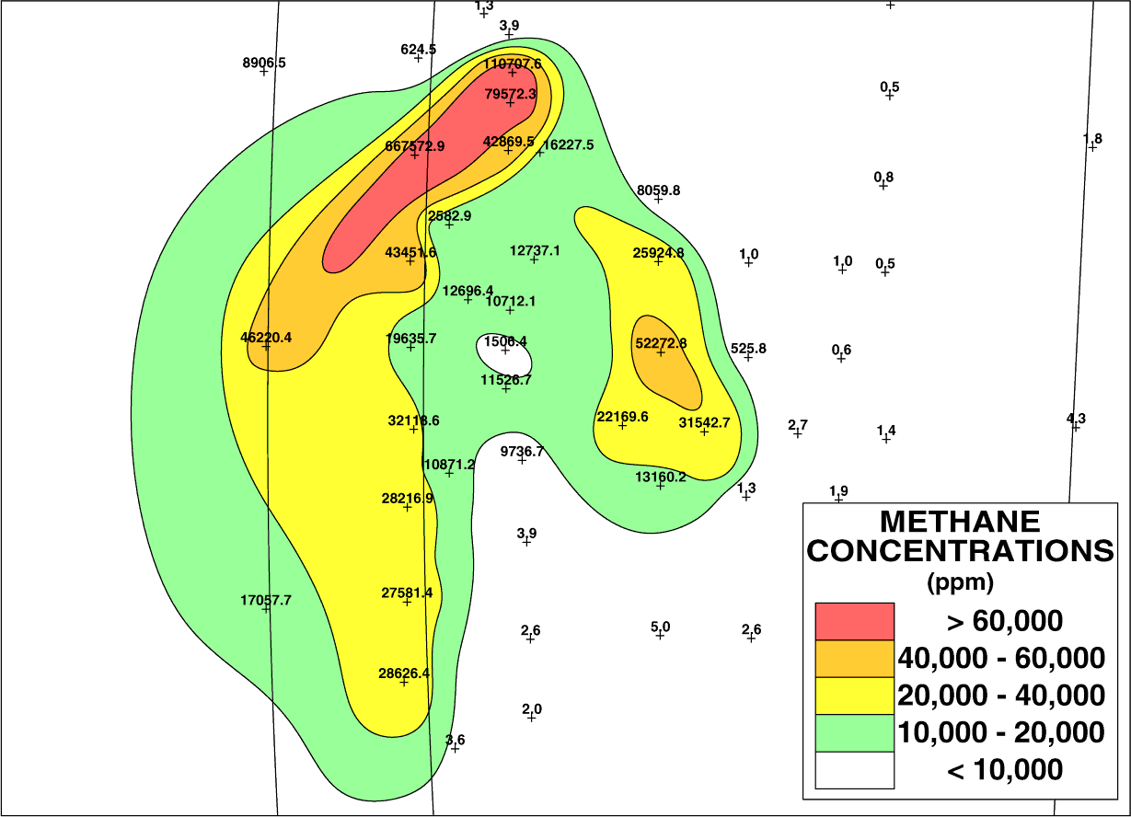
Guadalajara Mexico
Cookstove Propane
CO2 10%
methane 10%
Notes:
Pre-existing cookstove leak in a courtyard of a social services complex CH4 and CO2 form halos around the propane, where biological conditions are supportive.
CH4 in product < 0.4%. Biogenic CH4 ranges from 1 to 50%, indicating CH4 is generated directly from propane since surrounding soil are very low organic volcanic tuffs.
A much larger regional grid of soil gas shows that no biogenic methane exists in background areas adjacent to this propane leak

Slide 17
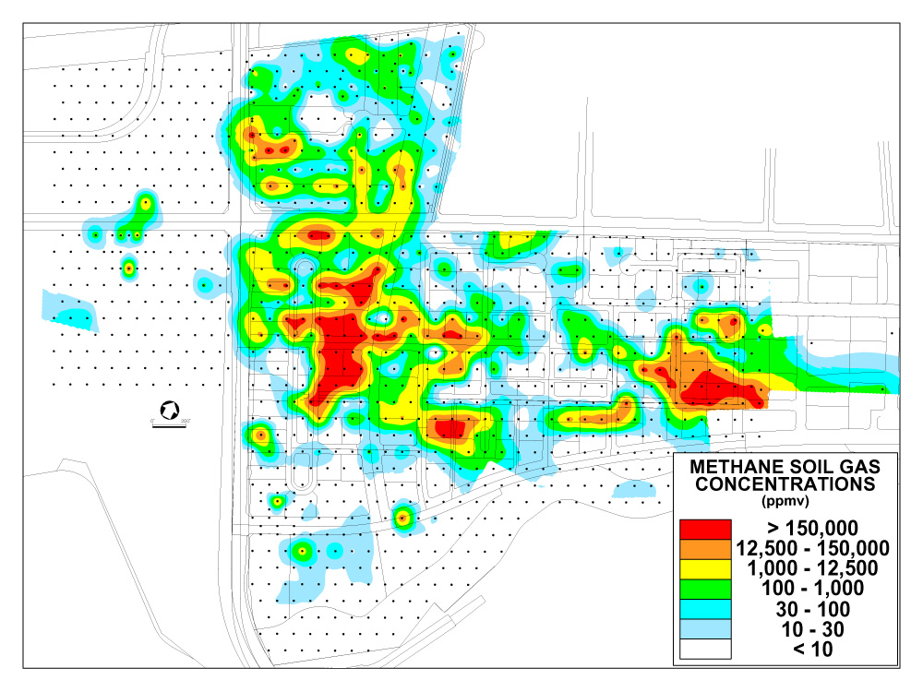
Notes:
This 800 site soil gas survey placed on 100 foot centers shows the distribution of methane seepage over dry land where bubbles cannot be used to locate the seepage. Note the unpredictable size and distribution of the seeps.
Previous analysis in scattered monitor wells conducted by environmental engineering firms reported only methane, so this survey was also designed to determine if there were any associated methane homologs (ethane, propane, or butanes) from a deep thermogenic source. Note that only a few of these very large magnitude methane seeps are laarger than 100 feet in width.

Slide 18
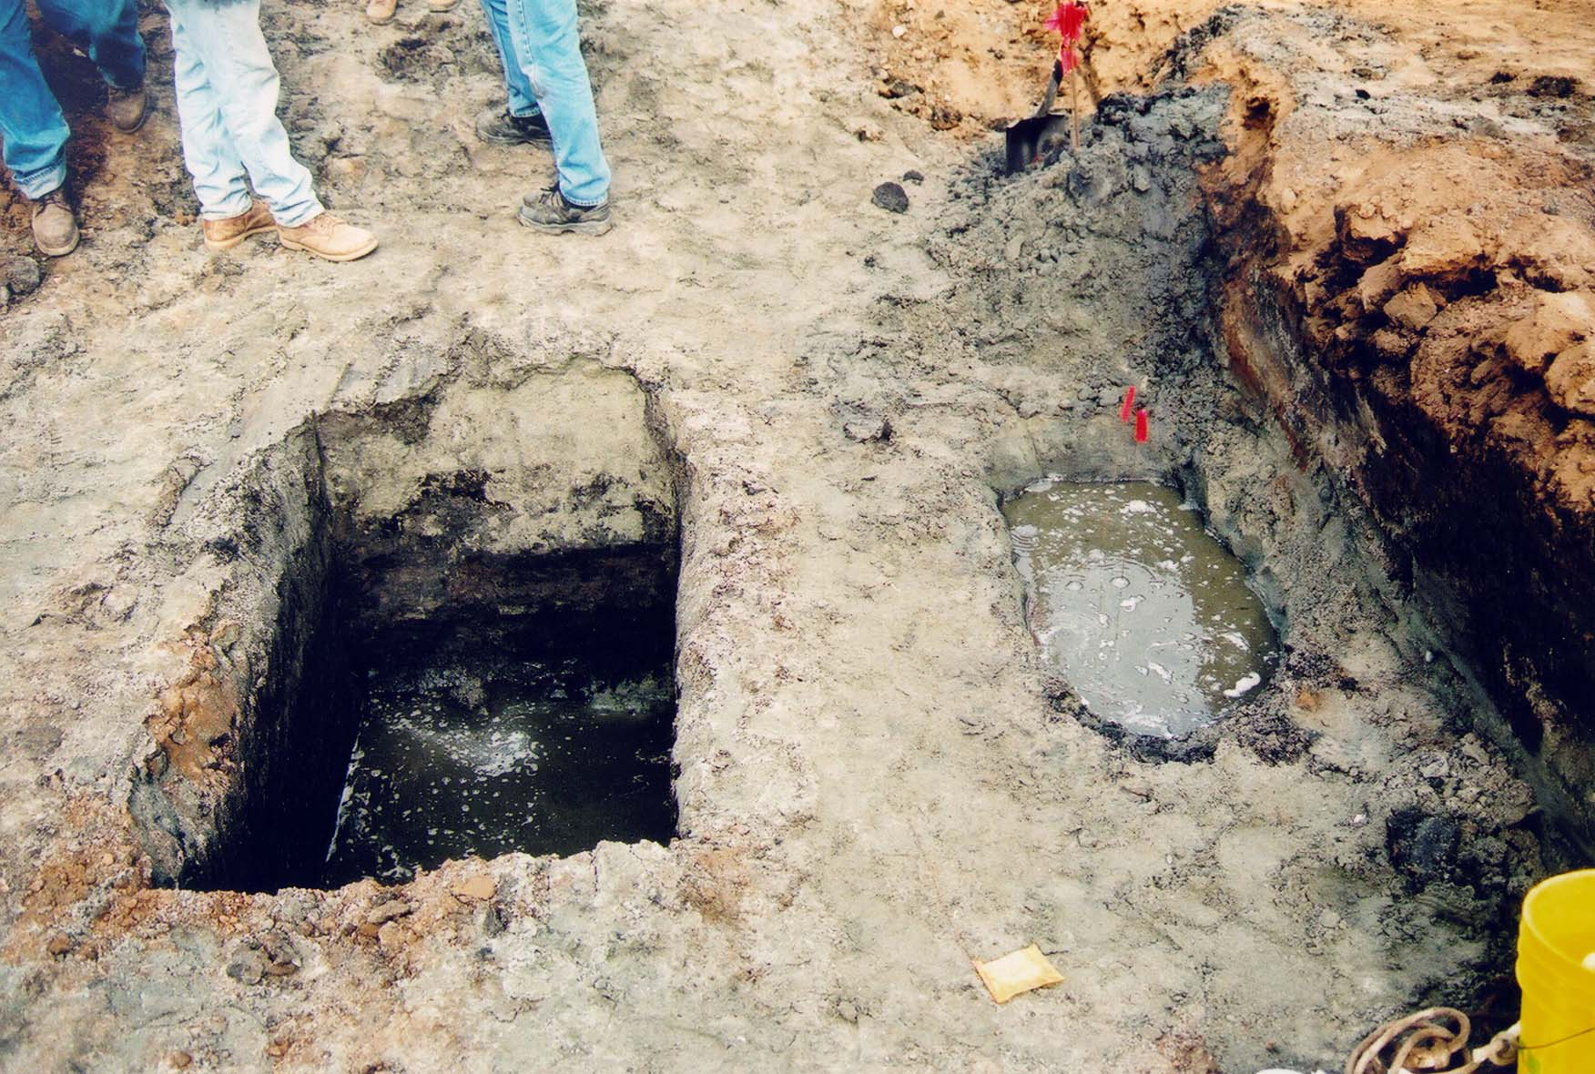
Notes:
Since bubbles cannot be seen on land, trenches were dug by backhoe and filled with water to confirm the methane flux indicated by the soil gas data.

Slide 19
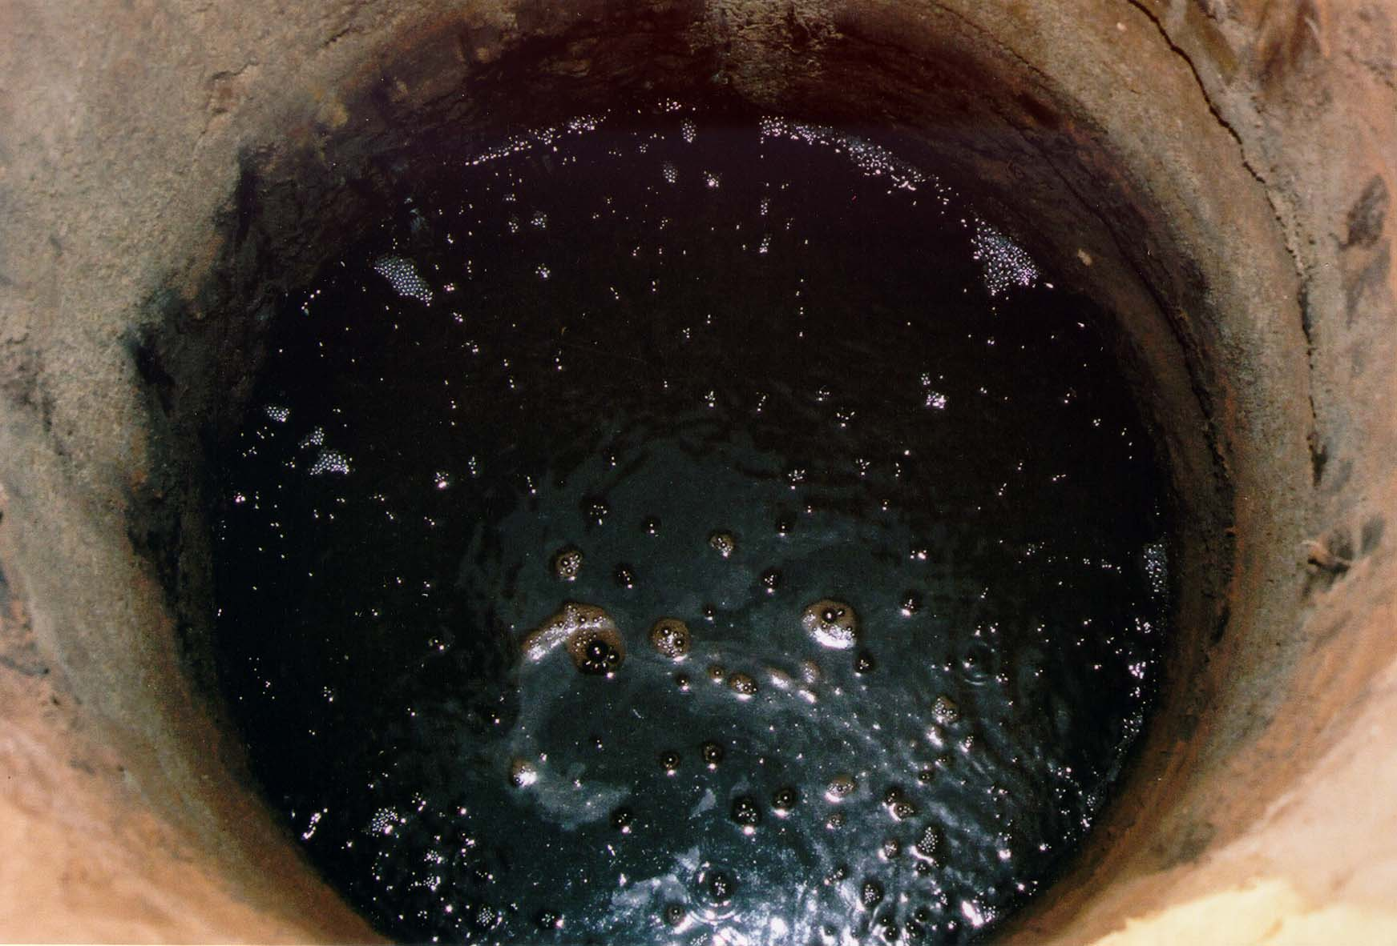
Notes:
24” diameter bucket auger holes followed for further gas flux observations

Slide 20
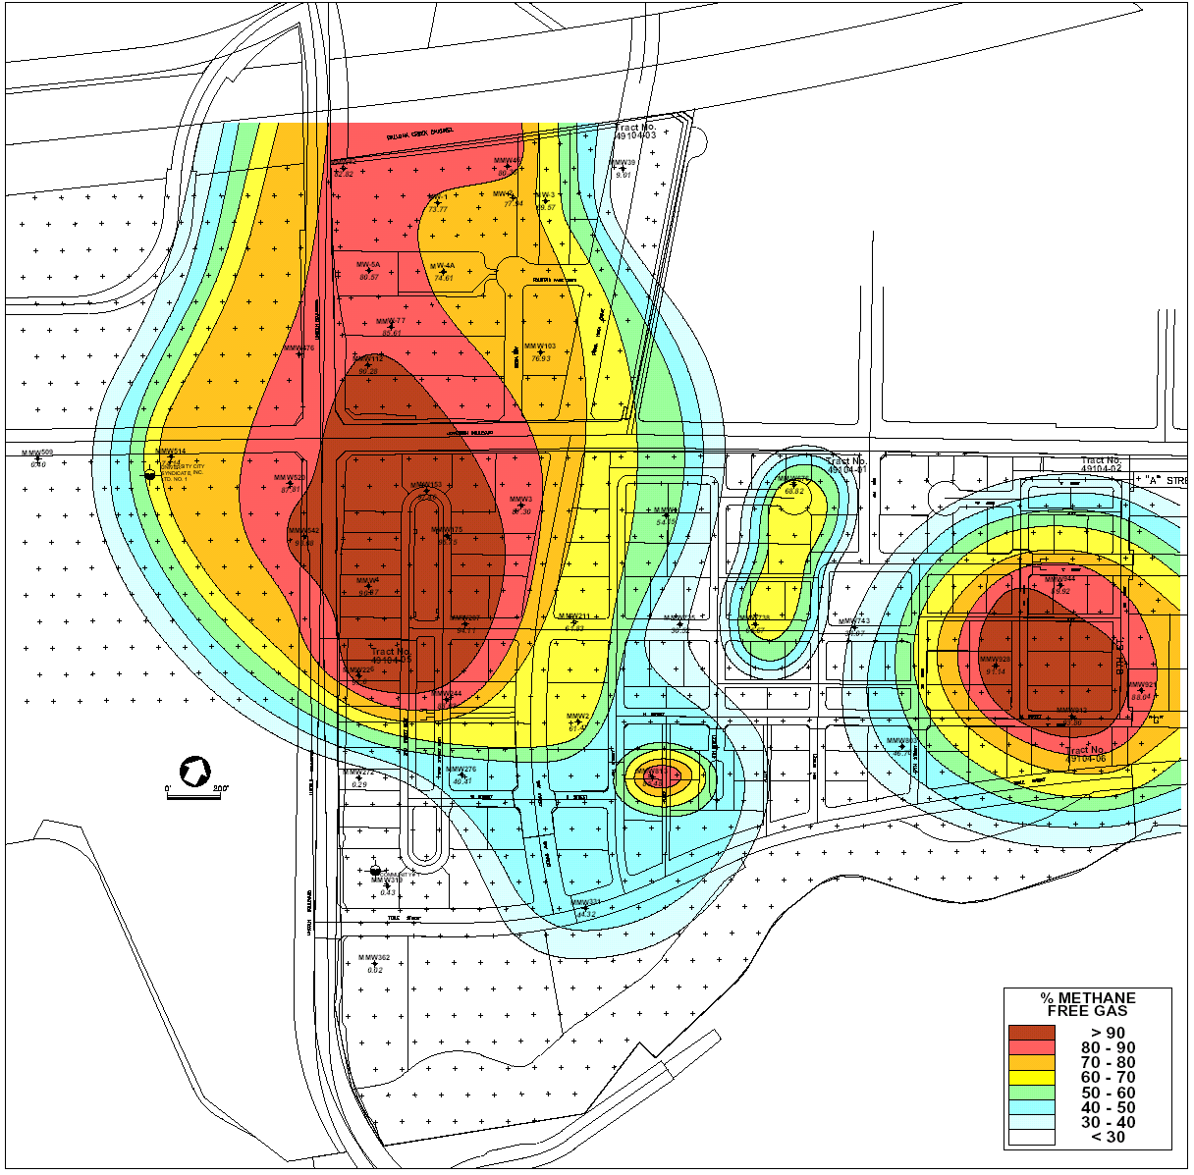
Notes:
Further confirmation by 41 monitor wells installed into the underlying 60 foot deep gravel aquifer. Red areas indicate saturation with 90% methane in the 60 foot deep aquifer.
A free gas sample was collected using a bubble pail and a dissolved gas sample was collected directly from the aquifer in a 125 ml bottle. Both samples were collected under water by water displacement, providing very high quality samples with no ambient air or other possible contaminants. Each well was pumped at a fairly low flow rate (approximately ½ gallon per minute) for an extended period of time, designed to provide numerous samples from successive well volumes. These free gas and dissolved gases samples were then averaged for each well and plotted on contour maps so that any methane gas anomalies in the 50-foot gravel aquifer could be mapped and studied. Average methane concentrations ranged from 0.005 mg/l to 48.3 mg/l (Plate 11). The highest concentration of methane (99.7%) was observed in MMW 226. This sample also contained the 48.3 mg/l dissolved gas concentration.

Slide 21
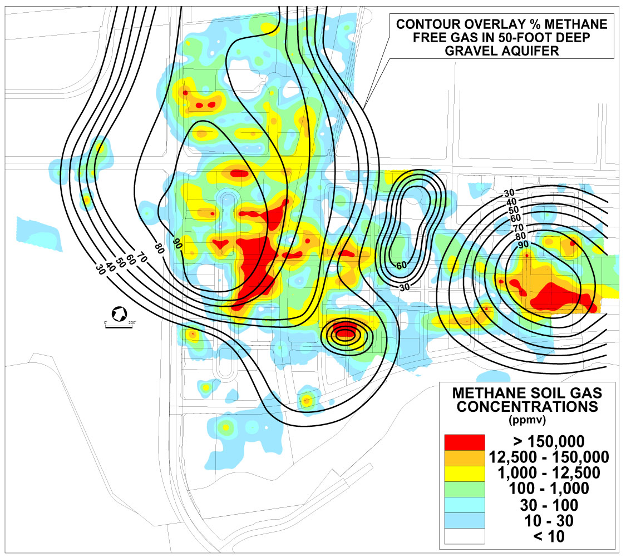
Notes:
Correlation between the surface soil gas and the gas in the 60 foot deep gravel aquifer. The aquifer anomaly suggests that the groundwater flow is north, towards the Ballona Channel, however, the soil gas seeps are vertical and not deflected by the groundwater flow.

Slide 22
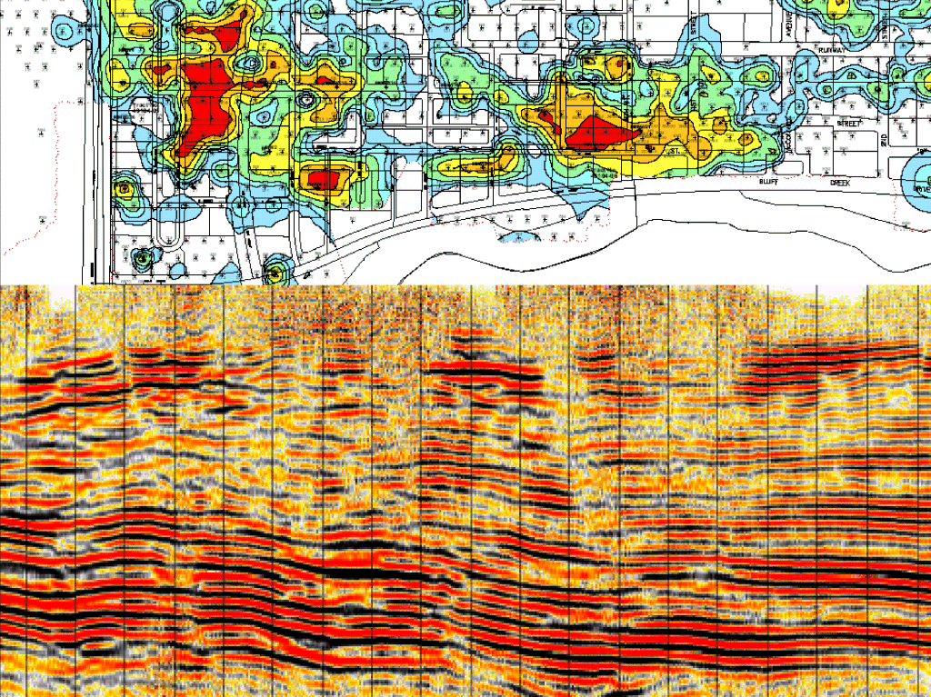
Notes:
An independent assessment using seismic data shows a gas charged wipeout zone directly under the gas seeps, indicating a deep gas source near 2000 feet. Gas is migrating vertically in faults and fractures, filling all available permeability channels before venting.

Slide 23
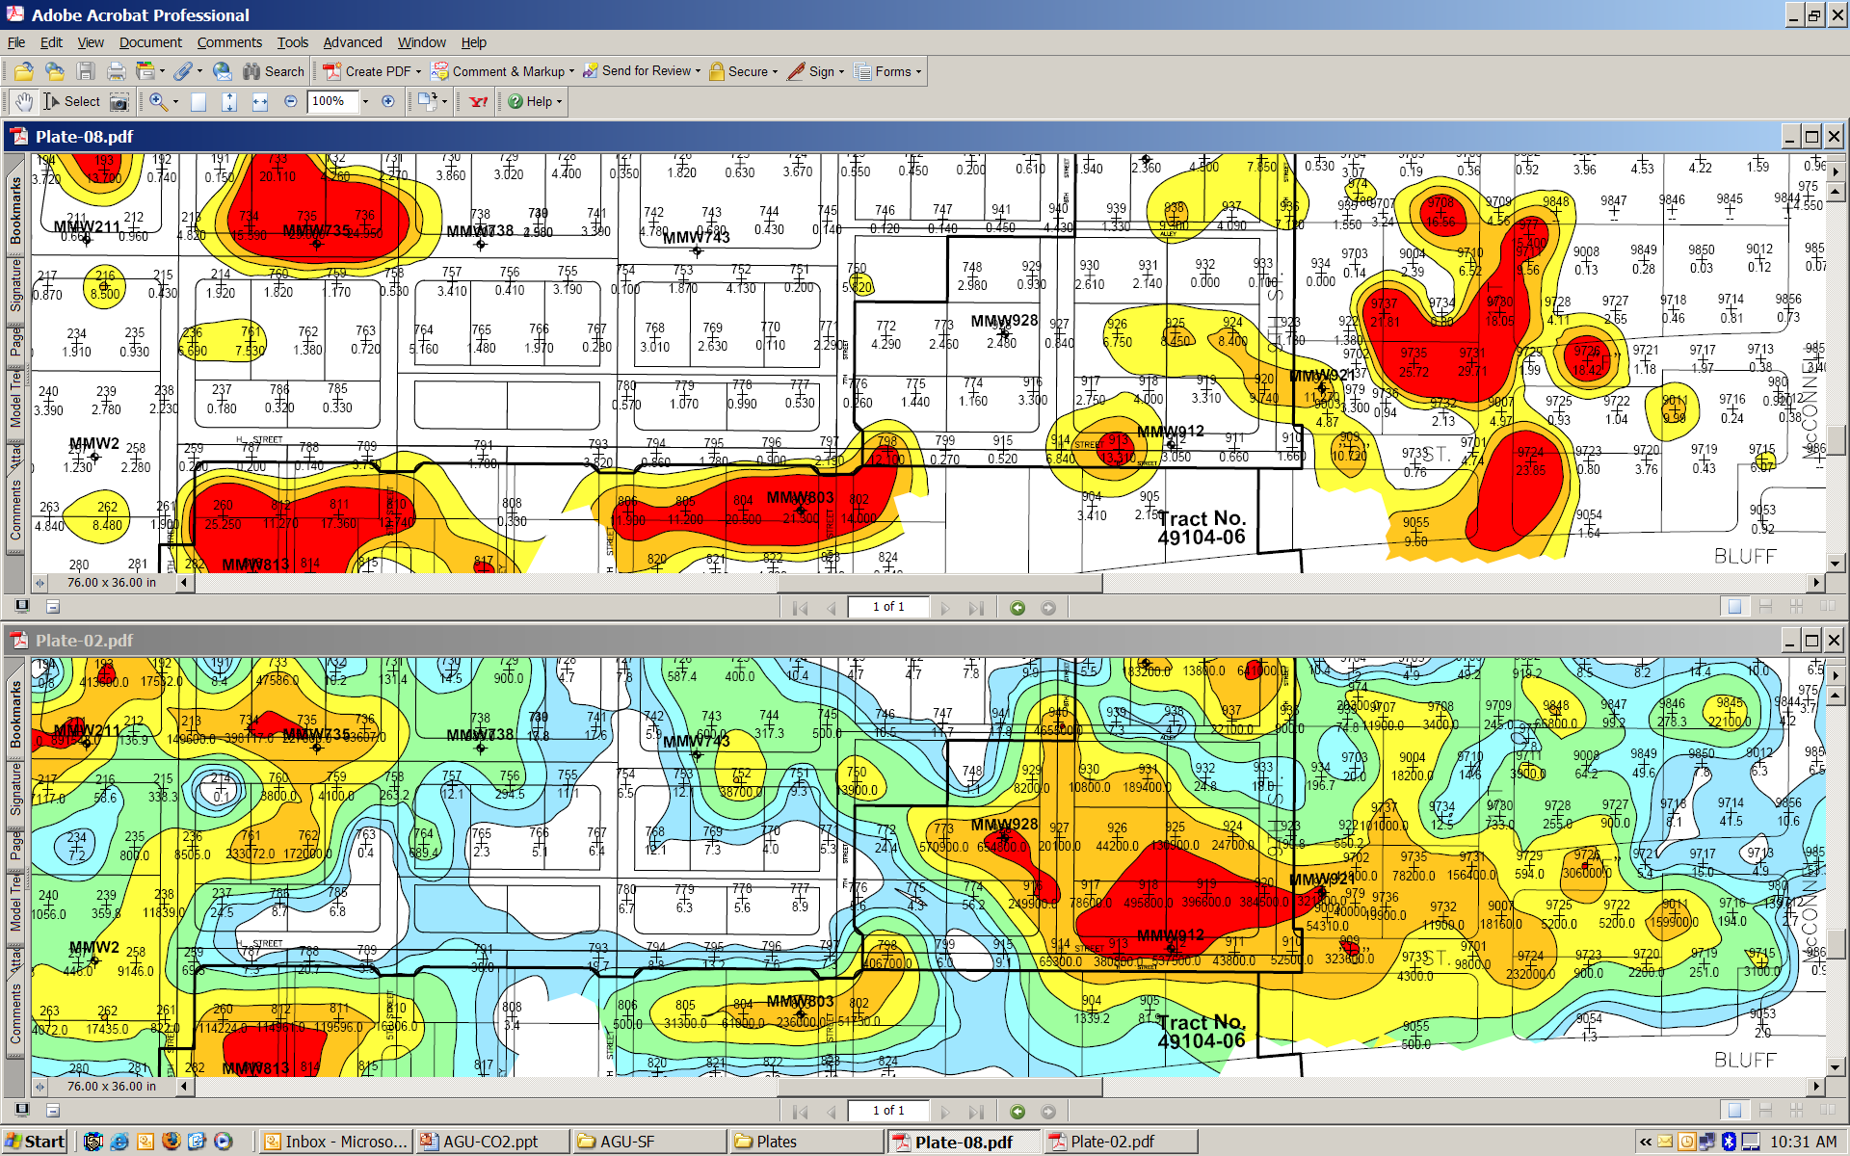
Playa Vista CA Natural Gas Seepage CO2 15 – 20%
Notes:
CO2 of 15 – 20%, on the upper map occurs in direct association with the very large methane, shown on the bottom map. In this case, methane is the deep source gas and CO2 is a biological degradation product. Coincident apical CO2 anomalies occur over the three large methane anomalies on the left side. A much more complex relationship is indicated on the right side methane anomaly. Even 100 foot spaced samples are inadequate for understanding this anomaly.

Slide 24
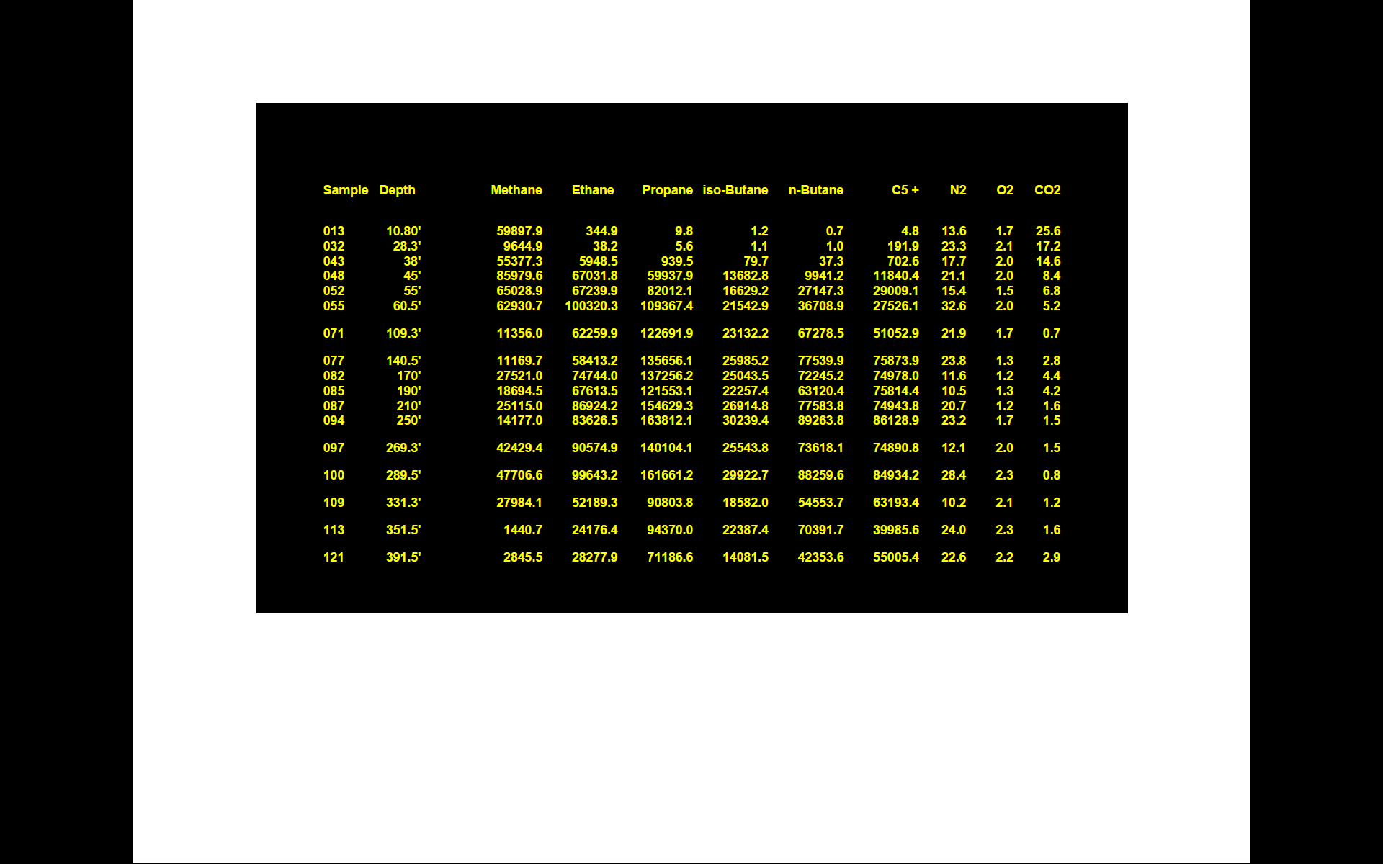
Notes:
As our final example let’s return to the GOM and look at a 400 foot deep boring placed in 120 feet of water. There is oil in all the cores, note the similarities of the ethane/propane ratios to our first oil stained cores collected in 1983. The CO2 concentration of 25.6% shown on the rightmost column 10 feet below the seafloor was surprising, but explains the oxidation of the hydrocarbons.

Slide 25
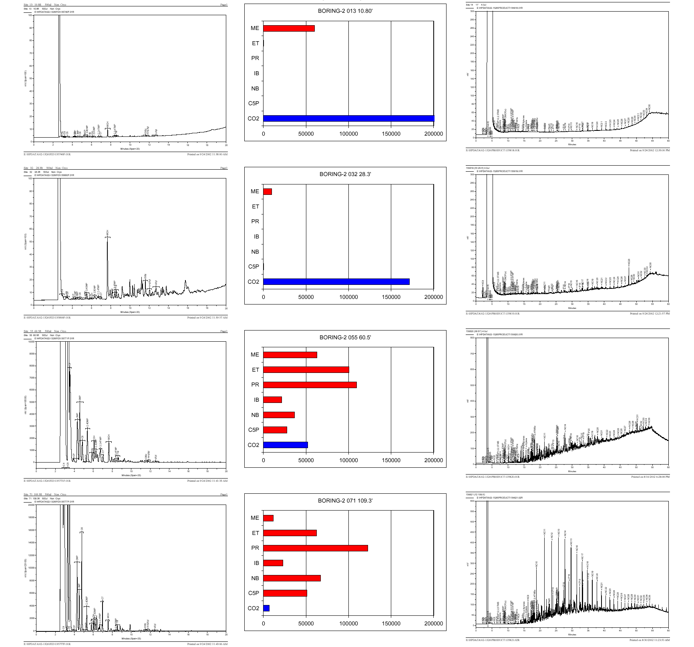
Notes:
This slide shows a graphic representation of the data from the previous table. Note CO2 concentrations shown by blue bars where CO2 decreases from 25% to less than 10 % in the upper 109 feet, causing severe degradation of the C15+ and C5+ gasoline range HC’s. The shallowest sample at 10 feet has one very significant component, methylcyclohexane (MCH), which is contained in essentially all oil and condensate reservoirs. MCH is the least degradable gasoline range component. Let us look more closely at the individual C15+ chromatograms

Slide 26
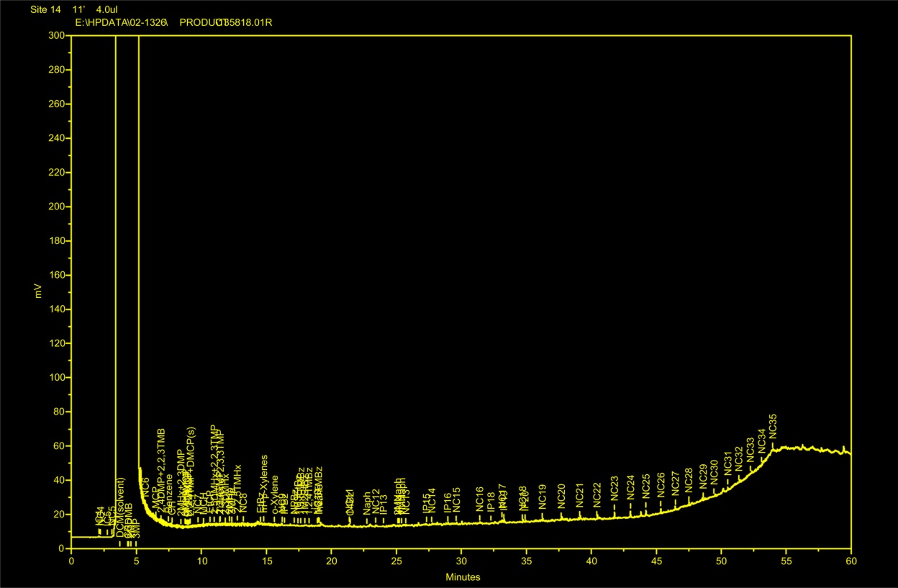
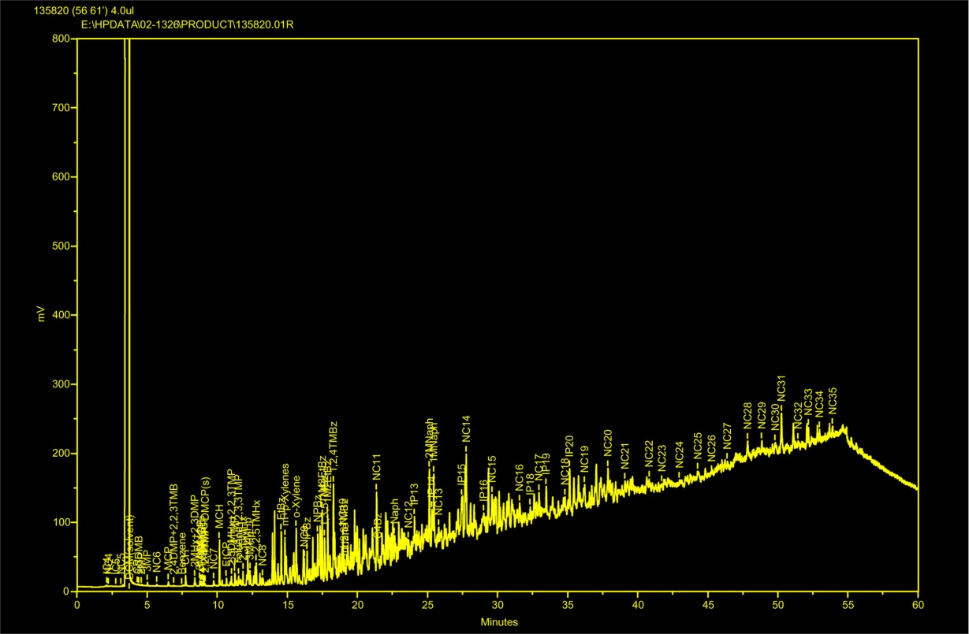
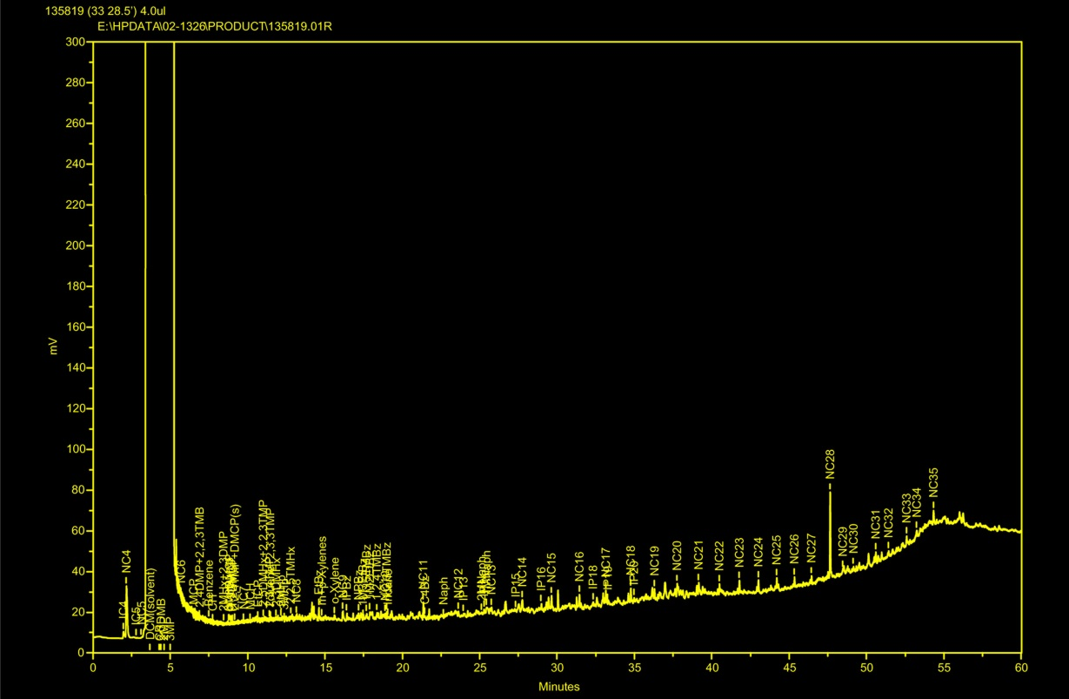
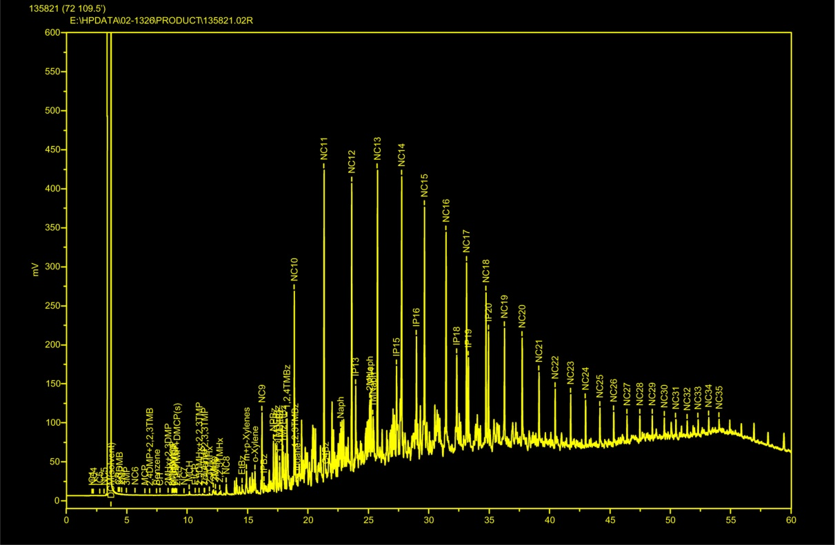
Notes:
This slide shows that the C15+ methylene chloride extracts are even more degradable than the C5+.

Slide 27
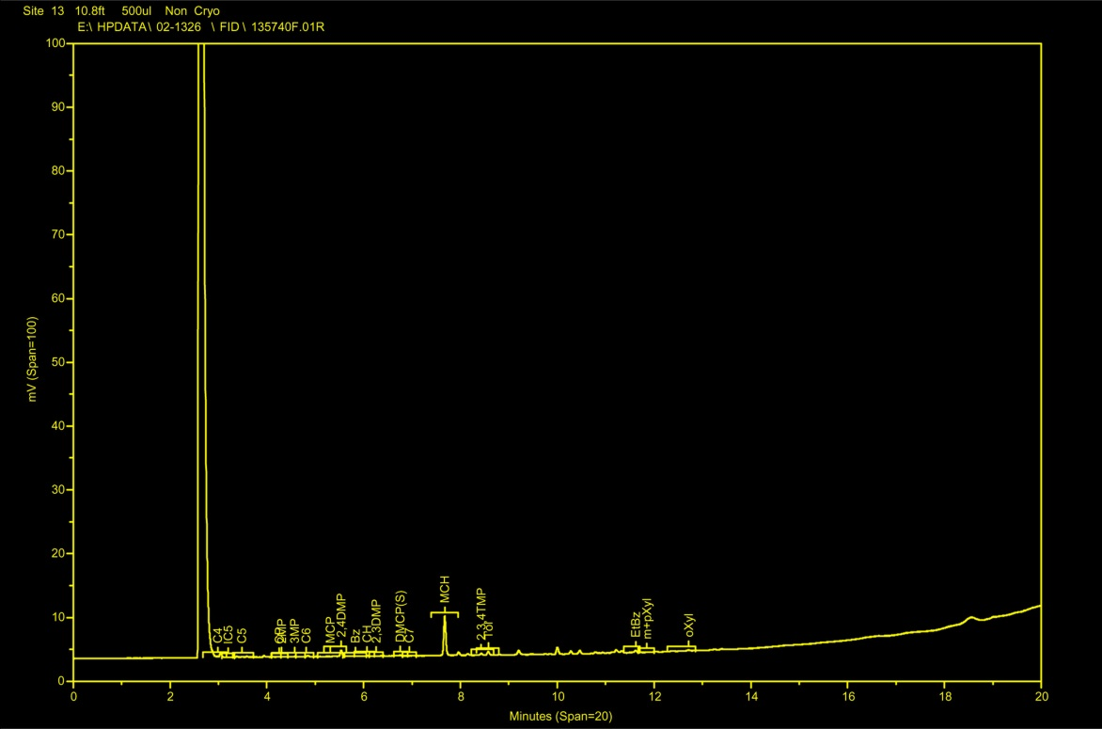



Notes:
The two shallowest C5+ headspace samples 10 and 28 feet below the sea bottom are dominated by MCH, while the next deepest at 38 and 45 feet still have all of the gasoline range components. However, note that the normal C6 and C7 alkanes have been preferentially degraded with respect to the 2MP and 3MP and MCH.
This analysis data shows that the more volatile light and gasoline range C5+ hydrocarbons can be determined by direct injection on the appropriate GC system without any extraction or disaggregation of the sediment. Sensitivity with these headspace methods provides accurate analysis down to sub-ppm concentrations. Since the magnitudes of the hydrocarbon components bears no relationship to the economics of the subsurface sources, there is no point in trying to enhance the magnitudes by a more aggressive methodology

Slide 28
Notes:
The magnitude variations of the propane through pentanes (note the largest values at 250 and 289 feet) suggest that we are sampling a variety of laterally distributed sands and not in a vertical seepage pathway. Both methane and ethane have been lost relate to their heavier analogs in all the deeper horizons. Only oxidation near the surface changes this relationship, leaving ethane and iso-butane as dominate, just as in our first core sampled in 1983.

Slide 29
CONCLUSIONS
Empirical results have demonstrated that biological gases CH₄ and CO₂ have significant value in mapping both exploration and environmental petroleum seepage
Significance of Biological CH₄ and CO₂ Gases
largest magnitude gases associated with seepage
CH₄ generated anaerobically
in direct contact with seepage forms direct anomalies
CO₂ generated aerobically/anaerobically
near seepage edges forms direct and halo anomalies

Slide 30
Implications for Environmental Assessments
Spatial variability followed by petroleum seepage is better defined by using CH4/ CO₂ soil gases in conjunction with specific petroleum seepage components, this is typically not done for environmental contamination because of government EPA rules which focus on BTEX
Implications for CO₂Sequestration
Sequestration is generally focused on injecting CO₂ into old oil fields which generally contain spills/leaks
Large CO₂ Concentrations are generated by all subsurface organic contamination sources

Slide 31

I WOULD LIKE TO PAY THANKS TODAY TO
Dr. Theodore “Ted” Weismann
Ted organized and
inaugurated the first
ACS GEOC Sessions
held in 1981-82-83-84
before there was a
GEOC Division

