Slide 1
Natural Hydrocarbon Seeps:
Toward Understanding a Complex Natural System
Spatial and Temporal Variability of Hydrocarbon Seepage,
Offshore Gulf of Mexico,
Regional and Local Variations as Defined by Natural Seeps
E
Paper Presented by:
Victor T. Jones, III, PhD., Patrick Myers and Bill O’Neal Exploration Technologies, Inc
Houston, Texas 77083
American Chemical Society
April 13, 2012
New Orleans, La.
Annual Meeting
Notes:
This morning we are going to briefly review Gulf Oil’s extensive “sniffer” dissolved gas data set collected in the GOM.
Because of the well known association of hydrocarbon seeps and petro­leum accumulations, the Gulf Oil Corporation in 1967 initiated a program to develop technology for locating hydrocarbon seeps in the marine environment. The first effort was directed toward the measurement of potential seep related hydrocarbons only near the sea surface.
In 1971, the system was advanced to monitor hydrocarbons to depths of 100 feet. Later, in 1974, a much more sophisticated system was developed and instal­led on Gulf’s seismic vessel, the R/V Hollis Hedberg. This system made possible the capability to simultaneously measure seep related hydrocarbons at three different intervals in the water column and provided digital recording of the data.
The R/V Hollis Hedberg system had the capability to employ three separate water inlets which continuously supplied sample streams from the near surface, intermediate depths to 450 feet and a deep towed sample inlet which operated at 600 feet while the ship was underway at normal seismic survey speeds. Each sample stream was analyzed for seven hydrocarbon gases once every three minutes with a sensitivity which was hydrocarbon dependent, but, for example, was about 50 picoliters of propane at STP per liter of seawater.

Slide 2
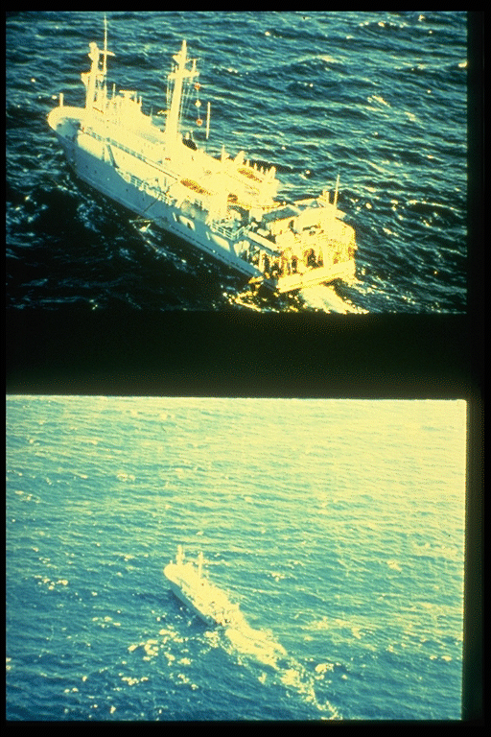
R/V HEDBERG 1974 to 1983
First privately owned and largest
marine geophysical research
vessel in the world, complete
on-board seismic data processing
capability, dissolved gas sampling
at three depths, surface, 450 and 600 foot
24 hour/day operation for 60 days
R/V GULFREX 1967 to 1974
First fully-integrated multi-sensor
Marine geophysical/geochemical
Gathering and processing vessel
First commercial satellite navigation
System
100 feet depth capability by 1971
Notes:
Gulf Oil’s sniffer program began in 1967 with the Gulfrex. After 7 successful years, the Hedberg was commissioned in 1974 and operated another 9 years until 1983.
Hollis Hedberg and Gulfrex seismic-sniffer ships operated by Gulf Oil
The R/V HOLLIS HEDBERG system employed three separate water inlets which continually supplied sample streams from the near surface, intermediate depths to 450 feet and a deep towed sample inlet which operated at 565 ft. depth while the ship was underway at normal seismic survey speeds. Each sample stream was analyzed for seven (7) hydrocarbon gases once every three minutes with a sensitivity which depends upon the hydrocarbon, but for example, is about 50 picoliters of propane at STP per liter of seawater. The purpose for using three inlets is to differentiate between surface contamination and microseeps.

Slide 3
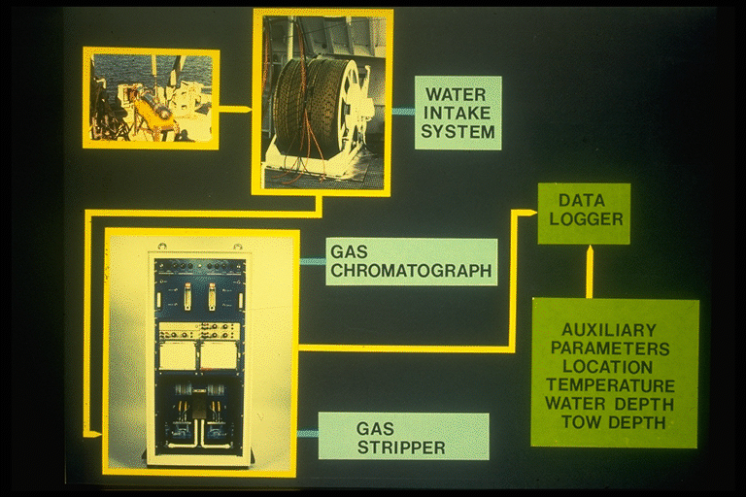
Notes:
The system consists of a towed fish which pumped water up a fared cable that carried water up and electrical signals down to the fish. The dissolved gas was stripped from the water and analyzed in gas chromatographs designed and built by Gulf.
The system consist of a towed pump/sensor system, connected by a fared umbilical to an onboard laboratory. The hydrodynamic towfish contains a submersible pump, conductivity, salinity, temperature and depth sensor (CSTD), and echo sounder transducer. Under normal operational conditions, the fish is maintained within the range of 4 to 8 meters above the seabed. The towfish is connected to the winch and handling gear by an umbilical which consists of a central nylon hose surrounded by power and signal conductors encased in a polyurethane sheath with a woven stainless braid. The umbilical usually is fully fared with low-drag hydrodynamic farings, which results in the towfish following close to the stern of the vessel, achieving the maximum depth for a minimum amount of deployed umbilical. Water is pumped through the umbilical to the laboratory module at approximately 6 to 9 liters per minute. The water sample is usually split into two independent streams to supply a dual gas extractor system
Duplication of the gas extractor system allows additional independent analytical equipment to be used, and provides redundancy when required due to failure, or for routine maintenance. Each extractor consists of a glass stripper chamber into which the seawater is sprayed through a fine jet nozzle. The water level in the stripper is maintained at a constant height by a pressure regulated flow control system.

Slide 4
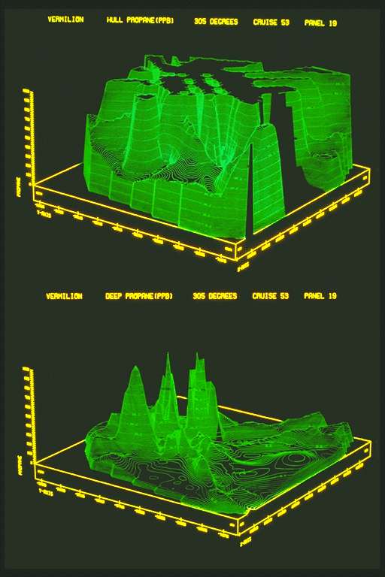
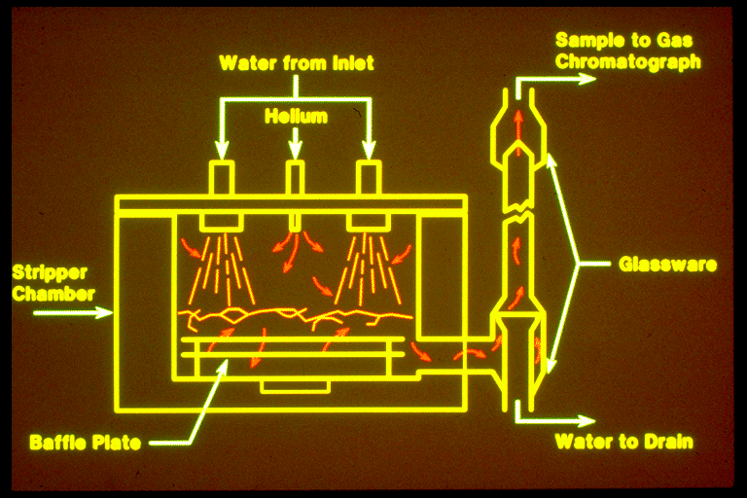
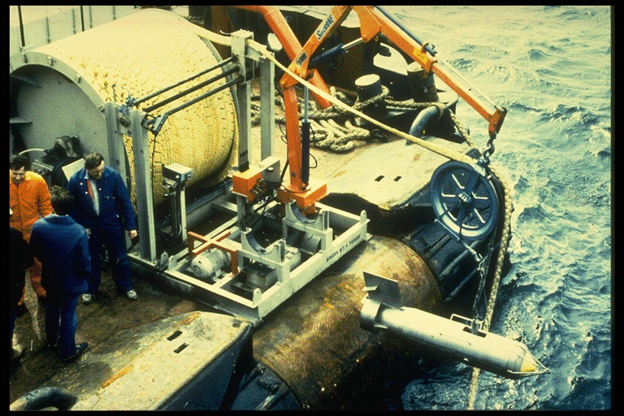
Notes:
Pictures of the Gulf Oil Gas stripper on top right, a 1200 foot depth capability ETI fish and winch. On the left are hull (surface) and deep propane contour maps showing how deep tow gas seeps can be distinguished from surface contamination
In the stripper, helium carrier gas is equilibrated with a water phase in such a way as to allow the stripper to be operated under pressure preventing any contamination from the onboard laboratory getting into the extracted gas stream. This dissolved gas analysis system has been demonstrated to be very reliable for conducting sniffer surveys because the stripper has no moving parts or pumps which can fail.
A computer system is used to continually monitor the conductivity, salinity and depth of the fish sensor signals, with navigation data in UTM coordinates acquired every 3 minutes at the start of the GC analysis. The time lapse between collection of the water sample and the navigation time must be accounted for by the computer system.
Surface contamination can be a major interference to shallow sampling, but is not a factor in producing the seeps observed by the deep inlet

Slide 5
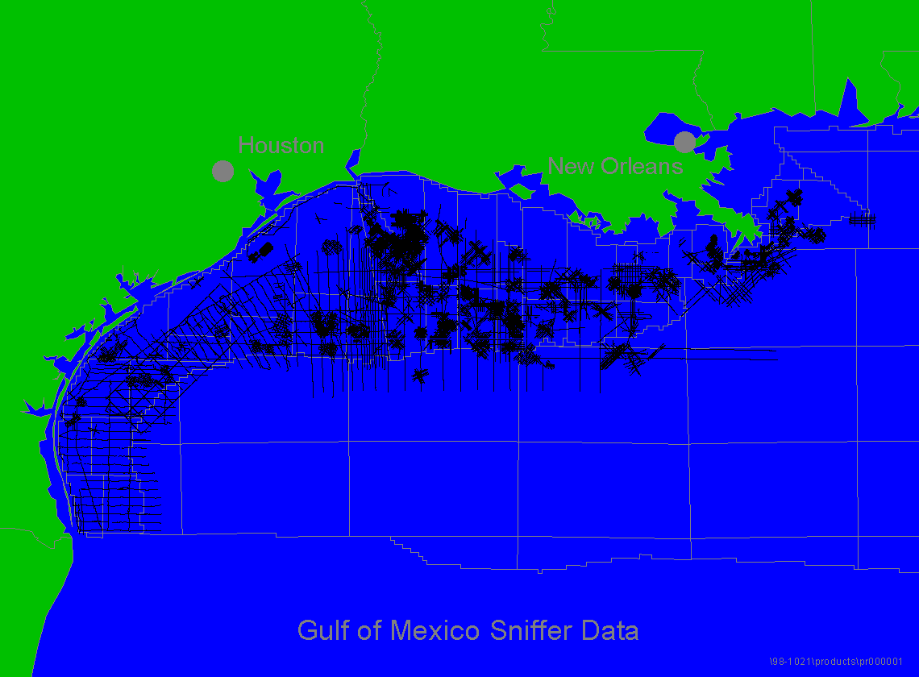
Notes:
The offshore Texas and Louisana Gulf Oil Gulf of Mexico sniffer data set consisting of over 190,000 gas measurements is shown in this slide
The data was given by Chevron to Texas Univ, then to Texas A&M, then to HARC (Houston Area Research Council) and purchased from HARC by ETI in December 2000.

Slide 6
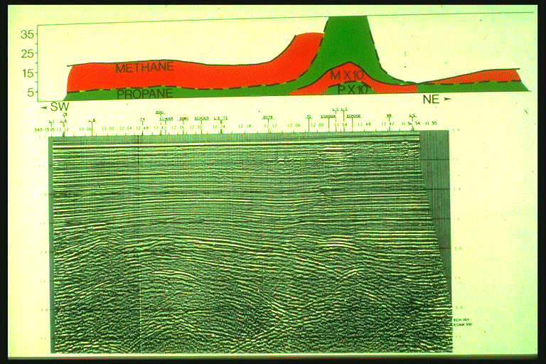
Notes:
The objective was to generate deep localized anomalies that could be related directly to specific seismic features. The bright spot under this anomaly is likely a shallow drilling hazard. Note the bright spots marching down the SW dipping fault

Slide 7
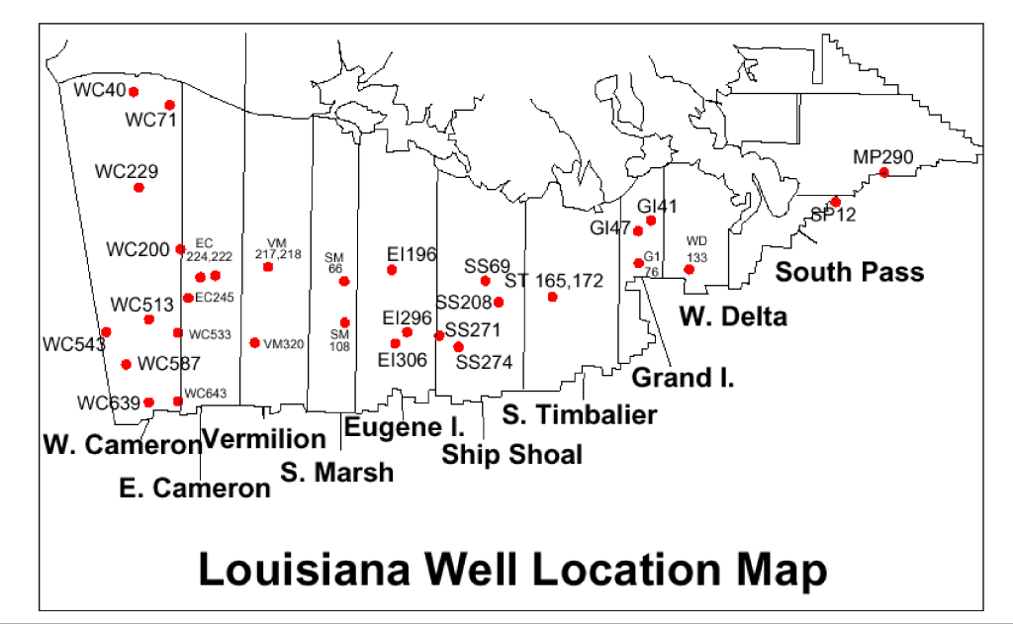
Notes:
For calibration we used the data from 70 wells from 32 oil and gas fields that was published in an open file USGS report by Duddley Rice in 1978.
A Duddly Rice (1978) USGS well data base was used to calibrate the compositional marine cross-plot scheme in the Gulf of Mexico. For each of the 32 fields shown on this figure, Rice published the composition of the production gases. These fields include gas fields, oil fields, and combined oil and gas to condensate fields. The 70 wells from these 32 fields were separated according to the four catagories listed below. As an alternative to simple compositional ratios, compositional cross plots were found to be useful for classifying marine hydrocarbon seeps and predicting their source reservoir fluid composition (Williams et al., 1981). All hydrocarbon reservoirs, even those which produce primarily liquids, contain low molecular weight hydrocarbon gases. The composition of these gases generally shifts toward higher molecular weight components (more propane and butane relative to methane) in oil reservoirs (Jones and Drozd, 1983)
Biogenically generated dry gas wells with no associated liquid hydrocarbons and an isotope ratio lower than -60. Thermally generated dry gas wells with no associated liquid hydrocarbons and an isotope ratio higher than -60. Gas associated with condensate with API gravity greater than 41. Gas associated with oil with API gravity less than 41.

Slide 8
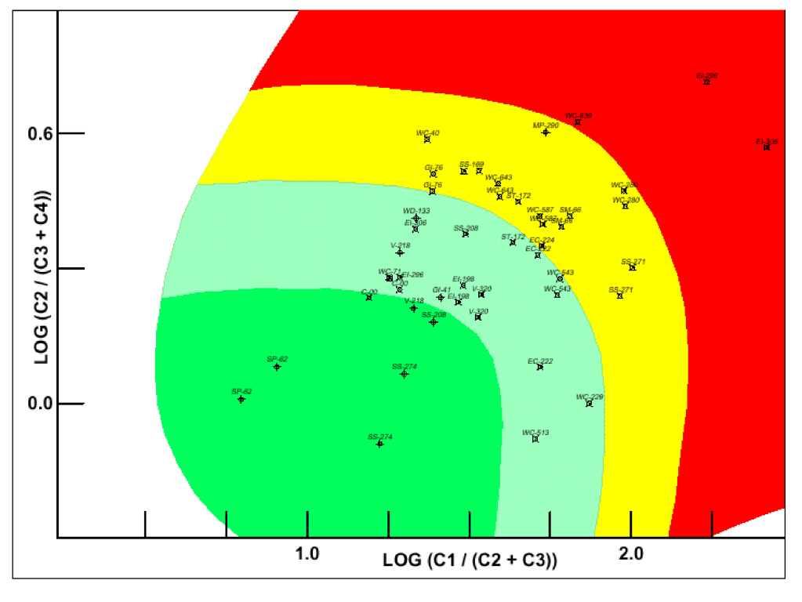
Notes:
The log of the ratio of ethane to propane plus butane is plotted against the log of the ratio of methane to ethane plus propane, providing a cross plot of the reservoir compositions of the gases from these 32 oil and gas fields.
A distinctive compositional clustering of hydrocarbon anomalies signifies different types of production: gases associated with oil plot near the origin and become drier as the points move up and to the right. This cross-plot scheme was used to successfully classify producing wells and their associated seepage anomalies as to their type; oil condensate, dry gas, or biogenic gas based upon the composition of the log of C₁/ (C₂ + C₃) and the log of C₂/ (C₃ + iC₄ + nC₄) ratios. Identification of biogenic gas from producing wells in the northern Gulf of Mexico on this plot was based on both their molecular and isotopic ratio data. An arbitrary boundary between oil-condensate and gas-condensate (based upon the above wells) has tentatively been drawn midway between the other boundaries, as shown by the interpretive line within the condensate window.

Slide 9
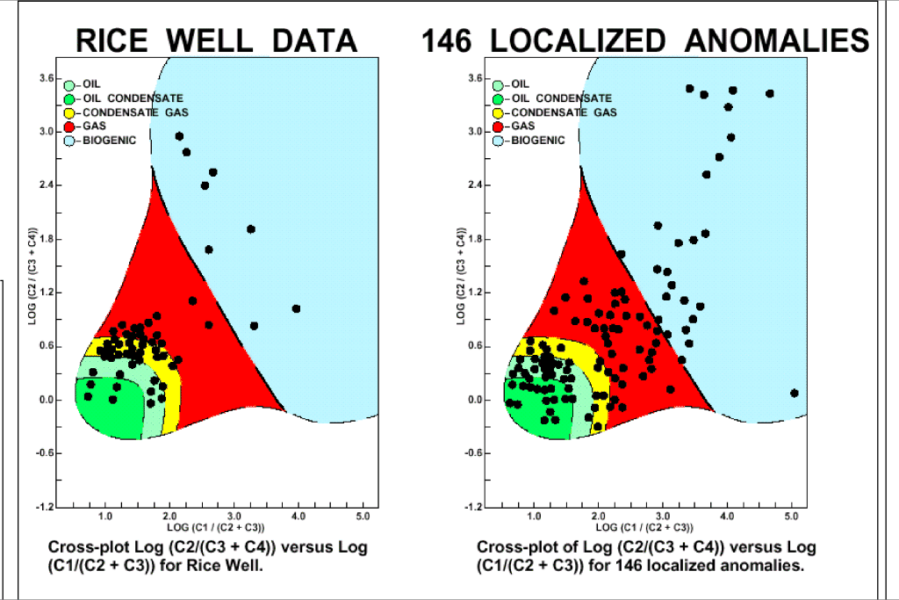
Notes:
Duddly Rice USGS well data on the left compared to 146 localized sniffer anomalies on right suggest this is a good approach.
In order to use these cross plots to tie surface data to well data, one must also assume that migration and mixing do not significantly alter the ratios of light hydrocarbons during migration to the surface. Numerous studies have shown that this approach yields good correlations in the Gulf of Mexico, where mixing of reservoir types is expected to have considerable impact (Williams et a1., 1981). Alternatively, if mixing or migration alters ratios, one must gather sufficient data over known fields to create new classification boundaries
Surface contamination can be a major interference to shallow sampling, but is not a factor in producing the seeps observed by the deep inlet

Slide 10
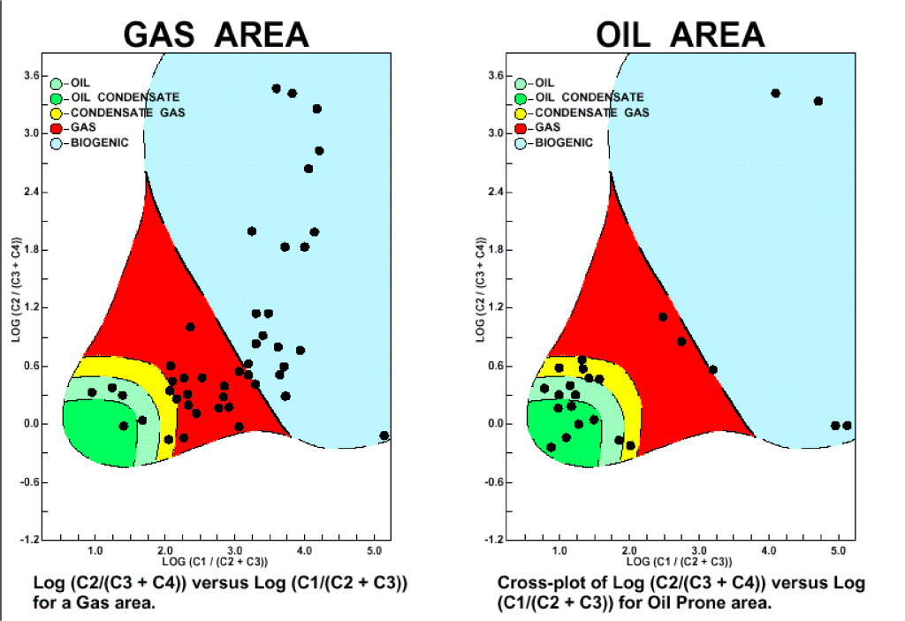
Notes:
Deep tow compositions from surveys conducted in gas versus oil prone areas. Although both surveys contain oil and gas seeps, they are biased towards the expected source, and some gas seeps will always occur in all areas.
The boundaries suggested for each reservoir type work on world­wide productive areas as regards major changes in composition, oil vs. gas. However, they are only approximate for any given area and must be modified according to compositions of known production for each basin in which this technique is applied.
Differences in regional sniffer anomalies are preserved, suggesting the dominant regional composition of near­ surface gas is that which occurs in the reservoir, or the source rock which charged the reservoir. There may, however, be samples that contain signi­ficantly different compositions, predominantly due to mixing of deep gases, or microbiological oxidation. In these cases, contributions of deep dry gases along basement-related faults, or alternatively, areas of shallow biologic activity, could explain excess methane

Slide 11
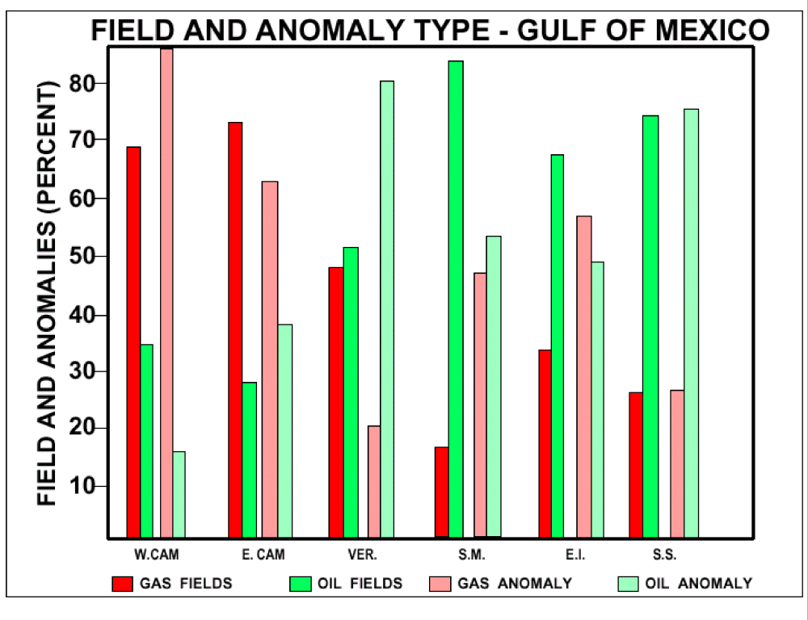
Notes:
A comparison of the oil and gas field reserves to number of gas versus oil seeps also appear to work in most areas. Note West Cameron, East Cameron, Ship Shoal and Eugene Island. Differences, in Vermillion and South marsh Island suggest exploration should be focused on Vermillion, where oil seeps dominate.

Slide 12
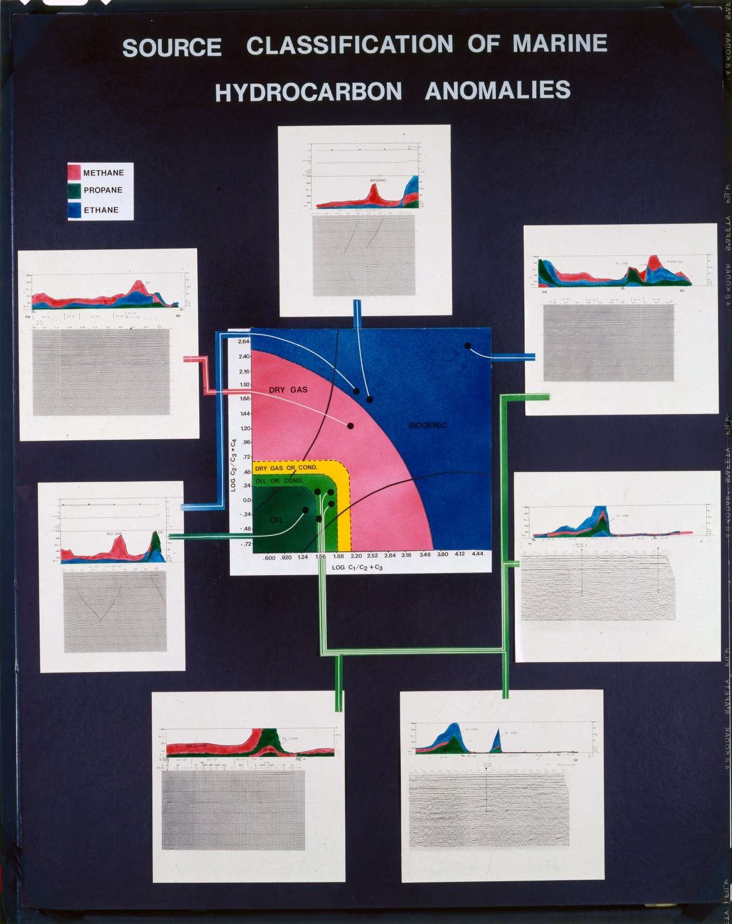
SOURCE
CLASSIFICATION
OF
MARINE
HYDROCARBON
ANOMALIES
Notes:
Each deep tow sniffer anomaly is plotted along the seismic line along with it’s composition for evaluation. Let us look at the density of anomalies near a few discoveries

Slide 13
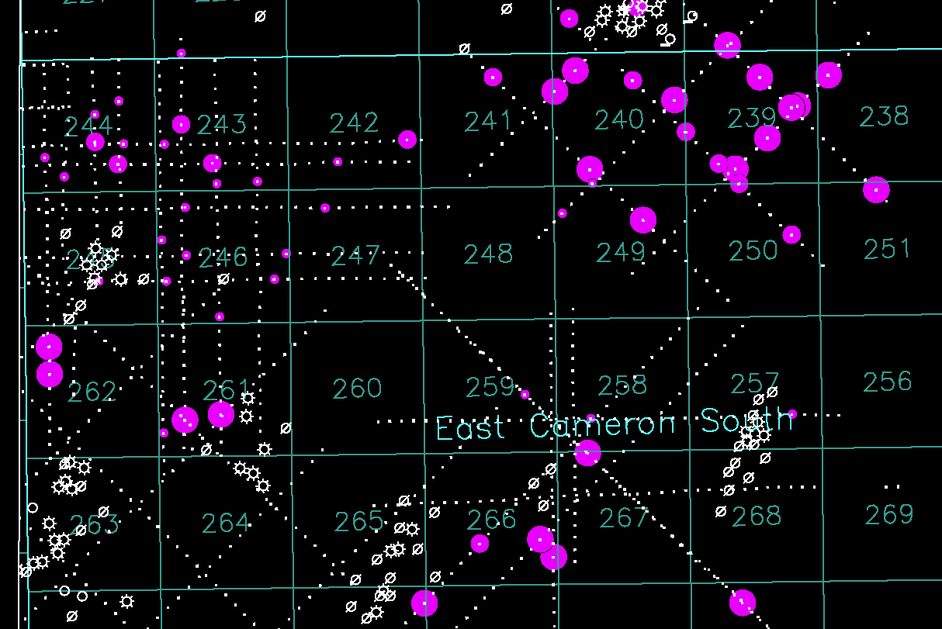
EAST CAMERON BLOCK 248 AREA - DATA AND WELLS THRU 1978
Notes:
This East Cameron area shows a typical density and spread of sniffer anomalies over Blocks 240 and 266 where no production has been found before 1978 when the sniffer data was collected. Sniffer anomalies are purple

Slide 14
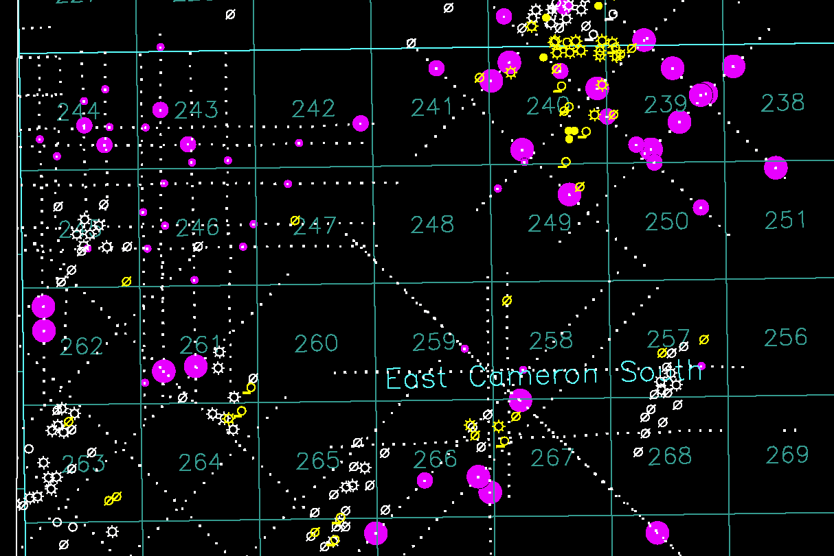
EAST CAMERON BLOCK 248 AREA – ALL DATA AND WELLS
Notes:
Note the new discoveries in blocks 240 and 266 that were made after the sniffer anomalies had been mapped. There is no correlation expected between individual wells and sniffer anomalies. The sniffer anomalies just highlight areas having potential for production. Seeps are deflected by faults and might not be directly over the reservoir source.

Slide 15
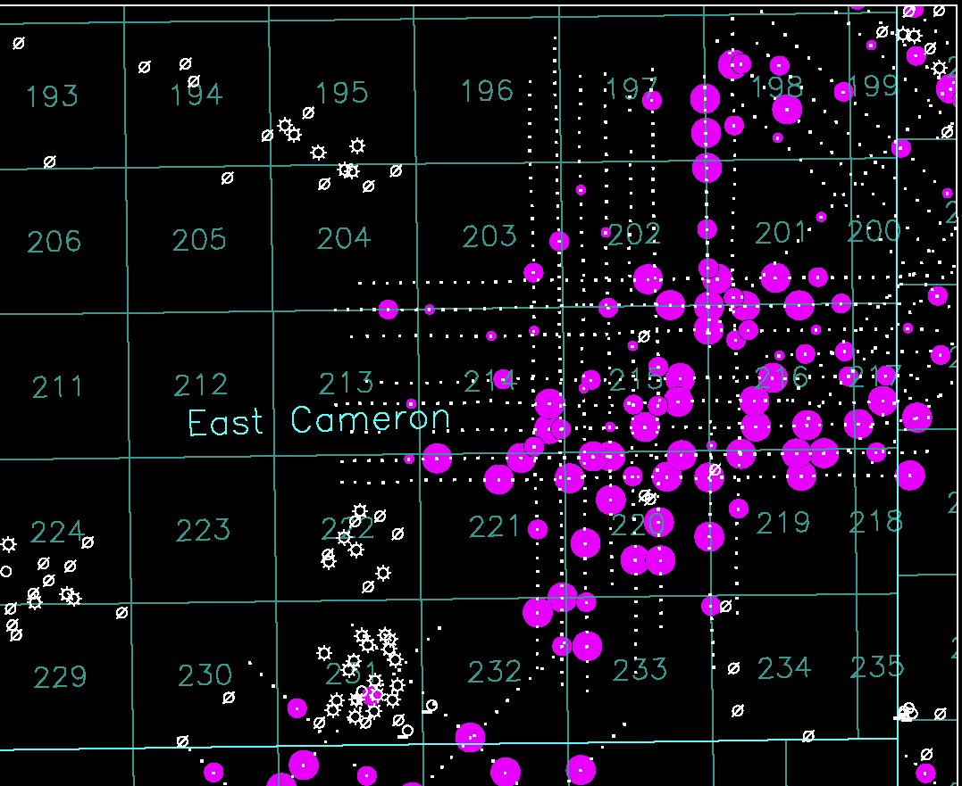
EAST CAMERON BLOCK 248 AREA – DATA AND WELLS THRU 1978
Notes:
Here is a large cluster of sniffer anomalies in blocks 215 and 220.

Slide 16
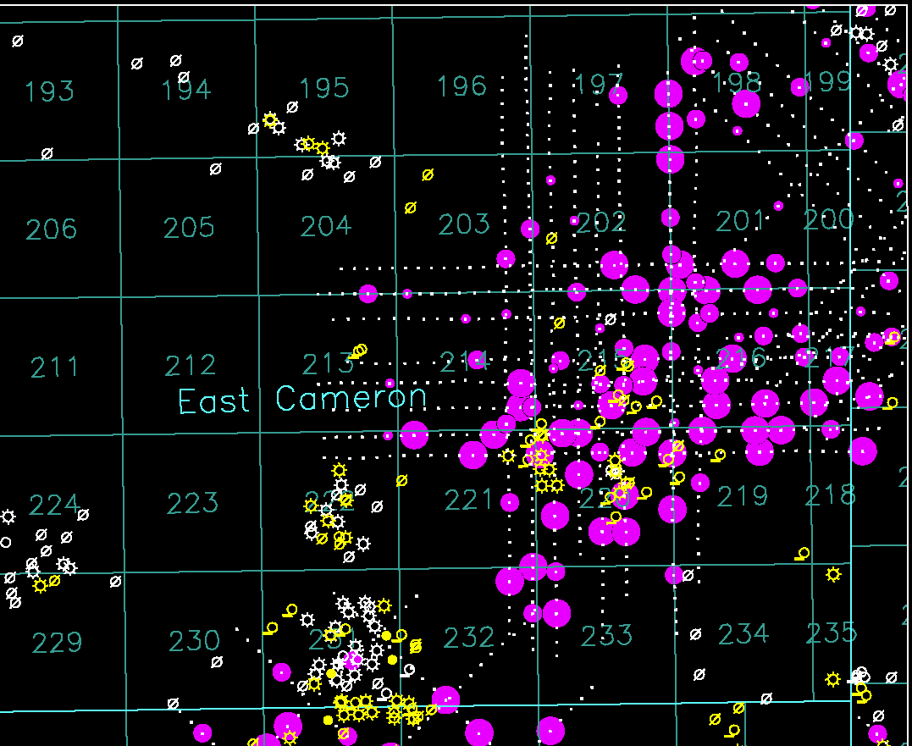
EAST CAMERON BLOCK 248 AREA – ALL DATA AND WELLS
Notes:
Note the discoveries made after the sniffer anomalies were mapped in 1978. Although time restricts further discussion today, there are clearly significant additional opportunities within the area.

Slide 17
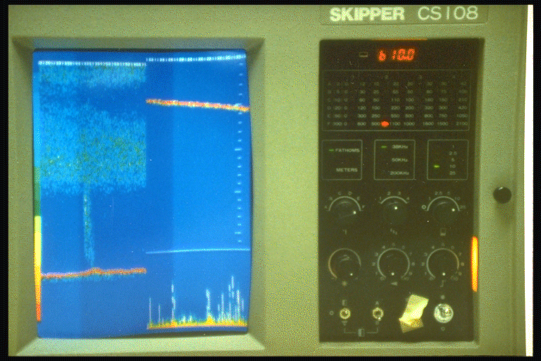
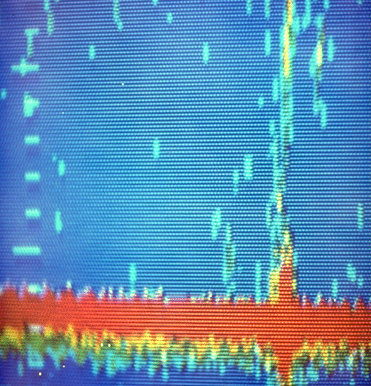
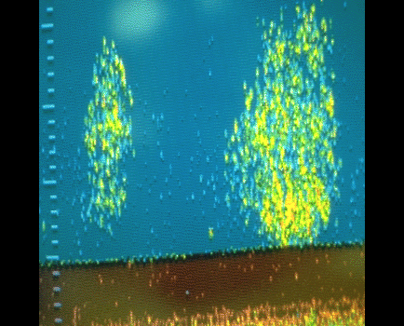
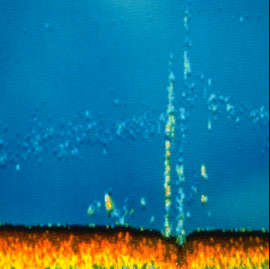
Notes:
As a further aid a fish finder was employed to provide images of the seeps. Note the gas buildup under the inversion layer on left top and pipeline on the top right. A sea floor fault on the bottom right and what looks like a school of fish on bottom left.
The Gulf Oil Co. marine gas sampling system also contained a color imaging sonar system which was used to provide a color picture of all marine seeps large enough to produce bubbles in the water column. Actual illustrations of seeps detected by the gas sampler and imaged by this color sonar system are shown in this slide. These high quality images provide actual profiles of the bottom sediments and aid considerably in defining the location of the fault or fracture that issued the seepage.
Fish finder added punch to presentation to management,

Slide 18
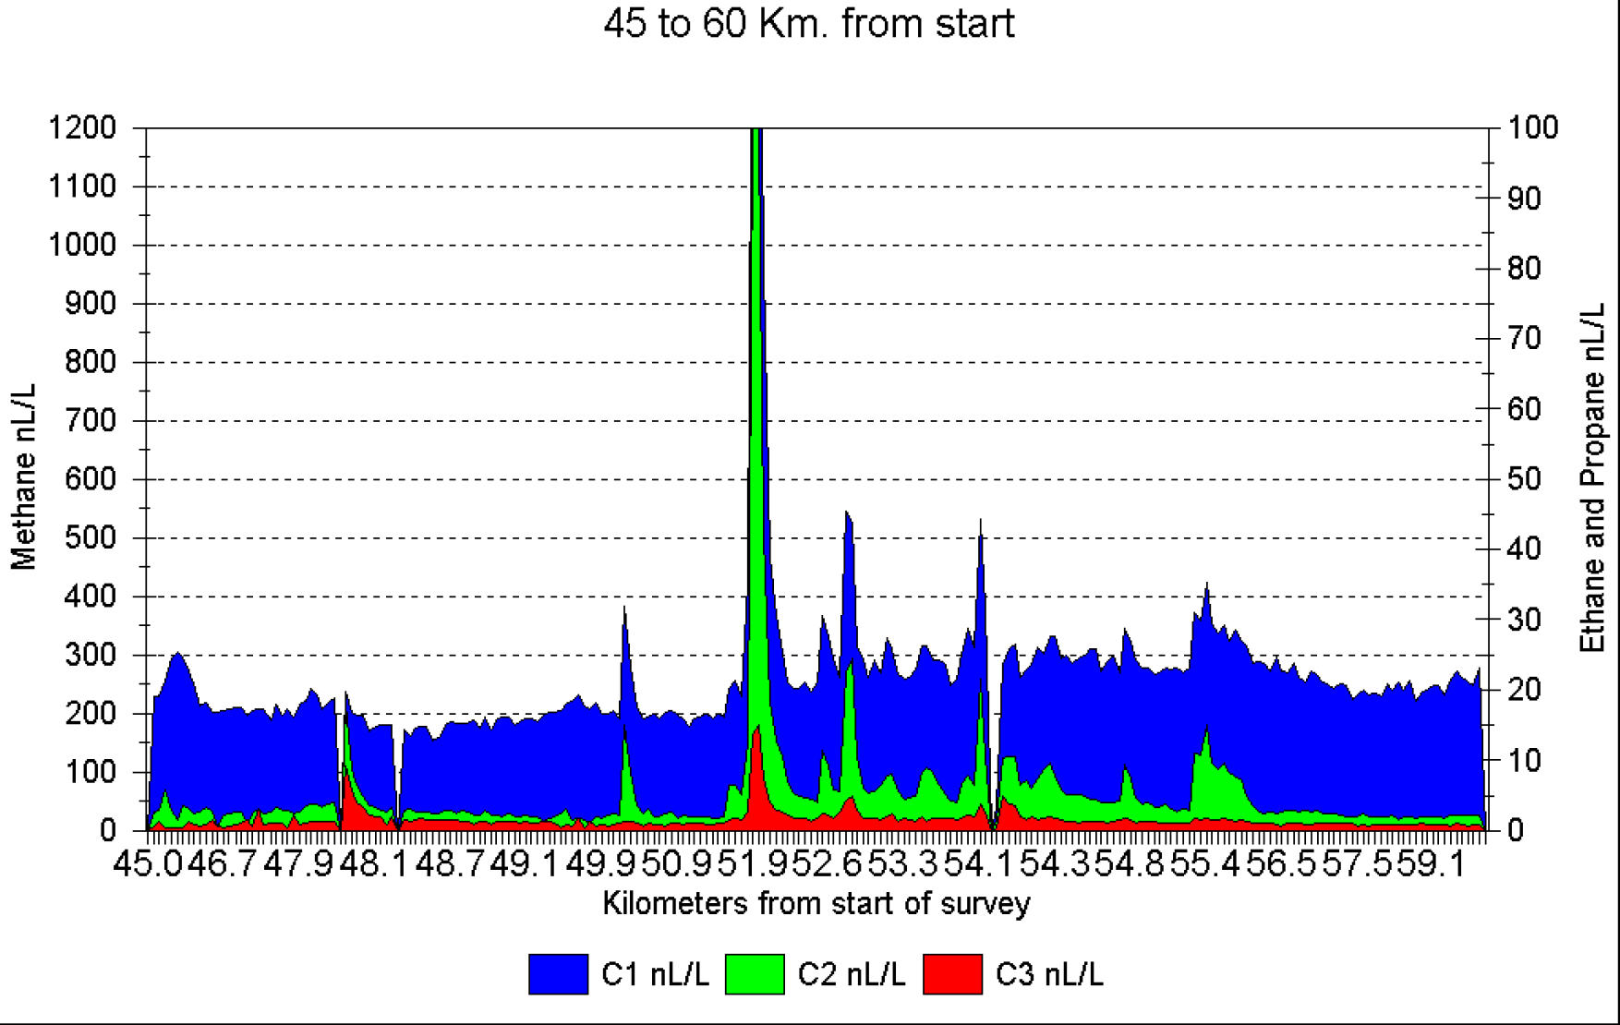
MARINE PIPELINE SURVEY in GULF of MEXICO
Notes:
This 82 km pipeline runs from a depth of 120 feet to the beach. Sniffer anomalies guided by a Oceaneering ROV allowed the direct detection of vertically rising seeps, the bigger seep had visual bubbles at the surface, smaller seeps did not.

Slide 19
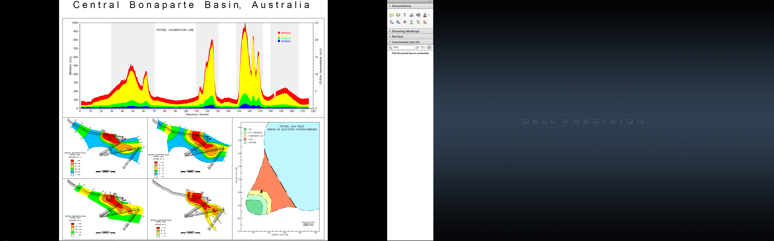
Notes:
This slide shows a leaking well casing in the Bonaparte Basin in Australia. An important distinction to natural seeps is the more continuous seepage that occurs from pipelines and well casings, which tend to be continuous, providing fairly vertical seeps even gas plumes that can be contoured .

Slide 20
Vermillion - RG0010A
Deep Inlet
Hull Inlet
 |  |  |  |  | Methane
5,000
4,500
4,000
3,500
3,000
2,500
2,000
1,500
1,000
500
0
0 | 20 | 40 | 60 | 80 | 100 120 140 | 160 | 180 | 200 | 220 | 240
 |  |  |  |  | Ethane
100
90
80
70
60
50
40
30
20
10
0
0 | 20 | 40 | 60 | 80 | 100 120 140 | 160 | 180 | 200 | 220 | 240
 |  |  |  |  | Propane
24
22
20
18
16
14
12
10
8
6
4
2
0
0 | 20 | 40 | 60 | 80 | 100 120 140 | 160 | 180 | 200 | 220 | 240
 |  |  |  |  | Ethylene (Green) Propylene (Yellow)
10
9
8
7
6
5
4
3
2
1
0
0 | 20 | 40 | 60 | 80 | 100 120 140 | 160 | 180 | 200 | 220 | 240
 |  |  |  |  | Water Depth
0
10
20
30
40
50
60
70
80
90
100
0 | 20 | 40 | 60 | 80 | 100 120 140 | 160 | 180 | 200 | 220 | 240
 |  |  |  |  | Methane
5,000
4,500
4,000
3,500
3,000
2,500
2,000
1,500
1,000
500
0
0 | 20 | 40 | 60 | 80 | 100 120 140 | 160 | 180 | 200 | 220 | 240
 |  |  |  |  | Ethane
100
90
80
70
60
50
40
30
20
10
0
0 | 20 | 40 | 60 | 80 | 100 120 140 | 160 | 180 | 200 | 220 | 240
 |  |  |  |  | Propane
24
22
20
18
16
14
12
10
8
6
4
2
0
0 | 20 | 40 | 60 | 80 | 100 120 140 | 160 | 180 | 200 | 220 | 240
 |  |  |  |  | Ethylene (Green) Propylene (Yellow)
10
9
8
7
6
5
4
3
2
1
0
0 | 20 | 40 | 60 | 80 | 100 120 140 | 160 | 180 | 200 | 220 | 240
 |  |  |  |  | Water Depth
0
10
20
30
40
50
60
70
80
90
100
0 | 20 | 40 | 60 | 80 | 100 120 140 | 160 | 180 | 200 | 220 | 240
Notes:
This N – S profile is located in Vermillion in about 20 fathoms of water. Both the deep tow and the hull give identical results. Note the small ethylene peak. Methane peak is about 5 miles wide and ethane only 1 mile wide, indicating some independent methane.
Note the large ethane-propane anomaly at site 110 . This anomaly includes all C2+ hydrocarbons, including methane. However in contrast to ethane the methane anomaly begins at about site 100 and is 15 to 17 sites (-4 miles) in width, while the C₂+ anomaly (with associated C₁) begins at ~110 and is only 5 sites (1 mile) wide.
The C₂+ composition is 0% between sites 100 to 110 and ~1.5% between sites 110 to site 115.

Slide 21
Eugene Island - RG0006
Deep Inlet
Hull Inlet
 |  |  |  | Methane
5,000
4,500
4,000
3,500
3,000
2,500
2,000
1,500
1,000
500
0
0 | 20 | 40 | 60 | 80 100 120 | 140 | 160 | 180 | 200
 |  |  |  | Ethane
100
90
80
70
60
50
40
30
20
10
0
0 | 20 | 40 | 60 | 80 100 120 | 140 | 160 | 180 | 200
 |  |  |  | Propane
24
22
20
18
16
14
12
10
8
6
4
2
0
0 | 20 | 40 | 60 | 80 100 120 | 140 | 160 | 180 | 200
 |  |  |  | Ethylene (Green) Propylene (Yellow)
5
4.5
4
3.5
3
2.5
2
1.5
1
0.5
0
0 | 20 | 40 | 60 | 80 100 120 | 140 | 160 | 180 | 200
 |  |  |  | Water Depth
0
10
20
30
40
50
60
70
80
90
100
0 | 20 | 40 | 60 | 80 100 120 | 140 | 160 | 180 | 200
 |  |  |  | Methane
5,000
4,500
4,000
3,500
3,000
2,500
2,000
1,500
1,000
500
0
0 | 20 | 40 | 60 | 80 100 120 | 140 | 160 | 180 | 200
 |  |  |  | Ethane
100
90
80
70
60
50
40
30
20
10
0
0 | 20 | 40 | 60 | 80 100 120 | 140 | 160 | 180 | 200
 |  |  |  | Propane
24
22
20
18
16
14
12
10
8
6
4
2
0
0 | 20 | 40 | 60 | 80 100 120 | 140 | 160 | 180 | 200
 |  |  |  | Ethylene (Green) Propylene (Yellow)
5
4.5
4
3.5
3
2.5
2
1.5
1
0.5
0
0 | 20 | 40 | 60 | 80 100 120 | 140 | 160 | 180 | 200
 |  |  |  | Water Depth
0
10
20
30
40
50
60
70
80
90
100
0 | 20 | 40 | 60 | 80 100 120 | 140 | 160 | 180 | 200
Notes:
On line RG006, the anomaly near sites 55-60 is composed of two distinct components, the first which includes all C₁-C₄ hydrocarbons with a composition, % C₂+ reaching 3%; and a second component of dry methane. Overall the methane anomaly is about 20 sites (5 miles) wide at depth with the C₂+ portion ~11 sites wide (2 ½ miles). Although the deep and hull are very similar, note the independent methane is missing at the surface. The dry methane component is not present in the shallow data, perhaps having dissolved before reaching the surface. Note small ethylene with deep dry gas.
Only the first part of the anomaly, which occurs in 15-20 fathoms of water on an N-S line in Eugene Island, reaches from depth to the surface apparently involving a rapidly rising stream of bubbles.

Slide 22
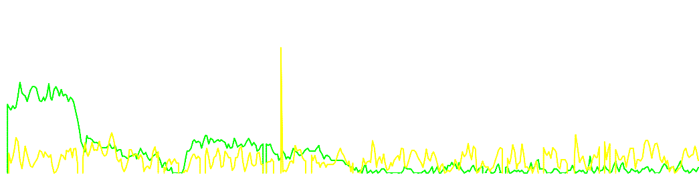
East Cameron - RG0012
Deep Inlet
Hull Inlet
 |  |  |  |  |  |  |  |  |  | Methane
5,000
4,500
4,000
3,500
3,000
2,500
2,000
1,500
1,000
500
0
0 |  | 20 | 40 | 60 | 80 | 100 | 120 | 140 | 160 | 180 | 200 | 220 | 240 | 260 | 280 | 300 | 320 | 340 | 360 | 380
 |  |  |  |  |  |  |  |  |  | Ethane
100
90
80
70
60
50
40
30
20
10
0
0 |  | 20 | 40 | 60 | 80 | 100 | 120 | 140 | 160 | 180 | 200 | 220 | 240 | 260 | 280 | 300 | 320 | 340 | 360 | 380
 |  |  |  |  |  |  |  |  |  | Propan | e
24
22
20
18
16
14
12
10
8
6
4
2
0
0 |  | 20 | 40 | 60 | 80 | 100 | 120 | 140 | 160 | 180 | 200 | 220 | 240 | 260 | 280 | 300 | 320 | 340 | 360 | 380
Ethylene (Green) Propylene (Yellow) 5 4.5 4 3.5 3 2.5 2 1.5 1 0.5 0 0
 |  |  |  |  |  |  |  |  |  | Water Depth
0
10
20
30
40
50
60
70
80
90
100
 | 0 | 20 | 40 | 60 | 80 | 100 | 120 | 140 | 160 | 180 200 |  | 220 | 240 | 260 | 280 | 300 | 320 | 340 | 360 | 380
 |  |  |  |  |  |  | Methane
5,000
4,500
4,000
3,500
3,000
2,500
2,000
1,500
1,000
500
0
0 | 20 | 40 | 60 | 80 | 100 | 120 | 140 160 180 200 220 | 240 | 260 | 280 | 300 | 320 | 340 | 360 | 380
 |  |  |  |  |  |  | Ethane
100
90
80
70
60
50
40
30
20
10
0
0 | 20 | 40 | 60 | 80 | 100 | 120 | 140 160 180 200 220 | 240 | 260 | 280 | 300 | 320 | 340 | 360 | 380
 |  |  |  |  |  |  | Propane
24
22
20
18
16
14
12
10
8
6
4
2
0
0 | 20 | 40 | 60 | 80 | 100 | 120 | 140 160 180 200 220 | 240 | 260 | 280 | 300 | 320 | 340 | 360 | 380
 |  |  |  |  |  |  | Ethylene (Green) Propylene (Yellow | )
5
4.5
4
3.5
3
2.5
2
1.5
1
0.5
0
0 | 20 | 40 | 60 | 80 | 100 | 120 | 140 160 180 200 220 | 240 | 260 | 280 | 300 | 320 | 340 | 360 | 380
 |  |  |  |  |  |  | Water Depth
0
10
20
30
40
50
60
70
80
90
100
0 | 20 | 40 | 60 | 80 | 100 | 120 | 140 160 180 200 220 | 240 | 260 | 280 | 300 | 320 | 340 | 360 | 380
Notes:
Several "sharp" anomalies on both the deep and hull inlets. The sharp anomaly at site #240 is about 5 sites wide with little change in width from sea floor to sea surface. No ethylene.
Line (RG0012) originates in deep water off the slope in East Cameron and proceeds north. The anomaly described occurs in about 15 to 20 fathoms of water.
Many "sharp" anomalies may be found throughout the data set. Several excellent examples are evident on Figure-11 and Figure-wever it is by far not the only change nor is it the largest change in composition along the line. This line (RG0012) originates in deep water off the slope in East Cameron and proceeds north. The anomaly described occurs in about 15 to 20 fathoms of water.

Slide 23
H-1912
Deep Inlet
Hull Inlet
1,000
Methane
1,000
Methane
900
900
800
800
700
700
600
600
500
500
400
400
300
300
200
200
100
100
0
0
20
40
60
80
100
120
140
160
180
200
220
240
260
280
300
320
340
360
0
0
20
40
60
80
100
120
140
160
180
200
220
240
260
280
300
320
340
360
10
9
Ethane
10
9
Ethane
8
8
7
7
6
6
5
5
4
4
3
3
2
2
1
1
0
0
20
40
60
80
100
120
140
160
180
200
220
240
260
280
300
320
340
360
0
0
20
40
60
80
100
120
140
160
180
200
220
240
260
280
300
320
340
360
5
4.5
Propane
5
4.5
Propane
4
4
3.5
3.5
3
3
2.5
2.5
2
2
1.5
1
1.5
1
0.5
0.5
0
0
20
40
60
80
100
120
140
160
180
200
220
240
260
280
300
320
340
360
0
0
20
40
60
80
100
120
140
160
180
200
220
240
260
280
300
320
340
360
10
Ethylene (Green) Propylene (Yellow)
10
Ethylene (Green) Propylene (Yellow)
9
9
8
8
7
7
6
5
6
5
4
4
3
3
2
2
1
1
0
0
20
40
60
80
100
120
140
160
180
200
220
240
260
280
300
320
340
360
0
0
20
40
60
80
100
120
140
160
180
200
220
240
260
280
300
320
340
360
0
Water Depth
0
Water Depth
10
10
20
30
20
30
40
40
50
50
60
60
70
70
80
80
90
90
100
0
20
40
60
80
100
120
140
160
180
200
220
240
260
280
300
320
340
360
100
0
20
40
60
80
100
120
140
160
180
200
220
240
260
280
300
320
340
360
Notes:
Line 1912 is in High Island South and shows a very different profile between the deep and hull inlets. Note the dry gas in the deeper water and well correlated anomalies on the northern portion of the profile. No ethylene.

Slide 24
So. Timbalier - H2790
Deep Inlet
Hull Inlet
 |  |  | Methane
5,000
4,500
4,000
3,500
3,000
2,500
2,000
1,500
1,000
500
0
0 | 10 | 20 | 30 40 | 50 | 60 | 70
 |  |  | Ethane
100
90
80
70
60
50
40
30
20
10
0
0 | 10 | 20 | 30 40 | 50 | 60 | 70
 |  |  | Propane
20
10
0
0 | 10 | 20 | 30 40 | 50 | 60 | 70
 |  |  | Ethylene (Green) Propylene (Yello | w)
5
4.5
4
3.5
3
2.5
2
1.5
1
0.5
0
0 | 10 | 20 | 30 40 | 50 | 60 | 70
 |  |  | Water Depth
0
2
4
6
8
10
12
14
16
18
20
22
24
0 | 10 | 20 | 30 40 | 50 | 60 | 70
 |  |  | Methane
5,000
4,500
4,000
3,500
3,000
2,500
2,000
1,500
1,000
500
0
0 | 10 | 20 | 30 40 | 50 | 60 | 70
 |  |  | Ethane
100
90
80
70
60
50
40
30
20
10
0
0 | 10 | 20 | 30 40 | 50 | 60 | 70
 |  |  | Propane
24
22
20
18
16
14
12
10
8
6
4
2
0
0 | 10 | 20 | 30 40 | 50 | 60 | 70
 |  |  | Ethylene (Green) Propylene (Yello | w)
5
4.5
4
3.5
3
2.5
2
1.5
1
0.5
0
0 | 10 | 20 | 30 40 | 50 | 60 | 70
 |  |  | Water Depth
0
2
4
6
8
10
12
14
16
18
20
22
24
0 | 10 | 20 | 30 40 | 50 | 60 | 70
Notes:
Sharp anomalies in magnitude and composition are observed in the deep data on line H2790 located in South Timbalier. The anomaly at site 10 on the left continues to the surface, while the anomaly at site 47 does not. Ethylene peaks at both deep seeps, but only left seep at hull.
This suggests that dispersion and dilution of dissolved hydro­carbons is not rapid. The range of composition is 8 to 9% C₂+ (possibly higher in the shallow data) in these anomalies.

Slide 25
H-2010A
Deep Inlet
Hull Inlet
5,000
Methane
5,000
Methane
4,500
4,500
4,000
4,000
3,500
3,000
3,500
3,000
2,500
2,500
2,000
2,000
1,500
1,500
1,000
1,000
500
500
0
0
20
40
60
80
100
120
140
160
180
200
0
0
20
40
60
80
100
120
140
160
180
200
100
90
Ethane
100
90
Ethane
80
80
70
70
60
60
50
50
40
40
30
30
20
20
10
10
0
0
20
40
60
80
100
120
140
160
180
200
0
0
20
40
60
80
100
120
140
160
180
200
24
22
20
18
16
14
12
10
8
6
4
2
0
Propane
24
22
20
18
16
14
12
10
8
6
4
2
0
Propane
0
20
40
60
80
100
120
140
160
180
200
0
20
40
60
80
100
120
140
160
180
200
10
Ethylene (Green) Propylene (Yellow)
10
Ethylene (Green) Propylene (Yellow)
9
9
8
8
7
7
6
5
6
5
4
4
3
3
2
2
1
1
0
0
20
40
60
80
100
120
140
160
180
200
0
0
20
40
60
80
100
120
140
160
180
200
0
Water Depth
0
Water Depth
10
10
20
30
20
30
50
40
60
50
70
60
80
70
90
80
100
90
20
40
60
80
100
120
140
160
180
200
100
0
20
40
60
80
100
120
140
160
180
200
Notes:
A broad full spectrum anomaly occurs in the deep data between sites 120 to 140, having a width of nearly 5 miles. This seepage may extend to the surface, but appear to have broadened and drifted to the right. Ethylene in deep inlet.
Note the associated ethylene anomaly in the deep data near site 131. Maximum magnitude of ethylene in the deep data in this anomaly is ~7 nl/l. The saturate hydrocarbons continue to the surface; however the ethylene is present only as broad area of somewhat increased background in the shallow data.

Slide 26
H2290A
Deep Inlet
Hull Inlet
2,000
Methane
2,000
Methane
1,800
1,800
1,600
1,600
1,400
1,200
1,400
1,200
1,000
1,000
800
800
600
600
400
400
200
200
0
0
20
40
60
80
100
120
140
160
180
200
220
240
260
280
300
320
340
0
0
20
40
60
80
100
120
140
160
180
200
220
240
260
280
300
320
340
20
18
Ethane
20
18
Ethane
16
16
14
14
12
12
10
10
8
8
6
6
4
4
2
2
0
0
20
40
60
80
100
120
140
160
180
200
220
240
260
280
300
320
340
0
0
20
40
60
80
100
120
140
160
180
200
220
240
260
280
300
320
340
5
4.5
Propane
5
4.5
Propane
4
4
3.5
3.5
3
3
2.5
2.5
2
2
1.5
1
1.5
1
0.5
0.5
0
0
20
40
60
80
100
120
140
160
180
200
220
240
260
280
300
320
340
0
0
20
40
60
80
100
120
140
160
180
200
220
240
260
280
300
320
340
10
Ethylene
10
Ethylene
9
9
8
8
7
7
6
5
6
5
4
4
3
3
2
2
1
1
0
0
20
40
60
80
100
120
140
160
180
200
220
240
260
280
300
320
340
0
0
20
40
60
80
100
120
140
160
180
200
220
240
260
280
300
320
340
0
Water Depth
0
Water Depth
50
50
100
150
100
150
200
200
250
250
300
300
350
350
400
400
450
450
500
0
20
40
60
80
100
120
140
160
180
200
220
240
260
280
300
320
340
500
0
20
40
60
80
100
120
140
160
180
200
220
240
260
280
300
320
340
Notes:
The big anomaly at site 140 is similar in both inlets, however, note the two anomalies in the hull data at sites 220 and 240, which appear only in the shallow hull data. This suggests a sharp but intermittent seep that was missed by the deep tow. Also note the ethylene peaks, particularly in the hull inlet.

Slide 27
Eugene Island - RG0005
Deep Inlet
Hull Inlet
5,000
Methane
5,000
Methane
4,500
4,500
4,000
4,000
3,500
3,500
3,000
3,000
2,500
2,500
2,000
1,500
2,000
1,500
1,000
1,000
500
500
0
0
20
40
60
80
100
120
140
160
180
200
220 240 260
280
300
320
340
360
380
400
420
440
460
480
500
0
0
20
40
60
80
100
120
140
160
180
200
220 240 260
280
300
320
340
360
380
400
420
440
460
480
500
100
Ethane
100
Ethane
90
90
80
80
70
70
60
60
50
50
40
40
30
30
20
20
10
10
0
0
20
40
60
80
100
120
140
160
180
200
220 240 260
280
300
320
340
360
380
400
420
440
460
480
500
0
0
20
40
60
80
100
120
140
160
180
200
220 240 260
280
300
320
340
360
380
400
420
440
460
480
500
24
22
20
18
16
14
12
10
8
6
4
2
0
Propane
24
22
20
18
16
14
12
10
8
6
4
2
0
Propane
0
20
40
60
80
100
120
140
160
180 200 220 240 260 280 300
Ethylene (Green) Propylene (Yellow)
320
340
360
380
400
420
440
460
480
500
0
20
40
60
80
100
120
140
160
180 200 220 240 260 280 300
Ethylene (Green) Propylene (Yellow)
320
340
360
380
400
420
440
460
480
500
100
100
90
90
80
80
70
70
60
50
60
50
40
40
30
30
20
20
10
10
0
0
20
40
60
80
100
120
140
160
180
200
220 240 260
280
300
320
340
360
380
400
420
440
460
480
500
0
0
20
40
60
80
100
120
140
160
180
200
220 240 260 280 300
320
340
360
380
400
420
440
460
480
500
0
Water Depth
0
Water Depth
10
10
20
20
30
30
40
40
50
50
60
60
70
70
80
80
90
100
0
20
40
60
80
100
120
140
160
180
200
220 240 260
280
300
320
340
360
380
400
420
440
460
480
500
90
100
0
20
40
60
80
100
120
140
160
180
200
220 240 260 280 300
320
340
360
380
400
420
440
460
480
500
Notes:
Line RG0005 in Eugene Island exhibits several sharp and mixed composition anomalies. The shallow and deep signals are very similar indicating flux from depth to the surface. This line is also unique because of the very large propylene anomalies in the surface data, which contain only ethylene in the deep data

Slide 28
RG016A
Deep Inlet
Hull Inlet
 |  |  |  |  |  |  | Methane
10,000
9,000
8,000
7,000
6,000
5,000
4,000
3,000
2,000
1,000
0
0 | 1 | 2 | 3 | 4 | 5 | 6 | 7 8 9 10 11 | 12 | 13 | 14 | 15 | 16 | 17 | 18 | 19
 |  |  |  |  |  |  | Ethane
500
450
400
350
300
250
200
150
100
50
0
0 | 1 | 2 | 3 | 4 | 5 | 6 | 7 8 9 10 11 | 12 | 13 | 14 | 15 | 16 | 17 | 18 | 19
 |  |  |  |  |  |  | Propane
240
220
200
180
160
140
120
100
80
60
40
20
0
0 | 1 | 2 | 3 | 4 | 5 | 6 | 7 8 9 10 11 | 12 | 13 | 14 | 15 | 16 | 17 | 18 | 19
 |  |  |  |  |  |  | Ethylene (Green) Propylene (Yellow)
1,000
900
800
700
600
500
400
300
200
100
0
0 | 1 | 2 | 3 | 4 | 5 | 6 | 7 8 9 10 11 | 12 | 13 | 14 | 15 | 16 | 17 | 18 | 19
 |  |  |  |  |  |  | Water Depth
0
10
20
30
40
50
60
70
80
90
100
0 | 1 | 2 | 3 | 4 | 5 | 6 | 7 8 9 10 11 | 12 | 13 | 14 | 15 | 16 | 17 | 18 | 19
 |  |  |  |  |  |  | Methane
10,000
9,000
8,000
7,000
6,000
5,000
4,000
3,000
2,000
1,000
0
0 | 1 | 2 | 3 | 4 | 5 | 6 | 7 8 9 10 11 | 12 | 13 | 14 | 15 | 16 | 17 | 18 | 19
 |  |  |  |  |  |  | Ethane
500
450
400
350
300
250
200
150
100
50
0
0 | 1 | 2 | 3 | 4 | 5 | 6 | 7 8 9 10 11 | 12 | 13 | 14 | 15 | 16 | 17 | 18 | 19
 |  |  |  |  |  |  | Propane
240
220
200
180
160
140
120
100
80
60
40
20
0
0 | 1 | 2 | 3 | 4 | 5 | 6 | 7 8 9 10 11 | 12 | 13 | 14 | 15 | 16 | 17 | 18 | 19
 |  |  |  |  |  |  | Ethylene (Green) Propylene (Yellow)
1,000
900
800
700
600
500
400
300
200
100
0
0 | 1 | 2 | 3 | 4 | 5 | 6 | 7 8 9 10 11 | 12 | 13 | 14 | 15 | 16 | 17 | 18 | 19
 |  |  |  |  |  |  | Water Depth
0
10
20
30
40
50
60
70
80
90
100
0 | 1 | 2 | 3 | 4 | 5 | 6 | 7 8 9 10 11 | 12 | 13 | 14 | 15 | 16 | 17 | 18 | 19
Notes:
In the shallow data along line RG016A, ethylene is found at depth, but not at the surface where propylene anomalies are associated with full spectrum hydrocarbon anomalies. Propylene is generally found more in the shallow data rather than at depth.

Slide 29
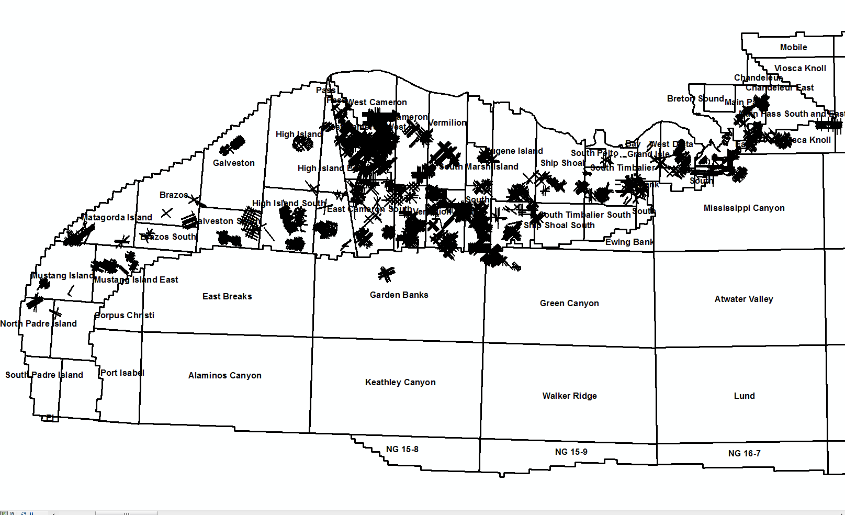
Detail Grids
Notes:
Detailed Exploration Grids, 60% were collected after 1980

Slide 30
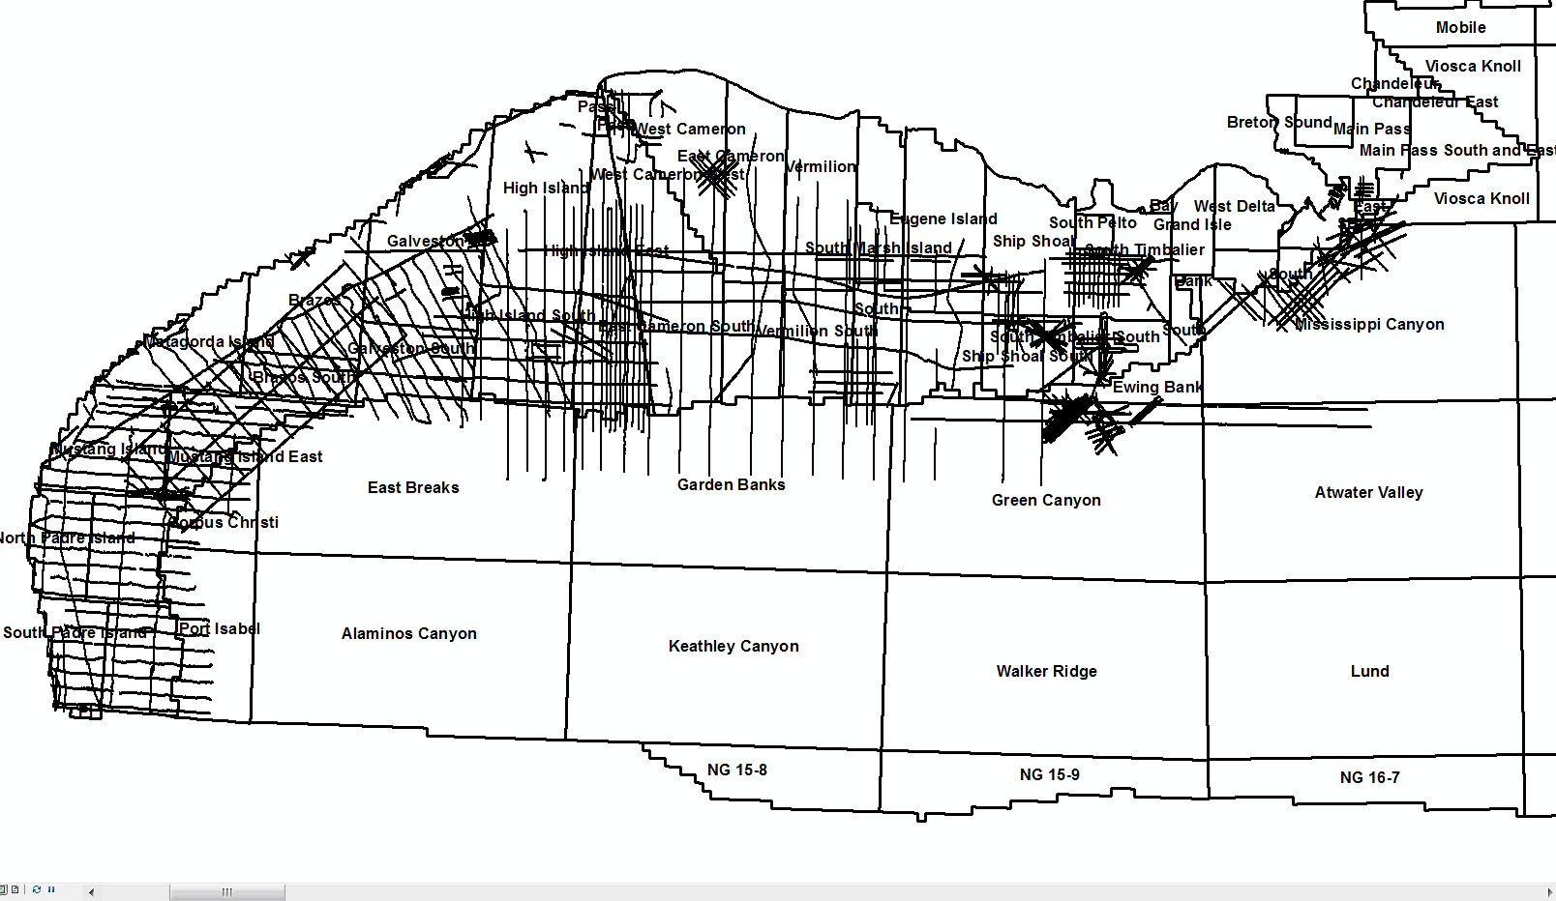
Regional Lines
15,000 miles of Dissolved Gas Data 0n ¼ mile spacing along 470 Regional Lines
Notes:
470 lines about 15,000 miles of data at 0.25 mile spacing of regional Lines collected between 1975 to 1983. Note that the offshore central Gulf has the lowest density coverage compared to offshore Texas and the eastern La offshore

Slide 31
methane
0
125
290
550
1150
Coordinate System: MMS9309 Projection: Albers
Datum: North American 1927
False Easting: 0.0000
False Northing: 0.0000
Central Meridian: -89.0000
Standard Parallel 1: 30.1667
Standard Parallel 2: 24.1667 Latitude Of Origin: 27.1667
Units: Foot US
0 25 50
100 150
1:6,000,000
200
Miles
2350
GULF OF MEXICO
METHANE MAGNITUDE CONTOUR MAP
Notes:
A moving average for the methane concentrations was calculated using a 50,000 foot diameter circle by moving the circle 25,000 feet (50%) for each calculation

Slide 32
propane
0.00
0.24
0.52
1.30
3.20
Coordinate System: MMS9309 Projection: Albers
Datum: North American 1927
False Easting: 0.0000
False Northing: 0.0000
Central Meridian: -89.0000
Standard Parallel 1: 30.1667
Standard Parallel 2: 24.1667 Latitude Of Origin: 27.1667
Units: Foot US
0 25 50
100 150
1:6,000,000
200
Miles
9.80
GULF OF MEXICO
PROPANE MAGNITUDE CONTOUR MAP
Notes:
A moving average for propane concentrations was calculated using a 50,000 foot diameter circle by moving the circle 25,000 feet (50%) for each calculation

Slide 33
ethylene
0
1
2
4
8
Coordinate System: MMS9309 Projection: Albers
Datum: North American 1927
False Easting: 0.0000
False Northing: 0.0000
Central Meridian: -89.0000
Standard Parallel 1: 30.1667
Standard Parallel 2: 24.1667 Latitude Of Origin: 27.1667
Units: Foot US
0 25 50
100 150
1:6,000,000
200
Miles
16
GULF OF MEXICO ETHYLENE MAGNITUDE CONTOUR MAP
Notes:
A moving average for ethylene (ethene) concentrations was calculated using a 50,000 foot diameter circle by moving the circle 25,000 feet (50%) for each calculation

Slide 34
Notes:
Dick Mousseau presented this slide at an AAPG meeting in Houston, Tx using Gulf Oil’s available sniffer data gathered by 1979. These mean propane values were used to rank the various offshore areas in the US, and even the world.
In 1979 the GOM contained about 66,000 dissolved gas measurements. Approximately 60 % of the data in the GOM was collected after 1979

Slide 35
ACS NEW ORLEANS, June 2003
Larry Cathles, Cornell University
GEOTIMES NOTES Raining hydrocarbons in the Gulf
Cathles suggested that 70% of the generated hydrocarbons were vented, with 10% in reservoirs and 20% remaining in the source
"We're dealing with this giant flow-through system where the hydrocarbons are generating now, moving through the overlying strata now, building the reservoirs now and spilling out into the ocean now,"
Notes:
It is fitting to mention that Larry Cathles from Cornell University made a 1983 presentation at an ACS Meeting in New Orleans. A follow-up note was published in the Geotimes Magazine entitled “Raining Hydrocarbon in the Gulf”.
Cathles made these conclusions by studying only a 9,600 square mile area of the GOM centered around the Eugene Island area, Cathles did not have access to this sniffer data set which confirms the presence of extensive and active seepage

Slide 36
CONCLUSIONS
Dissolved C₁ – C₄ Hydrocarbon Baseline Collected
At two depths, surface (hull inlet) and deep tow
2 – 3 fathoms above seafloor
Establishes Natural Hydrocarbon Concentrations
Collected 1974 – 1983 Before Significant Production
Magnitude/Composition/Density of Seepage
Related to Deep Source Potential
Sniffer Anomalies are Macroseeps
Notes:
This sniffer database shows that extensive seepage was observed and mapped in the GOM long before most of the producing fields were discovered. This seepage is widespread and often having complex, and intermittent patterns.
Offshore seep detection allows areas of the continental shelf to be surveyed for seeping hydrocarbons as part of an integrated exploration program. Seepage data can be interpreted to differentiate areas with a mature source rock from those without, and to provide evidence for differentiating between mature gas prone source rocks. Integrated with seismic/structural data, survey results can be used to identify or confirm likely migration routes, (e.g. gas chimneys), and in areas of sea floor pock marks, differentiate a biogenic from a thermogenic source for the gas. In exceptionally simple geological cases, such surveys have been used to identify hydrocarbon-filled structures at depth, although in most regions the relationship between surface anomalies and deep structure is complex, requiring an integrated interpretation of all available geological and geophysical data.
The advantages of ship towed seawater monitoring are that it is relatively inexpensive and provides large numbers of statistically significant analyses on a precisely located grid. Real-time analysis also allows for informed modification of the sampling program.

